Slide 1

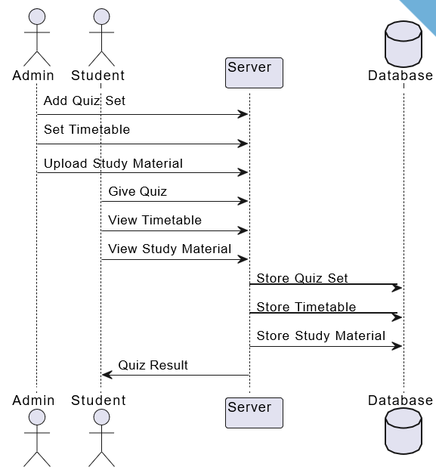
MIT SCHOOL OF COMPUTING
Class : TY-CSF-2
Group Id: 7
DEPARTMENT OF COMPUTER SCIENCE & ENGINEERING
Learning Management System-(College Doot)
By- Diptish, Harsh, Adrija, Pradhyum
Faculty Guide:
Prof. Hyderali Hingoliwala
Design Thinking- Empathy
Ideation
Interactive Learning Modules: Integrate interactive learning modules that offer multimedia content, simulations, and quizzes within the study materials. This can create a more engaging and immersive learning experience for students.
Discussion Forums: Incorporate discussion forums where students can interact with their peers, ask questions, and discuss course-related topics. This encourages collaborative learning and knowledge sharing.
Assignment Submission: Enable students to submit assignments online, allowing for paperless submission, timely feedback from instructors, and easy tracking of submissions.
Proposed Block diagram
P
User says: Students:- Frustration when unable to find course materials Overwhelmed by a heavy workload Teachers:- Pride when students excel in their courses Frustration when dealing with technical issues Satisfaction when effectively delivering content | User thinks: Students:- Is this course material relevant to my goals? Will I receive timely feedback on my assignments? Teachers:- Are my students understanding the material? How can I improve the learning experience?
Experiences and Interactions: Students: Navigating through course materials Submitting assignments and taking quizzes Participating in discussion forums Teachers: Creating and organizing course content Interacting with students through announcements | What user feels: Students: Clear course navigation and organization Timely feedback on assignments Accessible and engaging course content Teachers: User-friendly tools for content creation and assessment Efficient communication channels with students
User
Problem Statement
In today 's educational landscape, effective management and organization play a crucial role in delivering quality learning experiences. However, traditional methods of administering quizzes, setting timetables, and distributing study materials can often be timeconsuming, ineffificient, and prone to errors. To address these challenges, there is a growing need for a comprehensive software solution that streamlines educational management tasks, ensuring smooth communication and enhanced productivity for both administrators and students.
Proposed Solution
College Doot, administrators gain a powerful toolset to effortlessly manage quizzes, timetables, and study materials. The user-friendly interface empowers them to add quizzes, set timetables with ease, and upload study materials seamlessly.
Scope and Feasibility
Course Management:
User Management:
Communication and Collaboration:
Technical Feasibility:
Time Feasibility:

