Slide 1

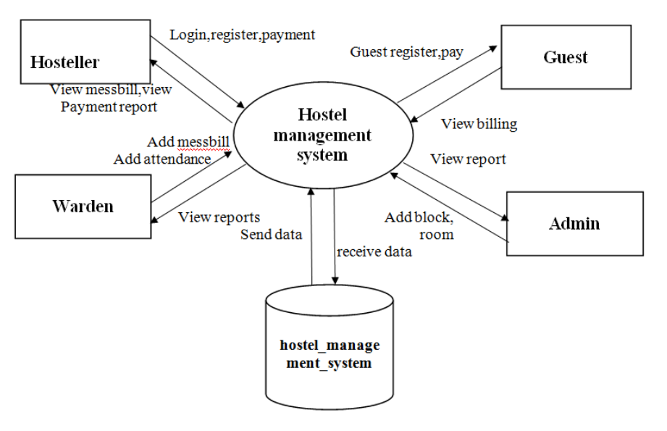
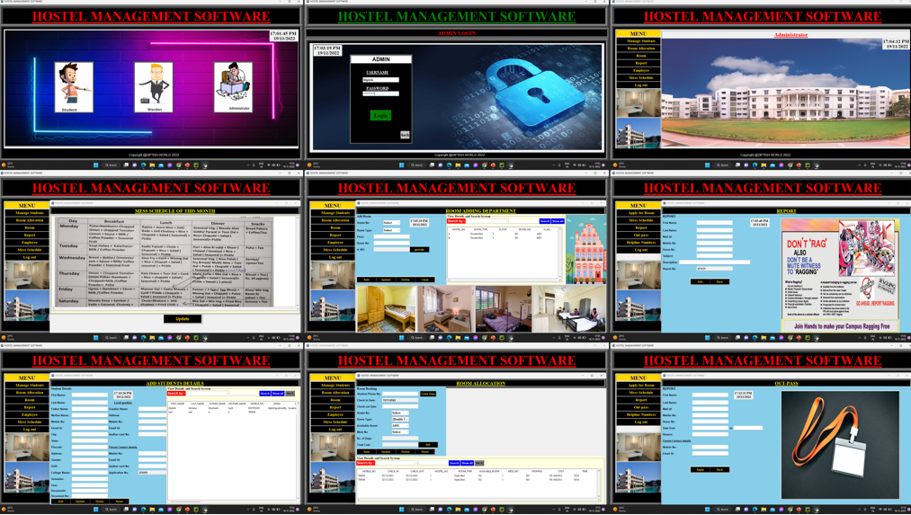
Hostel Management System Software
By-Diptish Gohane, Shrinidhi Kulkarni, Shivangi Agarwal, Khushna Kazi
Faculty Guide:-
Dr. Jayashree Prasad
Proposed Method
Results and Output Screen
Abstract/ Project Insights:-
We have got around 14 hostels in our university, which consist of 8 boy’s hostel and 6 girl’s hostels. All these hostels at present are managed manually by the hostel office. The Registration form verification to the different data processing is done manually. Thus, there are a lot of repetitions which can be easily avoided. And hence there is a lot of strain on the person who are running the hostel and software’s are not usually used in this context. This particular project deals with the problems on managing a hostel and avoids the problems which occur when carried manually Identification of the drawbacks of the existing system leads to the designing of computerized system that will be compatible to the existing system with the system which is more user friendly and more GUI oriented. We can improve the efficiency of the system, thus overcome the drawbacks of the existing system.
Future Scope:
Hostel Managements System is intended for Hostel (like schools, colleges).
There will be pre-characterized criteria for the Reserve to the hostels.
He checks the bore witness to application types of the student acquired from the web and confirm it with the student database.
If the students are qualified then they are designated to the hostel Room.
Participation in Project Compition/Exhibition/Conference and Award own details(if any)

