Slide 1
Medical Insurance Charges
Predictive
Analytics
A comprehensive predictive analytics study covering:
Exploratory Data Analysis · Linear Regression
Multiple Regression · Statistical Inference
Problem Set Analysis
2,772
7
0
~75%
Observations
Variables
Missing Values
R² (Full Model)

Slide 2
Dataset Overview — Medical Insurance
Variable | Type | Role | Description
age | Numeric | Predictor | Age of beneficiary (18–64)
sex | Categorical | Predictor | Male / Female
bmi | Numeric | Predictor | Body Mass Index (15.96–53.13)
children | Numeric | Predictor | Number of dependents (0–5)
smoker | Categorical | Predictor | Yes / No
region | Categorical | Predictor | NE / NW / SE / SW
charges | Numeric | Response | Annual medical insurance cost (USD)
Mean Charge:
$13,261
Max Charge:
$63,770
Smokers:
~20%
Medical Insurance — Predictive Analytics

Slide 3
Methodology — Techniques Applied
1. Exploratory Data Analysis
2. OLS Simulation Studies
Scatter plots, boxplots, summary statistics, outlier detection using IQR method. Maps to Problem Set 1.
Demonstrated that (a) population line is fixed while OLS varies, (b) OLS minimises RSS via grid search, (c) OLS is unbiased via 1000 Monte Carlo simulations. Maps to Problem Set 2.
3. Simple Linear Regressions
4. Multiple Linear Regression
Fit charges ~ each predictor individually. Compared R², RMSE, and p-values across 5 models. Maps to Problem Set 2, Section 4.
Full model with all predictors. Reported R², Adjusted R², RMSE. Generated residuals and Q-Q diagnostic plots. Maps to Problem Set 3.
5. Categorical Predictors
6. Log-Linear Model
Sequentially added qualitative variables (smoker, sex) to quantify their marginal contribution. Maps to Problem Set 3, Section 2.
Explored log(charges) ~ BMI to address heteroscedasticity and improve residual normality. Maps to Problem Set 3, Section 5.
Medical Insurance — Predictive Analytics

Slide 4
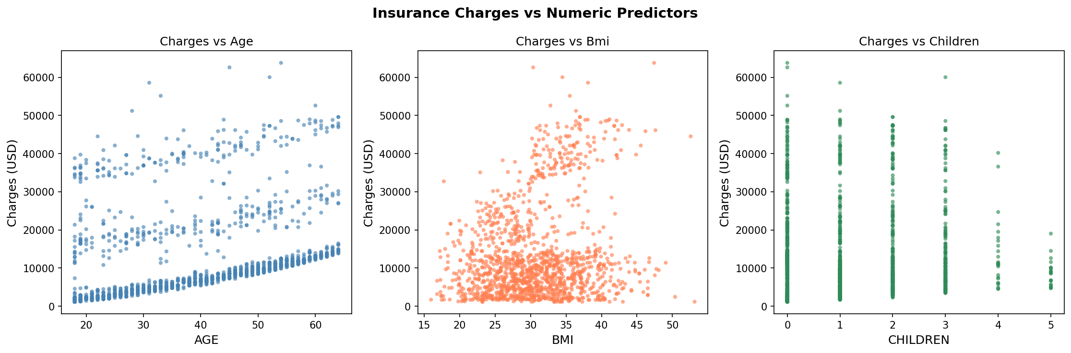
EDA — Scatter Plots: Charges vs Predictors
① Age: Positive trend — older individuals pay more. Three visible bands likely reflect smoker status.
② BMI: Slight positive trend with high-charge cluster at high BMI (smokers).
③ Children: Very weak relationship; charges do not vary strongly with family size.
Medical Insurance — Predictive Analytics

Slide 5
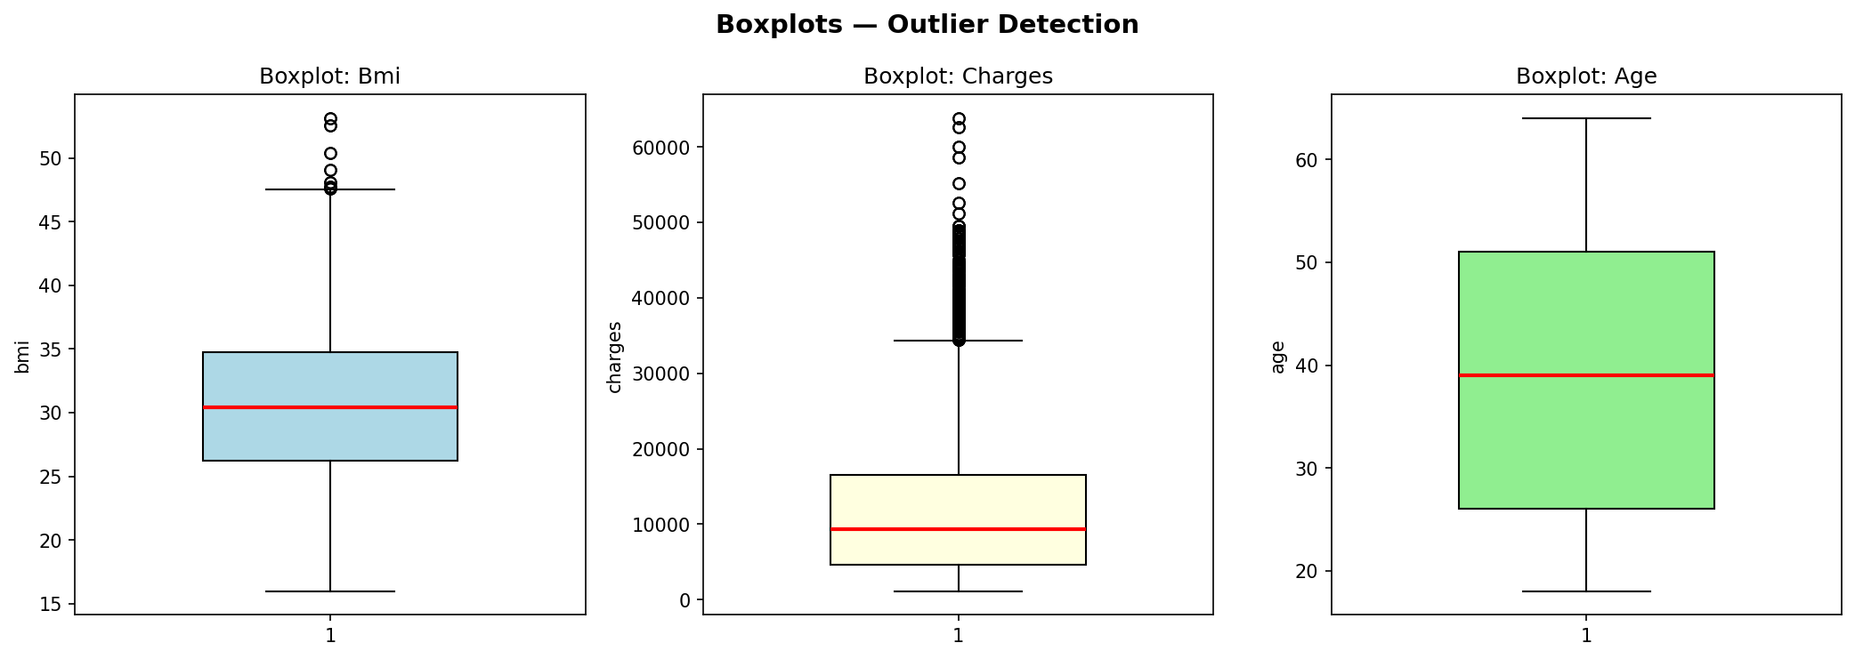
Outlier Detection — Boxplots
BMI Outliers
A few individuals exceed BMI 50. Rare but present.
Charge Outliers
Upper fence ≈ $34K. Outliers are predominantly smokers.
Key Insight: High-charge outliers are almost exclusively smokers, validating smoking as the primary cost driver.
Medical Insurance — Predictive Analytics

Slide 6
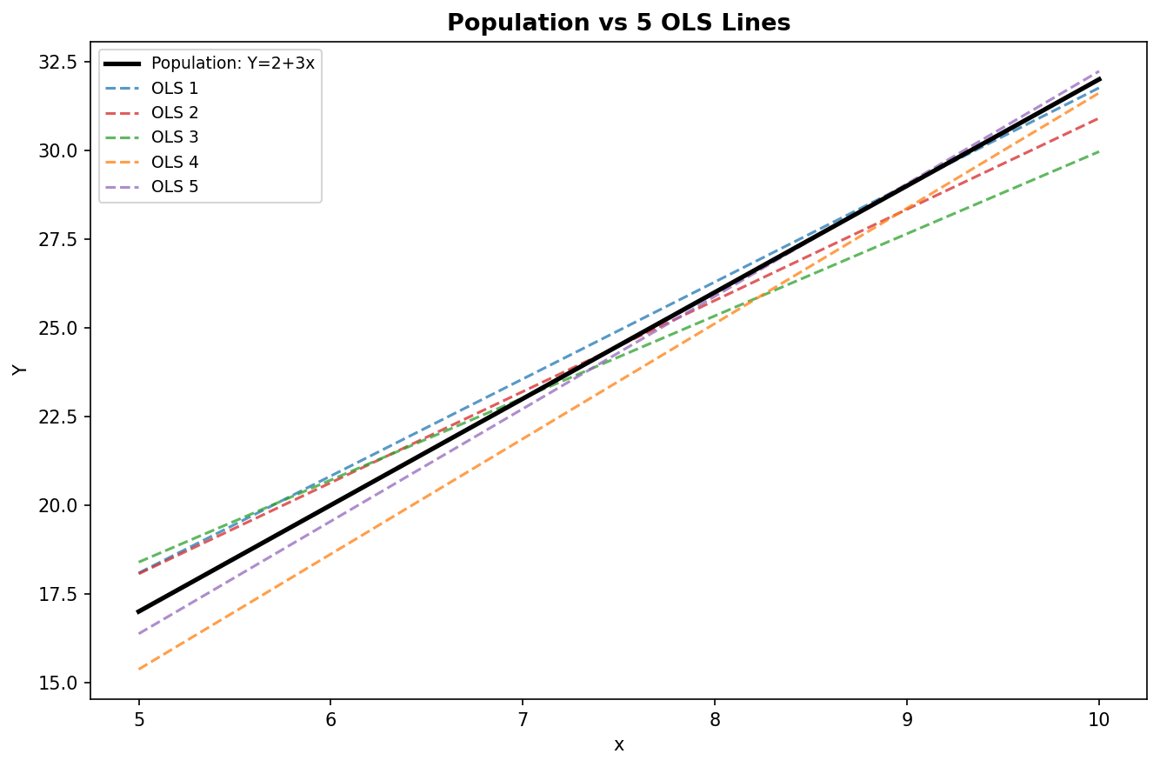
Simulation: Population vs OLS Regression Lines
Setup
n=50, seed=123
Y = 2+3x+ε
ε ~ N(0,16)
x ~ Uniform(5,10)
Finding
Each OLS line is different but all cluster around the true black population line.
Conclusion
OLS is unbiased: random variation exists, but estimates are centred on the truth.
Medical Insurance — Predictive Analytics

Slide 7
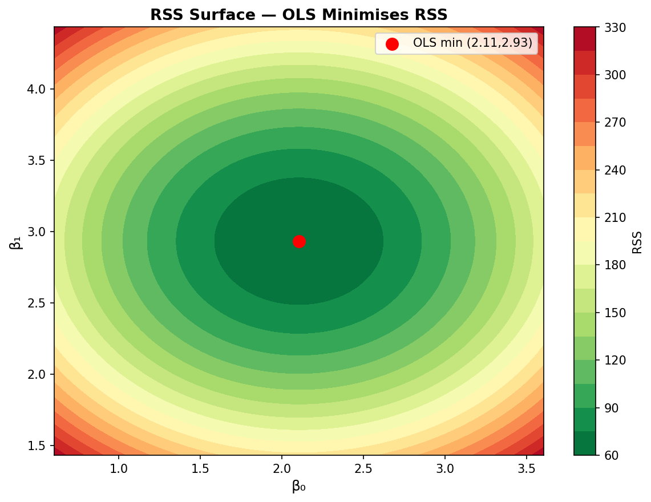
OLS Minimises RSS — Contour Surface
Method
Grid of 80×80 (β₀,β₁) values. RSS computed at each point.
Result
Red dot (OLS) sits exactly at the bowl's minimum — confirming RSS is minimised.
Implication
No other (β₀,β₁) pair yields a smaller sum of squared residuals.
Medical Insurance — Predictive Analytics

Slide 8
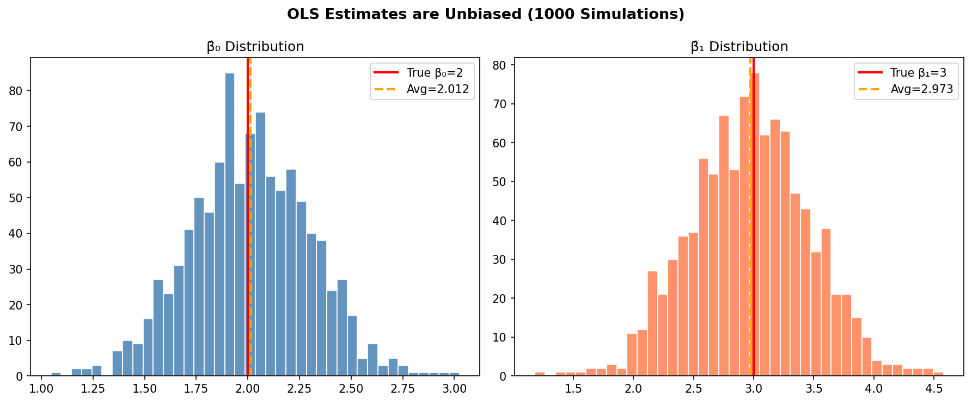
OLS Unbiasedness — 1000 Monte Carlo Simulations
Avg β̂₀ ≈ 2.00 (True: 2) | Avg β̂₁ ≈ 3.00 (True: 3) | Distributions are approximately normal (CLT)
Medical Insurance — Predictive Analytics

Slide 9
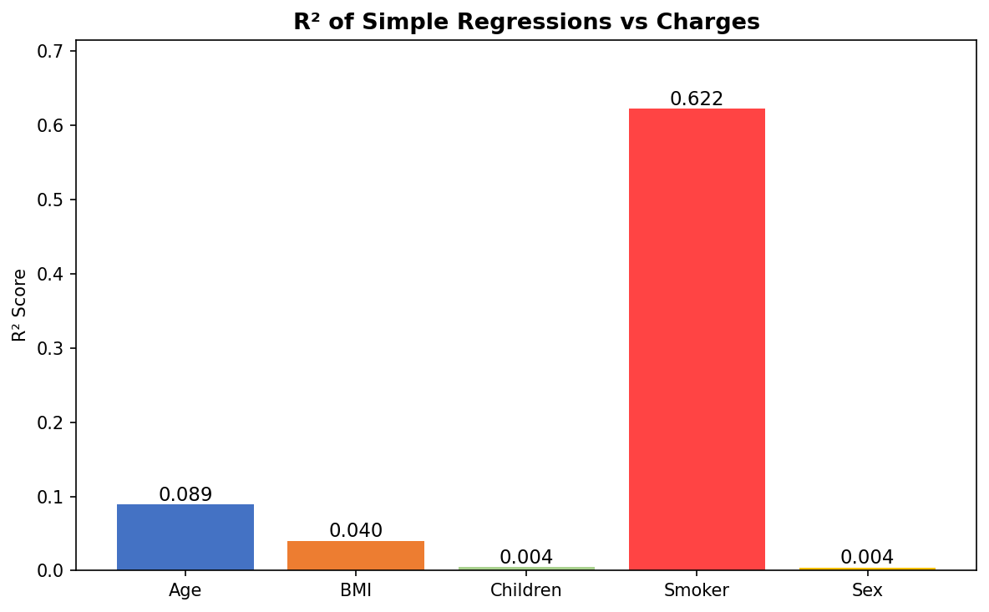
Simple Linear Regressions — R² Comparison
Predictor | Coeff. | R²
Smoker | +$23,616 | 0.619
Age | +$257 | 0.089
BMI | +$392 | 0.039
Children | +$722 | 0.013
Sex | +$1,388 | 0.006
★ Smoker explains 62% of variance alone — the dominant predictor by far.
Medical Insurance — Predictive Analytics

Slide 10
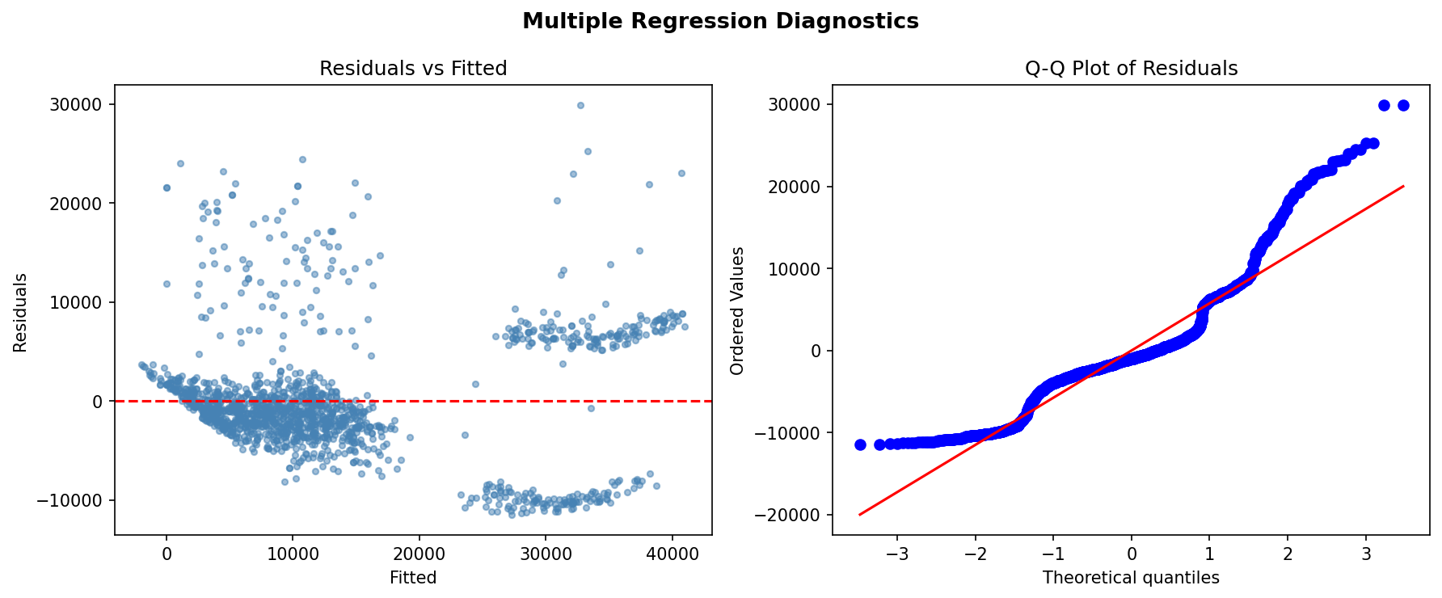
Multiple Linear Regression — Full Model
R²
~0.75 — Model explains 75% of variance in charges.
Adj. R²
~0.749 — Adjusted for number of predictors; still strong.
RMSE
~$6,100 — Average prediction error around $6,100.
Diagnostics
Residuals vs Fitted shows slight heteroscedasticity at high values. Q-Q plot shows mild tail departures — log transform recommended.
Medical Insurance — Predictive Analytics

Slide 11
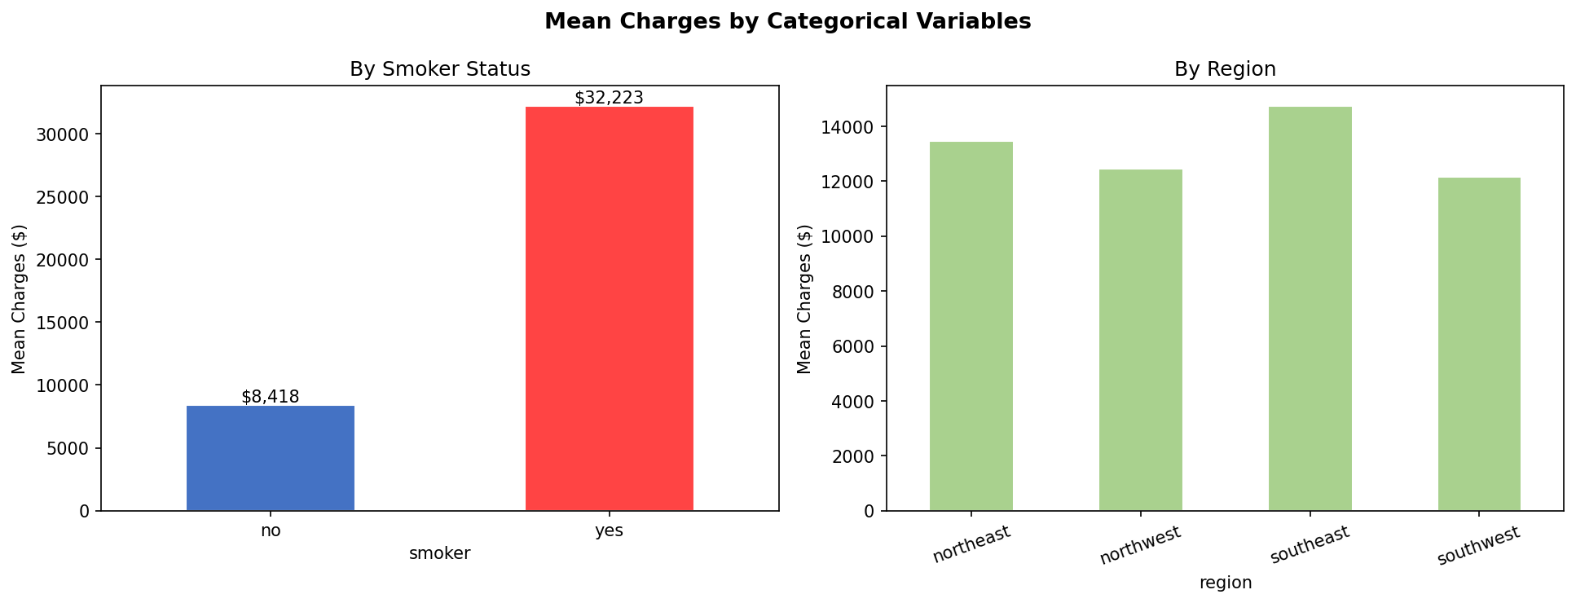
Effect of Categorical Predictors on Charges
Model | Adj. R² | RMSE
Smoker only | 0.619 | $7,500
+ Sex | 0.620 | $7,491
+ Sex + Age | 0.665 | $7,042
Medical Insurance — Predictive Analytics

Slide 12
Conclusions & Key Takeaways
Data Quality
Dominant Predictor
2,772 records, no missing values. Charges are right-skewed — driven by smokers.
Smoking status alone explains 62% of variation in charges (R²=0.619), with a coefficient of +$23,616.
OLS Properties
Full Model (MLR)
Simulation confirmed: OLS lines vary around fixed population line, estimates are unbiased (avg ≈ true β), and OLS sits at RSS minimum.
R² ≈ 0.75 using all predictors. RMSE ≈ $6,100. Age, BMI, and smoker are the most informative predictors.
Model Improvement
Methods Excluded
Log-transforming charges reduces heteroscedasticity. A nonlinear or interaction model (BMI × Smoker) could push R² higher.
Logistic regression, KNN, and Naive Bayes require a categorical response — not applicable to continuous insurance charges.
Medical Insurance — Predictive Analytics

