Slide 1


Slide 2

GROUP MEMBERS
Devashish Poudel
Dip Kumar Gyawali
Swastik Thapa

Slide 3

Introduction
With a focus on younger audiences, the cutting-edge software program "BakedBeats" was created to offer a vibrant and interesting platform for music teaching and discovery.

Slide 4
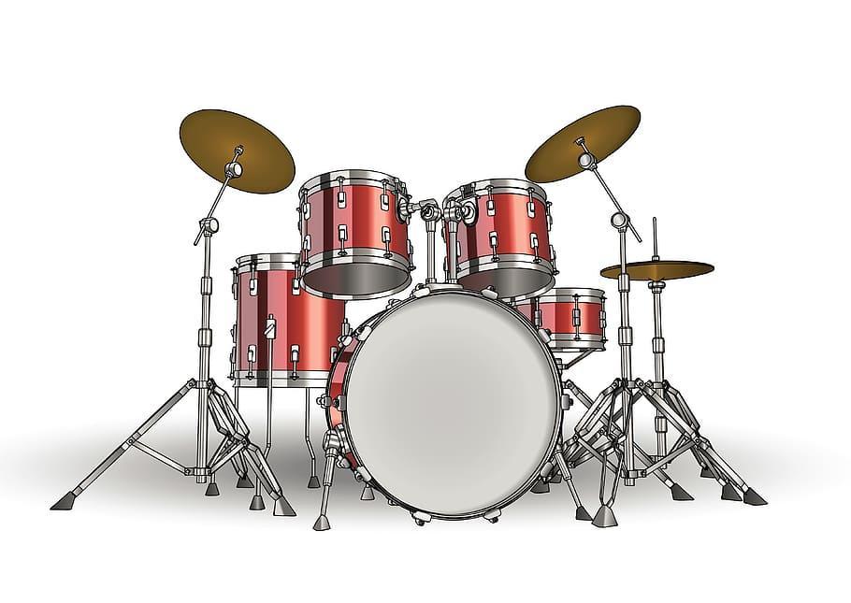
Features
Virtual instrument library
User interface
Audio engine
Basic educational features

Slide 5
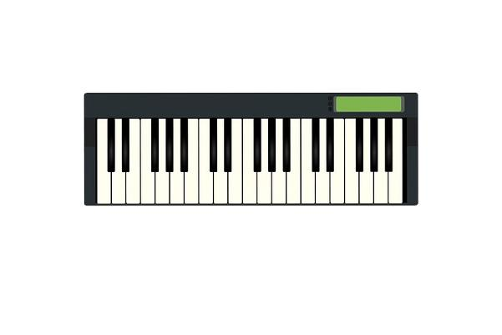
Objective
Create a diverse instrument library
Develop and intuitive user interface
Incorporate educational elements
Foster creativity and expression
Enhance accessibility

Slide 6
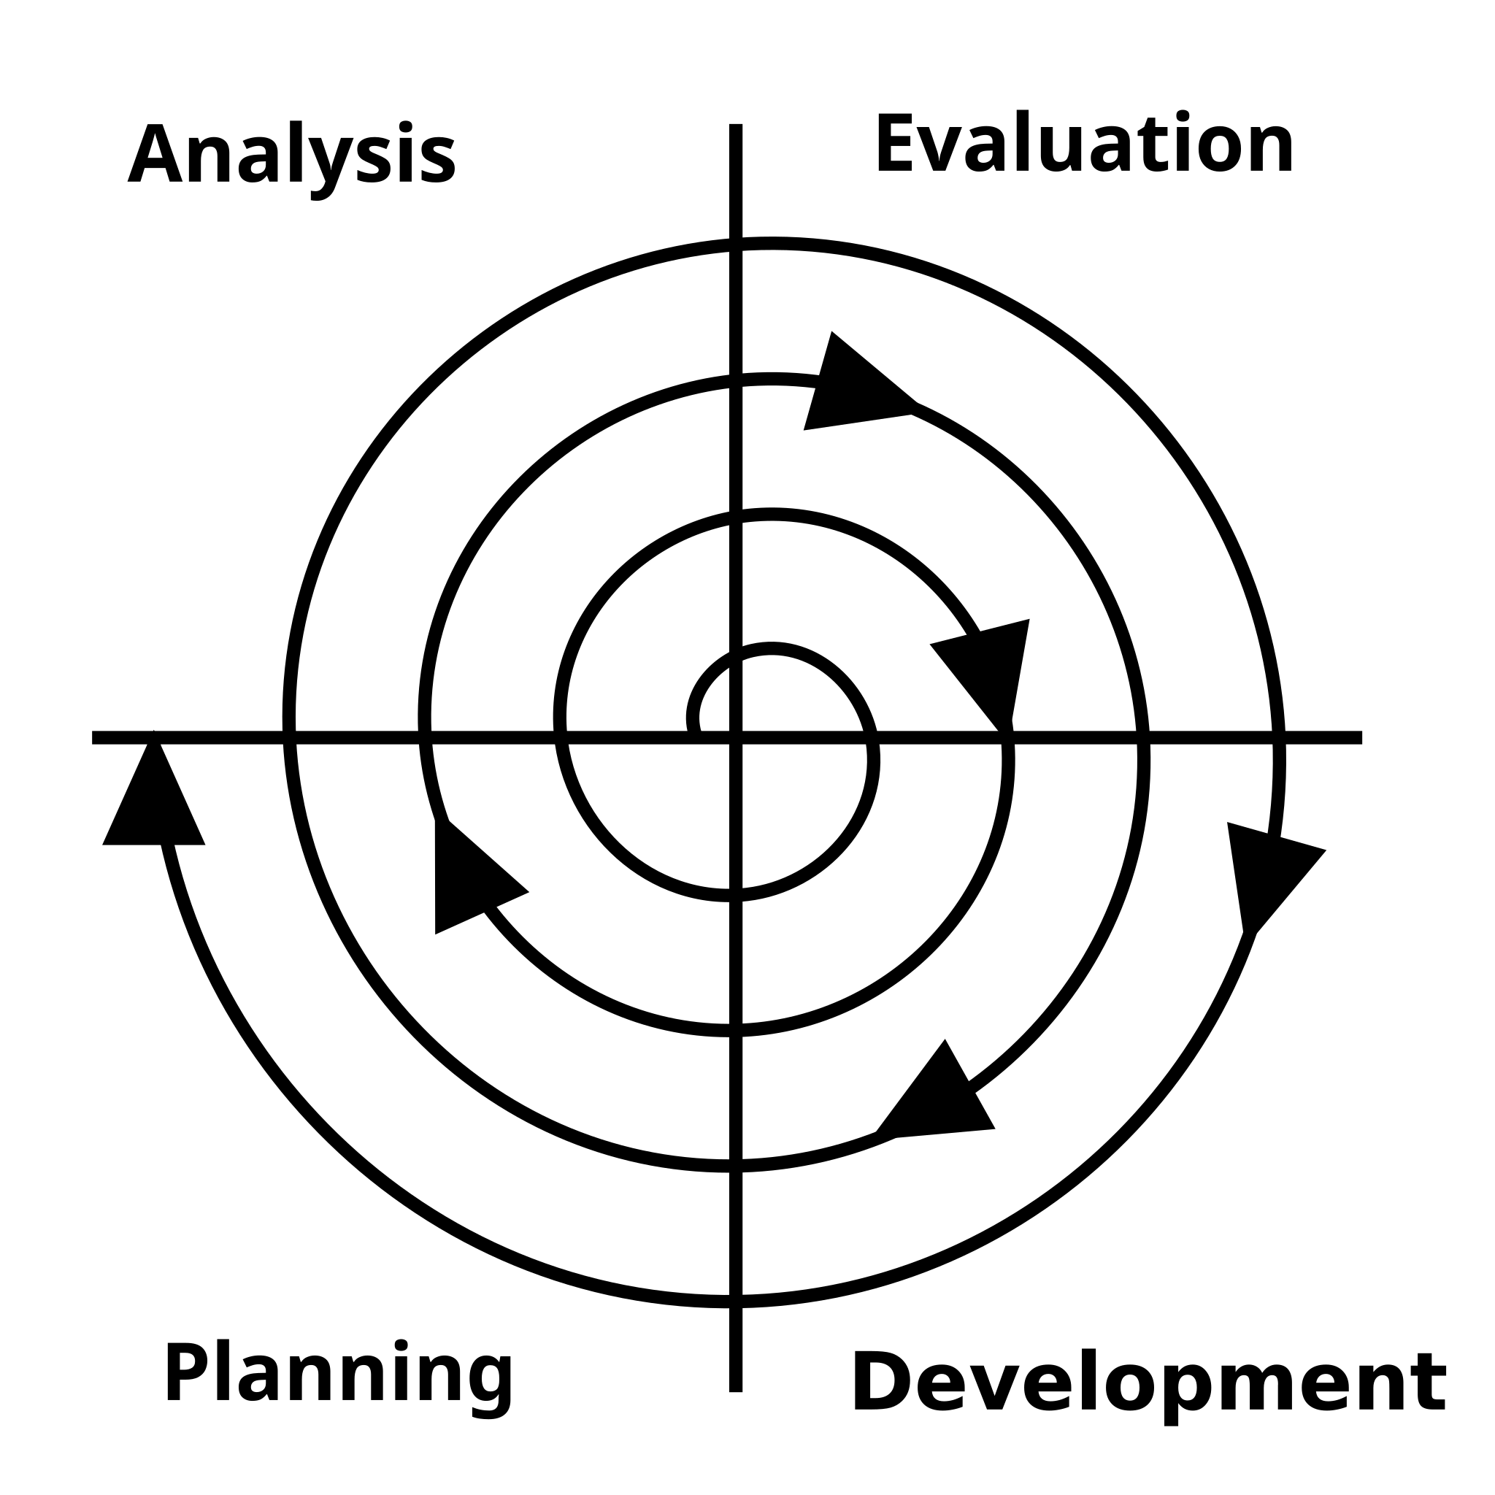
SDLC Model

Slide 7
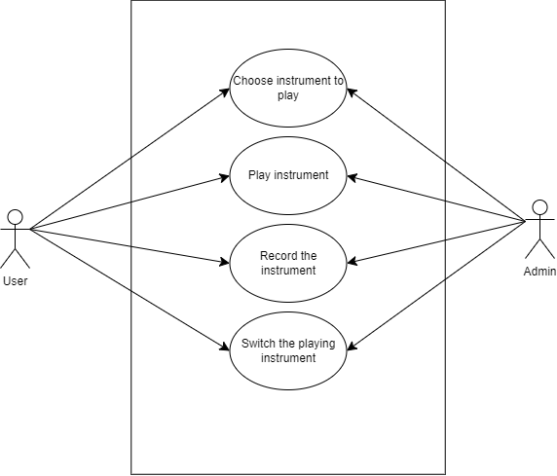
Use-Case Diagram

Slide 8

Scope for the Project
Expanded instrument library
Advanced audio engine
Multiplayer functionality

Slide 9

Future Prospect
Integrating multiple instrument’s recording to mash music
Uploading user’s recording online for other users to interact with
UI to be improved
More instruments to be added.

Slide 10
Conclusion

Slide 11


