Slide 1
Project Ta(r)ble
Super Friendship Arcade
Game Jam
Emil Rofors
Oct 10, 2026

Slide 2
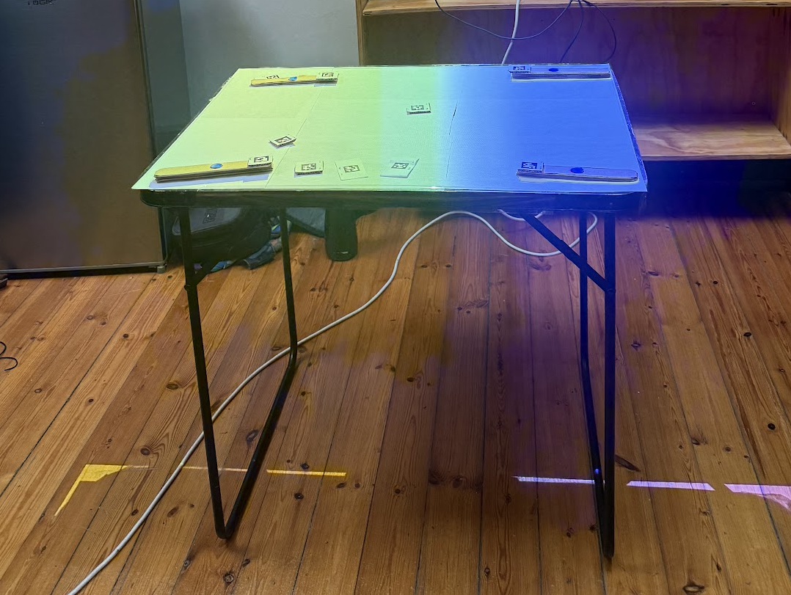

Button press detection
V1 white pad
V2 red pad
V3 blue pad
V4 blue unlit pad
“White” as seen by a camera!

