Slide 1
Python and Teradata
Working with Data at Scale for ML and Data Science

Slide 2
Agenda
General Overview
The Data Science and ML/AI Lifecycle
Python and Jupyter Notebook
Teradata Python Package
Key Concepts
Today’s Focus
Guiding Principles
Demonstration – code examples
Connecting and loading data
Exploration
Transformation
Analysis
© 2020 Teradata

Slide 3
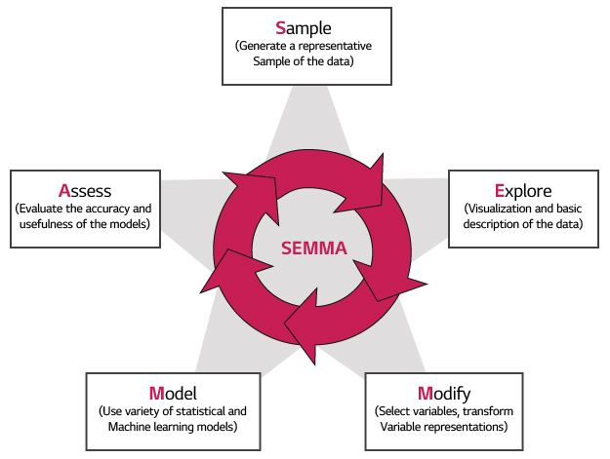
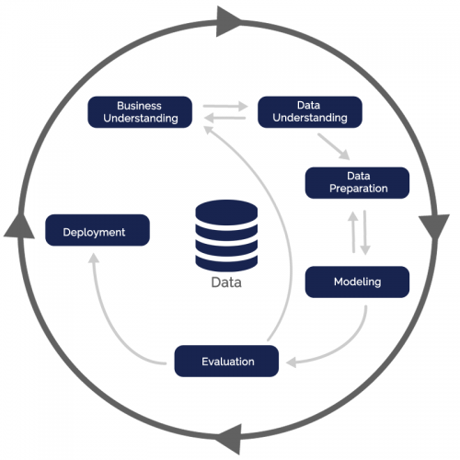
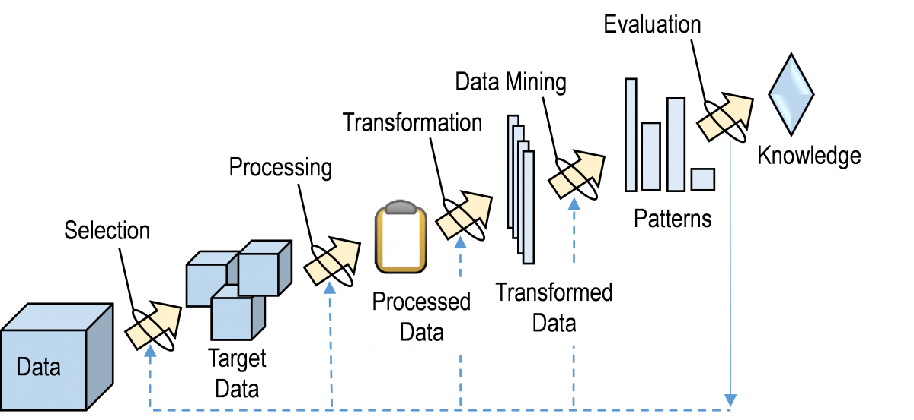
The “Process” of Data Science CRISP-DM, SEMMA, KDD and more…
SEMMA
CRISP-DM
KDD
Notes:
Timed animation
Too many times, incredible insights found in a lab environment do not make it into a production environment. There are many reasons for this, but chief of which is ALL PERSONA’s need to participate in an over-arching analytics process.
There are a few process models out there. All of them can really be looked at as a derivative of the empirical process. The three shown here are CRISP-DM (CRoss Industry Standard Process for Data Mining), KDD (Knowledge Discovery in Databases), SEMMA (Sample, Explore, Modify, Model, Assess).
They all boil down to a problem statement, hypothesis formulation, experiment design, data collection and analysis and conclusion…hence the comment on the empirical process
NOTE – Teradata (NCR) is a founding member of CRISP-DM, along with SPSS, Daimler AG, and OHRA (Dutch Insurance Agency). Most of this activity was in the early to mid-1990’s. We have been in this space for a LONG time, but kept it too quiet. Lets be loud about it now.
The end goal state is to operationalize your analytics models – we sometimes call this analytics ops, but it is really an automation of your analytics process.

Slide 4
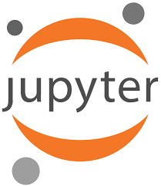
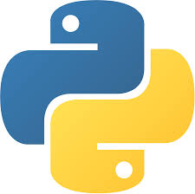
Jupyter Notebooks and Python
What is Jupyter Notebook?
An open-source web application that allows users to create and share documents that contain live code, equations, visualizations and narrative text. Uses include:
data cleaning and transformation
numerical simulation
statistical modeling
data visualization
machine learning
and much more.
What is Python?
Python is an interpreted, object-oriented, high-level programming language with dynamic semantics. Its high-level built in data structures, combined with dynamic typing and dynamic binding, make it very attractive for Rapid Application Development, as well as for use as a scripting or glue language to connect existing components together.
© 2020 Teradata

Slide 5
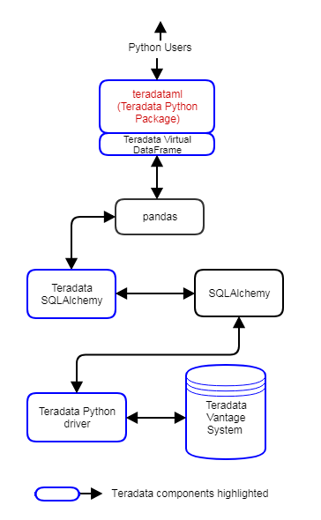
Teradata Python Clients
The Teradata Python Package: teradataml
Freely available Python add-on library for Teradata
Use your favorite Python IDE:
Jupyter Notebooks, JupyterLab, JupyterHub, PyCharm, etc.
User codes in Python, using teradataml interfaces
Works in conjunction with Teradata SQL Driver for Python
Context, database management interfaces
Exposes 100’s of Vantage Machine Learning and Graph Engine and 1000’s of Advanced SQL Engine functions as Python interfaces
Follows pandas DataFrame and SQLAlchemy conventions
Teradata DataFrame “mimics” a pandas data frame
Supports SQLAlchemy methods, aggregates and operators
Supports table/DataFrame conversion
Results are stored in Teradata as temporary tables
Notes:
Freely available Python add-on library for Vantage
SQL backend to connect and push SQL to Teradata Vantage
teradataml enables you to use your favorite Python IDE to access Vantage:
Jupyter Notebooks
JupyterLab and JupyterHub
PyCharm, etc.
With teradataml, user codes in Python. By using teradataml interfaces
One works in conjunction with Teradata SQL Driver for Python
The Context function provides database management interfaces
teradataml exposes 100’s of Vantage Machine Learning and 1000’s of Advanced SQL Engine Functions as Python interfaces
teradataml follows pandas DataFrame and SQLAlchemy conventions
Teradata DataFrame “mimics” a pandas DataFrame
Supports SQLAlchemy methods, aggregates and operators
Supports table-to-DataFrame conversion and vice-versa via:
to_sql() creates a table in the SQL Engine based on a teradataml DataFrame.
copy_to_sql() creates a table in the SQL Engine based on a teradataml or pandas DataFrame.
to_pandas() creates a Pandas DataFrame from a Teradata DataFrame.
Results are stored in Vantage as temporary tables, whereas the user has the ability to make them persistent tables, too.

Slide 6
Today’s Focus
SEMMA
CRISP-DM
KDD
Notes:
Timed animation
Too many times, incredible insights found in a lab environment do not make it into a production environment. There are many reasons for this, but chief of which is ALL PERSONA’s need to participate in an over-arching analytics process.
There are a few process models out there. All of them can really be looked at as a derivative of the empirical process. The three shown here are CRISP-DM (CRoss Industry Standard Process for Data Mining), KDD (Knowledge Discovery in Databases), SEMMA (Sample, Explore, Modify, Model, Assess).
They all boil down to a problem statement, hypothesis formulation, experiment design, data collection and analysis and conclusion…hence the comment on the empirical process
NOTE – Teradata (NCR) is a founding member of CRISP-DM, along with SPSS, Daimler AG, and OHRA (Dutch Insurance Agency). Most of this activity was in the early to mid-1990’s. We have been in this space for a LONG time, but kept it too quiet. Lets be loud about it now.
The end goal state is to operationalize your analytics models – we sometimes call this analytics ops, but it is really an automation of your analytics process.

Slide 7
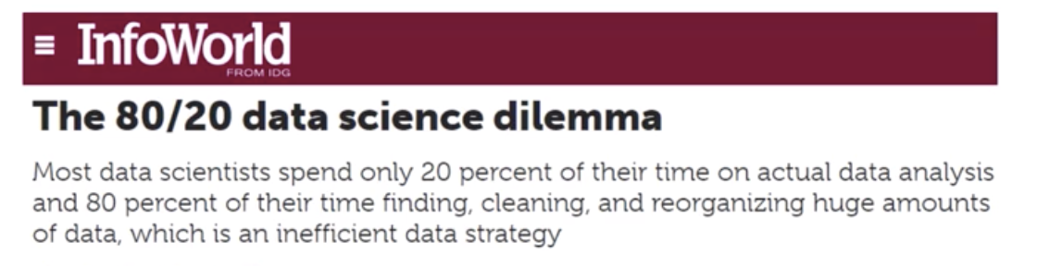
Some Guiding Principles
80% of Advanced Analytics is Logistics
Data Exploration
Analysis
Manipulation
Leverage Teradata for what it does best
Data Gravity
Massively Parallel Processing
Transfer as little as possible
Use the best fit technology
Open source, Third-party
Integrate when it makes sense
Take advantage of advanced analytical functions
Many functions available today
Performance at Scale
© 2020 Teradata

Slide 8
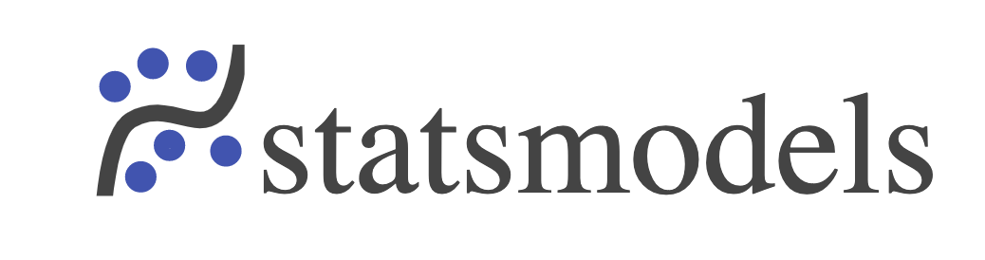

Bringing Open Source to the party
Popular libraries have broad adoption (stackoverflow) and lots of documentation
Statsmodels. Popular library for the statistical analysis and exploration of data.
Data manipulation (endog/exog)
Regression modeling and fitting (logistic, binomial, gaussian, etc.)
Diagnostics/plotting
Scikit-learn. General ML python library with broad industry adoption.
It’s cooler than statsmodels.
Wide array of data preparation and ML functions
Visualization and analysis.

Slide 9
Demo
Notebook and supporting data

Slide 10
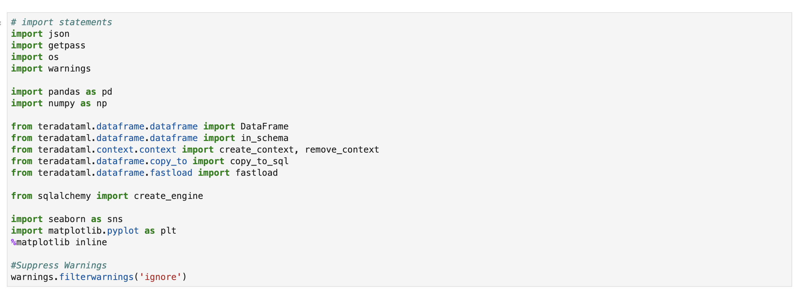
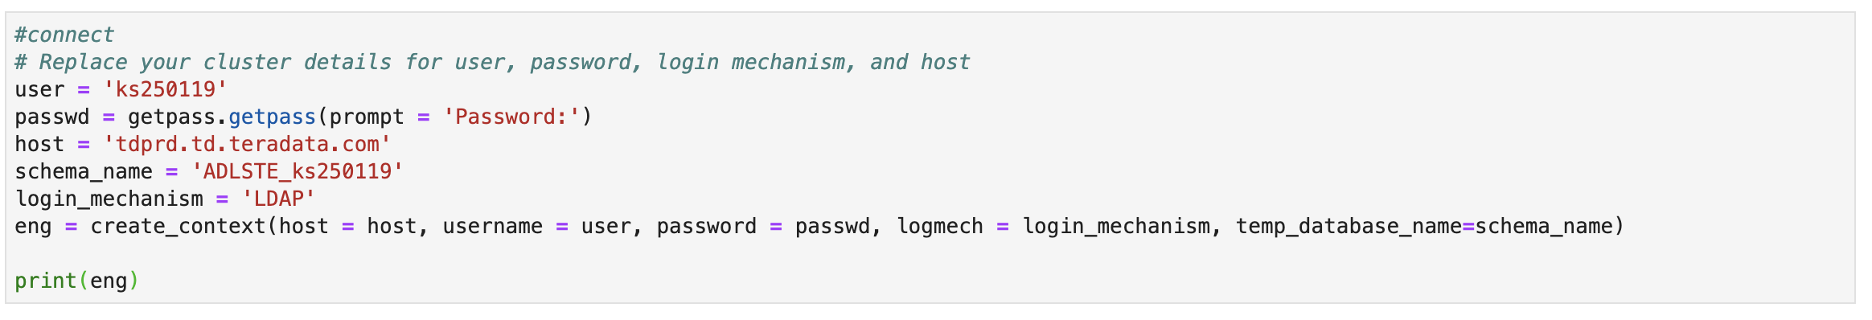
Demonstration
1. Load library packages and dependencies
2. Establish connection to a target Teradata server

Slide 11
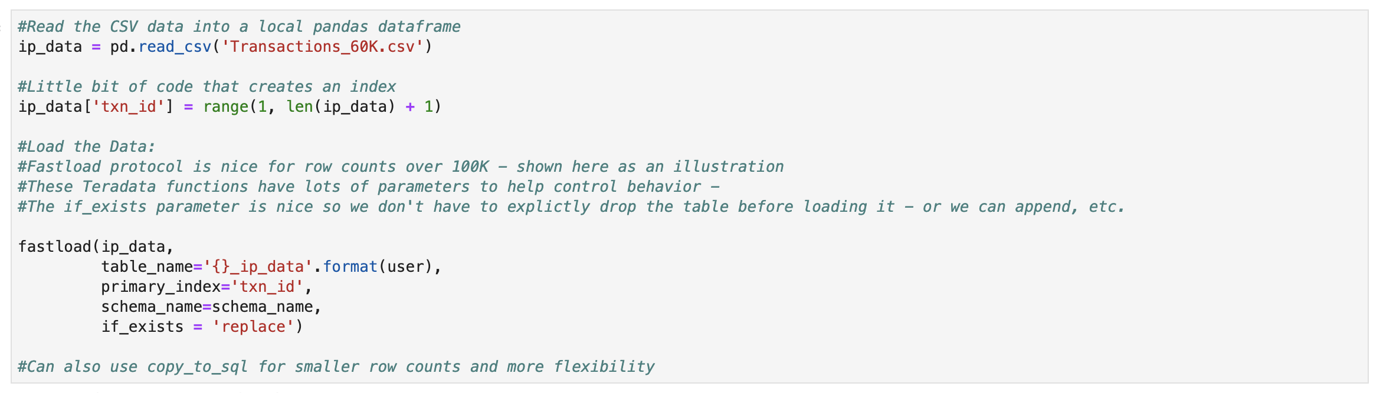
Demonstration
3. Load Data into Vantage

Slide 12
Demonstration
4. Create a local data object on client (teradataml DataFrame) and sample it

Slide 13
Demonstration
4. Create a local data object on client (teradataml DataFrame) and sample it

Slide 14
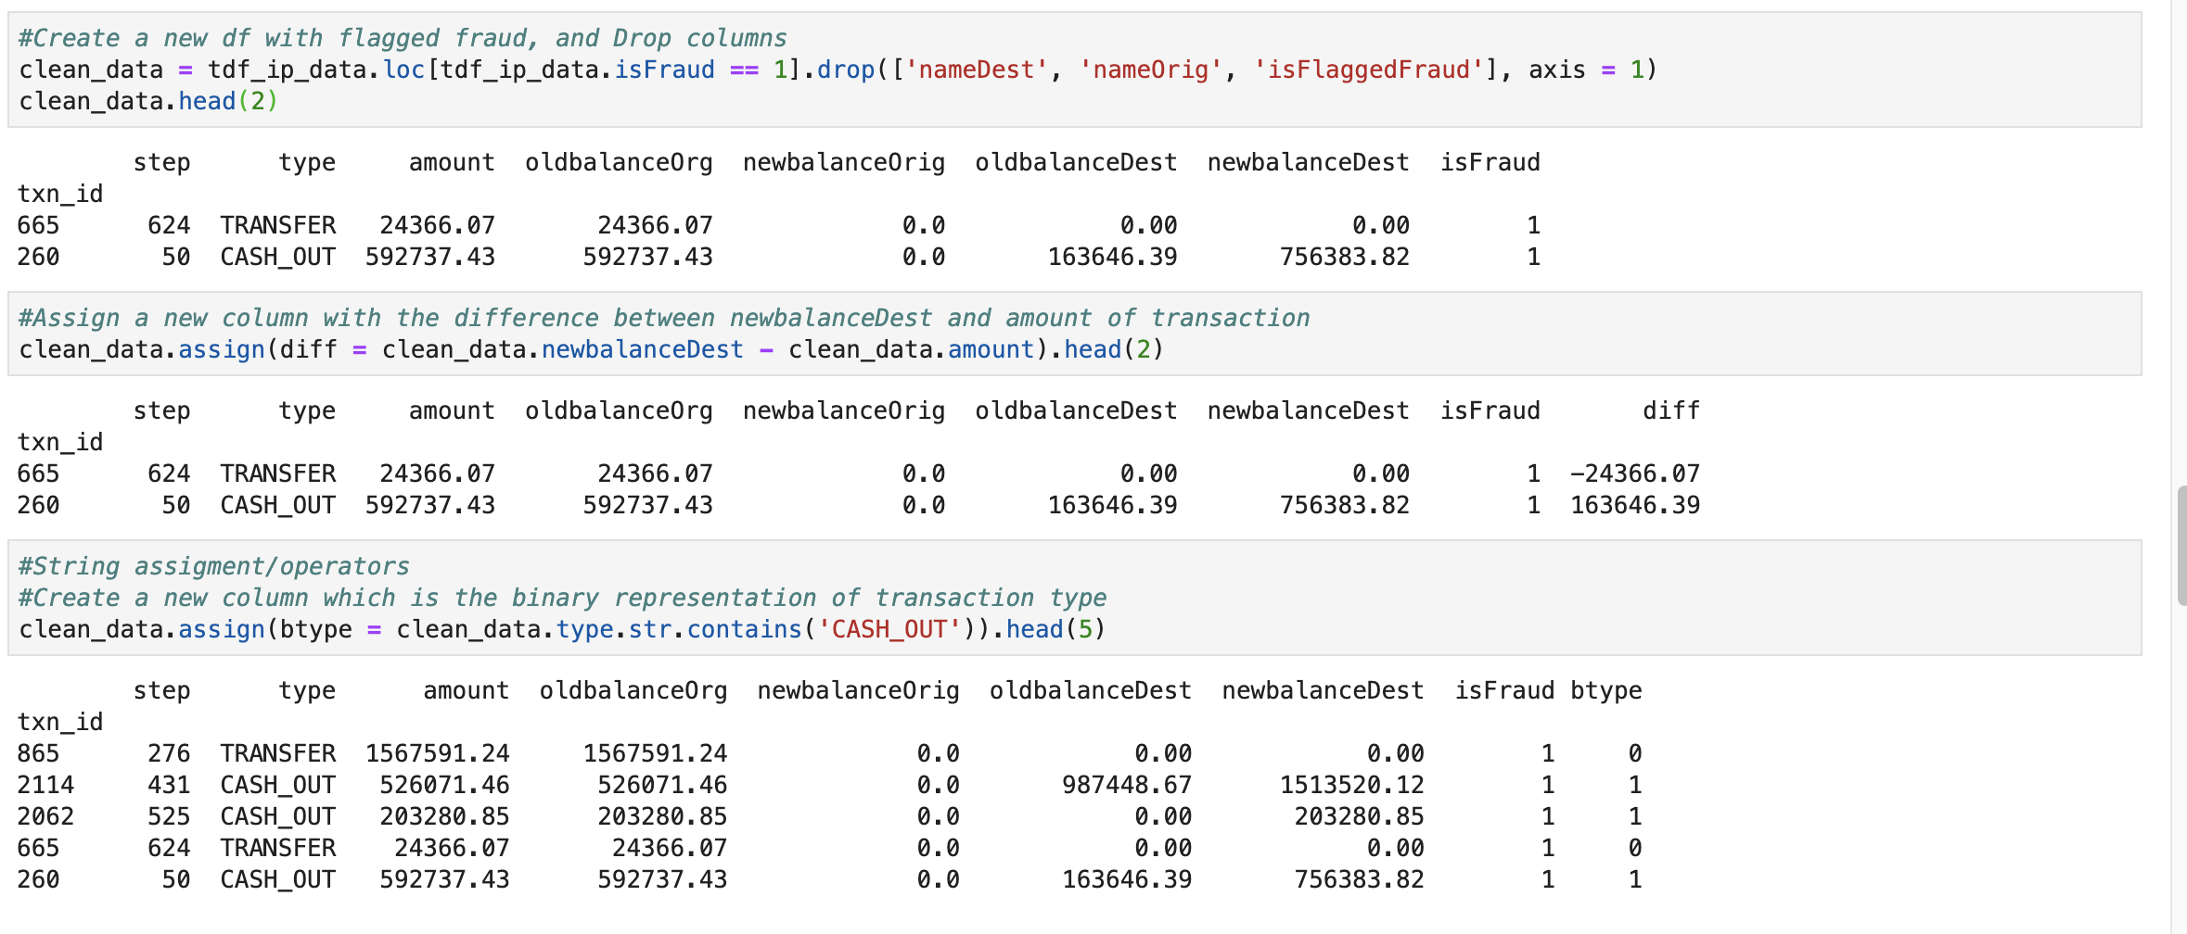
Demonstration
5. Transform and manipulate data

Slide 15
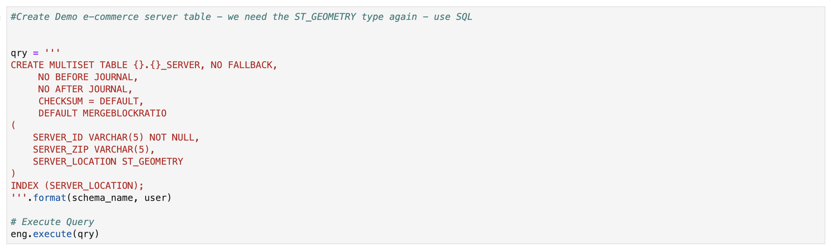
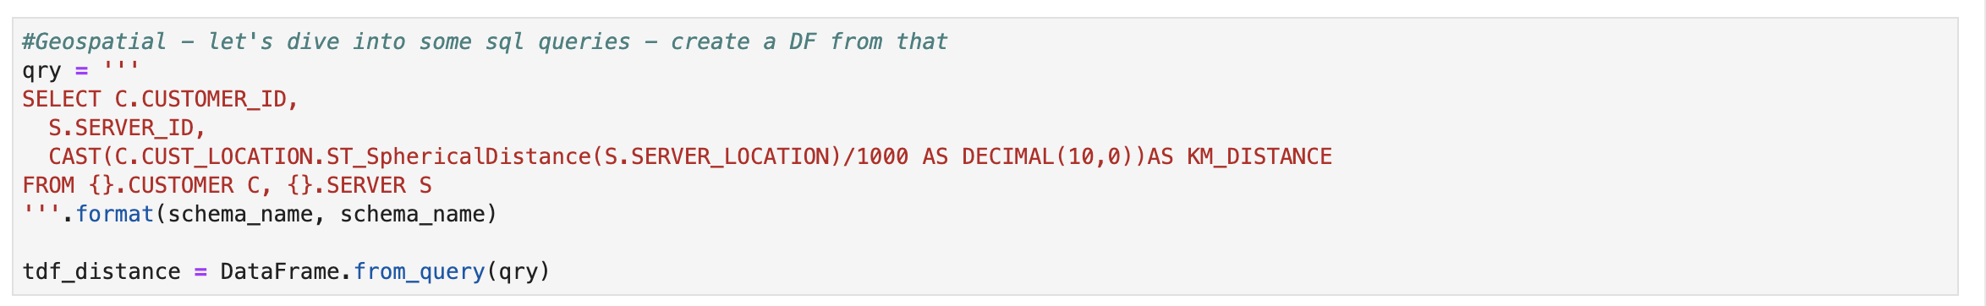
Demonstration
6. Execute SQL inline if desired

Slide 16
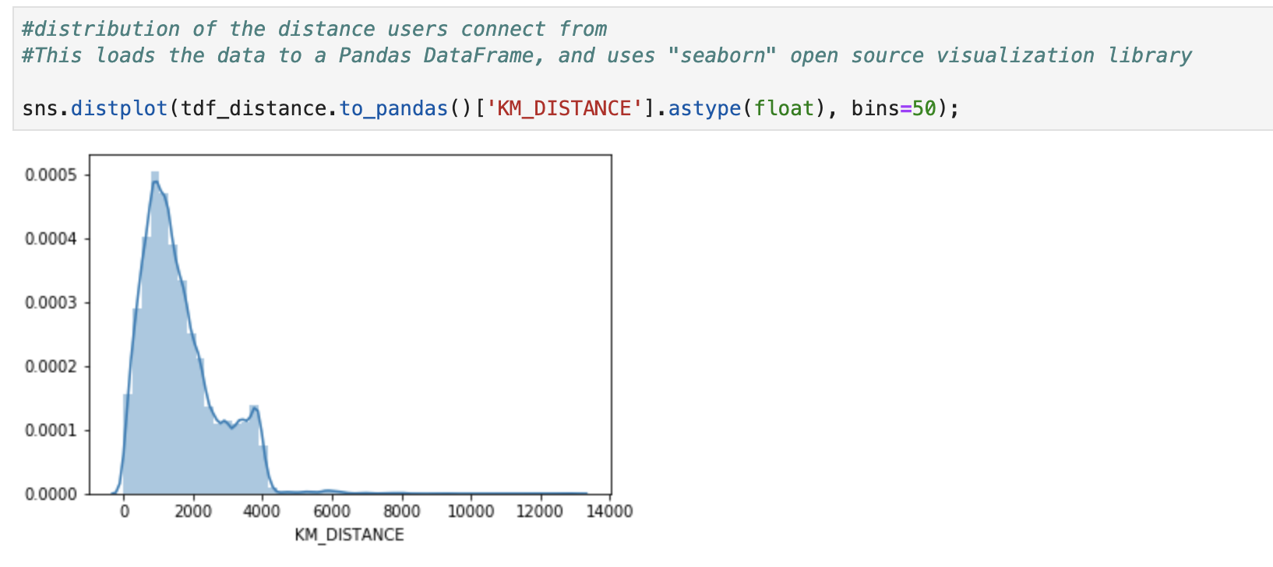
Demonstration
7. Use Third-Party and open source tools – visualization, ML/AI, etc.

Slide 17
Q&A

