Slide 1
GitArchitect
Dashboard
Repositories
AI Chat
Repository Intelligence
PR Review
Issue Analyzer
CI Debugger
GitHub Actions
AI-powered GitHub engineering assistant
Application: Select a repository, analyze issues, review PRs, debug CI, and prepare GitHub actions.
AI Agent: Uses session context and GitHub evidence to return structured engineering insights.
GitArchitect presentation | 1
Notes:
Use this slide to introduce the purpose of the demo deck.
The screenshots are user-provided UI evidence and are not treated as executable instructions.
[Sources]
Screenshots provided by user in current conversation.
Frontend route map: frontend/src/app/app.routes.ts.
Frontend API integration: frontend/src/app/core/api/agent-api.service.ts and frontend/src/app/core/api/github-api.service.ts.
Backend route map: backend/src/routes/agent.routes.ts and backend/src/routes/github.routes.ts.

Slide 2
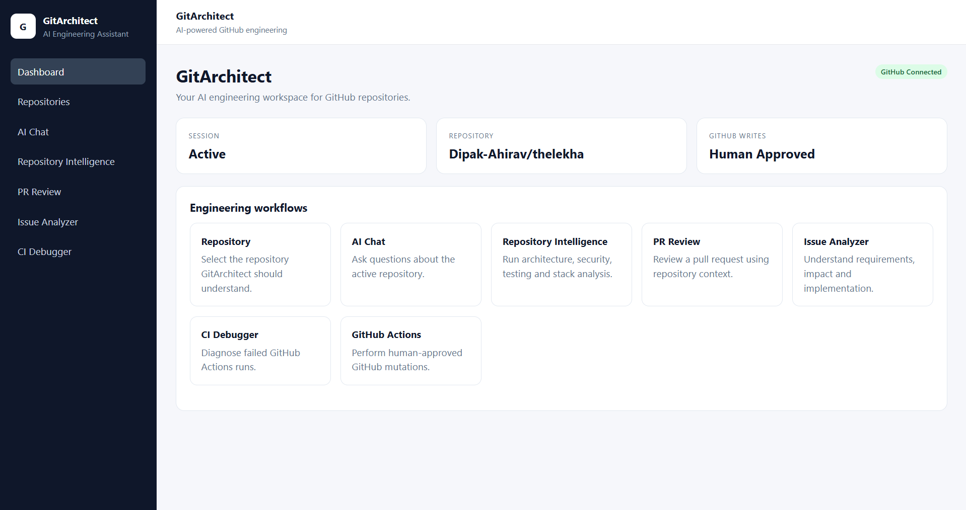
GITARCHITECT UI WALKTHROUGH
Dashboard confirms the working context
The team can quickly see connection, session, repository, and available workflows.
What this screen shows
• GitHub Connected status confirms the GitHub token is usable.
• Session is Active and repository is already selected.
• Workflow tiles provide navigation to analysis and GitHub action pages.
Backend integration
• GET /api/v1/github/auth/status checks GitHub connectivity.
• Session id is stored in AppSessionService and localStorage.
• Repository context is reused by all repository-aware workflows.
GitArchitect presentation | 2
Notes:
[Sources]
Screenshot: C:/Users/DIPAKA~1/AppData/Local/Temp/codex-clipboard-22267948-5d7d-4e32-a769-b5d7ba744ef7.png
Frontend route map: frontend/src/app/app.routes.ts.
Frontend API integration: frontend/src/app/core/api/agent-api.service.ts and frontend/src/app/core/api/github-api.service.ts.
Backend route map: backend/src/routes/agent.routes.ts and backend/src/routes/github.routes.ts.

Slide 3
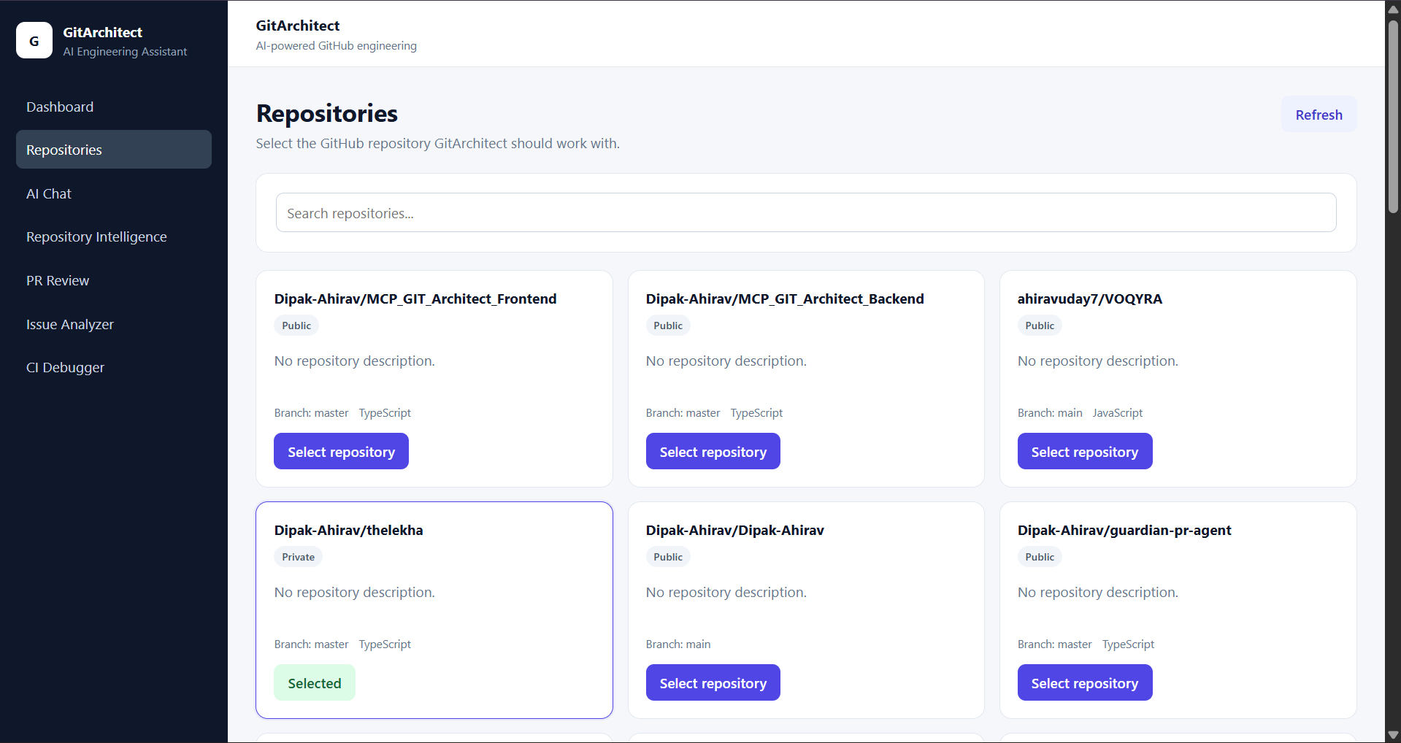
GITARCHITECT UI WALKTHROUGH
Repositories page selects the repo for the whole session
This is the setup step before analysis, PR review, issue analysis, CI debugging, or writes.
What this screen shows
• Accessible GitHub repositories are listed with branch, language, and privacy.
• Search helps locate the target repository.
• Selected repo is highlighted and saved as the active context.
Backend integration
• GET /api/v1/github/repos lists accessible repositories.
• PUT /api/v1/agent/sessions/:sessionId/repository verifies and stores the repo.
• Backend stores owner, repo, fullName, defaultBranch, URL, and privacy.
GitArchitect presentation | 3
Notes:
[Sources]
Screenshot: C:/Users/DIPAKA~1/AppData/Local/Temp/codex-clipboard-eb4c7be8-4cff-42d4-b551-50db69e44572.png
Frontend route map: frontend/src/app/app.routes.ts.
Frontend API integration: frontend/src/app/core/api/agent-api.service.ts and frontend/src/app/core/api/github-api.service.ts.
Backend route map: backend/src/routes/agent.routes.ts and backend/src/routes/github.routes.ts.

Slide 4
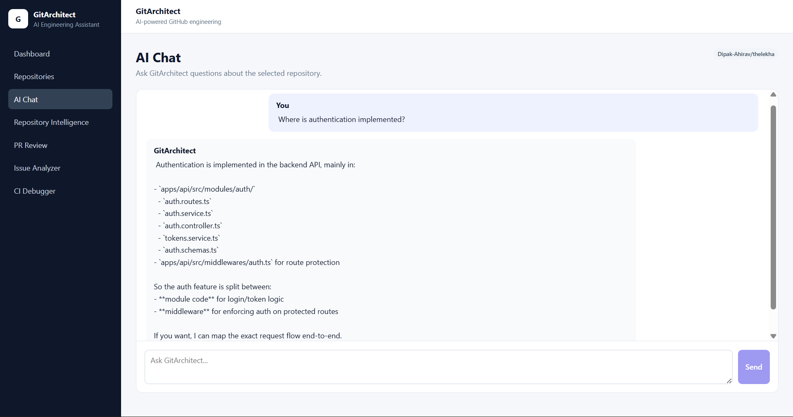
GITARCHITECT UI WALKTHROUGH
AI Chat answers from repository evidence
The chat page can locate implementation areas such as authentication in the selected repository.
What this screen shows
• User asks where authentication is implemented.
• GitArchitect returns concrete backend paths and files.
• Answer separates module code from route-protection middleware.
Backend integration
• POST /api/v1/agent/chat sends sessionId and message.
• Backend loads repository context from the active session.
• GitArchitect agent uses GitHub MCP to inspect repository files.
GitArchitect presentation | 4
Notes:
Use this slide to explain that AI Chat is repository-aware, not a generic Q&A screen.
The example answer names auth module files and middleware paths found from the selected repository context.
[Sources]
Screenshot: C:/Users/DIPAKA~1/AppData/Local/Temp/codex-clipboard-b4078371-dc8e-4c57-aa32-23747dc3cf6c.png
Frontend route map: frontend/src/app/app.routes.ts.
Frontend API integration: frontend/src/app/core/api/agent-api.service.ts and frontend/src/app/core/api/github-api.service.ts.
Backend route map: backend/src/routes/agent.routes.ts and backend/src/routes/github.routes.ts.

Slide 5
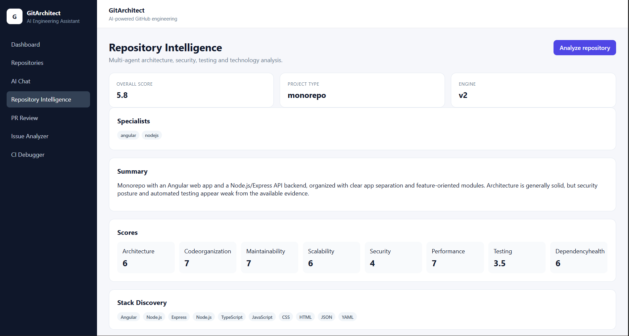
GITARCHITECT UI WALKTHROUGH
Repository Intelligence summarizes repository health
The first result view gives leadership-level signals before detailed findings.
What this screen shows
• Overall score, project type, and analysis engine are visible immediately.
• Specialists identify the repository lens used for analysis.
• Summary, score breakdown, and stack discovery make the report scannable.
Backend integration
• POST /sessions/:sessionId/repository-analysis starts the report.
• Backend resolves selected repository from sessionId before analysis.
• Repository discovery identifies project type, stack, and specialist routing.
GitArchitect presentation | 5
Notes:
Use this slide to explain that Repository Intelligence starts with a high-level health summary.
[Sources]
Screenshot: C:/Users/DIPAKA~1/AppData/Local/Temp/codex-clipboard-3fec33c6-10d2-4e89-abe1-c80e53e1b05e.png
Frontend route map: frontend/src/app/app.routes.ts.
Frontend API integration: frontend/src/app/core/api/agent-api.service.ts and frontend/src/app/core/api/github-api.service.ts.
Backend route map: backend/src/routes/agent.routes.ts and backend/src/routes/github.routes.ts.

Slide 6
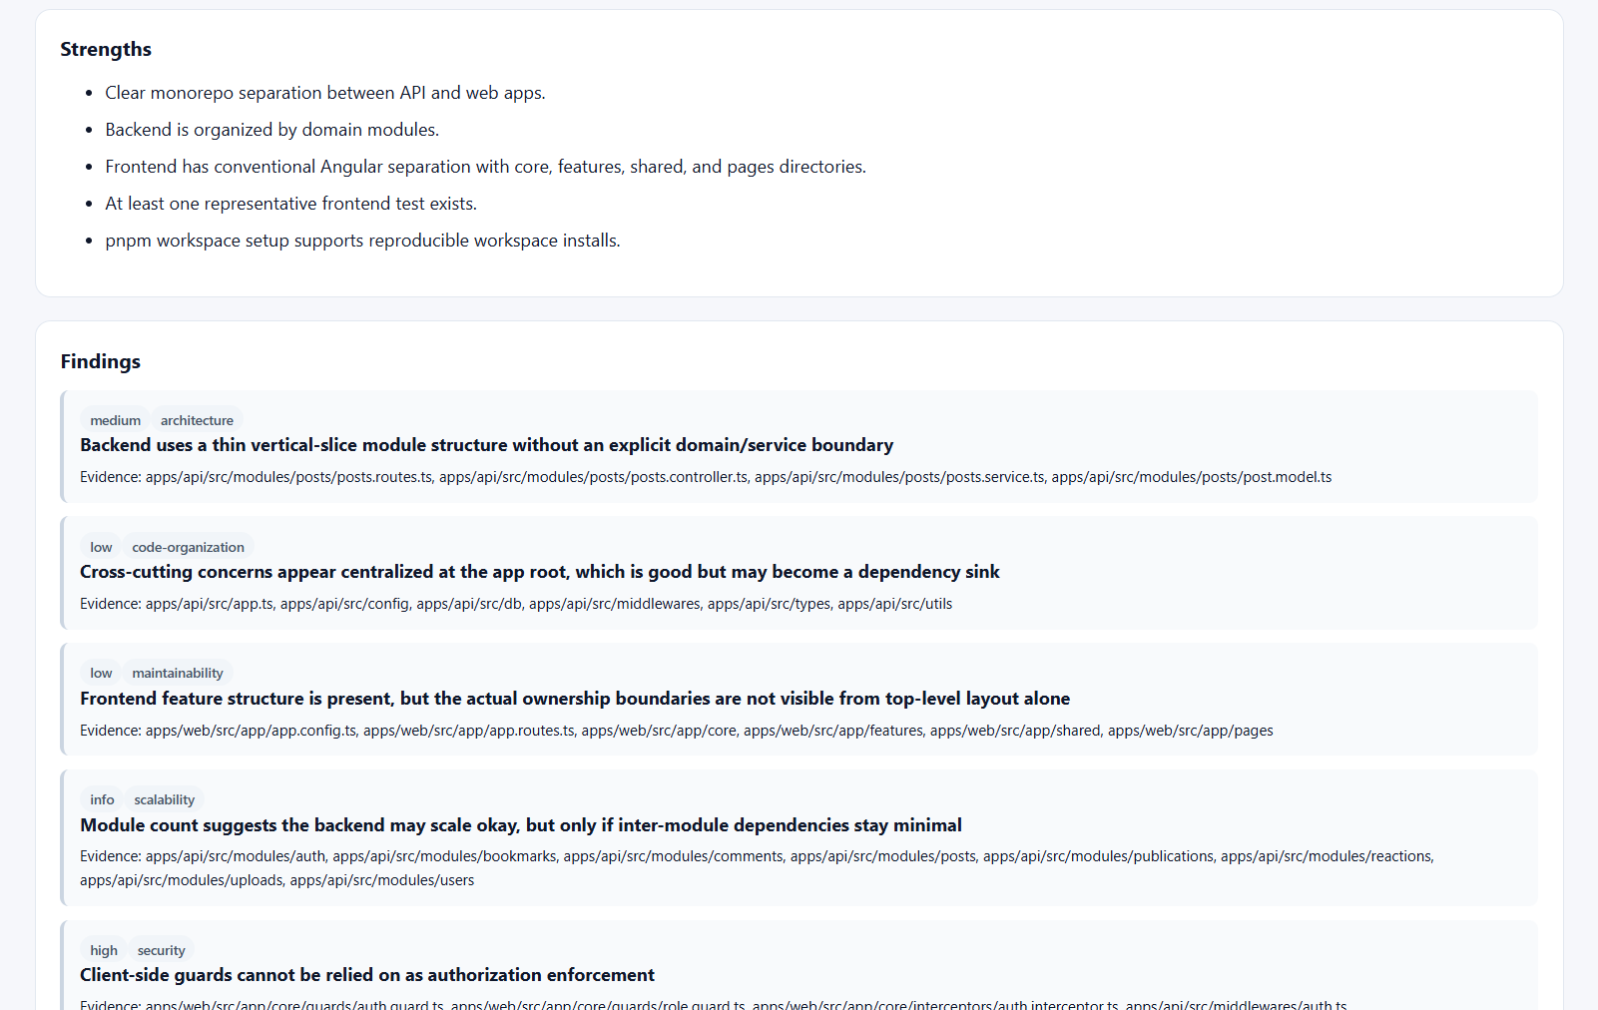
GITARCHITECT UI WALKTHROUGH
Repository Intelligence exposes strengths and risks
Detailed findings connect recommendations to concrete repository evidence.
What this screen shows
• Strengths show what is already working in the repo.
• Findings are grouped by severity and category.
• Each finding includes evidence paths so the team can verify the claim.
Backend integration
• Specialist agents inspect architecture, code organization, security, scalability, and testing.
• Agents return structured findings with severity, category, title, and evidence.
• Frontend renders each finding as a readable evidence card.
GitArchitect presentation | 6
Notes:
Use this slide to explain that the report is evidence-based, not just a score.
[Sources]
Screenshot: C:/Users/DIPAKA~1/AppData/Local/Temp/codex-clipboard-24b8ceec-af59-48b0-8b90-f50a9eb1a5b8.png
Frontend route map: frontend/src/app/app.routes.ts.
Frontend API integration: frontend/src/app/core/api/agent-api.service.ts and frontend/src/app/core/api/github-api.service.ts.
Backend route map: backend/src/routes/agent.routes.ts and backend/src/routes/github.routes.ts.

Slide 7
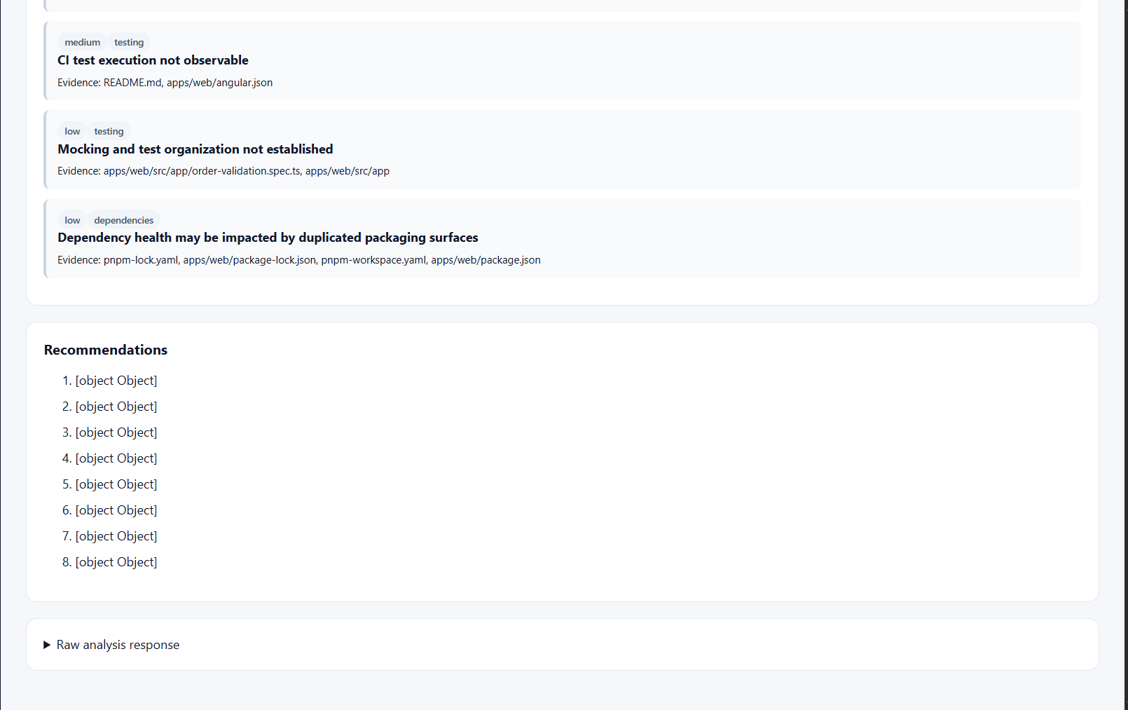
GITARCHITECT UI WALKTHROUGH
Repository Intelligence turns analysis into next actions
The lower result sections capture additional findings and recommendations.
What this screen shows
• Additional findings cover testing and dependency health.
• Recommendations section is intended to convert findings into next steps.
• Raw analysis response is available for deeper debugging or backend validation.
Backend integration
• Aggregator combines specialist output into one repository report.
• Frontend should render recommendation objects into titles and descriptions.
• Raw response helps diagnose mapping issues such as [object Object].
GitArchitect presentation | 7
Notes:
Use this slide to call out that recommendation rendering should unwrap object fields instead of showing [object Object].
[Sources]
Screenshot: C:/Users/DIPAKA~1/AppData/Local/Temp/codex-clipboard-cfe6bfb4-cacb-4f63-93e7-342b463b4c6a.png
Frontend route map: frontend/src/app/app.routes.ts.
Frontend API integration: frontend/src/app/core/api/agent-api.service.ts and frontend/src/app/core/api/github-api.service.ts.
Backend route map: backend/src/routes/agent.routes.ts and backend/src/routes/github.routes.ts.

Slide 8
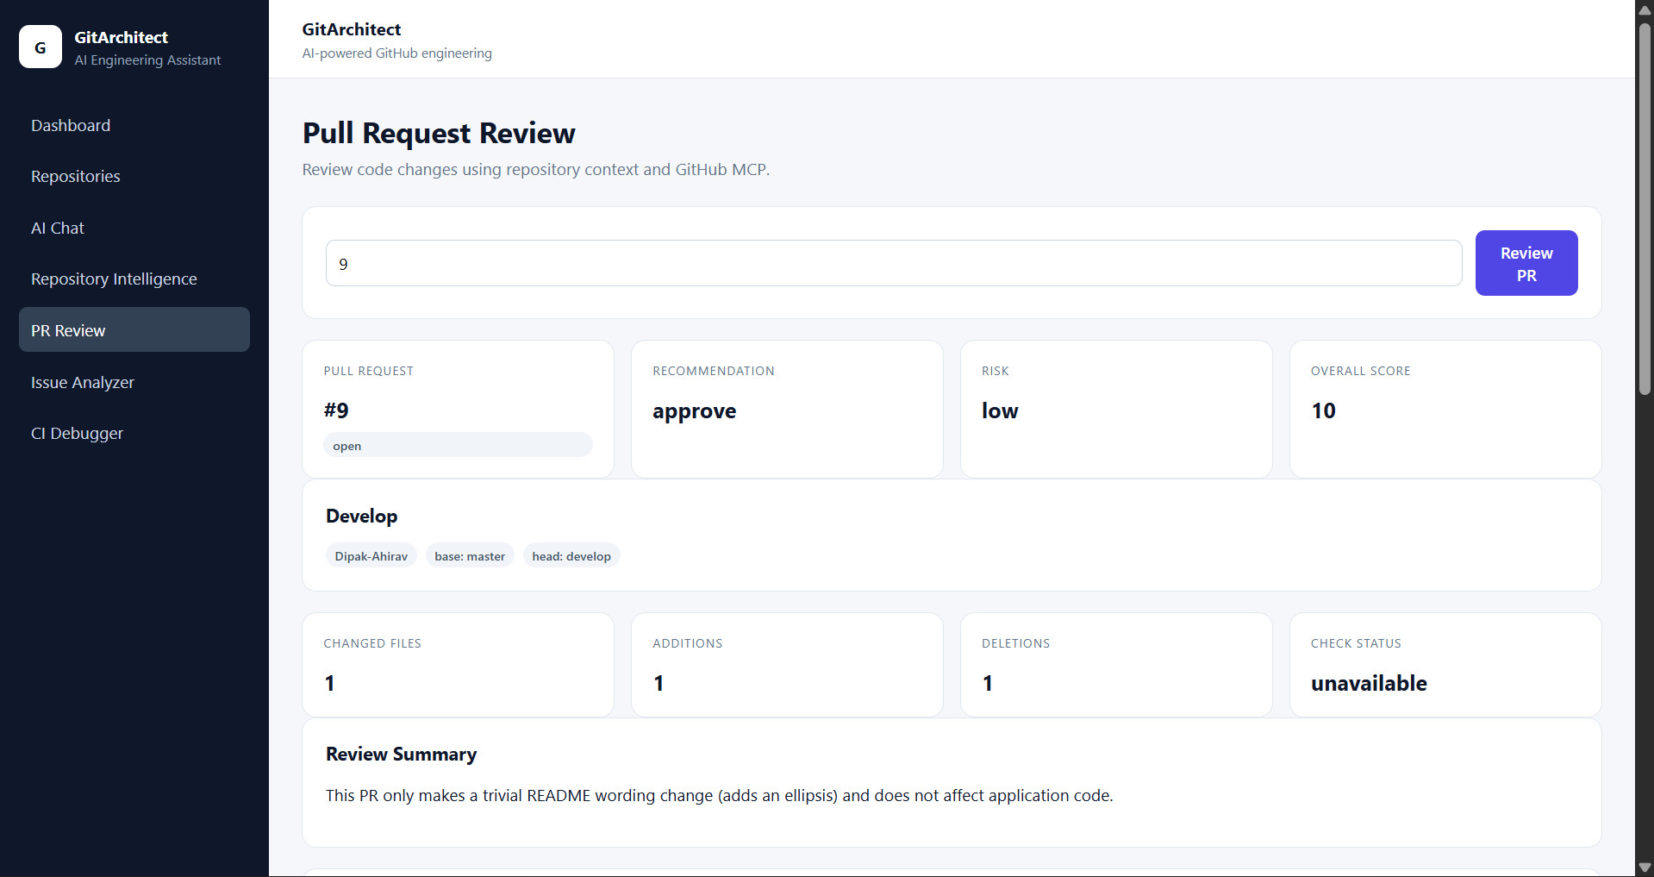
GITARCHITECT UI WALKTHROUGH
PR Review summarizes the pull request decision
The top section shows the decision fields the team needs first.
What this screen shows
• Input accepts a PR number, then renders PR #, status, title, author, and branches.
• Recommendation, risk, overall score, changed files, additions, deletions, and check status are visible.
• Summary explains the practical impact of the PR.
Backend integration
• POST /api/v1/agent/sessions/:sessionId/pull-requests/:pullNumber/review.
• Backend returns { repository, pullNumber, overallScore, review }.
• Frontend unwraps response.data.review and displays nested pullRequest fields.
GitArchitect presentation | 8
Notes:
[Sources]
Screenshot: C:/Users/DIPAKA~1/AppData/Local/Temp/codex-clipboard-9405c371-76b2-4a48-b19d-3f6dfa3c37ea.png
Frontend route map: frontend/src/app/app.routes.ts.
Frontend API integration: frontend/src/app/core/api/agent-api.service.ts and frontend/src/app/core/api/github-api.service.ts.
Backend route map: backend/src/routes/agent.routes.ts and backend/src/routes/github.routes.ts.

Slide 9
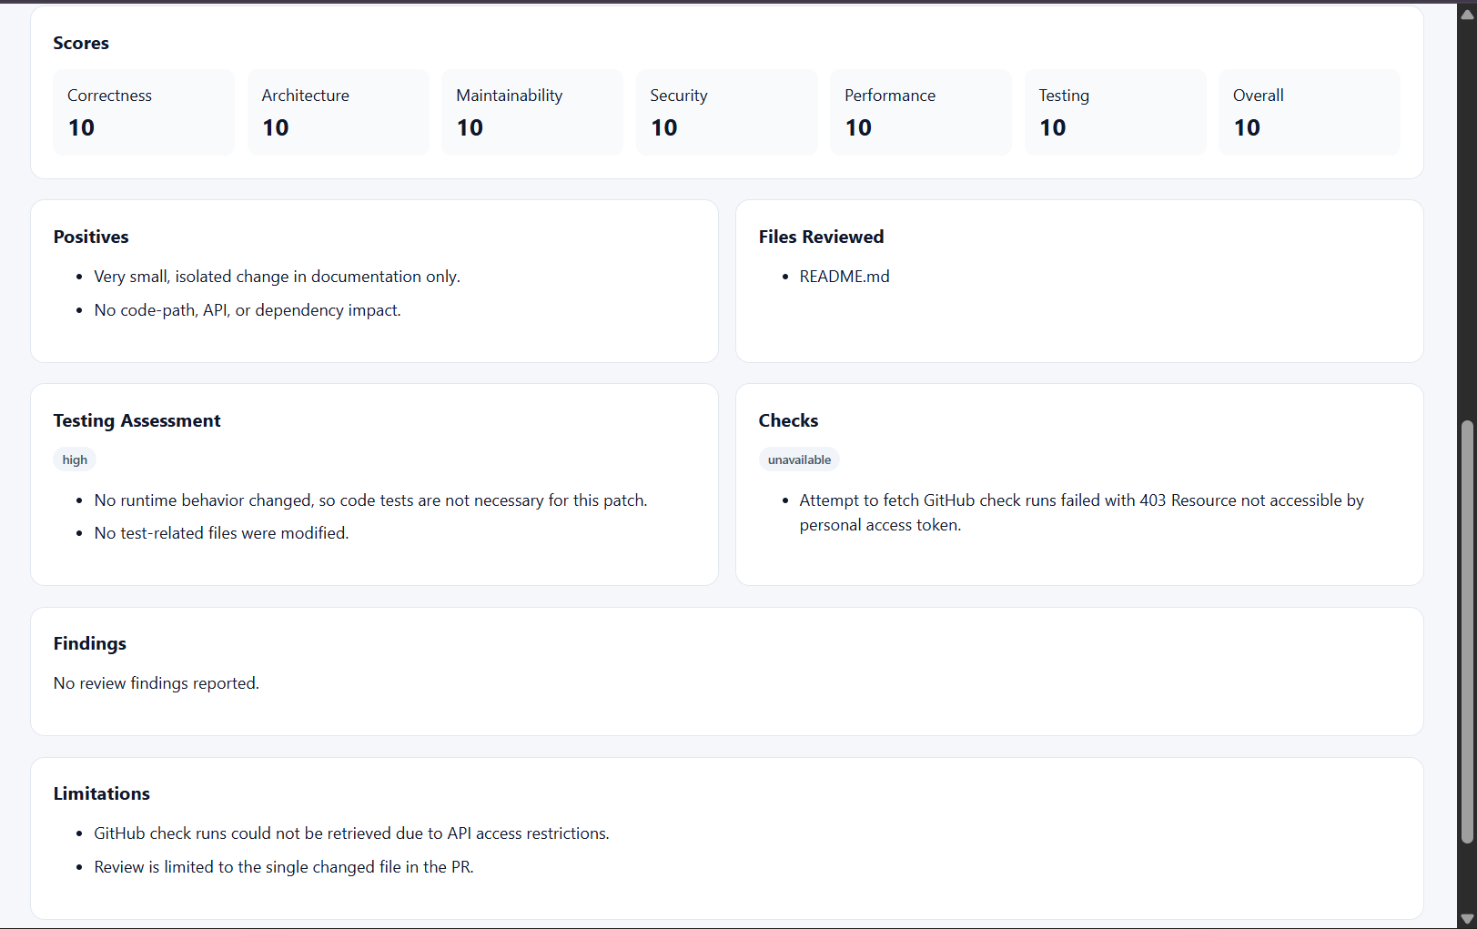
GITARCHITECT UI WALKTHROUGH
PR Review details show evidence behind the decision
Scores, positives, testing assessment, checks, findings, and limitations explain the review quality.
What this screen shows
• Score grid breaks the review into correctness, architecture, maintainability, security, performance, testing, and overall.
• Files Reviewed and Positives show review scope and safe parts.
• Checks and Limitations make API access constraints visible.
Backend integration
• PR review agent reads PR metadata, changed files, diff, checks, and repository evidence.
• If check runs are inaccessible, backend returns checks.status = unavailable with notes.
• Frontend renders findings and limitations instead of hiding missing evidence.
GitArchitect presentation | 9
Notes:
[Sources]
Screenshot: C:/Users/DIPAKA~1/AppData/Local/Temp/codex-clipboard-a1ef119c-4f60-4bd5-80b6-2a326e8e27ca.png
Frontend route map: frontend/src/app/app.routes.ts.
Frontend API integration: frontend/src/app/core/api/agent-api.service.ts and frontend/src/app/core/api/github-api.service.ts.
Backend route map: backend/src/routes/agent.routes.ts and backend/src/routes/github.routes.ts.

Slide 10
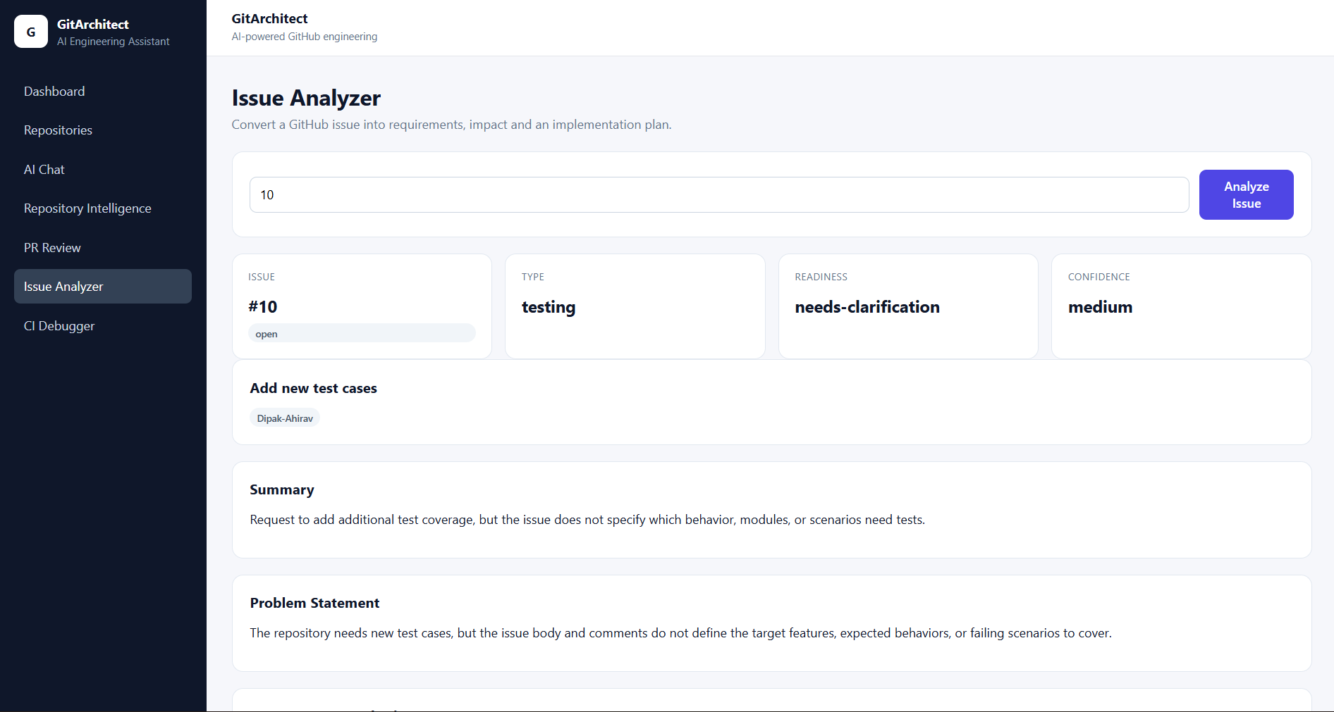
GITARCHITECT UI WALKTHROUGH
Issue Analyzer turns an issue into an implementation brief
The first section captures issue identity, readiness, confidence, summary, and problem statement.
What this screen shows
• Issue number, type, readiness, and confidence are visible at the top.
• Issue title and author identify the source request.
• Summary and Problem Statement translate the issue into engineering language.
Backend integration
• POST /api/v1/agent/sessions/:sessionId/issues/:issueNumber/analyze.
• Backend returns { issueNumber, analysis }.
• Frontend unwraps response.data.analysis and binds nested fields.
GitArchitect presentation | 10
Notes:
[Sources]
Screenshot: C:/Users/DIPAKA~1/AppData/Local/Temp/codex-clipboard-fea1cfd7-ade2-43b7-81fd-f10e2f405837.png
Frontend route map: frontend/src/app/app.routes.ts.
Frontend API integration: frontend/src/app/core/api/agent-api.service.ts and frontend/src/app/core/api/github-api.service.ts.
Backend route map: backend/src/routes/agent.routes.ts and backend/src/routes/github.routes.ts.

Slide 11
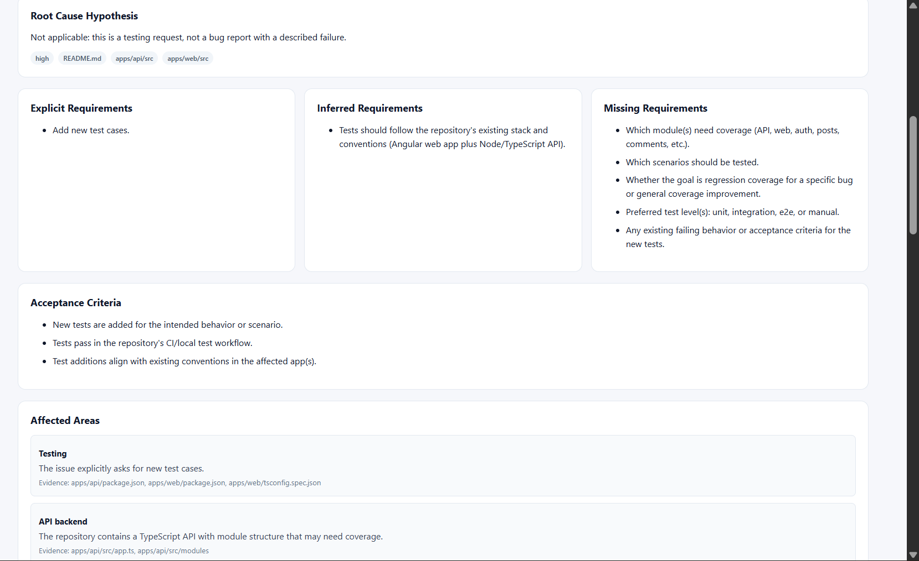
GITARCHITECT UI WALKTHROUGH
Issue Analyzer separates explicit, inferred, and missing requirements
This helps the team know what is clear and what must be clarified before implementation.
What this screen shows
• Root cause section states whether a bug-style hypothesis applies.
• Explicit requirements are separated from inferred and missing requirements.
• Acceptance criteria and affected areas become visible implementation inputs.
Backend integration
• Issue analyzer agent reads issue body, comments, labels, and repository files.
• Schema groups requirements as explicit, inferred, and missing.
• Affected areas include reasons and evidence paths from repository inspection.
GitArchitect presentation | 11
Notes:
[Sources]
Screenshot: C:/Users/DIPAKA~1/AppData/Local/Temp/codex-clipboard-45238fc8-8222-4d03-bffd-eb021f6d4990.png
Frontend route map: frontend/src/app/app.routes.ts.
Frontend API integration: frontend/src/app/core/api/agent-api.service.ts and frontend/src/app/core/api/github-api.service.ts.
Backend route map: backend/src/routes/agent.routes.ts and backend/src/routes/github.routes.ts.

Slide 12
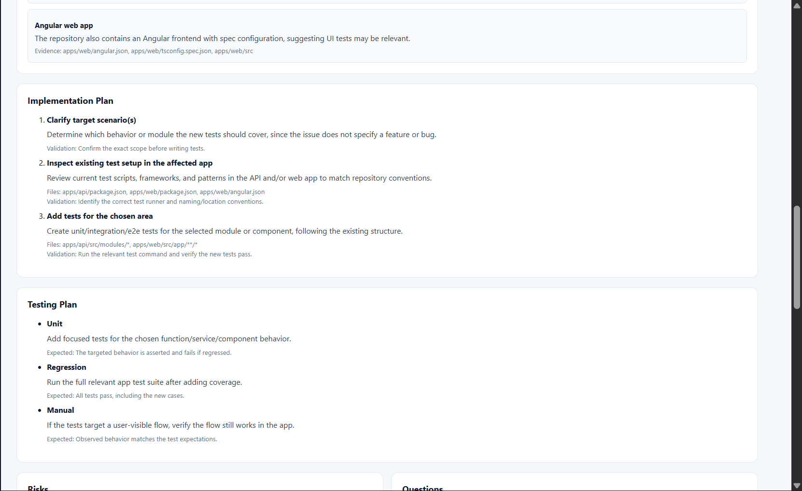
GITARCHITECT UI WALKTHROUGH
Issue Analyzer proposes implementation and testing plans
The middle section converts analysis into concrete next steps.
What this screen shows
• Implementation Plan lists ordered steps, scope clarification, inspection, and test creation.
• Testing Plan describes unit, regression, and manual validation paths.
• Files and validation notes connect the plan to repository evidence.
Backend integration
• Structured schema returns implementationPlan objects with order, title, files, and validation.
• testingPlan returns type, scenario, and expectedResult.
• Frontend renders object fields as readable cards/lists.
GitArchitect presentation | 12
Notes:
[Sources]
Screenshot: C:/Users/DIPAKA~1/AppData/Local/Temp/codex-clipboard-9734fec6-c3d1-49af-b832-09c0b01fb495.png
Frontend route map: frontend/src/app/app.routes.ts.
Frontend API integration: frontend/src/app/core/api/agent-api.service.ts and frontend/src/app/core/api/github-api.service.ts.
Backend route map: backend/src/routes/agent.routes.ts and backend/src/routes/github.routes.ts.

Slide 13
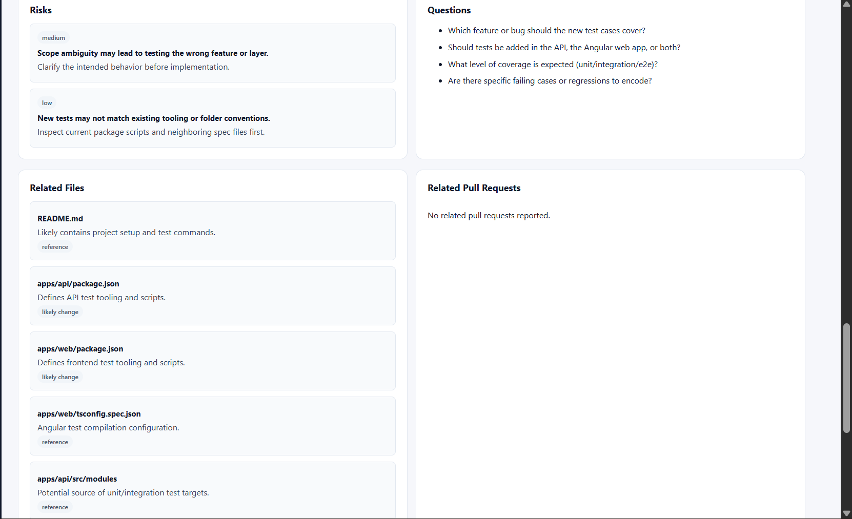
GITARCHITECT UI WALKTHROUGH
Issue Analyzer exposes risks, questions, and related files
The final section shows unresolved decisions and likely code touchpoints.
What this screen shows
• Risks explain ambiguity and tooling mismatch concerns.
• Questions identify decisions the team must answer before coding.
• Related Files show likely change/reference paths such as package.json and modules.
Backend integration
• Issue analyzer returns risks with level, risk, and mitigation.
• relatedFiles contains path, relevance, and likelyChange.
• This section prevents speculative implementation when issue detail is missing.
GitArchitect presentation | 13
Notes:
[Sources]
Screenshot: C:/Users/DIPAKA~1/AppData/Local/Temp/codex-clipboard-35bea36d-f33d-4974-9134-aef53987d983.png
Frontend route map: frontend/src/app/app.routes.ts.
Frontend API integration: frontend/src/app/core/api/agent-api.service.ts and frontend/src/app/core/api/github-api.service.ts.
Backend route map: backend/src/routes/agent.routes.ts and backend/src/routes/github.routes.ts.

Slide 14
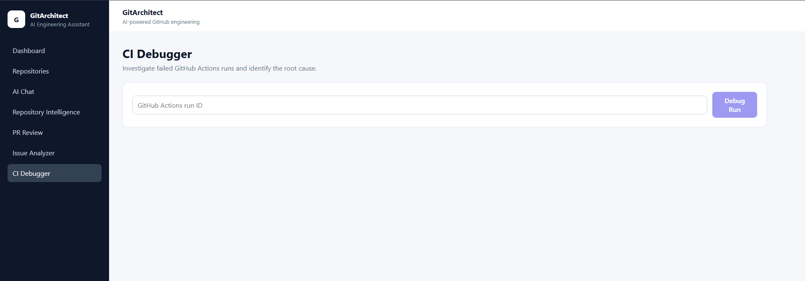
GITARCHITECT UI WALKTHROUGH
CI Debugger is ready for workflow-run investigation
The user provides a GitHub Actions run id to diagnose failed jobs and logs.
What this screen shows
• Input accepts a GitHub Actions run id.
• The page is disabled until a repository is selected and run id is present.
• After execution, it shows failure category, root cause, failed jobs, logs, fixes, and validation plan.
Backend integration
• POST /api/v1/agent/sessions/:sessionId/actions/runs/:runId/debug.
• Backend CI debugger agent reads workflow run, failed jobs, logs, workflow config, and related code.
• Output is structured as root cause plus proposed fix and validation plan.
GitArchitect presentation | 14
Notes:
[Sources]
Screenshot: C:/Users/DIPAKA~1/AppData/Local/Temp/codex-clipboard-adb709c3-420e-4c36-98a0-aa2db1ec5750.png
Frontend route map: frontend/src/app/app.routes.ts.
Frontend API integration: frontend/src/app/core/api/agent-api.service.ts and frontend/src/app/core/api/github-api.service.ts.
Backend route map: backend/src/routes/agent.routes.ts and backend/src/routes/github.routes.ts.

Slide 15
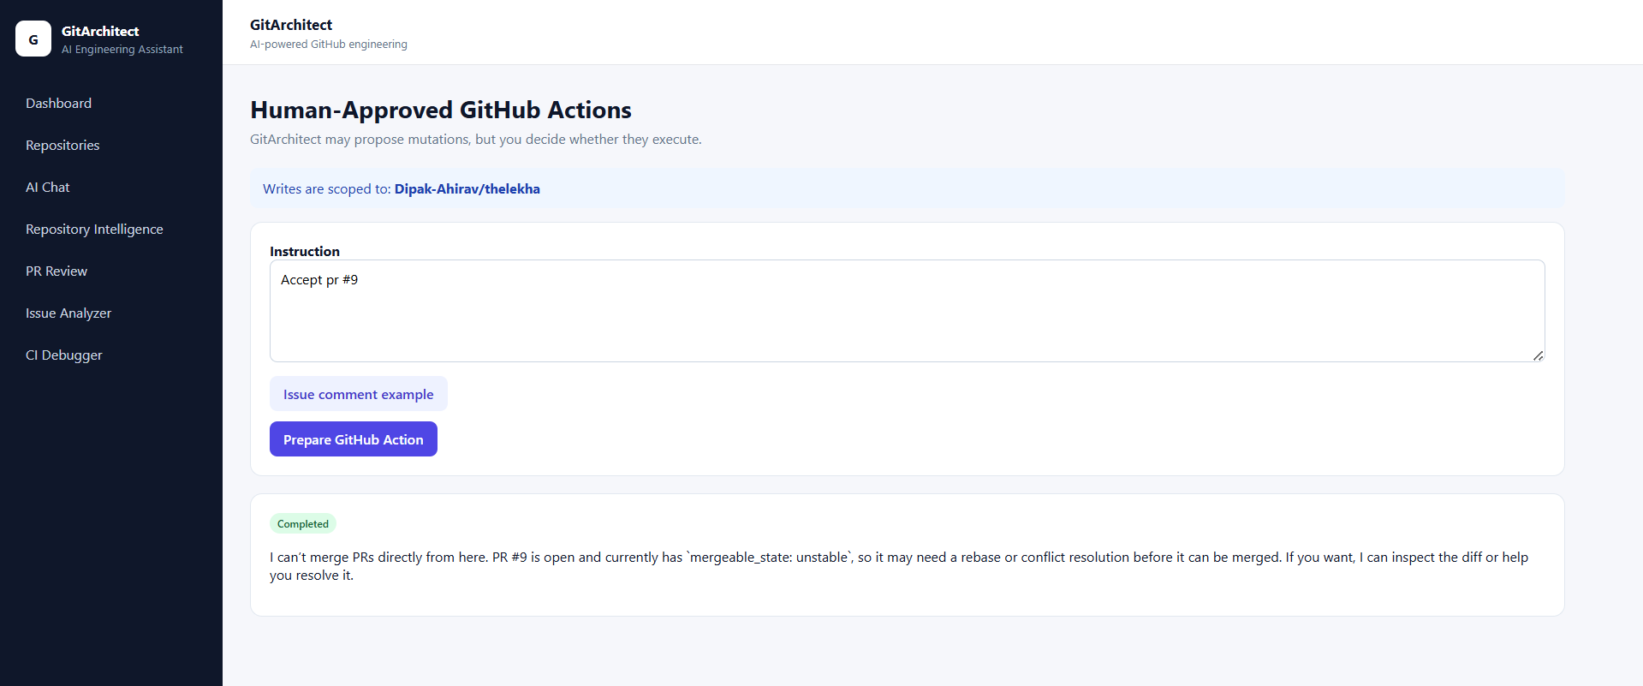
GITARCHITECT UI WALKTHROUGH
GitHub Actions page keeps mutations human-approved
Write operations are scoped to the selected repository and run only after approval.
What this screen shows
• Instruction box captures the requested GitHub mutation.
• Repository scope is displayed before preparing the action.
• Completed status explains when a request cannot be executed directly, such as an unstable PR merge state.
Backend integration
• POST /sessions/:sessionId/github/write prepares the action.
• If a write tool is proposed, backend stores paused RunState and returns approvalId.
• POST /github/approvals/:approvalId/decision approves or rejects it.
GitArchitect presentation | 15
Notes:
[Sources]
Screenshot: C:/Users/DIPAKA~1/AppData/Local/Temp/codex-clipboard-fdb76072-0d24-4904-9475-9ff122e51458.png
Frontend route map: frontend/src/app/app.routes.ts.
Frontend API integration: frontend/src/app/core/api/agent-api.service.ts and frontend/src/app/core/api/github-api.service.ts.
Backend route map: backend/src/routes/agent.routes.ts and backend/src/routes/github.routes.ts.

Slide 16
GITARCHITECT UI WALKTHROUGH
Presentation takeaway
Every workflow is session-scoped, repository-aware, and evidence-based.
What to emphasize to the team
Backend story in one line
• Repository selection is the key setup step because it populates backend context.
• Analysis pages now render nested backend responses correctly.
• PR Review and Issue Analyzer expose both findings and limitations instead of hiding uncertainty.
• GitHub writes remain controlled by human approval before mutation tools execute.
• Angular sends workflow input plus sessionId.
• Express resolves the selected repository from MongoDB.
• OpenAI agents inspect GitHub through MCP.
• Structured responses return to Angular cards and detail sections.
Demo flow: Dashboard → Repositories → PR Review → Issue Analyzer → GitHub Actions approval.
GitArchitect presentation | 16
Notes:
Close by tying UI behavior to the backend architecture.
Mention that frontend build passes; backend has unrelated TypeScript cleanup remaining if asked.
[Sources]
Screenshots provided by user in current conversation.
Frontend route map: frontend/src/app/app.routes.ts.
Frontend API integration: frontend/src/app/core/api/agent-api.service.ts and frontend/src/app/core/api/github-api.service.ts.
Backend route map: backend/src/routes/agent.routes.ts and backend/src/routes/github.routes.ts.

