Slide 1
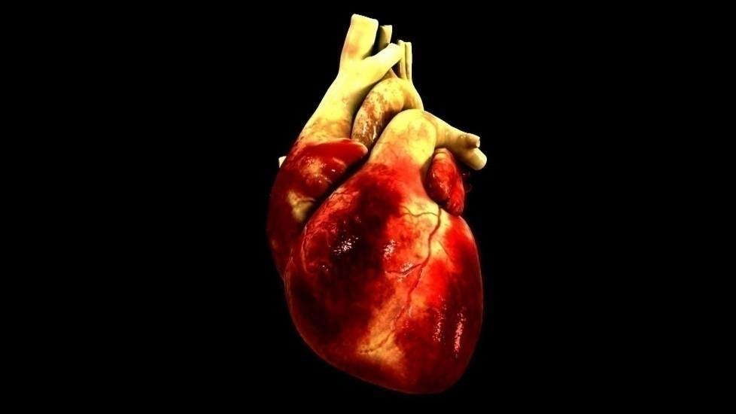
WELCOME TO HEART CLINIC
PRESENTATION BY --- Aasha Giri

Slide 2
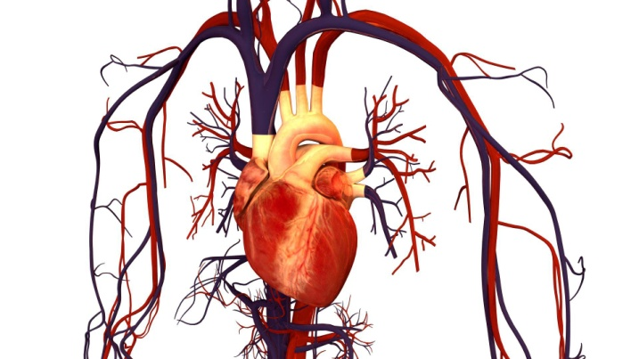
INTRODUCTION OF HEART ATTACK
Heart Attack
A heart attack, also called a myocardial infarction, happens when a part of the heart muscle doesn’t get enough blood. The more time that passes without treatment to restore blood flow, the greater the damage to the heart muscle.

Slide 3

OUR CONTENT
Introduction Of Heart Attack
symptoms
How we can before heart attack
Where we go
Introduction of our Web site
How to visit
How to full fill online register
etc

Slide 4
What are the symptoms of heart attack?
The major symptoms of a heart attack are
i. Chest pain or discomfort.
ii. Feeling weak, light-headed, or faint.
iii. Pain or discomfort in the jaw, neck, or back.
iv. Pain or discomfort in one or both arms or shoulders.
V .Shortness of breath.

Slide 5
Recognizing the Symptoms
These vary from person to person. Not all heart attacks begin with the sudden, crushing chest pain that most of us have heard about. In fact, some cause no symptoms at all, especially those that happen to people with diabetes.
They may begin slowly, with mild pain and discomfort. They can happen while you're at rest or active. How severe they are can depend on your age, gender, and medical conditions.

Slide 6
What to Do When They Happen
If you or someone you’re with has chest discomfort or other heart attack symptoms, call 911 right away. (Check your community plan, because some communities require dialing a different number.)While your first impulse may be to drive yourself or the heart attack victim to the hospital, it’s better to get an ambulance. Emergency medical services (EMS) personnel can start treatment on the way to the hospital. They’re also trained to revive a person if their heart stops.

Slide 7
INTRODUCTION OF DOCTORS

Slide 8
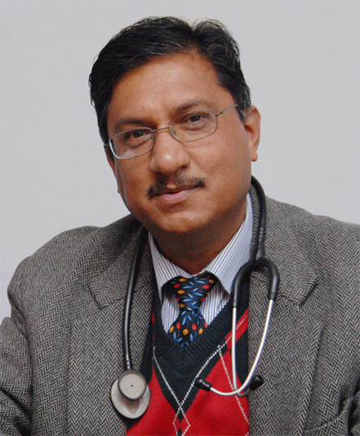
Dr. Prakash Raj Regmi
President of Nepal NCD alliance.
Dr. Regmi well known in field of cardiac intervention in Nepal.
TIME:10AM-6PM

Slide 9
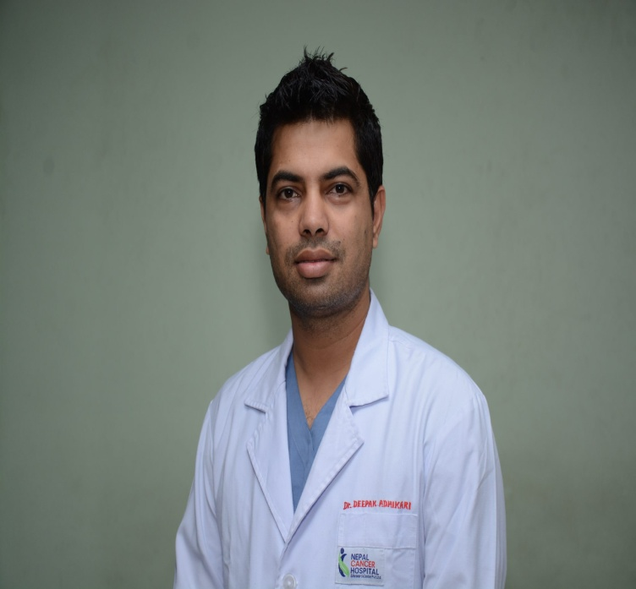
Dr Deepak Adhikari
MBBS, MD (NMC Regd. 13175)
Assistant Consultant Anesthesiologist
TIME:6-10PM

Slide 10
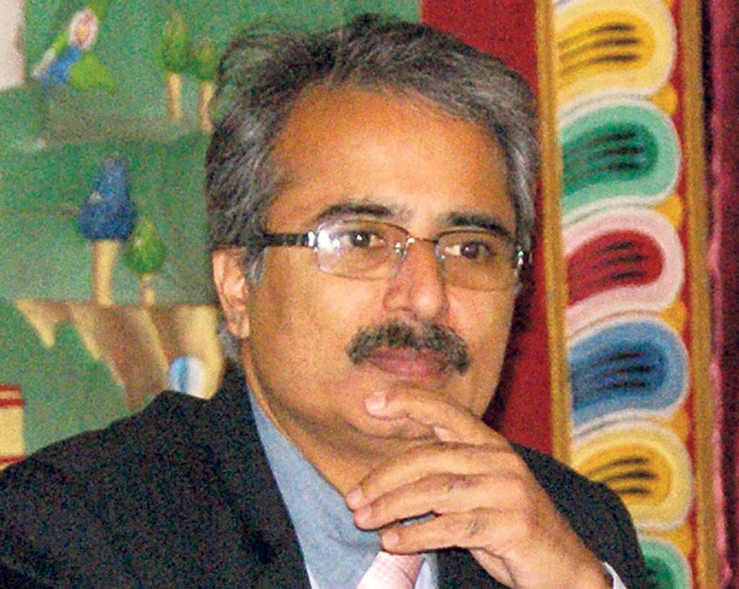
Dr Rajneesh Kappor
Vice Chairman - Interventional Cardiology
Interventional Cardiology , Heart Institute
Time: 2-6PM

Slide 11

Thank You Everyone

