Slide 1
PRESENTATION
By DIPAK KUMAL

Slide 2
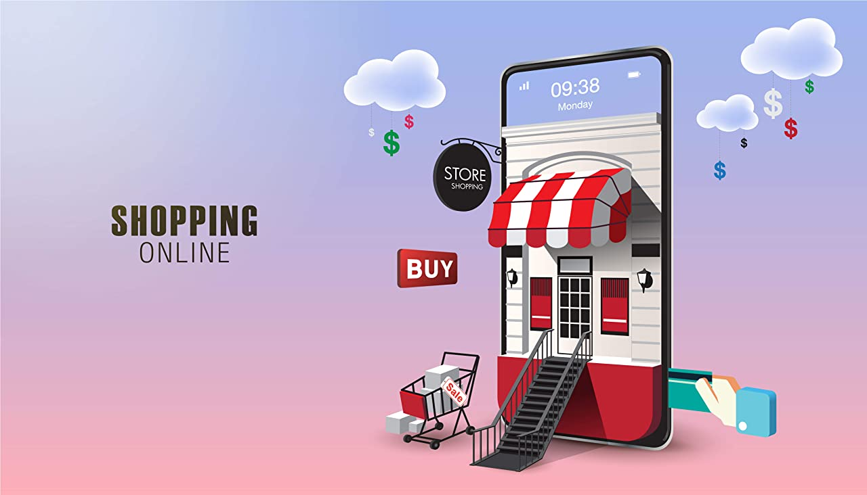
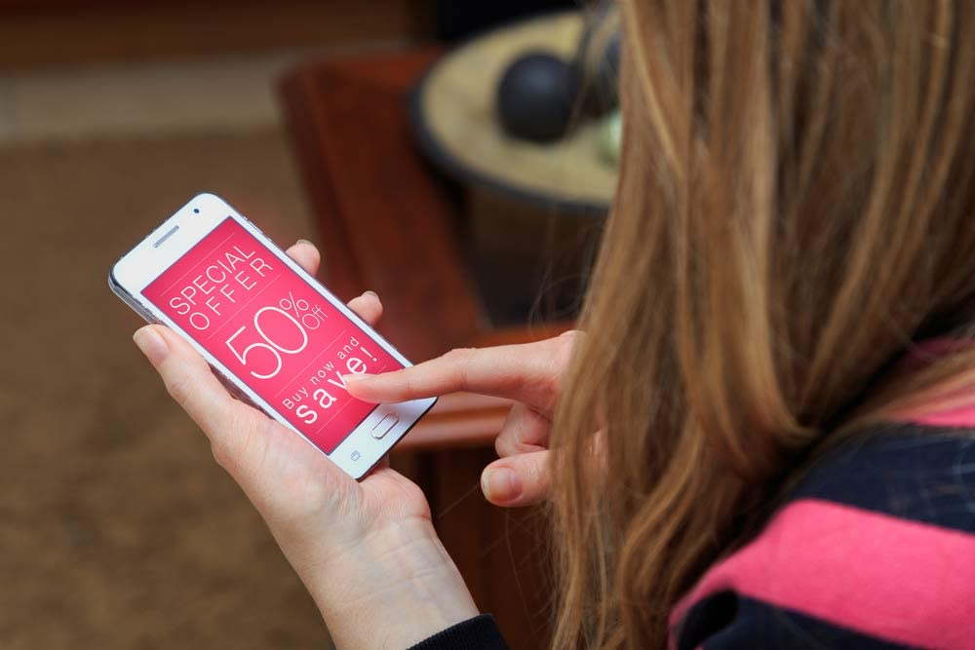

E-COMMERCE

Slide 3

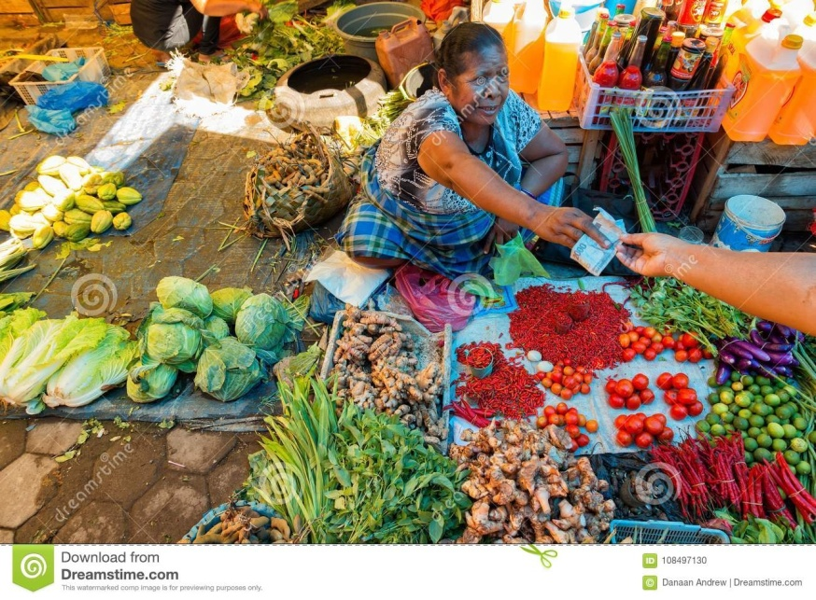
INTRODUCTION
TRADITIONAL COMMERCE
Business happens face to face
Limited to particular geographic location.
Delivery of goods is instant
Limited to certain business hours typically during day time.

Slide 4

INTRO MYSELF
Namaste Everyone ! My name is DIPAK KUMAL. I’m from Lalmatiya,Ramnagar . I’m 4th semester student in Adarsha. As well as I’m a Web developer as a beginner.

Slide 5
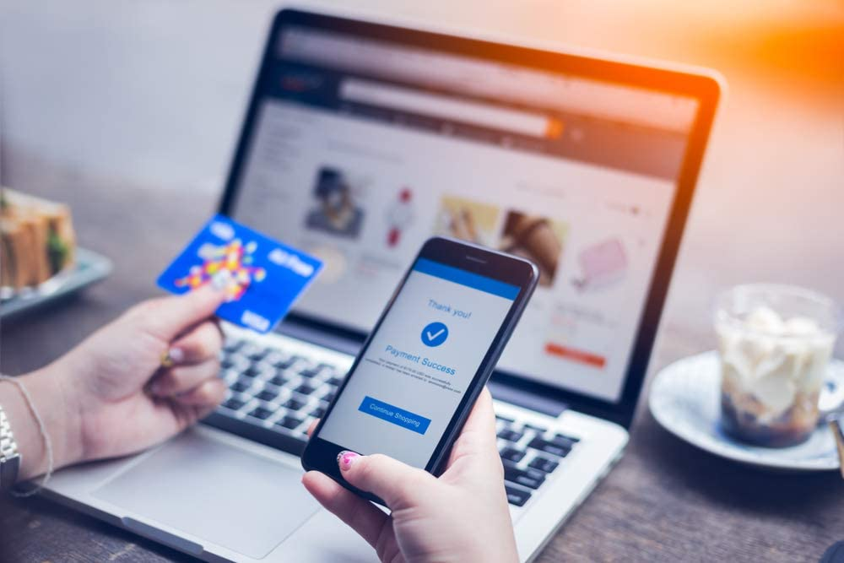
INTRODUCTION
E-COMMERCE
Process of buying and selling of goods or services using an electronic medium such as internet
Sales happens online
We can potentially sell across the world.
There is limited personal interaction.
Delivery of goods and services might take some times.
It is available 24/7 and can be done day or night.

Slide 6

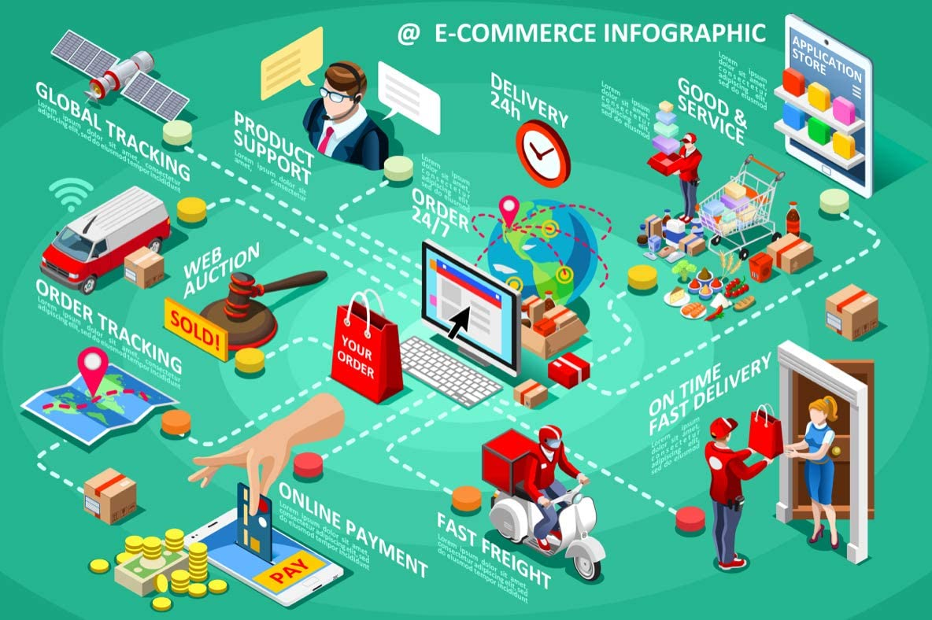
Why E-Commerce?
Faster buying process
Store and product listing creation
Cost reduction
Affordable advertising and marketing
Flexibility for customer
No reach limitations
Product and price comparison
Faster response to buyer/market demands
Several payment modes

Slide 7

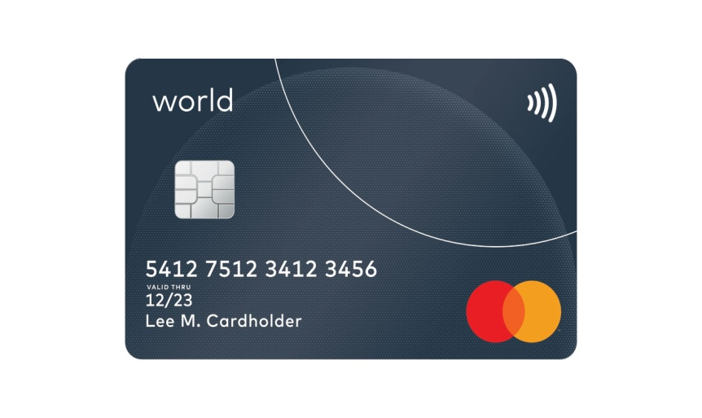
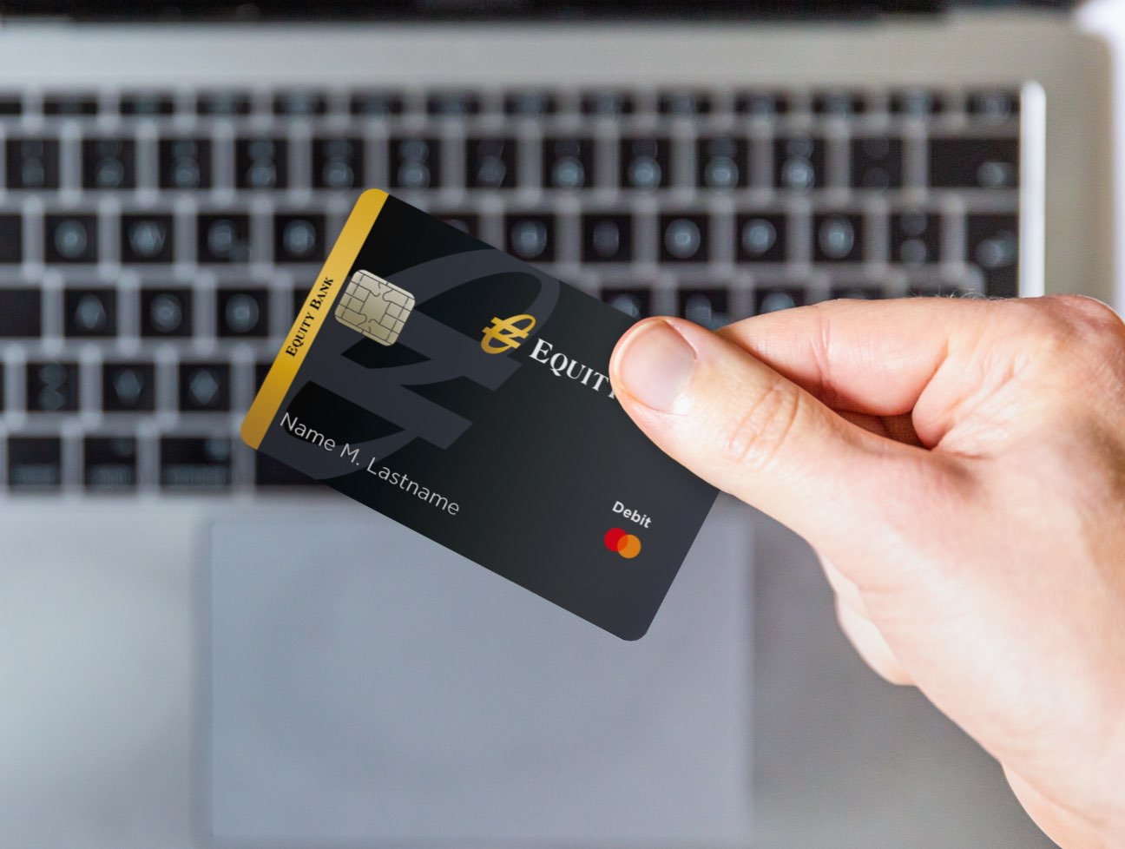

Online Payment

Slide 8





INFORMATION
ONLINE
How E-commerce Works?
GOODSSF
Delivery

Slide 9
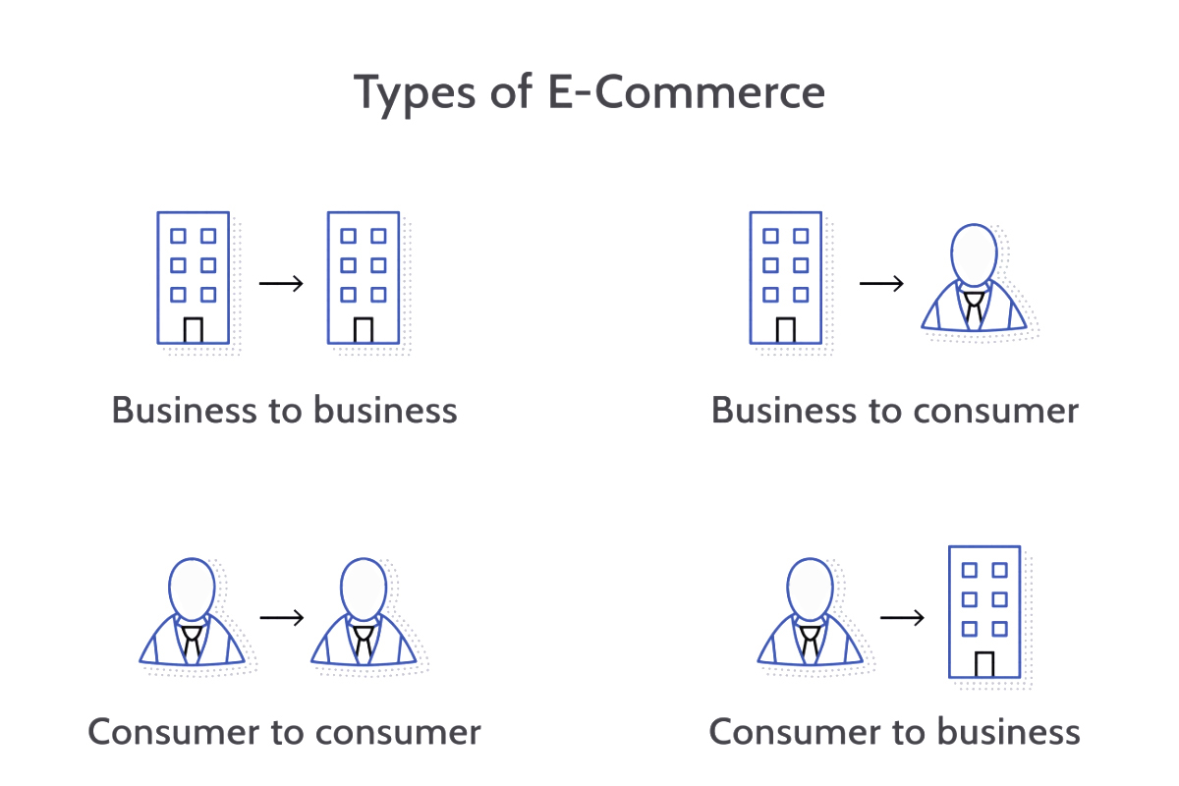

Slide 10

Demo Of E-commerce Website
Flower Website
Select
Order
Payment
Receive
Review
Comment

Slide 11
Why Choose Us?
We Are Proud To Offer Beautiful Flowers That Are Always Arranged And Delivered By Local Florists! We Make It Easy To Send Online Flowers. If You Need To Order Flower Arrangements Last-Minute, We Have Same-Day Flower Delivery.

Slide 12
THANK YOU

