Slide 1


“Predicting Survival on the Titanic”
Gaphale Aditya Rajaram
Gawalwad Dipak Rajaram
Godase Sayam Bhausaheb
Gite Siddhesh Ramdas

Slide 2
Content
Abstract
Problem Statement
Objective
Data Collection and Preparation
Proposed Solution (Methodology)
Model Performance Evaluation
Screenshots / Demonstration (video)
Future Scope
Conclusion
Notes:
Abstract
Problem Statement (Clearly define the challenge)
Objective (State your project's goal)
Background and Research (Discuss existing solutions, trends, and gaps)
Data Collection and Preparation (Focus on data sources, cleaning, and augmentation)
Proposed Solution (Methodology)
Model Architecture (e.g., CNN, U-Net, YOLOv5)
Key Techniques (e.g., Transfer Learning, Image Augmentation)
Model Performance Evaluation
Metrics (Accuracy, Precision, Recall, IoU, etc.)
Graphs (Confusion Matrix, ROC Curve, etc.)
Screenshots / Demonstration (Visual proof of system functionality)
Future Scope (Improvements, scalability, and integration ideas)
Conclusion (Summarize results and impact)
Q&A Session

Slide 3
Abstract
This project leverages machine learning to predict passenger survival on the Titanic. By meticulously preprocessing the dataset, conducting in-depth exploratory data analysis (EDA), and training a robust classification model, we aim to achieve high accuracy in survival predictions. This study not only showcases the power of data-driven decision-making but also highlights the significance of feature selection and model optimization in predictive analytics.

Slide 4
Problem Statement
The tragic sinking of the Titanic resulted in significant loss of life, raising critical questions about the factors that influenced passenger survival. This project aims to analyze these key factors—such as age, gender, and ticket class—and develop a machine learning model to predict survival probabilities. By leveraging data-driven insights, we seek to uncover patterns that dictated survival outcomes and demonstrate the effectiveness of predictive analytics in real-world scenarios.

Slide 5
Objective
Data Preprocessing & Cleaning: Handle missing values and prepare data for analysis.
Exploratory Data Analysis (EDA): Identify survival patterns based on key factors.
Model Development & Training: Train and fine-tune a machine learning model.
Performance Evaluation & Insights: Assess model accuracy and extract meaningful insights.

Slide 6
Data Collection and Preparation
Dataset: Titanic dataset from Seaborn.
Missing Value Handling: Impute missing values for age, fare, and embarked.
Categorical Encoding: Convert categorical variables into numerical format.
Feature Scaling: Normalize numerical features for better model performance.

Slide 7
Proposed Solution (Methodology)
1. Data Preprocessing :
Address missing values to improve data integrity.
Convert categorical variables into a machine-readable format.
Normalize numerical features for consistent scaling.
2. Model Training : Utilize a Random Forest Classifier to predict survival outcomes.
3. Model Evaluation : Measure performance using accuracy, confusion matrix, and classification report for reliable predictions.

Slide 8
Model Performance Evaluation
Model Used: Random Forest Classifier
Accuracy Achieved: ~83%
Evaluation Metrics: Confusion Matrix and Classification Report to assess precision, recall, and overall model performance.

Slide 9
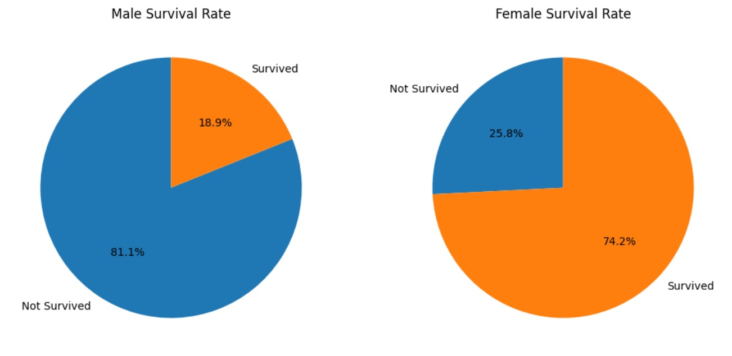
Screenshots

Slide 10
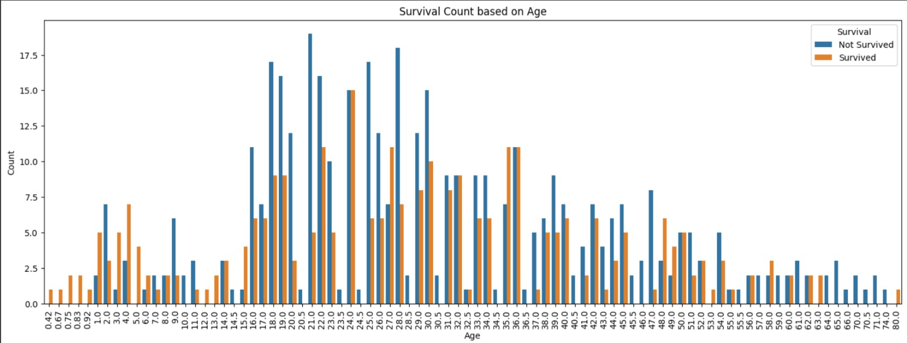
Screenshots

Slide 11
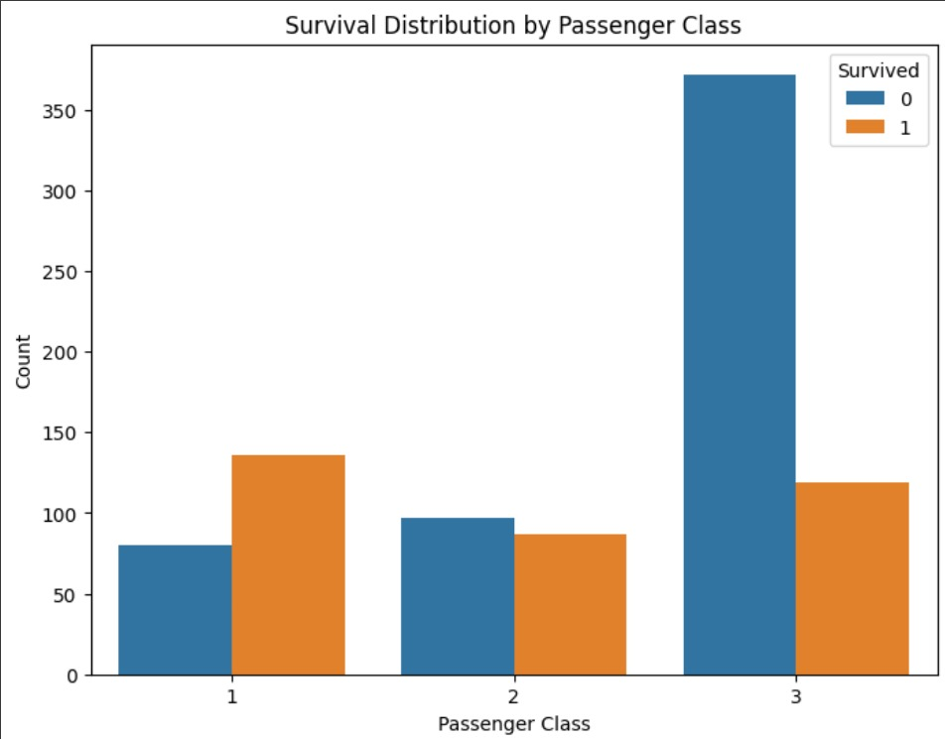
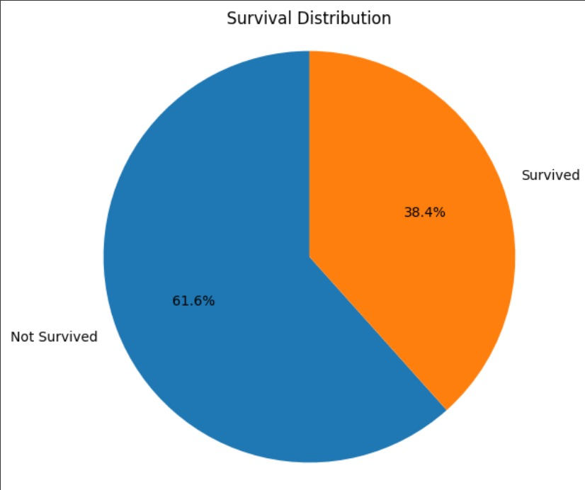
Screenshots

Slide 12
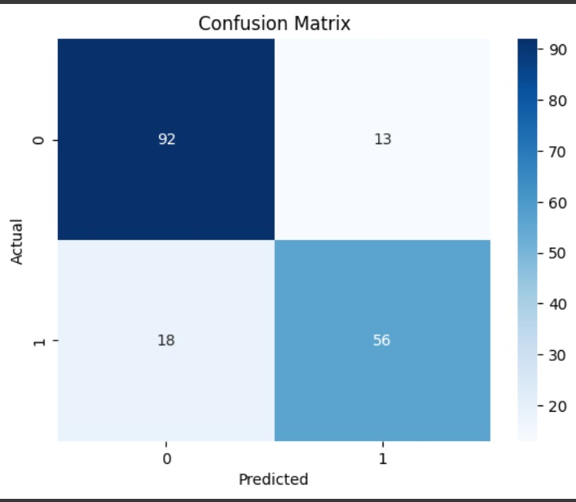
Screenshots

Slide 13
Future Scope
Enhance feature engineering using domain-specific insights.
Explore advanced ML models like XGBoost for improved performance.
Integrate deep learning techniques to boost prediction accuracy.

Slide 14
Conclusion
This project effectively showcases data preprocessing, exploratory analysis, and machine learning model training for predicting Titanic survival. The trained model not only achieves accurate predictions but also offers valuable insights into key factors that influenced passenger survival.

