Slide 1
E-COMMERCE TESTING PROJECT
Manual Testing | Automation Testing | API Testing | CI/CD | AI Testing
Application: Automation Exercise
Presented By: Dipali Pawar
Technologies & Tools:
Java | Selenium | TestNG | Maven | Postman | Rest Assured | Jenkins | Jira | Testim

Slide 2
AGENDA
Application Overview
Project Objectives
Testing Scope
Manual Testing
Automation Testing
API Testing
CI/CD with Jenkins
AI Testing
Test Results & Reports
10Conclusion

Slide 3
APPLICATION OVERVIEW
• Application Name: Automation Exercise
• Application Type: E-Commerce Web Application
• Purpose: To test major e-commerce functionalities from user registration to order placement.
• Main Modules:
Registration
Login
Products
Product Search
Product Details
Cart
Checkout
Payment
Order Confirmation
Logout
• Testing Approach:
Manual Testing
Selenium Automation Testing
API Testing
AI-based Testing

Slide 4
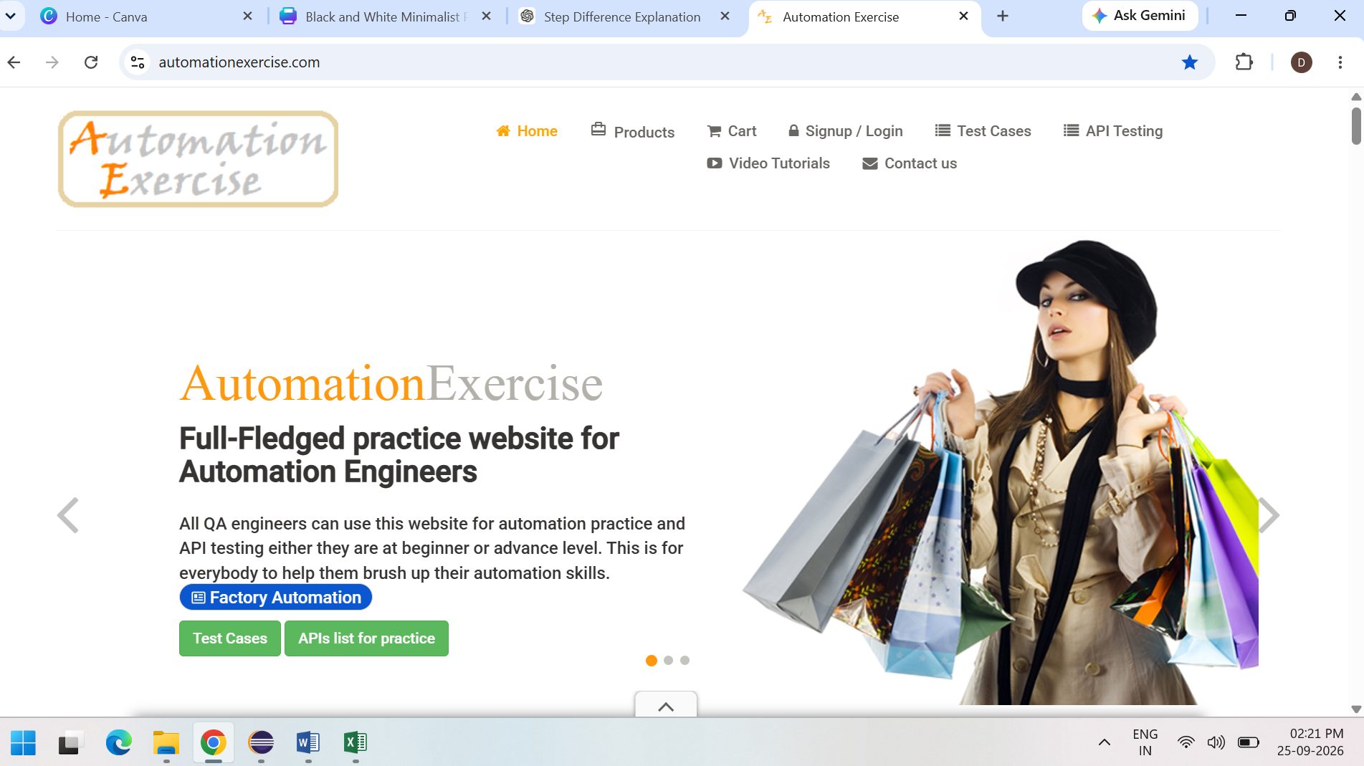
APPLICATION HOMEPAGE
Automation Exercise – E-Commerce Application Homepage • User-friendly e-commerce interface • Product browsing, cart and checkout • Application under test

Slide 5
PROJECT OBJECTIVES
• To validate the functionality of the e-commerce application.
• To identify defects and verify application behavior.
• To perform functional and UI testing of major modules.
• To automate important test scenarios using Selenium and TestNG.
• To validate APIs using Postman and Rest Assured.
• To use AI-based testing tools for test automation and validation.
• To generate test reports and maintain testing evidence.

Slide 6
TESTING SCOPE
• Registration and Login
• Product Browsing and Search
• Product Details
• Shopping Cart
• Checkout Process
• Payment
• Order Confirmation
• Logout
• API Validation
• Automation Testing
Testing focused on functional, UI, positive, negative and regression scenarios.

Slide 7
TEST ENVIRONMENT
Operating System: Windows 11
Browser: Google Chrome
Programming Language: Java
IDE: Eclipse
Automation Tool: Selenium WebDriver
Testing Framework: TestNG
Build Tool: Maven
API Testing Tools: Postman and Rest Assured
Application Under Test: Automation Exercise

Slide 8
SOFTWARE TESTING LIFE CYCLE (STLC)
Requirement Analysis
Understanding application requirements.
Test Planning
Defining testing scope and approach.
Test Case Design
Preparing test scenarios and test cases.
Test Environment Setup
Configuring browser and testing tools.
Test Execution
Executing test cases and recording results.
Defect Reporting
Reporting and tracking identified defects.
Test Closure
Preparing test summary and reports.
Requirement Analysis → Test Planning → Test Case Design → Environment Setup → Test Execution → Defect Reporting → Test Closure

Slide 9
MANUAL TESTING APPROACH
• Created test scenarios and test cases for major application modules.
• Covered positive and negative test scenarios.
• Verified functional and UI behavior of the application.
• Executed test cases and recorded Actual Results and Expected Results.
• Identified and documented failed scenarios.
• Prepared test execution evidence using screenshots.
• Performed regression testing for important functionalities.

Slide 10
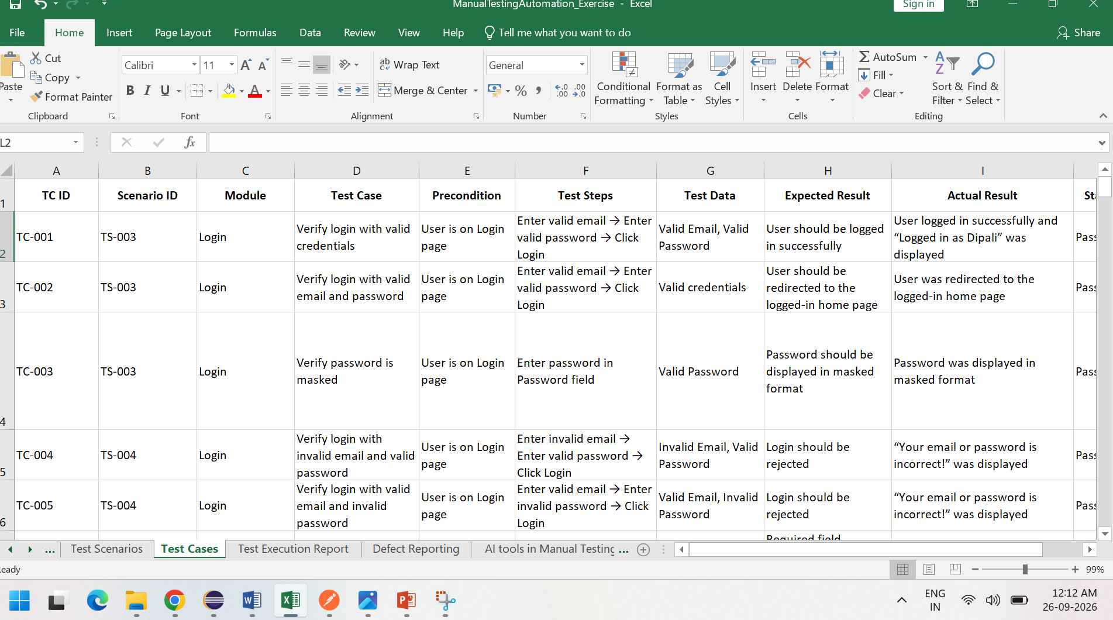
MANUAL TEST CASES
• Prepared manual test cases for major e-commerce modules.
• Covered Registration, Login, Products, Search, Cart, Checkout and Payment.
• Included positive, negative and boundary test scenarios.
• Defined test steps, test data, expected results and actual results.
• Recorded test execution status as Pass, Fail or Pending.
• Maintained test evidence using screenshots.

Slide 11
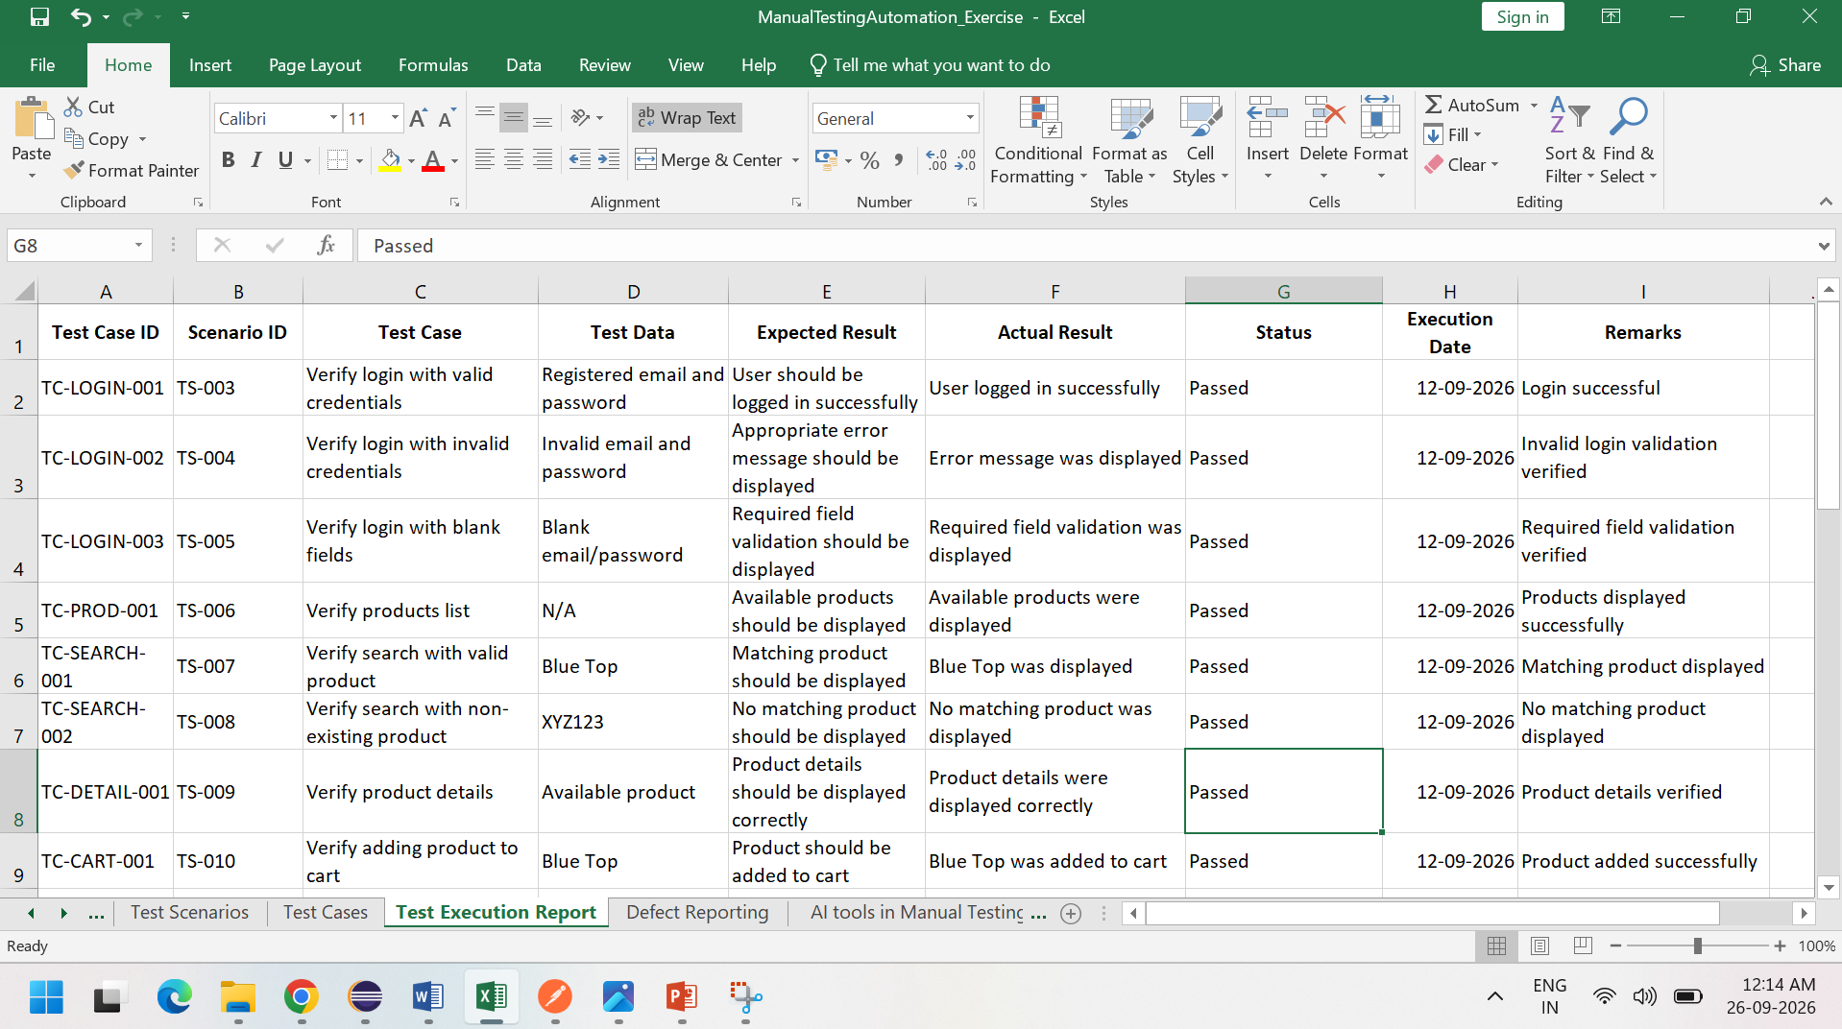
MANUAL TEST EXECUTION
• Executed the prepared manual test cases on the Automation Exercise application.
• Verified actual results against expected results.
• Recorded Pass, Fail and Pending statuses.
• Captured screenshots as test execution evidence.
• Re-tested failed scenarios after making necessary checks.
• Maintained the final test execution results for project reporting.

Slide 12
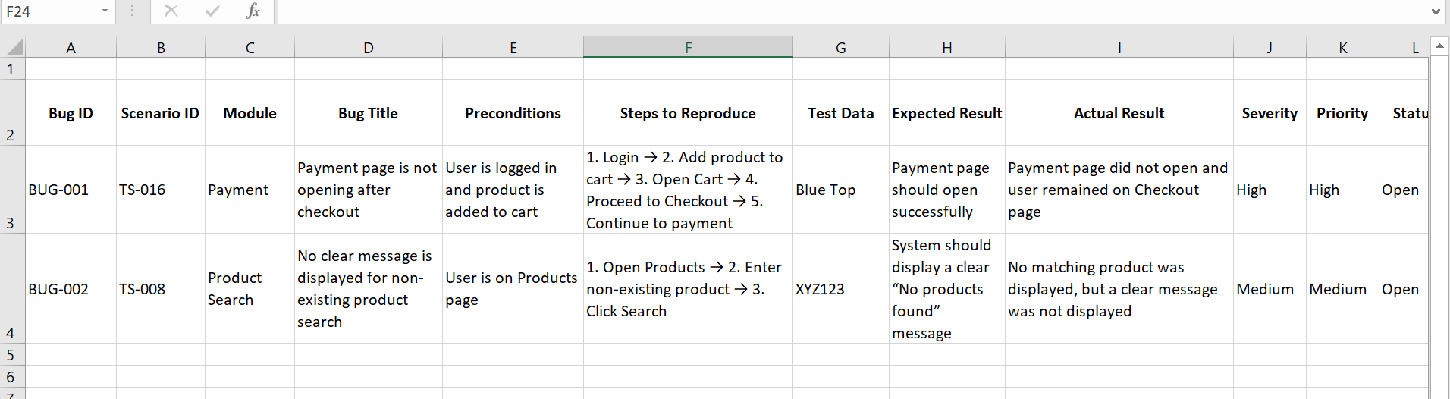
DEFECT / BUG REPORTING
Identified defects during manual and automation testing.
• Documented defects with clear steps to reproduce.
• Recorded Expected Result and Actual Result.
• Captured screenshots as defect evidence.
• Verified the defects after re-testing.
• Maintained defect details for final project reporting.

Slide 13
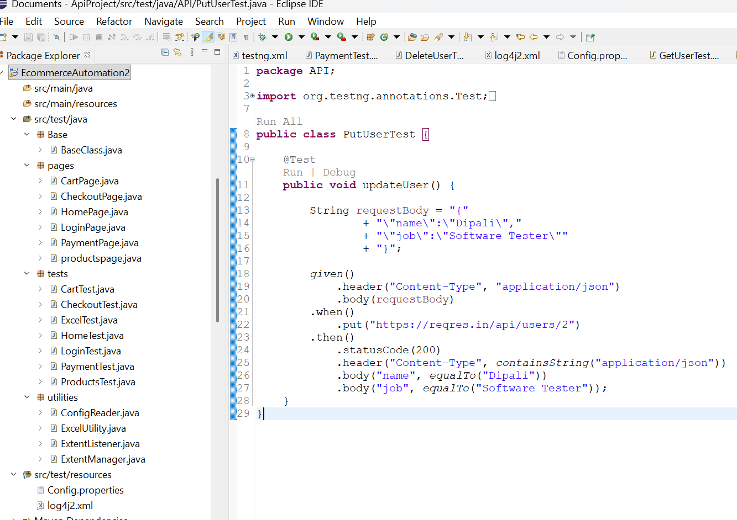
AUTOMATION TESTING OVERVIEW
Automated web application testing using Selenium WebDriver.
• Developed automation scripts using Java.
• Used TestNG for test execution and assertions.
• Used Maven for project and dependency management.
• Implemented Page Object Model (POM) for better code organization.
• Automated important e-commerce scenarios such as Login, Products, Cart, Checkout and Payment.
• Generated execution reports and captured screenshots for failed test cases.

Slide 14
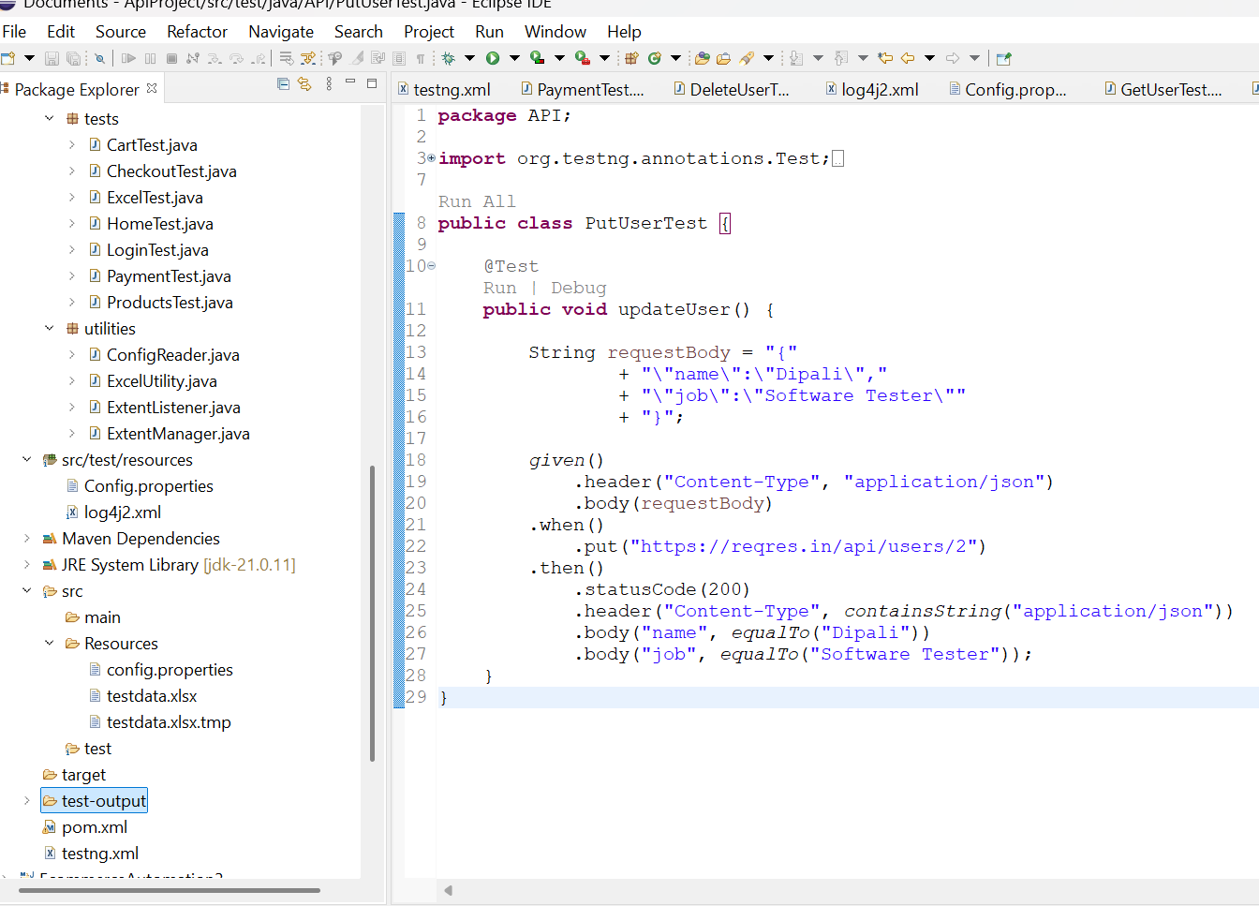
AUTOMATION FRAMEWORK
Technology: Java + Selenium WebDriver
• Testing Framework: TestNG
• Build Tool: Maven
• Design Pattern: Page Object Model (POM)
• Page Classes: Login, Products, Cart, Checkout and Payment
• Utilities: WebDriver setup, screenshots and reusable methods
• Reporting: Extent Reports and TestNG Reports
• Logging: Log4j
• Test Data and configuration are managed separately for better maintainability.

Slide 15
PAGE OBJECT MODEL (POM)
• Implemented Page Object Model to organize automation code.
• Each application page is represented by a separate Java class.
• Locators and page actions are maintained inside page classes.
• Test classes call reusable page methods instead of directly using locators.
• Improves code readability, reusability and maintainability.
• Helps reduce code duplication when application elements change.
Example Page Classes:
LoginPage → ProductsPage → CartPage → CheckoutPage → PaymentPage

Slide 16
AUTOMATION TEST FLOW
Launch the Automation Exercise application.
Initialize WebDriver and browser configuration.
Execute TestNG test cases.
Perform actions using Page Object Model classes.
Validate expected behavior using assertions.
Capture screenshots when a test case fails.
Generate TestNG and Extent Reports
Automation Flow:
TestNG Test → Page Object → Selenium WebDriver → Application → Assertion → Report
TestNG Test
↓
Page Object
↓
Selenium WebDriver
↓
Application
↓
Assertions
↓
Test Report

Slide 17
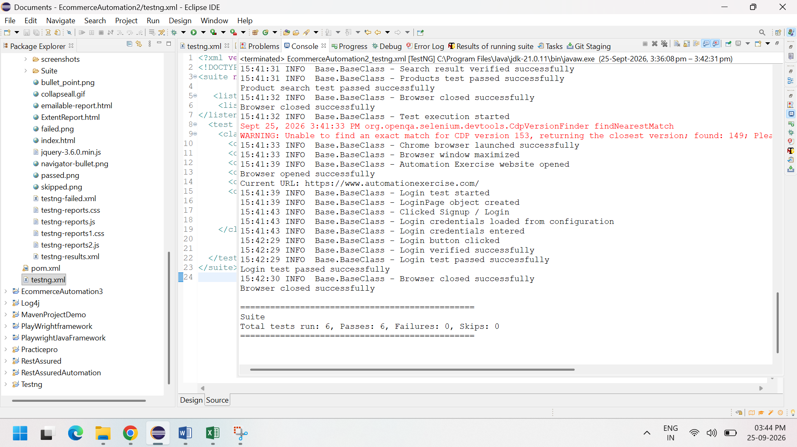
AUTOMATION TEST EXECUTION
• Executed automation test cases using TestNG.
• Automated key e-commerce modules including Login, Products, Cart, Checkout and Payment.
• Selenium WebDriver performed browser-based actions.
• TestNG assertions were used to validate expected behavior.
• Failed test cases were analyzed using execution logs and screenshots.
• Test execution results were recorded for reporting and further analysis.

Slide 18
AUTOMATION REPORTS
AUTOMATION REPORTS
• Test execution results were generated using TestNG.
• Extent Reports were used to present detailed test execution results.
• Reports show passed and failed test cases.
• Failure screenshots were captured for debugging and analysis.
• Execution logs were maintained using Log4j.
• Reports helped in analyzing test failures and overall automation execution.

Slide 19
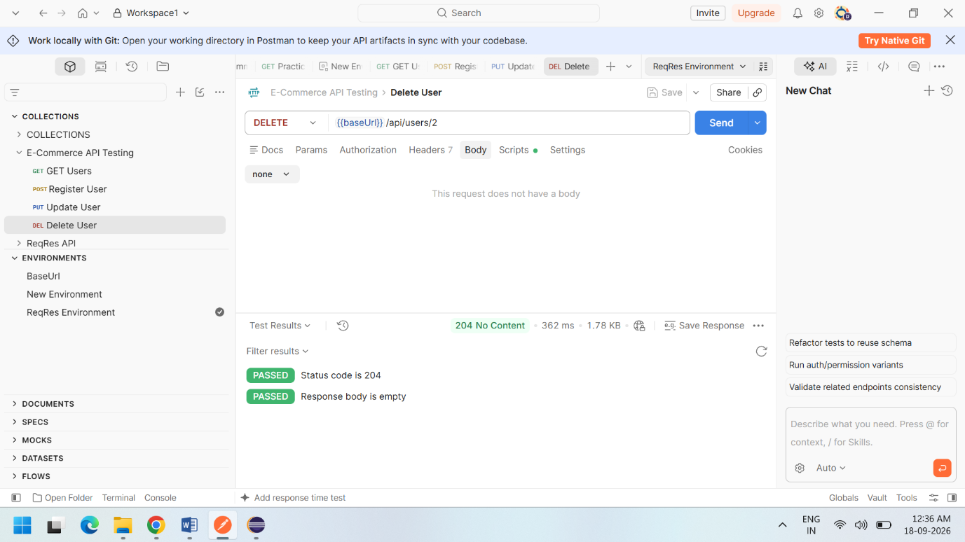
API TESTING OVERVIEW
• Performed API testing to validate backend API behavior.
• Used Postman for API request creation and response validation.
• Used Rest Assured with Java for automated API testing.
• Validated HTTP status codes, response headers and response body.
• Covered GET, POST, PUT and DELETE request methods.
• Used assertions to verify expected API responses.
• API testing helped validate data and service-level functionality independently of the UI.

Slide 20
API TEST CASES
TC ID | API | Test Scenario | Validations | Result
API-001 | GET | Retrieve user information | Status Code, Content-Type, Response Body, User Data | Passed
API-002 | POST | Register a new user | Status Code, Content-Type, User ID, Registration Token | Passed
API-003 | PUT | Update existing user information | Status Code, Content-Type, Updated Name, Updated Job | Passed
API-004 | DELETE | Delete an existing user | HTTP Status Code | Tested
API VALIDATION AREAS
• Response Status Code
• Response Headers
• Response Body
• Expected API Response Data
Tools: Postman | Rest Assured | Java | TestNG | Eclipse IDE

Slide 21
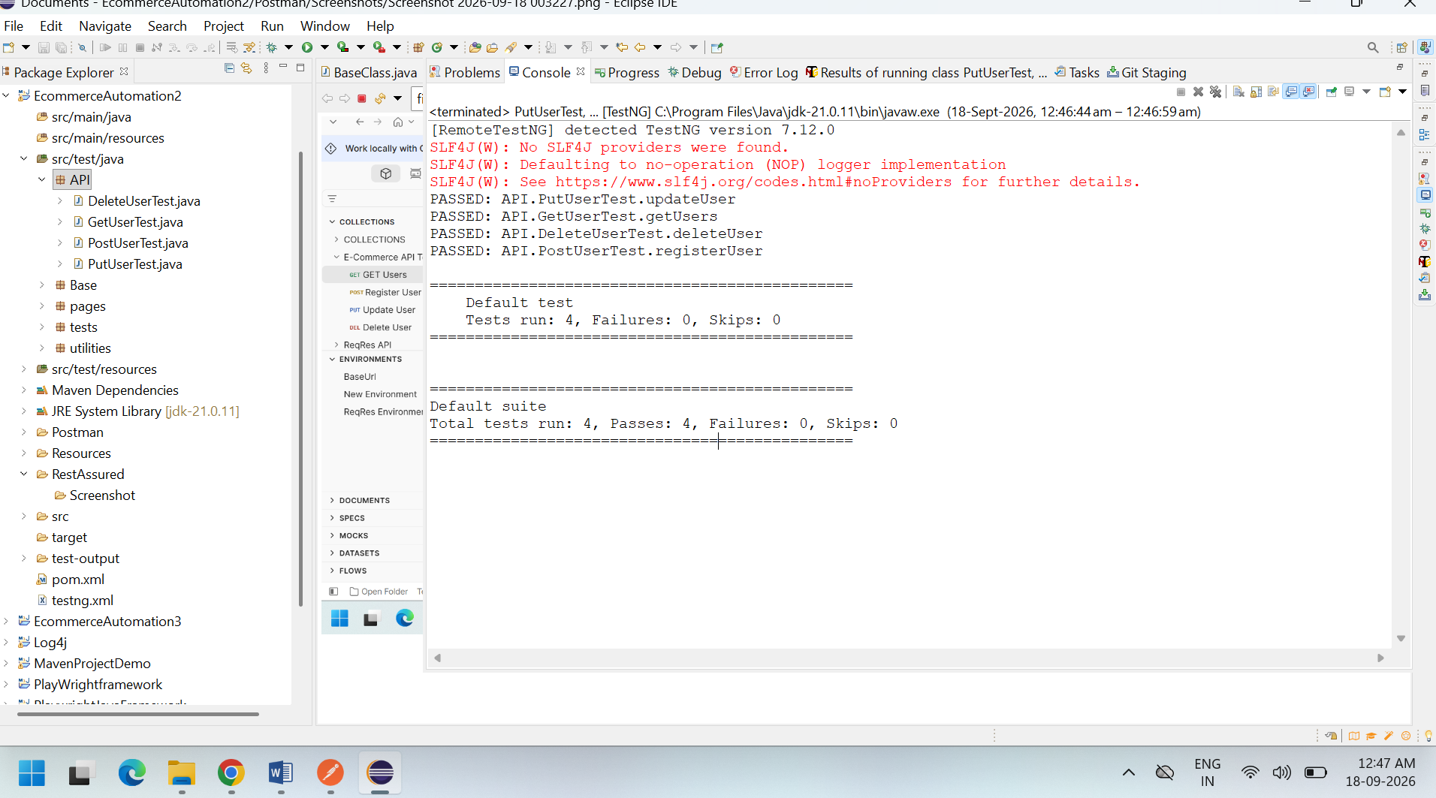
API EXECUTION RESULTS
• API requests were executed using Postman and Rest Assured.
• GET API execution was completed successfully and returned 200 OK.
• POST API execution was completed successfully and returned 200 OK.
• PUT API execution was completed successfully and returned 200 OK.
• DELETE API was tested and the expected response status was 204 No Content.
• Response status codes, headers and response body were validated.
• API response data was verified against the expected results.
Execution Summary:
GET → Passed
POST → Passed
PUT → Passed
DELETE → Tested

Slide 22
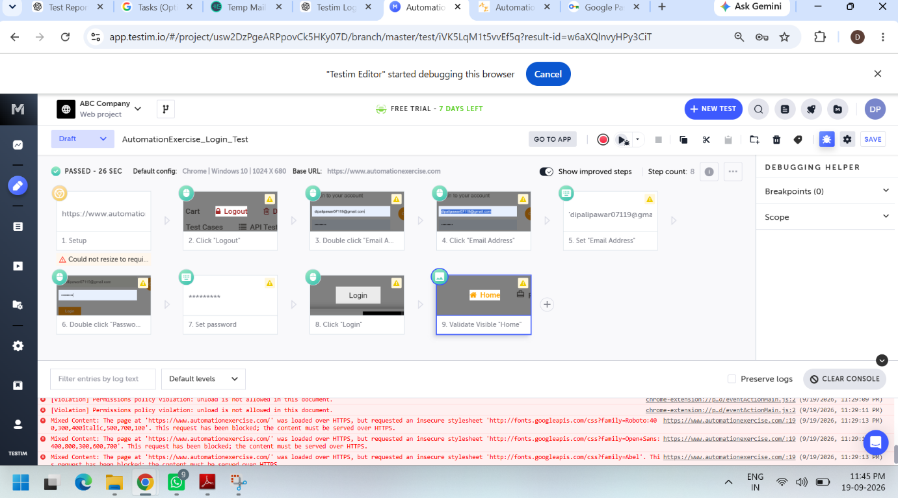
AI TESTING TOOL – TESTIM
AI TESTING TOOL – TESTIM
• Testim was used for AI-assisted test automation.
• Created an automated login test flow for the application.
• Recorded user actions using Testim's test recording feature.
• Validated the login flow and dashboard navigation.
• Used Testim to reduce the effort required for creating automated test steps.
• Test execution and validation were performed using the recorded test flow.
TOOL USED:
Testim – AI-assisted Test Automation

Slide 23
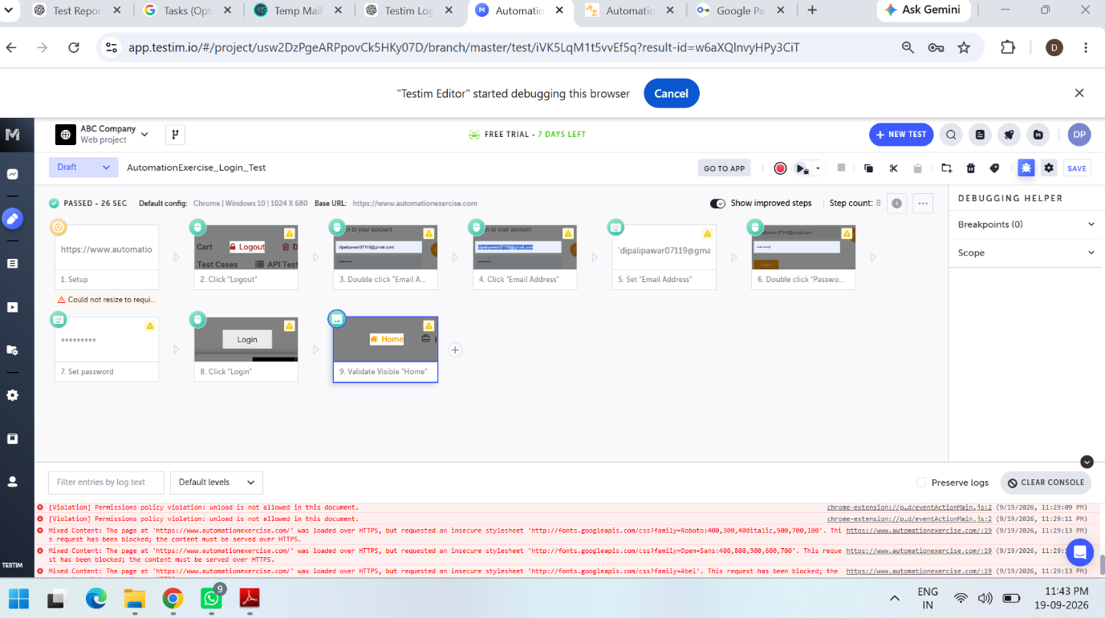
AI TEST EXECUTION
• Created a login automation test using Testim.
• Recorded the user actions during the login process.
• Validated the login flow using the recorded test steps.
• Verified successful navigation to the dashboard after login.
• Used Testim validation steps to verify application behavior.
• Captured screenshots as evidence of the AI-based test execution.
TEST FLOW:
Launch Application → Enter Login Details → Login → Validate Dashboard

Slide 24
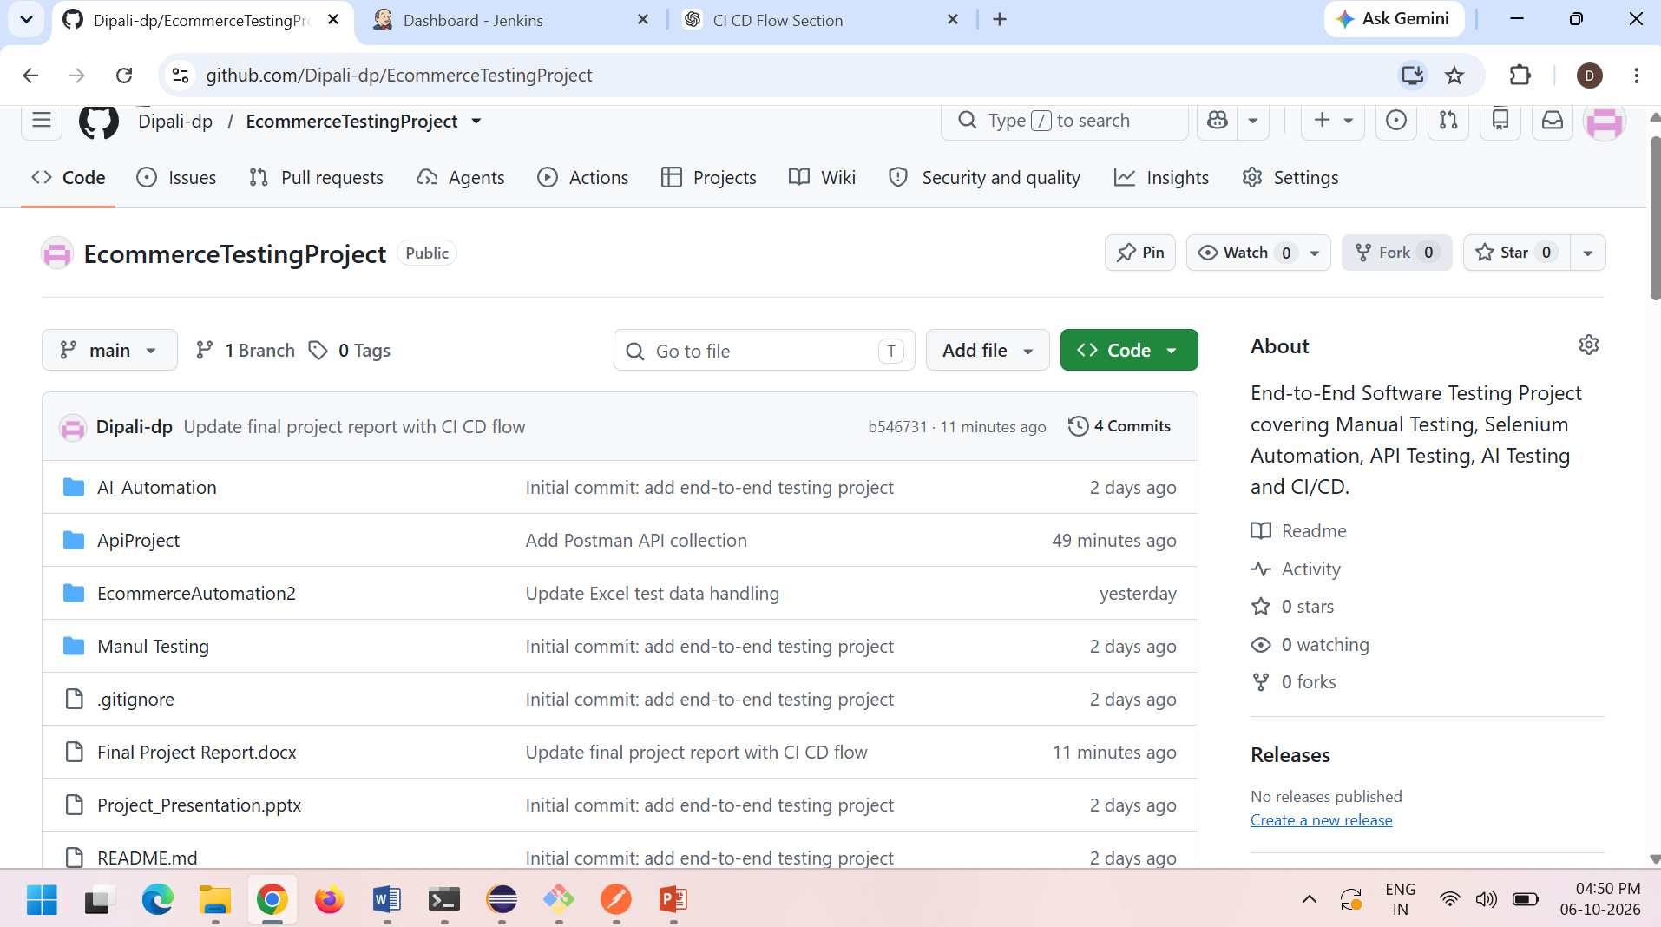
GitHub Integration
GitHub is used for source code management and version control.
Complete testing project is maintained in GitHub.
Project includes Manual Testing, Selenium Automation, API Testing and AI Testing.
Changes are committed and pushed to the GitHub repository.

Slide 25
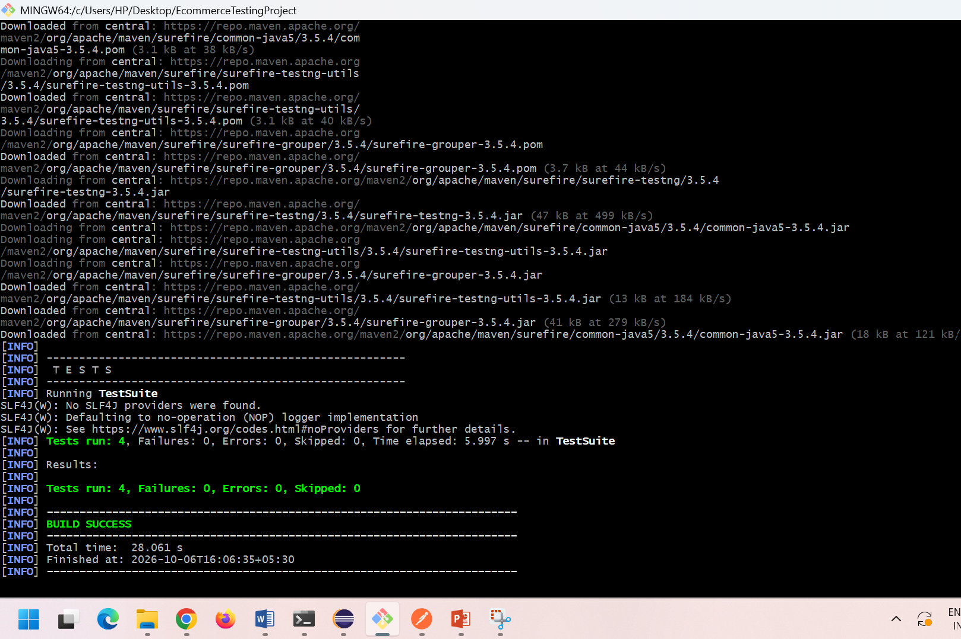
Git Version Control
Local Project
↓
Git Add
↓
Commit
↓
Push
↓
GitHub
git add .
git commit -m "Update project"
git push origin main

Slide 26
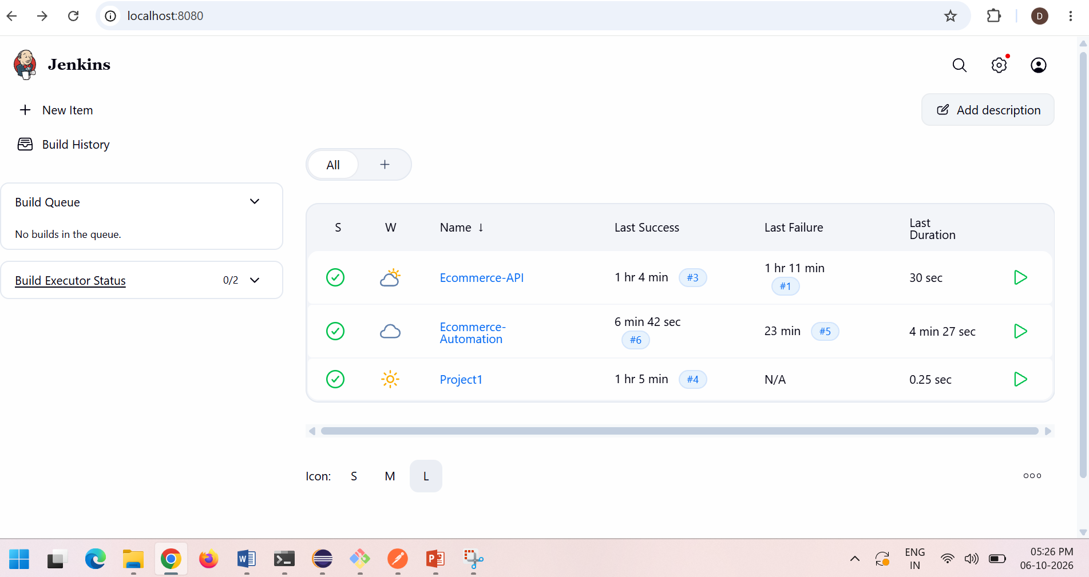
CI/CD Pipeline
GitHub
↓
Jenkins
↓
Maven
↓
Automated Test Execution
↓
Test Results

Slide 27
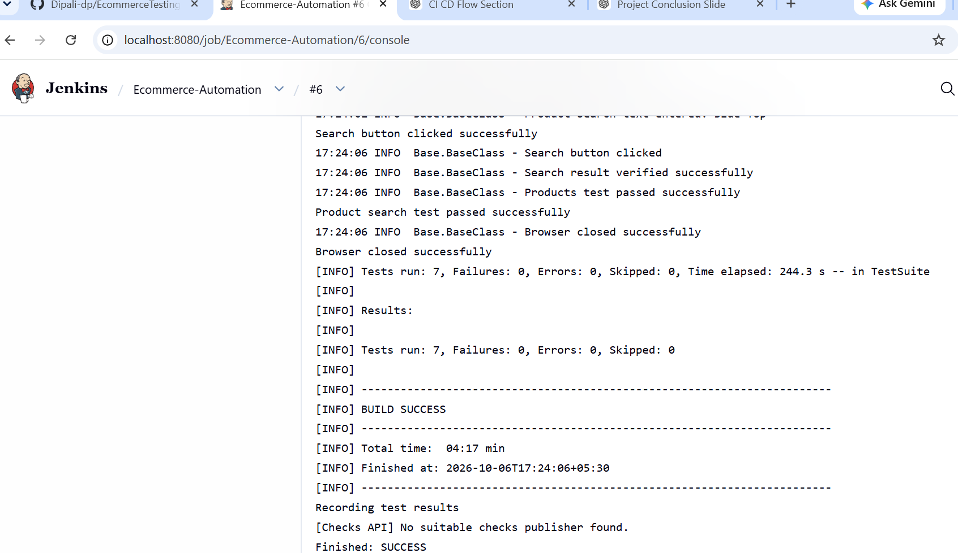
Jenkins – CI/CD Execution
Jenkins retrieves the project from GitHub.
Maven builds and executes the automation tests.
Selenium and TestNG tests are executed automatically.
Test execution results are available in Jenkins.
mvn -f EcommerceAutomation2/pom.xml clean test

Slide 28
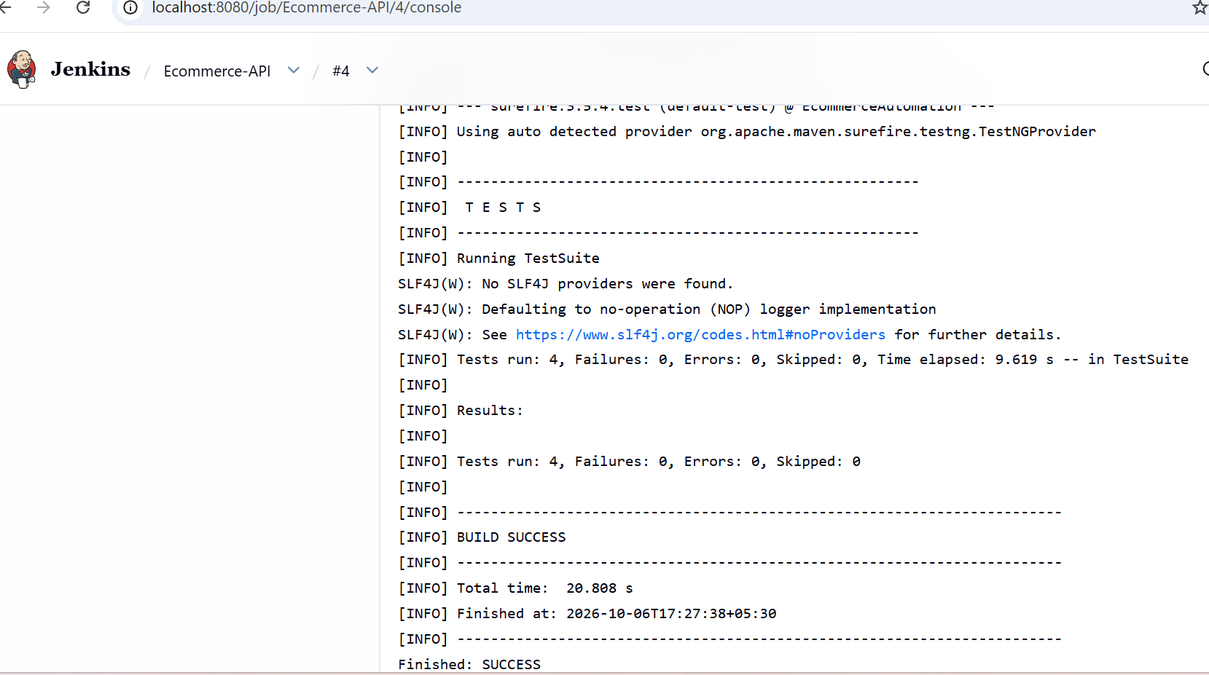
CI/CD Execution Result
GitHub successfully integrated with Jenkins.
Maven automation build executed through Jenkins.
Selenium automation tests executed successfully.
API automation has a separate Jenkins job: Ecommerce-API.
Test execution results were verified in Jenkins.
📸 Screenshots:

Slide 29
Conclusion
Successfully tested the Automation Exercise E-Commerce application using multiple testing approaches.
Performed Manual Testing for major e-commerce modules.
Implemented Web Automation Testing using Selenium, Java, TestNG, Maven, and POM.
Performed API Testing using Postman and Rest Assured.
Used AI-based testing to support test automation and validation.
Integrated the automation project with GitHub and Jenkins to demonstrate CI/CD execution.
Generated and reviewed test results and reports to evaluate application quality.
This project provided practical experience in Manual Testing, Automation Testing, API Testing, AI Testing, and CI/CD.
Overall, the project helped me understand the complete software testing process and gain hands-on experience with industry-relevant testing tools and techniques.

Slide 30
THANK YOU
Questions & Answers
E-Commerce Application Testing Project
Manual Testing | Selenium Automation | API Testing | AI Testing| GitHub| CI/CD Pipelines

