Slide 1



Predicting Solar Power Output using Linear Regression
Collage - Institute of Engineering and Management, Kolkata
Name – Dipan Basak

Slide 2

Learning Objectives
Understand the importance of solar power prediction in energy management.
Learn how to apply Linear Regression for predicting solar power output.
Explore data pre-processing techniques to handle missing values and outliers.
Implement machine learning using Python and Scikit-Learn.
Evaluate the model’s performance using R² Score and RMSE.
GOAL
Source :
www.freepik.com/

Slide 3
Problem Statement:
With the increasing adoption of solar energy, accurately predicting power generation is crucial.
Challenges include:
Variability due to weather conditions.
Need for efficient energy grid management.
Demand for an accurate forecasting model.

Slide 4
Tools and Technology used
Programming Language: Python
Libraries:
pandas (for data handling)
numpy (for numerical computations)
seaborn & matplotlib (for data visualization)
scikit-learn (for machine learning)
tkinter (for GUI-based user interaction)
Jupyter Notebook (for interactive coding and visualization)

Slide 5
Methodology
Data Collection: Load a dataset containing solar power generation details.
Data Exploration: Analyse missing values, duplicates, and distributions.
Data Pre-processing: Handle missing values, drop duplicates, and normalize features if needed.
Feature Selection: Identify relevant features influencing solar power generation.
Model Training:
Split data into training and testing sets.
Apply Linear Regression for prediction.
Model Evaluation:
Calculate Root Mean Squared Error (RMSE) to measure prediction accuracy.
Use R² Score to determine the model's effectiveness.
Interactive Prediction UI: Create a Tkinter GUI to allow user inputs for prediction.

Slide 6
Solution:
Develop a Machine Learning Model using Linear Regression to predict solar power output.
Preprocess Data to ensure high model accuracy.
Provide an Interactive UI where users can input parameters and get real-time predictions.

Slide 7
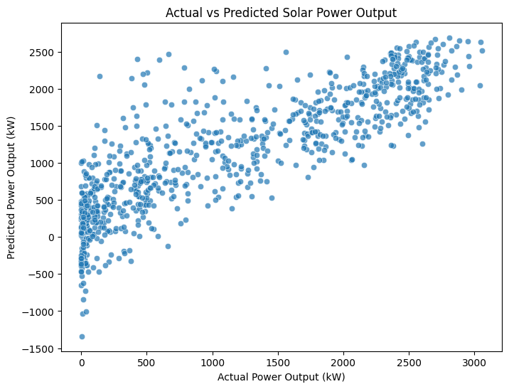
Screenshot of Output:

Slide 8
Conclusion:
Solar power prediction helps in efficient energy planning and grid stability.
Linear Regression provides a simple yet effective way to predict power output.
Python-based implementation ensures ease of use and adaptability.
A user-friendly UI makes predictions accessible for decision-makers.

