Slide 1

Project Title Sales Insights Data Analysis
Collage - Institute of Engineering and Management, Kolkata
Name - Dipan Basak

Slide 2

PROBLEM STATEMENT
a computer hardware manufacturer, is facing issues tracking sales and getting business insights. The sales director, is frustrated because the current method of getting insights through phone calls with regional managers is unreliable. The regional managers tend to sugarcoat the facts or lie, and sales director doesn't get a complete picture of what's going on. On top of that, the insights are provided in numerous Excel files, which are too cumbersome and time-consuming to analyze. Sales director would prefer a clear, concise dashboard that shows the real data so he can make data-driven decisions.

Slide 3
Project Description
Create a data-driven sales dashboard for a computer hardware and peripherals supplier, to provide the sales director, with a clear and actionable understanding of the business. The dashboard should enable data-driven decision-making to increase sales in a dynamically growing market.

Slide 4

WHO ARE THE END USERS?
Sales Director
Stakeholders
Employees
Sales Team

Slide 5

Technology Used
PowerBI
MySQL
ETL
Data Cleaning
Data Visualization

Slide 6
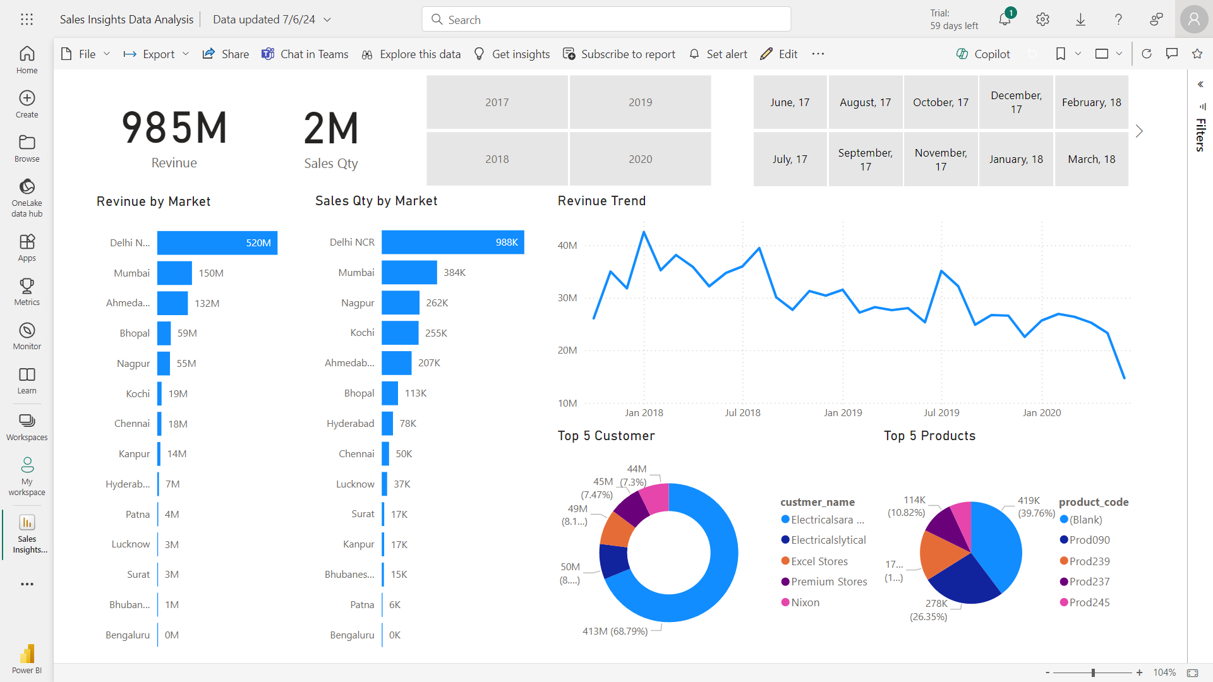
RESULTS

Slide 7
Thank you
Project Link -
https://app.powerbi.com/links/x6xJvu_o01?ctid=41ef9d53-cb31-4b40-a55d-0893334a4059&pbi_source=linkShare
GitHub Link -
https://github.com/Dipan46/Sales-Insights-Data-Analysis-Project.git

