Slide 1
Design Of A PD Controller For A Given RLC Circuit To Improve It’s SETTLING TIME
Group Member’s Name: ID:
1.Dipanjan Swarnakar 021172010
2.Fahim Ahsan 021161021
3.Abu Jayed 021172018

Slide 2
Introduction:
We tried to reduce the settling time by using A PD controller.
We have reduced the settling time of the RLC circuit by ½ maintaining the same Overshoot.
Ts(new)=Ts*(1/2)

Slide 3
WHAT IS CONTROLLER
A Controller is an implementation of control logic of a control system.
A controller is a mechanism that seeks to minimize the difference between the actual value of a system.
It generates an output signal based on the input signal it receives

Slide 4
WHY WE USE
It improves the steady state accuracy by decreasing the steady state error.
As the steady state accuracy improves,the stability also improves.
It can control the maximum overshoot of the system.
It can help in reducing the noise signals produced by the system.

Slide 5
WHAT IS PD CONTROLLER
A proportional derivative controller, as its name indicates,is a controller with a “proportional action” and a “derivative action”
The PD controller produces an output which is the combination of the outputs of proportional and derive controllers.
It is basically used to improve the stability of control system without affecting the steady state error.

Slide 6
ADVANTAGE OF PD CONTROLLER
PD controller improves transient performance.
Easy to stabilize faster response.
Reduces settling time by improving damping and reducing overshoot.

Slide 7
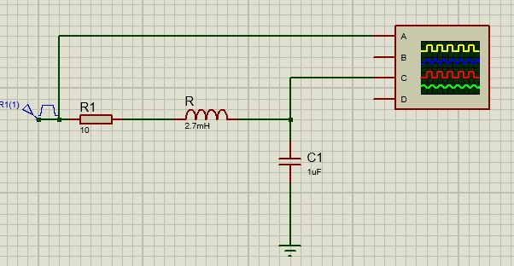
RLC Circuit:

Slide 8
Procedure:
Using SISO Design tool, create the design for a unity negative feedback system with G(s) and plot the root locus.
Draw the zeta line for required overshoot. Select the closed-loop pole at the intersection of shadowed region and the root locus.
Calculate the imaginary part, ωd and real part, σd of the compensated dominant pole from the two-third value of uncompensated peak time and half of uncompensated settling time.
Find the Zc by calculating the pole angle.
Put the value of Zc in pole/zero .

Slide 9
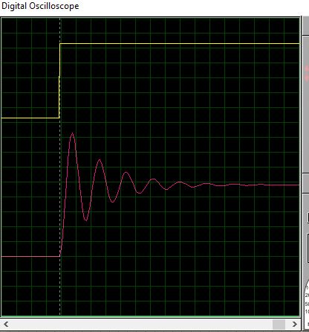
Uncompensated In Proteus :

Slide 10

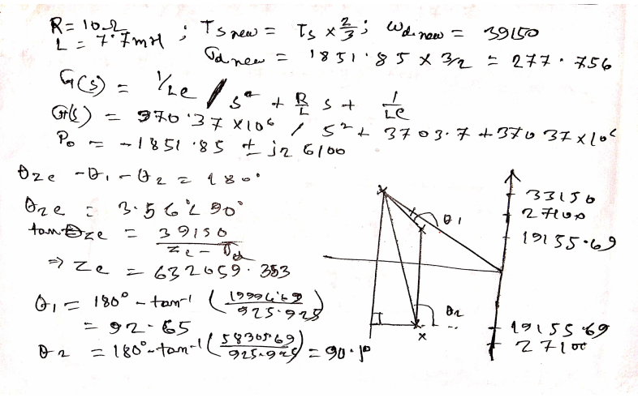
Hand Calculation:
Same Over Shoot
θ1=92.65
θ2=90.1
θzc=3.56
Zc=6320259.

Slide 11
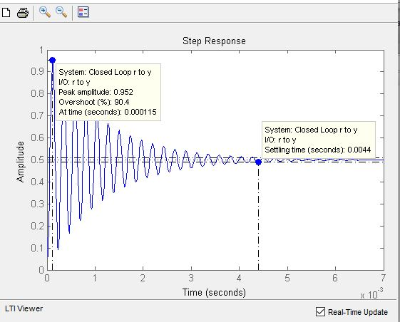
Uncompensated In MATLAB:

Slide 12
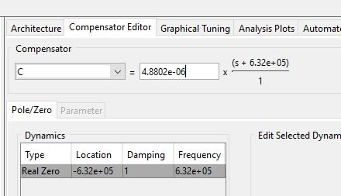
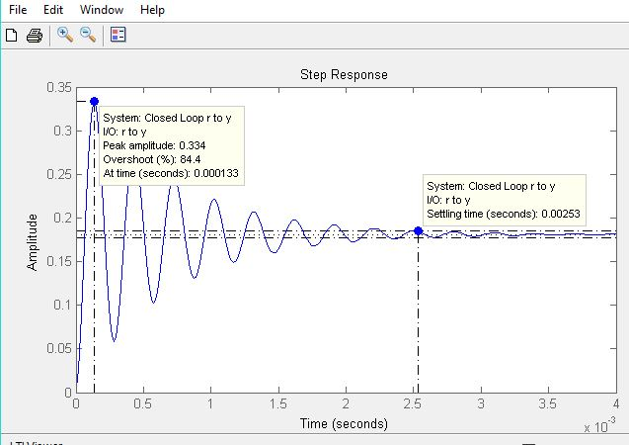
Compensated In Matlab:

Slide 13
Comparison Between Uncompensated & Compensated Output:
Uncompensated
Overshoot(%) = 90.4
Settling time(seconds) = 0.0044
Compensated
Overshoot(%) = 84.4
Settling time(seconds) = 0.00253

Slide 14
Design Of PD Controller :
PD=K(S+Zc) = R₂C(s+1/R₁C)
K= 4.8802*10^-6 (from matlab)
Zc= 632059.353(from hand calculation)
1/R1*C=Zc= 632059.353 Let, C=0.1uF
R1=1/(C*Zc) =15.82 ohm
R2*C= 4.8802*10^-6
R2=48.8 ohm

Slide 15
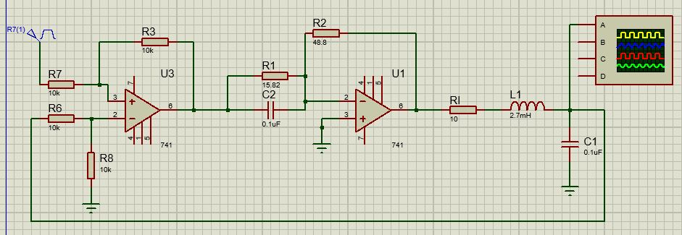
Implemented Circuit In Proteus:

Slide 16


