Slide 1
WELCOME

Slide 2
TOPIC : Modulation & Demodulation three massage signal and run in a single .slx file as user demand.

Slide 3
Submitted By:
Dipanjan Swarnakar
ID: 021172010
MURSHIDA KHATUN
ID: 021162001
FARIA HAIDER CHOWDHURY
ID: 021172036

Slide 4
Objectives:
i) Process in a single .slx file
ii) Recover accurate data
iii) User demand

Slide 5
Blocks :
Constant block
If block
If Action subsystems

Slide 6
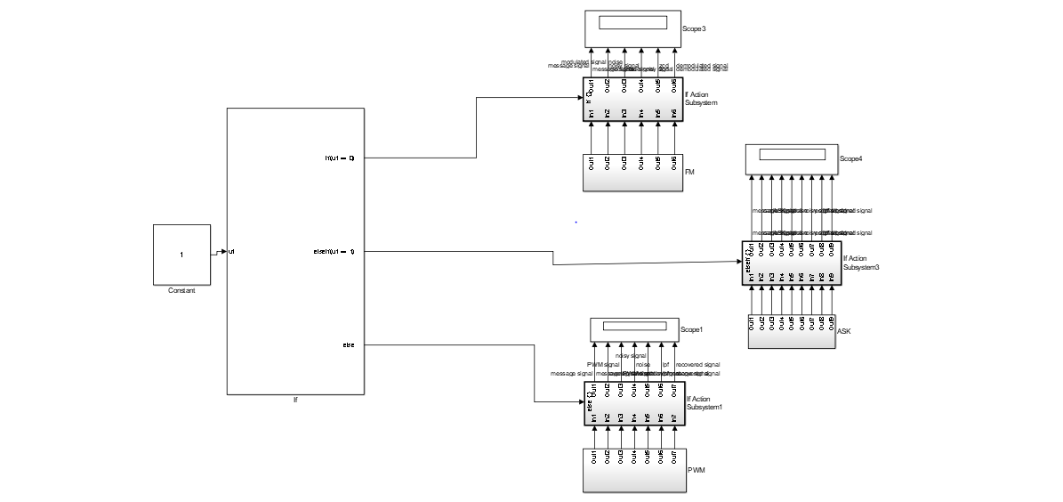
Features:

Slide 7
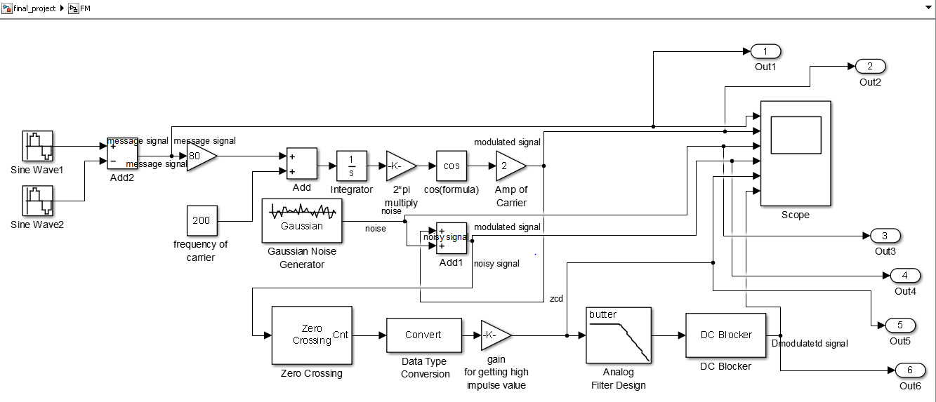
If input = “0” then it will show FM

Slide 8
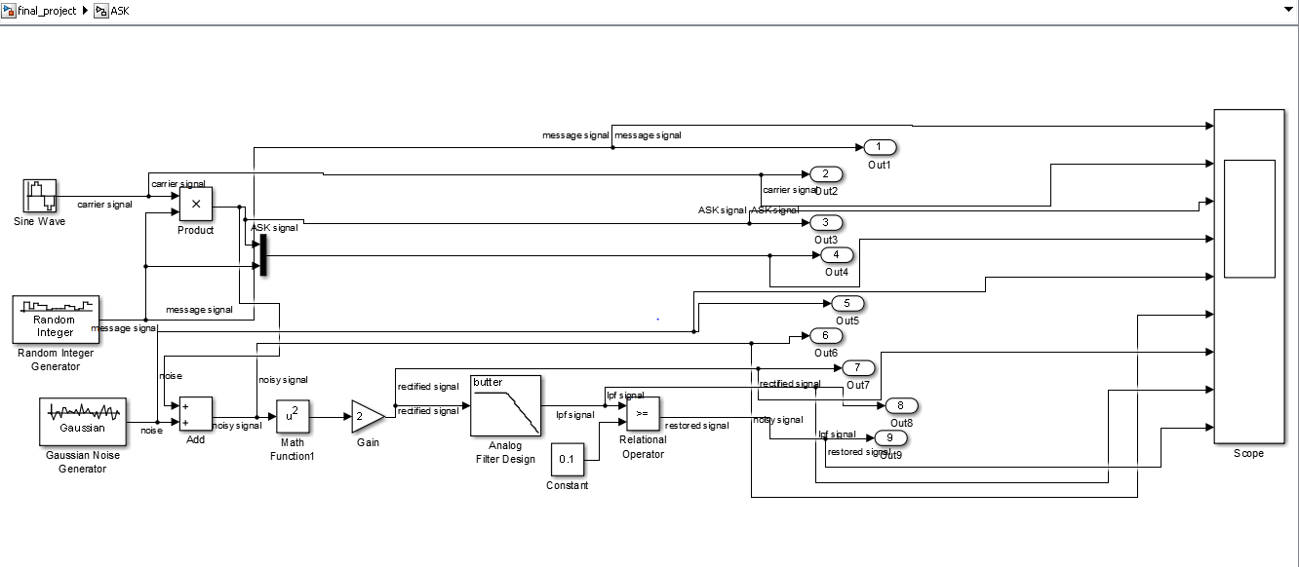
If input = “1” then it will show ASK

Slide 9
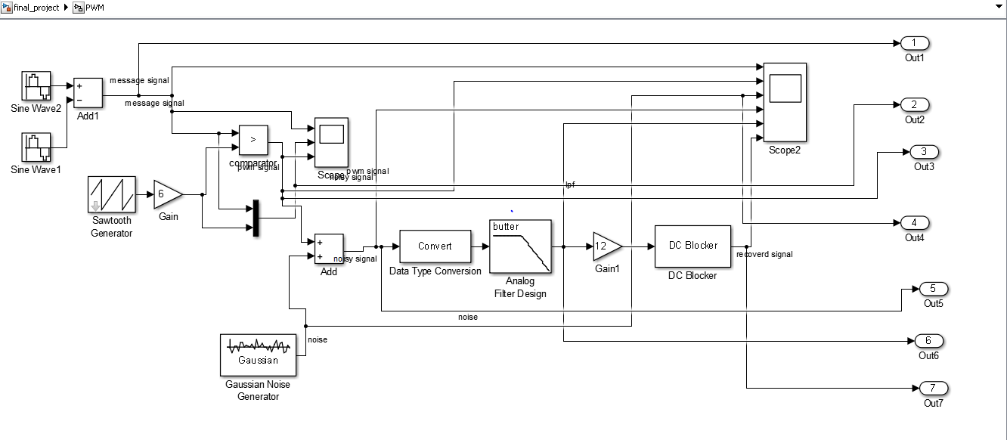
If input = “anything without 0 and 1 ” then it will show PWM

Slide 10
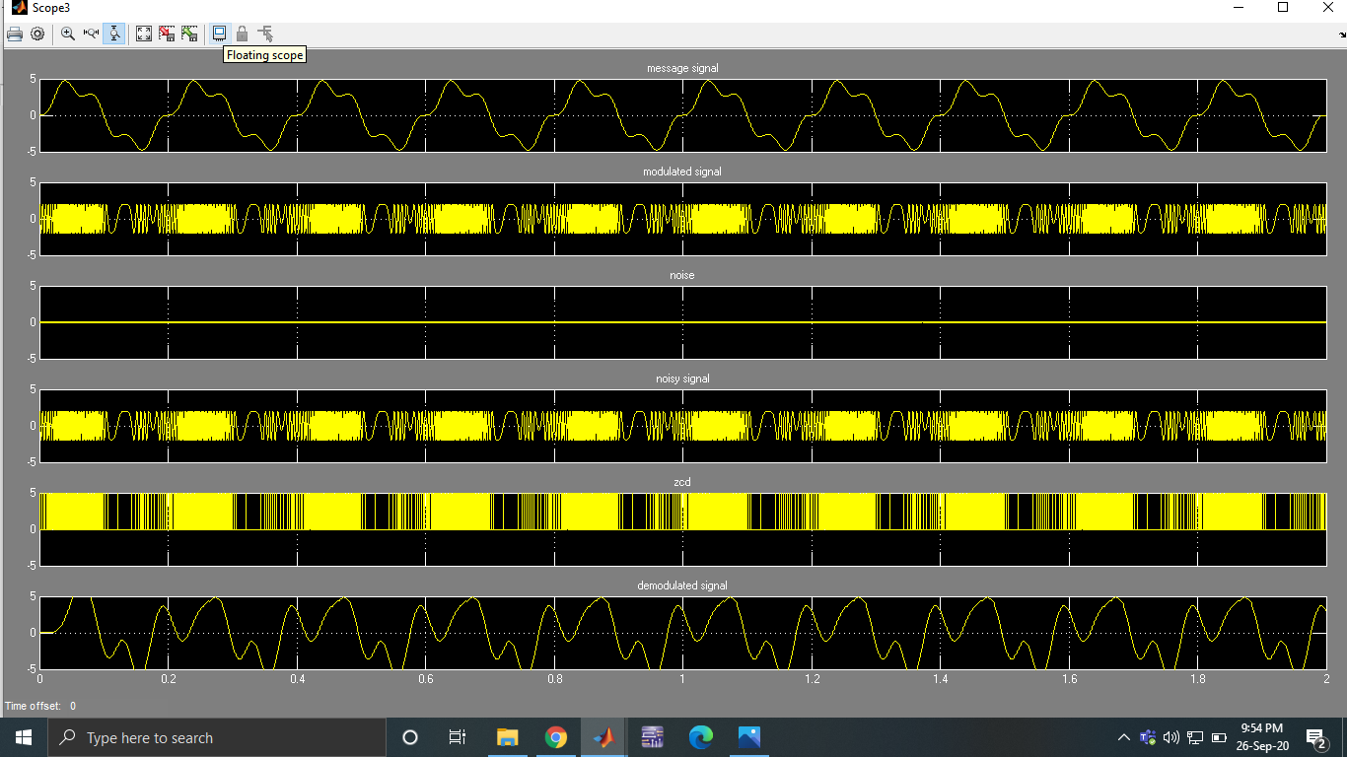
Outputs of The Project respectively:
Fm :

Slide 11
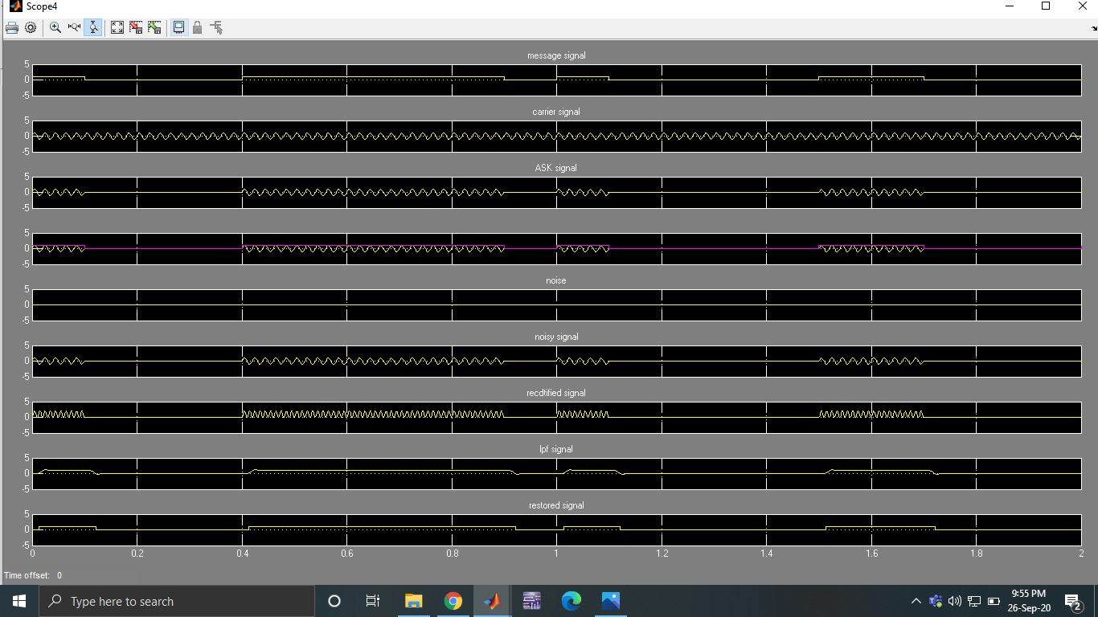
ASK:

Slide 12
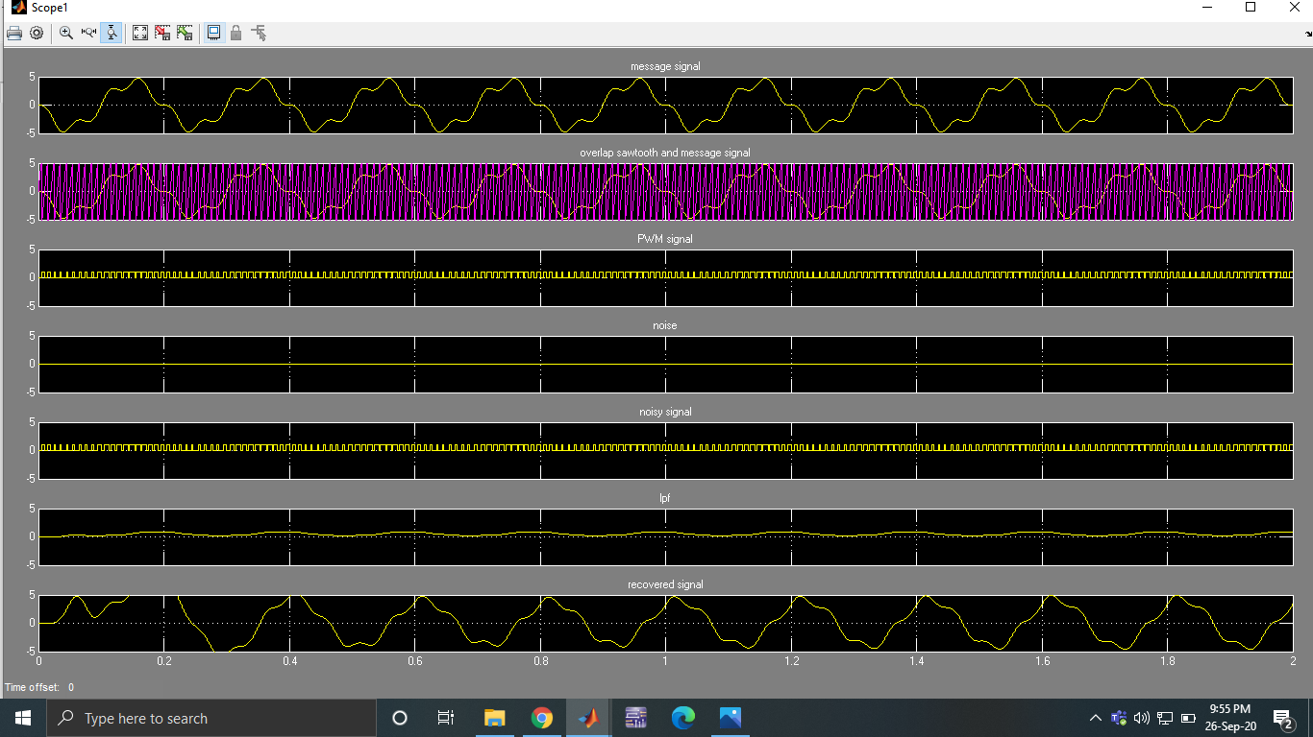
PWM

Slide 13
Any Questions?

Slide 14
Thanks for your Patience

