Slide 1
A presentation on
Explaining Black-boxes on sequential data
using weighted Automata
by
Dipanjana De
Source :
1. Ayache, S., Eyraud, R. and Goudian, N., 2019, February.
Explaining black boxes on sequential data using weighted automata.
In International Conference on Grammatical Inference (pp. 81-103). PMLR.
2. Hinton, G., Vinyals, O. and Dean, J., 2015. Distilling the knowledge in a neural network.
arXiv preprint arXiv:1503.02531.

Slide 2
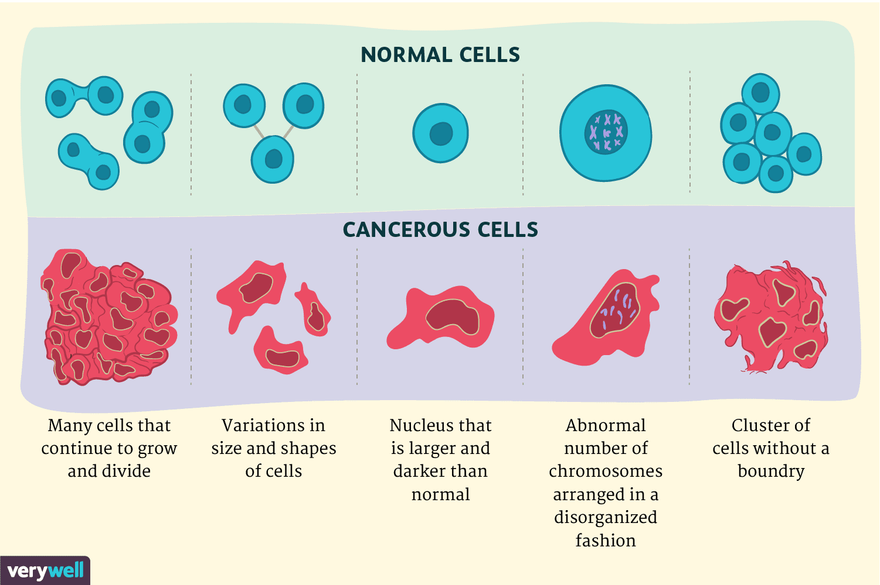
Black-Box interpretability
Introduction : To know the behaviour of a black-box model interpretation is important.
Without the knowledge of the inner representation of the hidden layer
of the network it is possible to interprete the black-box inspite of its non-
deterministic, probabilistic behaviour.
Two types of interpretability are:
Local interpretability : When a decision
is taken on a particular datum.
example: In image processing
demonstrate a particular region
to justify it’s classification

Slide 3
Black-Box Interpretability
2. Global Interpretability : It’s basically generalisation of the network through mapping
black-box’s inputs to its output.
Five classification models for interpretability :
Decision trees
Classification rules
Decision table
Nearest neighbour
Bayesian network classifiers
Decision trees model and knowledge distillation approach have been used in this paper

Slide 4
Decision Trees Classification model: Decision tree is a hierarchial graphical structure
containing subset of attributes. It helps user to focus
on the relatively more important attributes.
How to decide the importance of the attributes:
Attributes with smaller depth are more relevant.
In case of multiple occurrence of an attribute:
* The mean depth is considered
Drawbacks with assigning relevance to an attribute in decision tree:
Attribute with comparatively higher depth can be more relevant
Some branches may have irrelevant attributes which can lead to overfiting
Solution:
Consider the summation of of the values of leaf nodes of associated path
Sometimes removing extraneous attribute but not always.

Slide 5
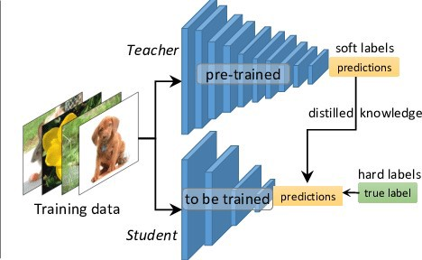
Knowledge Distillation Approach: To compress and transfer knowledge from different
models and assemble into a single model.
Distilling knowledge from a large model to a smaller
model and train the smaller model for generalisation.

Slide 6
Limitations with previous works:
Various extraction algorithms such as quantization algorithm, clustering algorithm, query
and counter examples algorithm have limitation that all these RNNs are trained for
binary classification. These give insights on performance of an RNN.
2. Another limitation is all these model access the inner black-box of an particular RNN and
shows the representation of the network. Doesn’t give any insight on behaviour of any
general black-box model.

Slide 7
Important Points
Spectral Learning : Spectral algorithm measures the learning complexity in terms of the
smallest singular value of the Hankel matrix. Drawback of this method
is it learns automata from a particular distribution, lacks generalisation.
Weighted Finite Automata : Weighted automata determines how many ways a word can be
accepted and can give idea about maximum used resources .
It can determine the quantative properties and it is also consi-
-dered as a class of probabilistic automata.
Linear representation of WA consists of three vectors.
1. initial weights
2. terminal weights
3. labeled transition weights

Slide 8
Important Points
Extraction of WA from Hankel matrix :
A function can be defined by Hankel matrix iff its hankel matrix rank is equal to the minimum
number of states of any WA which is finite.
Rows of the hankel matrix consist of prefixes and columns consist of suffixes.
Spectral algorithm considers finite sub-blocks of hankel matrix where the content of the
sub-block is estimated according to the number of occurrence of string in a learning sample.
Basis is a function that is used to define such sub-blocks of hankel matrix.

Slide 9
Proposed Algorithm
Algorithm has three steps:
1. Select a basis
2. Fill the required sub-block’s content with few data of trained
black-box
3. Extract WA
Select a basis: Basis can be selected by recursively sampling over distribution of symbols
given by trained black-box model.
Once a string is obtained all the prefixes and suffixes are combined separately.
Fill the sub-blocks: Queries all the string which are made with selected prefixes and suffixes
and their answer be the content of the blocks.
Extract WA: To extract WA it follows spectral algorithm and performs a Single Value Decom-
-position on selected sub-blocks of hankel matrix to generate WA.

Slide 10
Conclusion
RNN is able to compute the probability of occurrence of a string. Linear projection of
extracted Wa is almost similar to the non-linear projection of RNN.
For better approximation To generate the basis RNN should be used.
Algorithm works on general model as well as probabilistic model because WA isn’t limited
with probabilistic distribution.
Scalability issue exists. Algorithm depends on parameters and rank of matrix. For smaller
rank small WA is extracted but when states of the network is increased it is hard to learn the
model due to non-deterministic and probabilistic nature.
For the cost effective ease of computation this algorithm uses distillation approach because
computation is complex and costly in non-linear model.
-----------------

