Slide 1
PART -I
RNN and DFA

Slide 2
Introduction
The history of FSA and Neural Network is long.
It is proved that ‘Every FSA is equivalent to, and can be simulated by some neural network’[Minsky67].
Inferring Grammar from sample strings of a language is a NP-hard problem.
RNN is able to solve this NP-hard problem by inferring FSA.

Slide 3
Introduction
RNN can control the infiniteness problem of a finite automata.
Regular automata theory only works on binary logic, fuzzy automata can be created with help of RNN.
FSA with help of RNN can achieve learning ability of natural languages.
FSA is discrete and finite but RNN is continuous which makes RNN more powerful.

Slide 4
To study the state dynamics and inner representation of a neural network model, extraction of FSA from a learned network model is quite helpful.
Aim: Extraction of FSA to describe the state dynamics and inner representation of a trained RNN.
Many researchers have proposed many extraction algorithms to extract FSA. We will study few important extraction algorithms for FSA and draw some observations from it.

Slide 5
Learning and extracting FSA from 2nd order RNN [Giles et al. 92]
Extracting FSA is extracting what model has learned.
2nd order RNN learns to infer small regular grammars from training samples.
Initial conditions, training set size, order of RNN and network architecture can affect the learning.

Slide 6
Extraction algorithm-1: Quantization algorithm
Motivation: To train a network to correctly classify unseen strings and extract the full FSA that represents all the states of the network.
Dataset: Set of seven relatively simple regular grammars studied by Tomita.
Extraction: Extracting what model has learned.

Slide 7
Rules of extraction
Extraction is followed by the following steps:
Clustering of FSA states
Construct the state transition diagrams
Identify the loops
Minimization of FSA

Slide 8
Hypothesis: During training the hidden state space of the network is divided into q partitions of equal width and each partition represents a state in FSA.
For N hidden neurons there exists q^N number of possible partitions.
Time complexity= partition[O(q^n)] + construct DFA[BFS traversal O(n)] + Minimisation[Hopcroft algorithm O(nlogn)]; where n= no. of states

Slide 9
Network is trained with unary encoding; one input for each character of the alphabet for each time step.
Error criteria:
1. Rejection of the positive strings.
2. Acceptance of the negative strings.
Error function is defined by a specific response neuron whose value is measured with respect to response tolerance parameter.

Slide 10
Algorithm2- Inducing regular grammars using RNN [Cohen et al. 17]
Aim: Induce a grammar from example which is in or outside a regular language, without assumptions on its structure.
A novel technique is proposed for extraction of DFA using clustering techniques for partition without defining the number of clusters, which makes the process more unconstrained.
Time complexity= Quantization[k-means clustering algorithm O(ndkt)] + build DFA[ BFS traversal O(n)] + minimisation[ Myhill-Nerode O(nlogn)]; where n= no. of states

Slide 11
Algorithm
Input: A regular language L and a labelled dataset of strings X of language L is given.
Output: An extracted DFA which accepts language L.
Collecting states: Collect RNN’s continuous state vectors at the time of training.
Partition: K-means clustering algorithm is applied.
Minimization of DFA: Myhill-Nerode algorithm

Slide 12
Data generation
For simple regular grammar: Random sequences (set of +ve and –ve strings) are generated from a given regular expression.
Generating negative strings:
1. Randomly generated negative strings which is almost identical to the positive one.
2. Generating ungrammatical strings by word deletions, additions and movements.

Slide 13
Algorithm 3- extraction of DFA using queries and counter example [Weiss et al. 18]
Aim: Extraction of a DFA to describe the state dynamics of a trained RNN.
Motivation: After training the RNN-acceptor and RNN with same data set, extract DFA from the trained RNN and check extracted DFA and RNN-acceptor accept the exactly same language.

Slide 14
Algorithm and components
RNN-Acceptor: RNN+ binary classification
component
L* exact learning algorithm is used here where RNN-acceptor is a teacher who answers queries and return strings which are not equivalent as counter examples.
Data set: Set of seven simple regular grammars used by Tomita.

Slide 15
Comparison among three algorithms
Criteria | Algorithm 1 | Algorithm 2 | Algorithm 3
String acceptance | Empty string is not accepted | Empty string is accepted. | Empty string is accepted.
Quantization | Value of quantization parameter is predefined and it is changed at the time of training. | No prior knowledge requires for quantization parameter. A heuristic is applied to select the correct number of states. | Almost no parameters required.
Minimisation of FSA | Hopcroft minimisation algorithm is used. | Myhill-Nerode minimisation algorithm is used. | Extracted FSA is minimised. No requirements of minimisation.

Slide 16
Criteria | Algorithm 1 | Algorithm 2 | Algorithm 3
Generalisation | Requirement of prior knowledge about network and parameter makes the process less general. | Process is more general and can be implemented to any model. | Good in generalisation.
Learning the data | Accept the positive strings Reject the negative strings. | For negative strings generate random sequences of word, identical to positive strings or generate ungrammatical strings. | By iterating on membership queries accept the positive strings and equivalence queries tell when to stop. Reject negative strings by returning counter examples.

Slide 17
Criteria | Algorithm 1 | Algorithm 2 | Algorithm 3
Dataset and language | Model is trained on Tomita Grammars for simple regular grammar. | Model is trained on labelled dataset. Learn simple regular grammar as well as synthetic regex inspired by natural language. | Same as Algorithm 1.
Performance generalization | Correctly classify small strings. Performance is better when Hidden dimension is less. | Correctly classify strings in or outside regular language. | Performance is not affected with dimension of the network. Accuracy is high.

Slide 18
PART-II
RNN and Weighted Automata

Slide 19
Introduction
Theoretical analysis of RNN with discrete time data is difficult because of its continuous state space.
On other hand WFA can compute probability distribution function defined by any HMM and simplify transition behaviour of HMM decision process. Hence WFA is quite helpful to study RNN.

Slide 20
To interpret a neural network which is treated as black-box, extraction of weighted Automata from a learned RNN is helpful.
Weighted automata determines how many ways a word can be accepted and can give idea about maximum used resources .
It can determine the quantative properties and it is also considered as a class of probabilistic automata.

Slide 21
Many researchers have proposed many extraction algorithms to extract WFA.We will study few important extraction algorithms for WFA and draw some observations from it.
Linear representation of WFA consists of three vectors:
1. Initial weights
2. Terminal weights
3. Labeled transition weights

Slide 22
Algorithm-1: Spectral learning algorithm [Ayache et al. 19]
Aim: To show RNN and WFA expressively equivalent. 2nd order RNN is a generalisation of WFA.
Contribution: A unique learning algorithm for 2-RNN with linear activation function with continuous vector inputs.

Slide 23
Extraction of WFA
Spectral learning algorithm computes the learning complexity in terms of smallest singular Value of Hankel matrix(ascending skew diagonal).
A function of WFA can be defined by Hankel matrix iff rank of its hankel matrix must be equal to the number of states in WFA.
Fundamental theoretical concept is selecting the proper sub-blocks of Hankel matrix.
Basis is a function , used to define sub-blocks of hankel matrix.

Slide 24
Learning Algorithm for WFA
Low rank matrix estimation
Hankel Matrix
Factorization and linear algebra
WFA
Data
Induced
latent states
SVD
Why Hankel matrix?
For a one letter alphabet string concatenation of string is commutative.
In Hankel matrix left to right elements in diagonals are equal. Therefore it can give
the real time analysis by linear algebra.

Slide 25
Basis : Basis can be called as super set of all the prefixes and suffixes of string w, generated by WFA.
It is prefix closed iff all prefixes are element of basis matrix.
Complete iff rank of Basis matrix and Hankel matrix is equal.

Slide 26
Algorithm
Input: A learned black box model, Set of prefixes and suffixes, rank approximation matrix.
Output: WFA
Generate_Basis() : Basis is selected by recursively sampling over distribution of symbols until a string a string is obtained.

Slide 27
Fill_Hankels() : Content of sub-blocks is filled with answer of queries . A string is obtained by selecting prefix and suffix randomly and queries each string to the black-box model.
Extraction() : SVD is done on Basis matrix while Basis matrix= PS for given rank approximation parameter.
generates WFA.
Time complexity= Hankel matrix[O(PS*N)] + SVD and linear algebra[O(P*S*n)]; where N is samples of string and n is number of states.

Slide 28
Algorithm 2: WFA from RNN via regression on state space [Okudono et al. 19]
An extension of Angluin’s L* algorithm using regression method for equivalence queries.
Motivation: Extraction of a quantative Finite State Machine which accepts values which are real numbers instead of booleans.

Slide 29
Learning: The algorithm learns automata by a set of membership and equivalence queries.
Iterates membership queries to construct WFA and equivalence queries says when to stop.
When WFA and RNN is equivalent iteration stops.

Slide 30
Abstraction of state space of RNN: Gaussian Process Regression(GPR) and Kernel Ridge Regression(KRR) methods are used.

Slide 31
Algorithm 3: Extraction of PDFA using Queries and counter example [Weiss et al.20]
Aim: Lower the total variation distance between next-token distribution of PDFA and LM-RNN.
Input: Language-Modelling RNN
Output: PDFA

Slide 32
Membership queries: Gives the probability of last token in a sequence.
Equivalence Queries: Accept or Reject a hypothesis PDFA.
Counter examples: Returns the sequence for which it differs.

Slide 33
Comparison: Algorithm-1, 2 & 3
Criteria | Algorithm-3[PDFA] | Algorithm-1[WA] | Algorithm-2
Analogy | Each state defines next token distribution. | Non-deterministic ; Not properly analogous to RNN.
Time | Processing sequence is simple and fast. | Processing sequence slow.
Complexity | No need of matrix multiplication. | Need of Matrix multiplication in every step.
Hypothesis | Always return a stochastic hypothesis. | May or may not return stochastic hypothesis.
Function | Uses quadratic function. | Uses linear function.
Performance | Gives better error rate and distributed cumulative gain. | Comparatively poor.

Slide 34
PART-III
Comparison among RNN, FSA and
Weighted Automata

Slide 35
Criteria | RNN | FSA | WA
Inputs | Takes continuous vector inputs and able to process the same. | Can process discrete inputs. | Can compute probabilistic distribution function with continuous vector inputs.
Analysis | Theoretical analysis of RNN is difficult. | It is not quite helpful to analyse RNN due to inability of processing continuous inputs. | Can simplify transition behaviour of network and helpful for analysis.
Behaviour analysis | RNN is treated as black-box model. | Extraction of FSA can give insights on state dynamics and inner representation of RNN. | Extraction of FSA can give insights on behaviour of network by mapping input to the output.

Slide 36
Criteria | RNN | FSA | WA
Knowledge requirement | RNN is a network with memory. It stores output of its previous state. | Extraction of FSA needs knowledge about inner representation of the network. | No prior knowledge requires.
Parameters | Little modification in architecture of RNN can help to reduce the number of used parameter. | The value of quantization parameter varies but it doesn’t have any effect in number of states in minimised FSA. Larger value of quantization parameter takes more time to execute. This can be considered as overhead. | Parameter helps to select the correct basis to extract WA. Maximum length parameter can be used to obtain the correct basis.

Slide 37
Criteria | RNN | FSA | WA
Behavioural property | It is deterministic. | Initial random split of depth makes the learning divergent which can ends up extracting NFA sometimes but the underlying network is always deterministic. | WA is non-deterministic.
Complexity | Complexity of RNN depends on the architecture of RNN. The number of layers, hidden units, activation function have effects on complexity. | Extraction of FSA is less simpler. | Extraction of WA requires matrix multiplication in every step so it is complex.

Slide 38
Criteria | RNN | FSA | WA
Logic | RNN can be trained for any logic. | FSA works on binary logic. To extract a FSA from RNN network is trained for binary classification. | To extract WA from RNN model is trained with real valued data.
Expressibility | RNN is more expressive practically. | Theoretically any FSA is equivalent to some RNN but practically it is not possible. | Theoretically it can be proved that WA is expressively equivalent to RNN but practically it is not possible.
Generalization | RNN before quantization maps new state to same state which is seen before but it is surprising for continuous vector inputs. It can be considered as evidence of generalization. | No requirements of any prior knowledge to extract FSA can make the process more general. | Correct selection of Basis to extract WA gives better approximation about black-box.

Slide 39
PART-IV
IMPLEMENTATION

Slide 40
Description of data set
Tomita Grammar constitutes of the most primitive representation therefore no feature extraction is required.
Rules of Tomita Grammar:
Tomita 1: 1* // string shouldn’t contain any zero
Tomita 2: (10)* // string contains consecutive 10
Tomita 3: string doesn’t contain odd series of consecutive 1’s and consecutive 0s.
Tomita 4: string doesn’t contain 000 as substring
Tomita 5: string contains even no. of 01’s and 10’s.
Tomita 6: Number of 1’s and number of 0’s is a multiple of 3
Tomita 7: 0*1*0*1*

Slide 41
Experiment-1
Extraction of DFA from 2-RNN

Slide 42
Architecture
2nd order RNN with N hidden layers, L input layers and (N^2)*L real-valued weights.
The number of input layers should be less than the number of hidden layers to make the network less complex.
With the above approach complexity grows as
O(N^2).
To compute next state vector for each hidden neuron sigmoid discriminant function is used as activation function.

Slide 43
Training
To avoid trade-off of bias and variance initial training set of 1024 strings of maximum 16 length was taken.
Train set= 30
Pre test set= misclassified strings + remaining data
Misclassified strings are added to pre test data to avoid local minima problem.

Slide 44
Results
No. of hidde-n layers | Initial Training set | Augmented pre test set | epochs | Positive strings | Negative strings | DFA size | Minimized DFA size
3 | 30 | 1011 | 500 | 7 | 319 | 2,3,5 | 2,3,4
5 | 32 | 1307 | 500 | 23 | 264 | 3,4,12 | 3,4,8
10 | 32 | 1310 | 500 | 19 | 526 | 4,6,10,16 | 4,5,10,12

Slide 45
Observation
Every unminimised extracted FSA was unique.
All network converged during training within 500 epochs time that means the network has learned the whole training set.
Extracted FSA with same number of states consists of a large equivalence class of Neural network generated FSA.
The equivalence class varies both in size of neurons and initial conditions.
Empty string is not accepted.
Value of parameter q dynamically changes, increases convergence time.
Restrictive for larger strings and more number of hidden units.

Slide 46
Experiment-2
Extraction of DFA by queries and counter example

Slide 47
Building the RNN-acceptor model and training
2- LSTM layers with 3 input dimensions
and 5 hidden dimensions.
Batch size for training data: 20
Sampling: Random sampling is done
Calculate loss : after every 100 second

Slide 48
Time of training
Convert char(alphabet) to input vector.
Traversing the states of RNN.
Forming word with respect to input alphabet.
Classification of states.
Check whether formed word is over input alphabets
Classification of word
Calculate loss on word

Slide 49
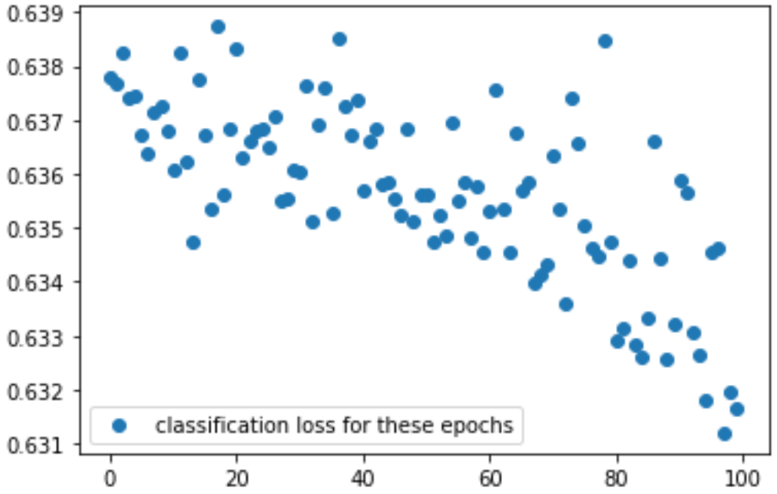
Result after training RNN-classifier
Train data set size: 1991
Right classification of word: 921
Classification Loss graph:

Slide 50
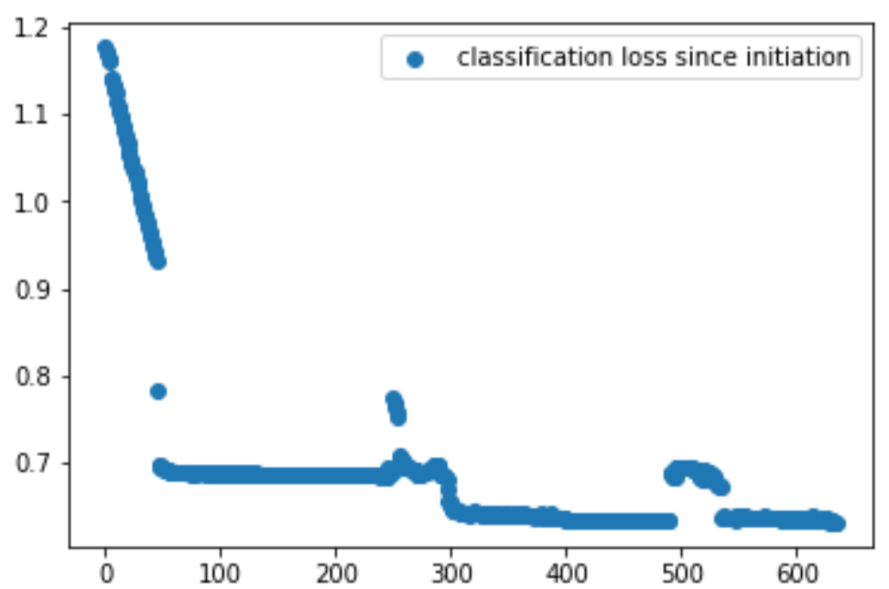
Classification loss
After every 100 seconds classification loss is calculated.
Classification loss since initiation:

Slide 51
Building RNN model
2 layers bidirectional LSTM with hidden unit size 64 and 2 classifier layers.
Learning rate: 0.001
Sampling: train data set size maximum 300 each time out of 3000 records
Time: 100

Slide 52
Extraction and Refinement
Quantization: SVM function is used
SVM decision tree split depth(number of layers taken at a time): 10
Leaf nodes of SVM represents the actual cluster of partitioning .
If split is not perfect or DFA is not equivalent refinement is done.
At the time of refinement only effected cluster is refined and rest remain same.

Slide 53
Extraction Result
Target | DFA size | Counter example | Equivalence check | Refinement time
Tomita 5 | 6 | 001010, 011110 | 0.0247, 0.108 | 0.039
Tomita 5 | 7 | 0000111, 1111100 | 0.025, 0.0119 | 0.047
Tomita 5 | 5 | 11000 | 0.0013 | 4.236

Slide 54
Accuracy check
Hidden size | Time | DFA size | Average 10 | accuracy 50 | on length 100 | Train
10 | 36s | 12, 15, 21 | 46.78% | 49% | 68.09% | 46.25%
50 | 49s | 2, 4, 14, 85 | 83.1% | 85.04% | 72% | 59.96%
100 | 56s | 2, 3, 6, 24, 169 | 100% | 100% | 98% | 54.68%
200 | 78s | 2, 4, 10, 20, 52, 263, 429 | 100% | 85% | 99.01% | 89.20%

Slide 55
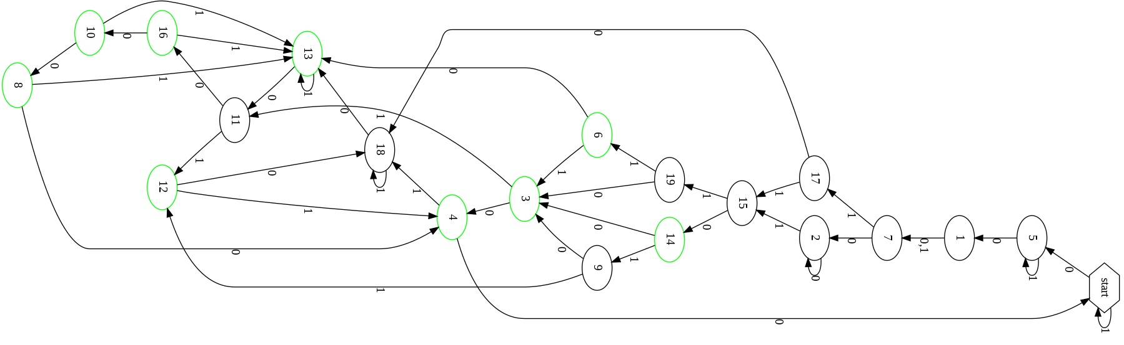
Some extracted DFAs

Slide 56
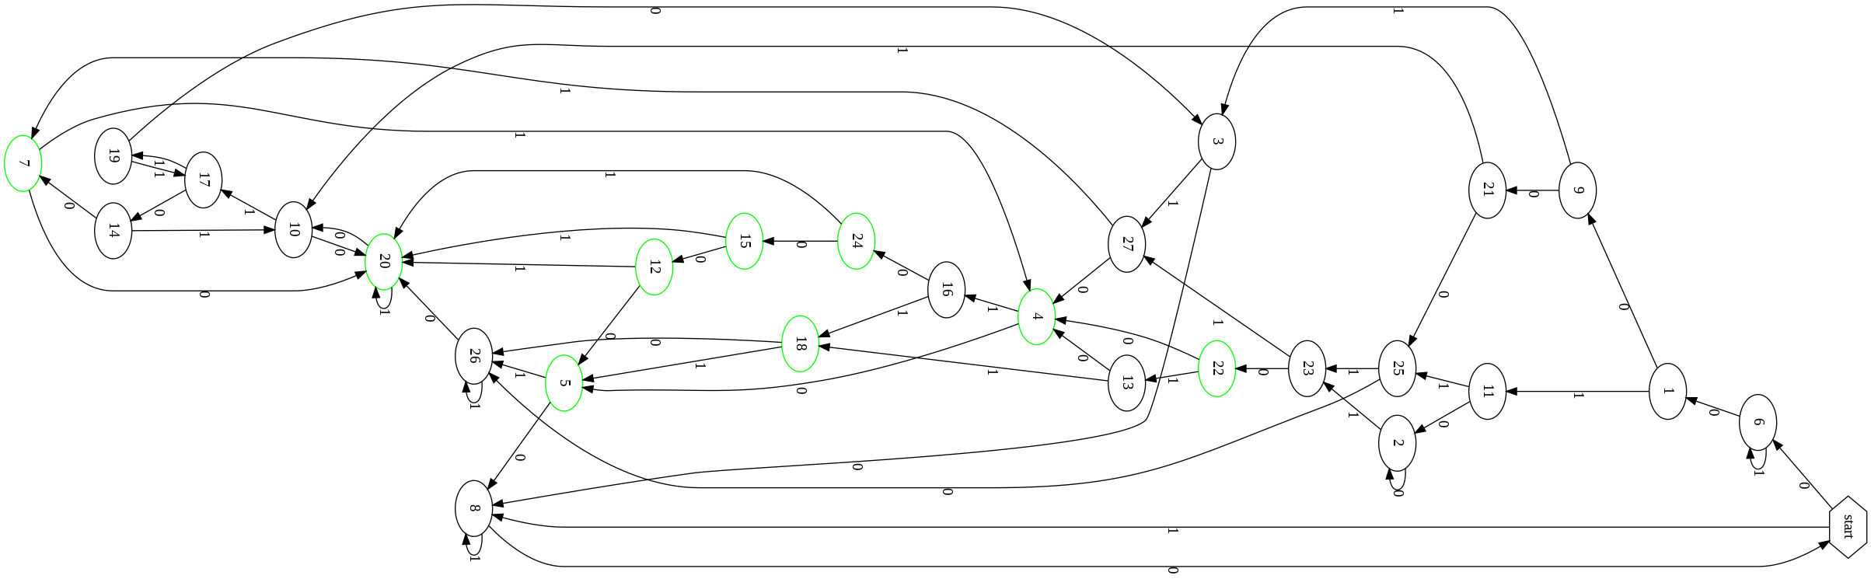

Slide 57
Observation
Internal configuration of the network is not considered.
Dynamically no parameter is required.
Extract larger state automata in less time.
Number of states in minimal DFA is more than number of states in network.
Gives better accuracy in less time and is not much affected by size of hidden dimension.

Slide 58
Experiment-3
Extraction of WFA using spectral learning algorithm

Slide 59
Dataset Description
Penn Treebank dataset
3000 learning examples with 20 different symbols.
Training set contains 15,000 sequences.
Test set contains 10,000 sequences.
Parameters:
value of S (set of suffix size)=200*200
value of P (set of prefix size)= 100*100
basis size= 25*25, 50*50, 100*100
rank value= 2
Metric : Error rate in predicting the next symbol in the sequence

Slide 60
Data set : Penn Treebank
Word Error
rate(%)
unigram | 25 | 5 | 67.96
unigram | 25 | 10 | 64.00
unigram | 25 | 15 | 65.98
unigram | 25 | 20 | 69.87
unigram | 50 | 10 | 63.89
unigram | 50 | 15 | 63.00
unigram | 50 | 20 | 63.57
Number of
states
Word sequence
Basis K

Slide 61
unigram | 50 | 25 | 62.43
unigram | 100 | 10 | 63.92
unigram | 100 | 15 | 64.00
unigram | 100 | 20 | 63.97
unigram | 100 | 25 | 63.54
Number of
states
Word Error
rate(%)
Word sequence
Basis K

Slide 62
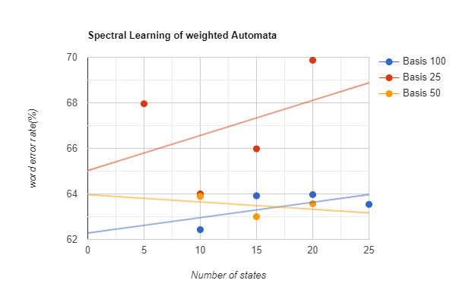

Slide 63
Observation
When basis is small error rate is high with respect to increment in number of states.
As size of basis increases overall error rate declines.
Error rate increases with increment in number of states irrespective of size of basis.

Slide 64
PART-V
Interpretation

Slide 65
RNN is superior over FSA :
a. RNN can process continuous input vectors but FSA can process discrete data.
b. The number of states of minimal FSA is larger than the number of states in RNN. It cannot give any insight about capacity of network.
c. All the partitions of state space of neural network are not reachable to extract FSA therefore analysis of exact state dynamics is not possible.

Slide 66
2. WFA can be the approximation of the RNN but it is not equivalent to RNN practically.
3. WFA is better in generalisation over FSA because it doesn’t need any prior knowledge about RNN.
4. The abstraction of network in the form of FSA or WFA gives interpretable representation of the RNN and also says what system has learned.

Slide 67
Interpretation on learnability of RNN
Grammar induction into RNN method gives insights about RNN as a learning model.
It is hard to decide that which DFA best models the unknown regular grammar.
It is hard to distinguish between NFA with a small number of states and DFA with a large number of states.

Slide 68
RNN can be modeled as turing machine. Halting problem of TM can be proved by RNN.
Equivalence of WA and LM-RNN is undecidable.
RNN is inconsistent due to its dynamicity therefore finding highest-weighted string for an arbitrary RNN in undecidable.
Clustering effects doesn’t effect generalisation of a network. It gives insights about representation of the network.

Slide 69
Clustering theory of learning language says if two hidden vectors representing two different prefix are in the same cluster are need to stay close to each other to be grouped in the same cluster when another new symbol is run from these two vectors.
If the network is contractive any two vectors in the vector space will come close to each other at an exponential rate that means all the prefixes will belong to the same language.

Slide 70
Results
2 layers bidirectional LSTM with hidden unit size 5 and 2 classifier layers.
Learning rate: 0.001
Sampling: train data set size maximum 300 each time out of 1000 records
Time: 100
Data set: Generated by Rules of Tomita Grammar

Slide 71
Results-1
I/P= a binary string is given, DFA accepts if the represented number is divisible by 5(empty string is accepted).
O/P= acceptance or reject
1st input sequence generated= “10” #2
O/P= accepting status=False… #correct
2nd input sequence=“111” #7
O/P= accepting status=False… #correct

Slide 72
Result-1
3rd input sequence generated=“101” #5
O/P= accepting status=True…. #correct
4th input sequence generated= “1011” #11
O/P= accepting status=False…. #correct
2nd input sequence generated=“1111” #15
O/P= accepting status=True…..#correct
3rd input sequence generated=“100011” #35
O/p= accaepting status=True……#correct

Slide 73
Result-1
4th input sequence generated=“10011011101” #1245
O/P= accepting status= null
After resetting…
4th input sequence generated=“10011011101” #1245
O/P= accepting status= False….. #wrong
Counter example=“10011011111”

Slide 74
Result-1
5th input sequence generated=“1110101011101” #7517
O/P= accepting status= null
After refinement:
O/P= accepting status=True….. #correct

Slide 75
Result-2
I/P= String which ends with 0 and should be accepted
Each state is represented by a vector in RNN.
1st DFA has 3 states:
{[1.00, 1.00, 0.00], [1.00,1.00,1.00], [0.00,0.00,0.00]}
Starting state: [0.00,0.00,0.00]
Accepting state: [1.00,1.00,1.00]

Slide 76
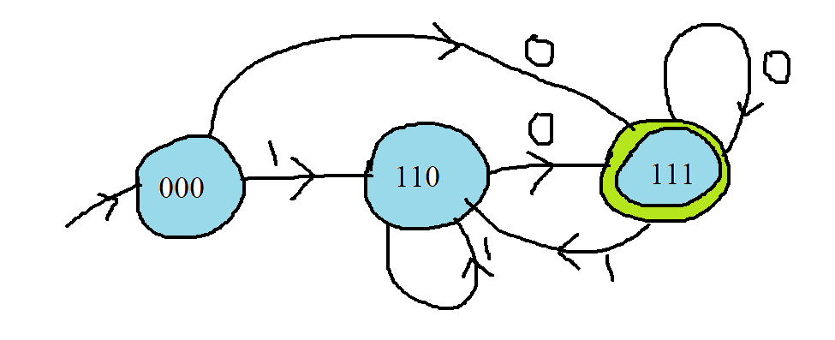
Result-2
Transitions Functions of DFA-a:
 | [1.00,1.00,0.00] | [1.00,1.00,1.00] | [0.00,0.00,0.00]
0 | [1.00,1.00,1.00] | [1.00,1.00,1.00] | [1.00,1.00,1.00]
1 | [1.00,1.00,0.00] | [1.00,1.00,0.00] | [1.00,1.00,0.00]
Current accepting state: [0.00,0.00,0.00]
Accepting status: False

Slide 77
Result-2
Generated I/P sequence= “1100011”
Current state after traversal= [1.00,1.00,0.00]
Accepting status: False…#correct
Generated I/P sequence=“ 111010”
Current status= null
After refinement: False….#wrong
Generated I/P sequence=“11101011”
Current state after traversal=[1.00,1.00,0.00]
Accepting status= false……#correct

Slide 78
Result 2
Generated I/P sequence: “1100011”
Accepting status= False… #correct
Current state= [1.00,1.00,1.00]…. #false
After refinement: current state=[1.00,1.00,0.00]
Generated I/P sequence: “100110”
Current state=[1.00,1.00,1.00]… #correct
Accepting status=True…..#correct

Slide 79
Result-2
Performing minimisation on previous DFA-a:
After applying Myhill-Nerode minimization algorithm:
Minimised DFA has two states:
([1.00,1.00,0.00],[1.00,1.00,1.00])
Starting state= [1.00,1.00,0.00]
Accepting state=[1.00,1.00,1.00]

Slide 80
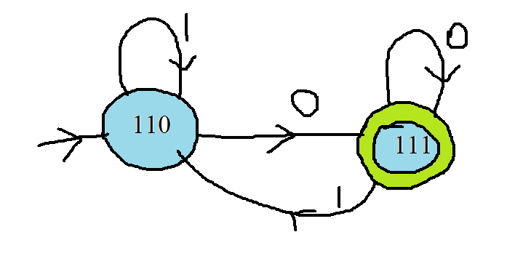
Result-2
Transition Function for minimised DFA-a:
 | [1.00,1.00,0.00] | [1.00,1.00,1.00]
0 | [1.00,1.00,1.00] | [1.00,1.00,1.00]
1 | [1.00,1.00,0.00] | [1.00,1.00,0.00]
Current state : [1.00,1.00,1.00]
Accepting status: True……#correct

Slide 81
Conclusion
Model gives mostly correct results.
Forming loops:
Mapping new state into an exact same state which it has already seen before.
RNN’s states are considered as random vectors so probability of getting exact same state is almost zero.
It can be said that for an infinite set of sequence networkwill always traverse the same path and predict the label.
which can be considered as generalisation.

Slide 82
Experiments on Text dataset
Training data set= Penn Treebank, Conll corpora(POS tagged)
Test data set= Penn Treebank,(Alice-in-wonderland, text format)
Sampling: training= 15,000 strings
validation= 10,000 strings
Test= 10,000 strings

Slide 83
For mapping: POS category map from NLTK library
Training data set is divided into grammatical and ungrammatical sentences.

Slide 84
Parameters
Data: grammatical source- Penn_treebank[PTB]
Regex:
for text: D?A*NV(D?A*N)
alphabet= A, D, N, V [adj, det, noun,verb]
max_length=100
min_length=1

Slide 85
Parameters
Grammar for train data set: [PTB]
alphabet: N, V, A, D, J, B
RNN: Num_Epochs=15
state_size=10
Clustering model: model= K-means

Slide 86
Defined Grammatical Rules
terminals are lowercase (president)
preterminals are capitalized (Noun)
other non-terminals are all-caps (NP)
S = sentence, NP = noun phrase, VP = verb phrase, PP = prepositional phrase, Det = determiner (sometimes called "article"), Prep = preposition, Adj = adjective

Slide 87
Defined Grammatical production rules
S --→NP VP
VP -→Verb NP
NP-→ Det N
NP-→ N
NP→ NP PP
PP -→Prep Det N
N → Adj N
N → Noun
Noun-→Adj Noun

Slide 88
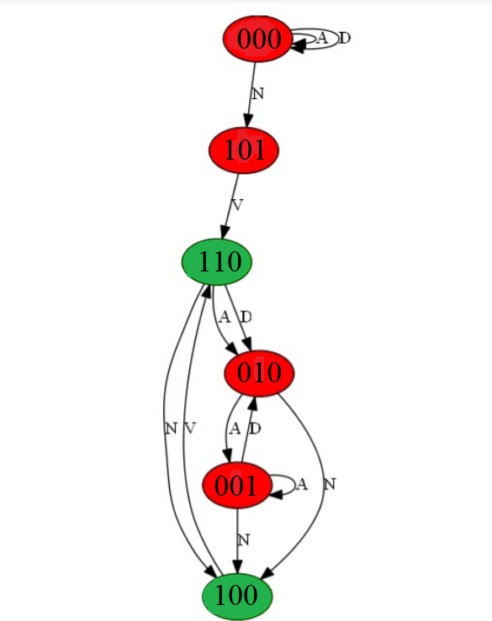
Results
Accepting sentences:
1. The white rabbit still in sight. …#correct
2. The rabbit was no longer to be seen. …#correct
3. She came upon a little table….. # correct
4. The the rabbit jumps ….#wrong
Rejecting sentences:
1. Little door about fifteen inches high. ..#correct
2. The little golden key #correct

Slide 89
Further work
Extraction of DFA againusing TEXT data set with proper loss and performance graph
Extraction of WA using text data set with proper results, loss and performance graph
Compare both
Check whether both models can predict anything.
IF yes then compare both

Slide 90
References
[Minsky 67] : Minsky, Marvin Lee. Computation. Englewood Cliffs: Prentice-Hall, 1967.
[Giles et al. 92] : Giles, C.L., Miller, C.B., Chen, D., Chen, H.H., Sun, G.Z. and Lee, Y.C., 1992. Learning and extracting finite state automata with second-order recurrent neural networks. Neural Computation, 4(3), pp.393-405.
[Cohen et al. 17]: Cohen M, Caciularu A, Rejwan I, Berant J. Inducing regular grammars using recurrent neural networks. arXiv preprint arXiv:1710.10453. 2017 Oct 28.
[Weiss et al. 18]: Weiss G, Goldberg Y, Yahav E. Extracting automata from recurrent neural networks using queries and counterexamples. InInternational Conference on Machine Learning 2018 Jul 3 (pp. 5247-5256). PMLR.
[Ayache et al. 19]: Ayache S, Eyraud R, Goudian N. Explaining black boxes on sequential data using weighted automata. InInternational Conference on Grammatical Inference 2019 Feb 4 (pp. 81-103). PMLR.
[Okudono et al. 19]: Okudono T, Waga M, Sekiyama T, Hasuo I. Weighted automata extraction from recurrent neural networks via regression on state spaces. InProceedings of the AAAI Conference on Artificial Intelligence 2020 Apr 3 (Vol. 34, No. 04, pp. 5306-5314).
[Weiss et al.20]: Weiss G, Goldberg Y, Yahav E. Learning deterministic weighted automata with queries and counterexamples. arXiv preprint arXiv:1910.13895. 2019 Oct 30.

