Slide 1
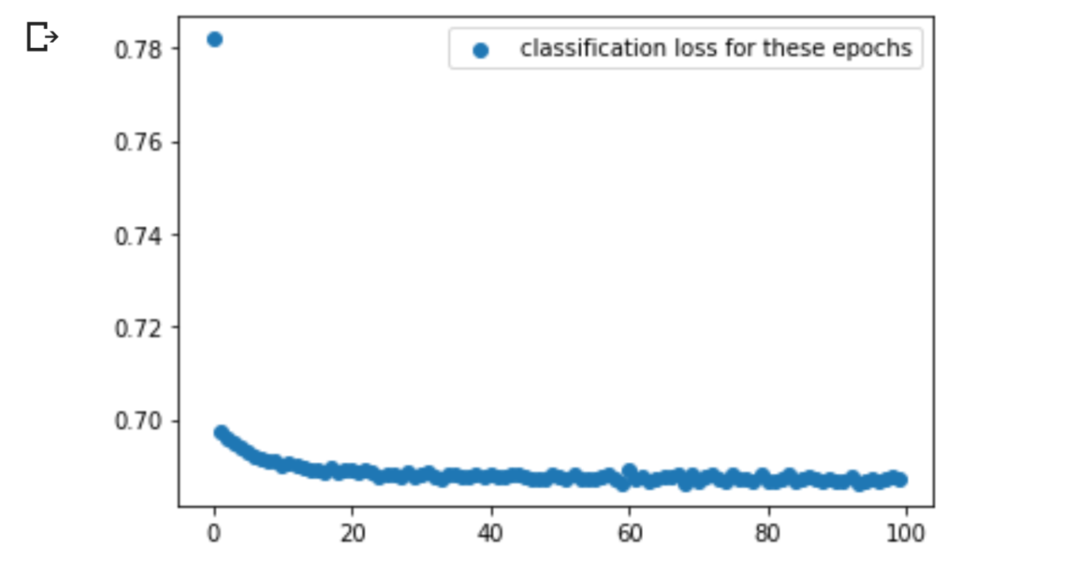
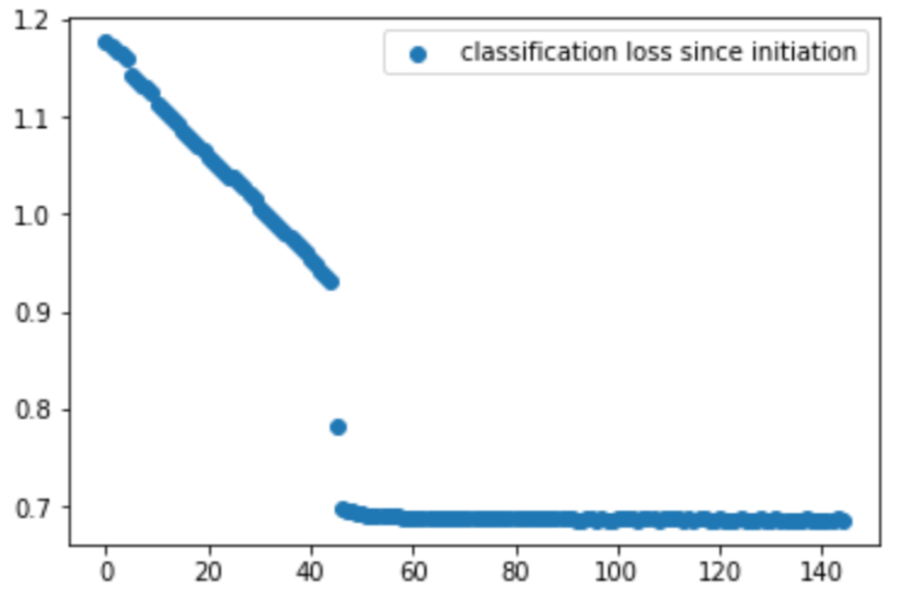
Train set size : 1991 Positive examples: 921
Current average loss respectively: 0.68900
0.68789
0.68640
0.68799
0.68698

Slide 2
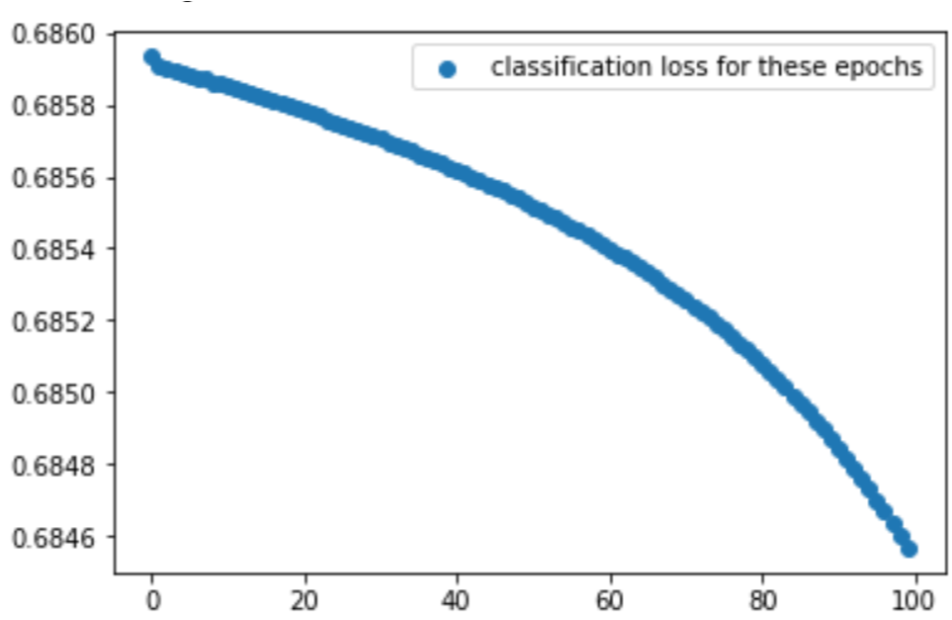
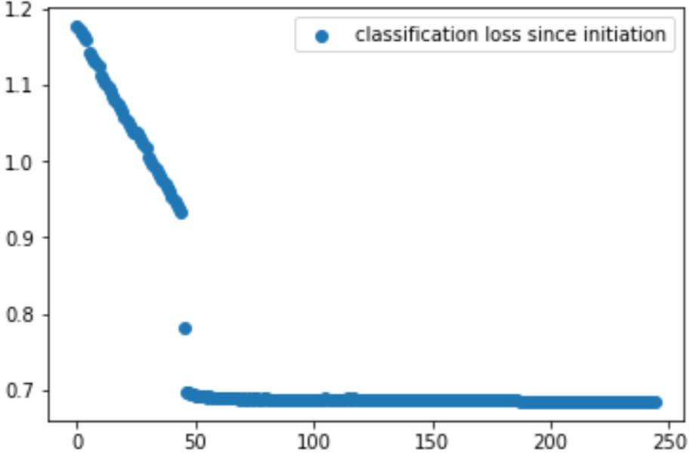
Train set size : 1991 Positive examples: 921
Current average loss respectively: 0.68579
0.68562
0.68541
0.68509
0.68456

Slide 3
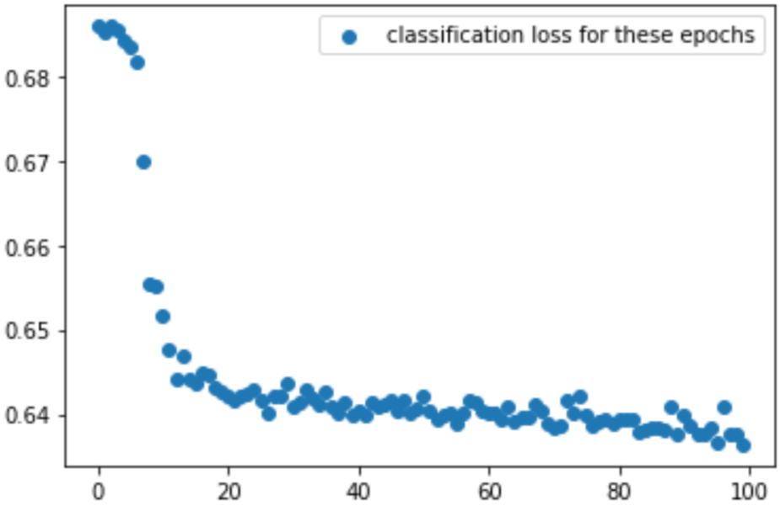
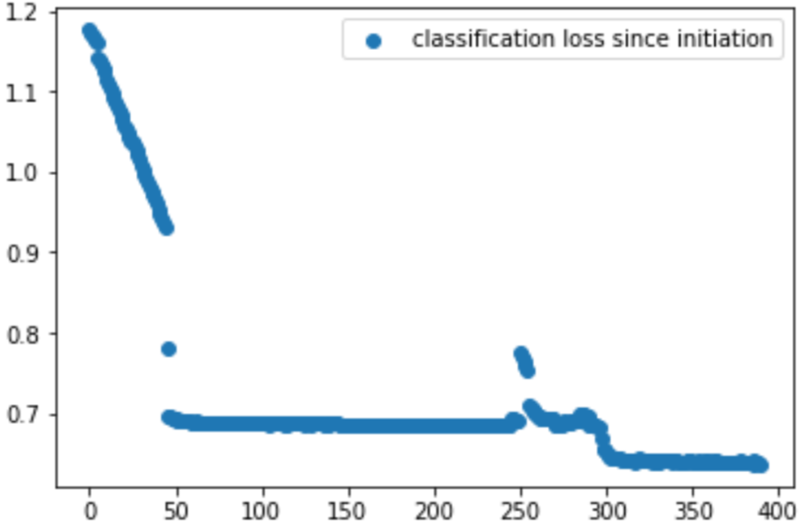
Train set size : 1991 Positive examples: 921
Current average loss respectively: 0.64259
0.63994
0.64041
0.63887
0.63639

Slide 4
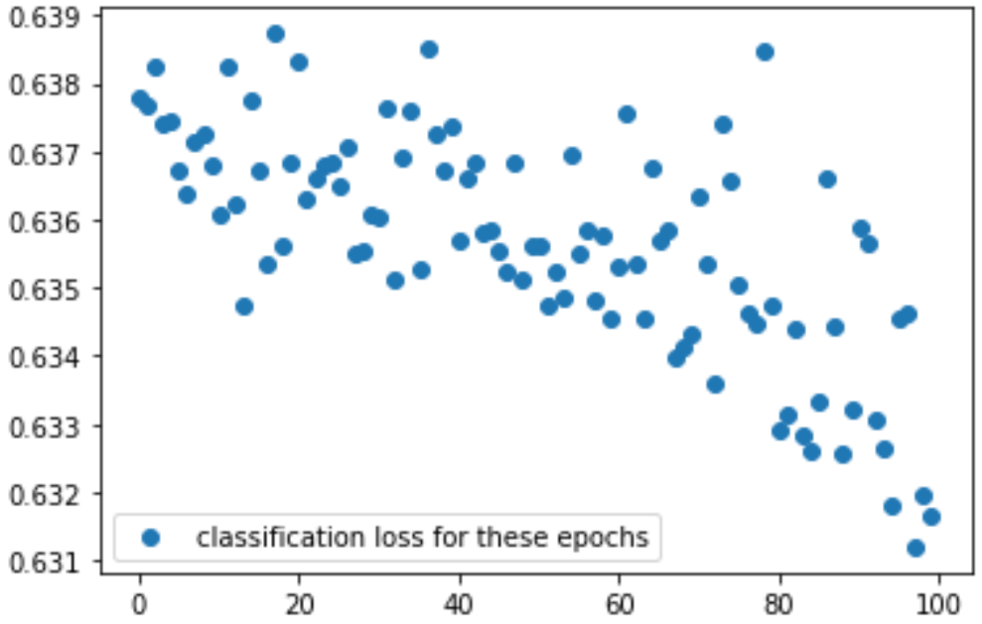
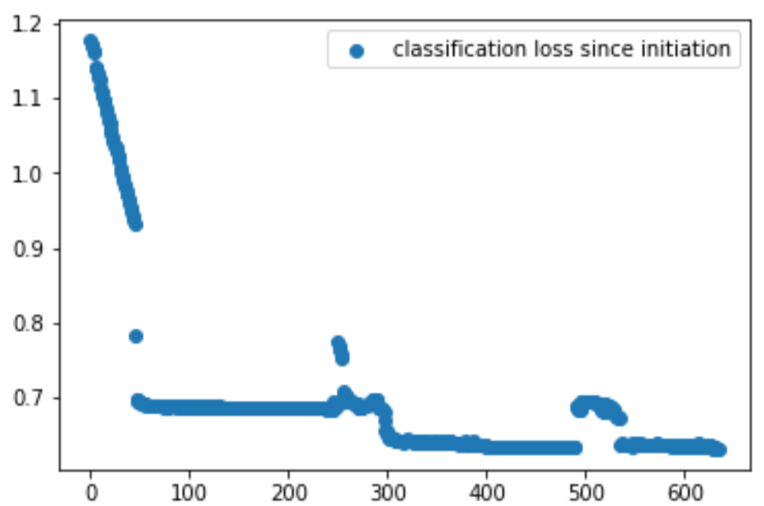
Train set size : 1991 Positive examples: 921
Current average loss respectively: 0.63683
0.63737
0.63454
0.63474
0.63165

Slide 5
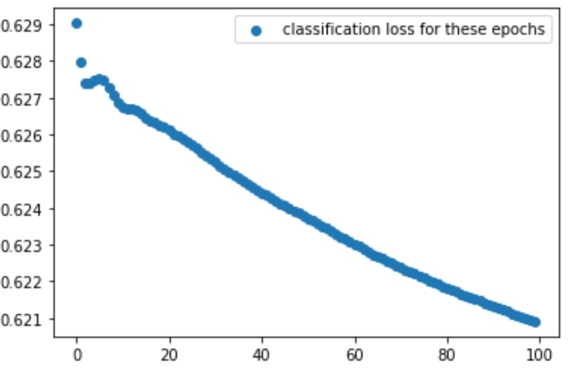
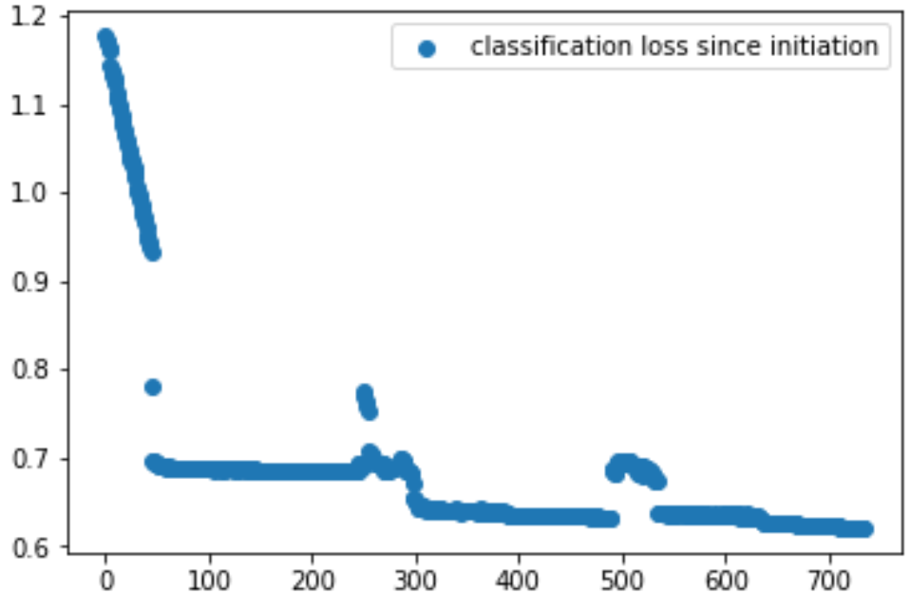
Train set size : 1991 Positive examples: 921
Current average loss respectively: 0.62198
0.62450
0.62307
0.62186
0.62091

Slide 6
Overall classification loss on train set for current batch: 0.62091
Size of DFA generated : 2 , 4, 12, 15, 21, 52, 85, 169, 263, 421, 449
Accuracy on train set: 46.25%
Accuracy on Test set:
Accuracy | Test data size
RNN score against target on test set 59.96% | 1194
Extracted DFA score against RNN on test set 87.34% | 1739
Extracted DFA score against target on RNN’s test set 57.25% | 1140

Slide 7
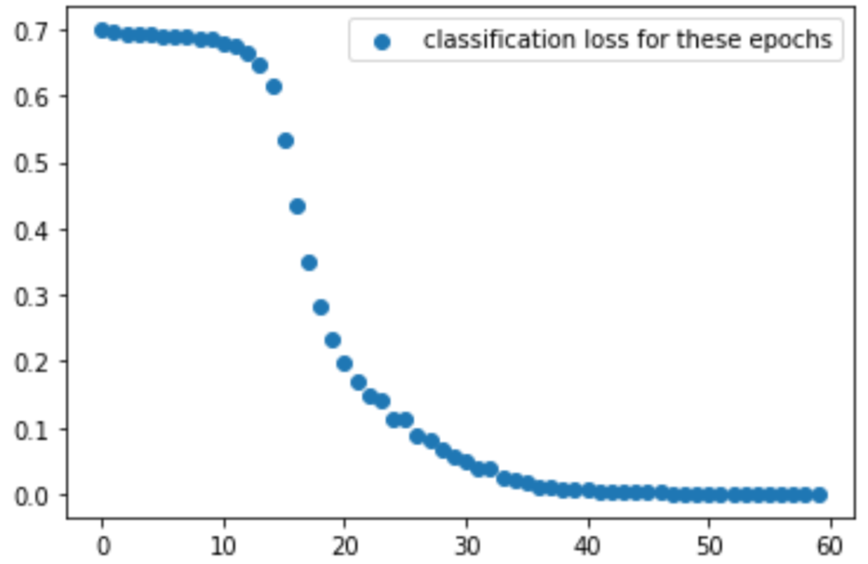
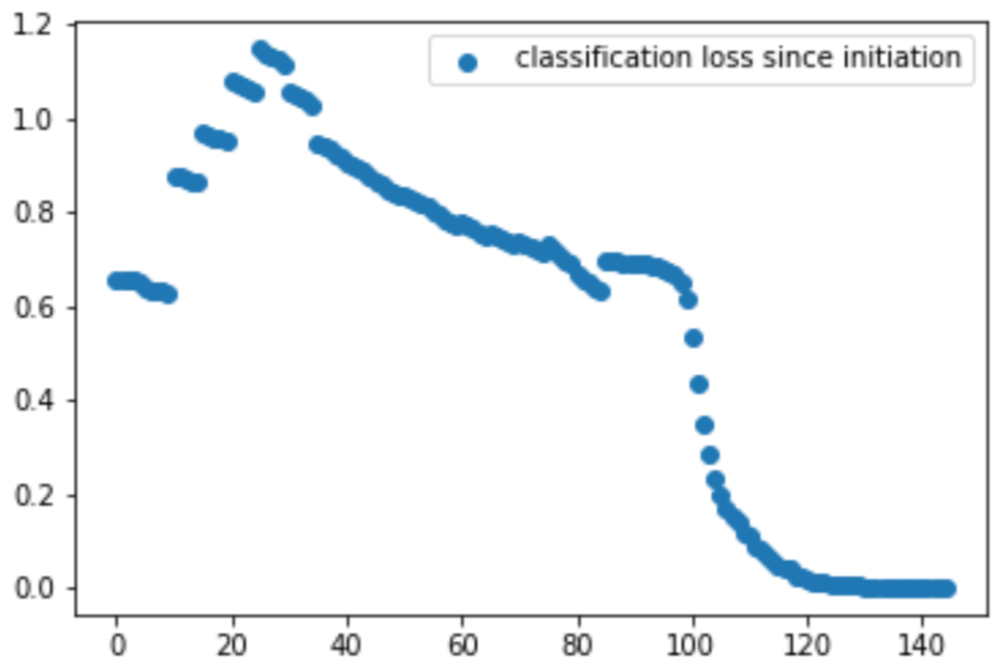
Train set size : 2728 Positive examples: 1307
Current average loss respectively: 0.23258
0.00732

Slide 8
Overall classification loss on train set for current batch: 0.0004671
Size of DFA generated : 1, 2, 4, 5
Accuracy on train set: 47.91%
Accuracy on Test set:
Accuracy | Test data size
RNN score against target on test set 100% | 2728
Extracted DFA score against RNN on test set 100% | 2728
Extracted DFA score against target on RNN’s test set 100% | 2728

Slide 9
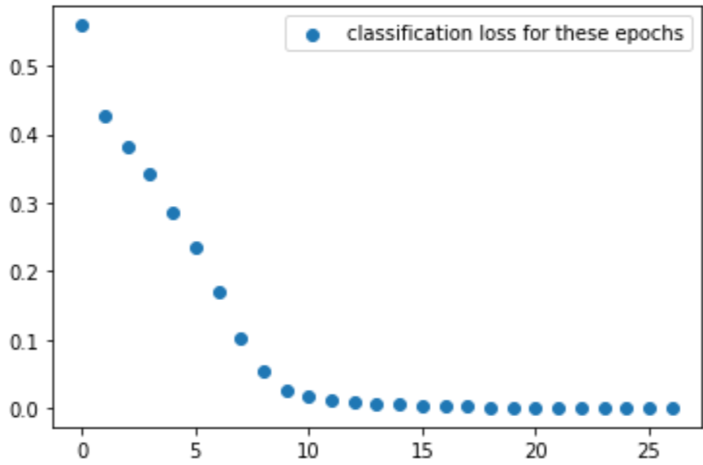
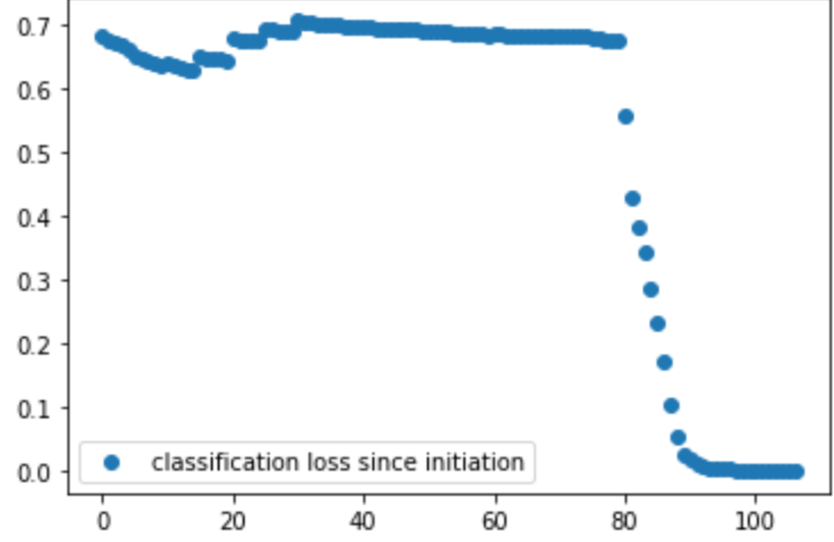
Train set size : 3405 Positive examples: 1741
Current average loss respectively: 0.0012084

Slide 10
Overall classification loss on train set for current batch: 0.00045653
Size of DFA generated : 3, 4, 5 , 6
Accuracy on train set: 51.13%
Accuracy on Test set:
Accuracy | Test data size
RNN score against target on test set 100% | 3405
Extracted DFA score against RNN on test set 100% | 3405
Extracted DFA score against target on RNN’s test set 100% | 3405

