Slide 1
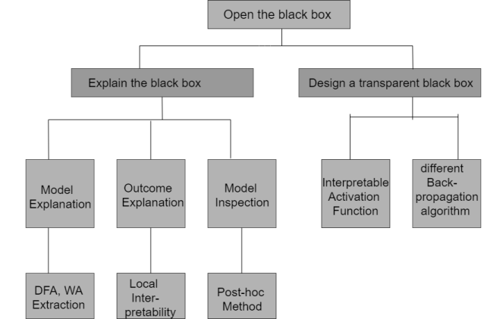
Modelling Automata by Sequential Neural Network:
Deep learning model performs interpolation on training dataset using its internal representation.
Internal representation is extracted in the form of automata.

Slide 2
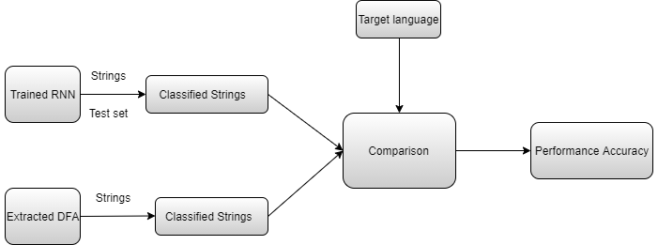
State space of a deep learning model is divided into clusters to build states in automata to trace the state dynamics of the model.
RNN is trained with seven rules of tomita grammar.
Extracted DFA is also trained with the same dataset.
A target is predefined and both RNN and DFA has to classify string according the target.
The correctness of string classification is measured as accuracy in both the cases.
If result doesn’t differ much then we can say extracted DFA can be called as equivalent to the RNN.

Slide 3
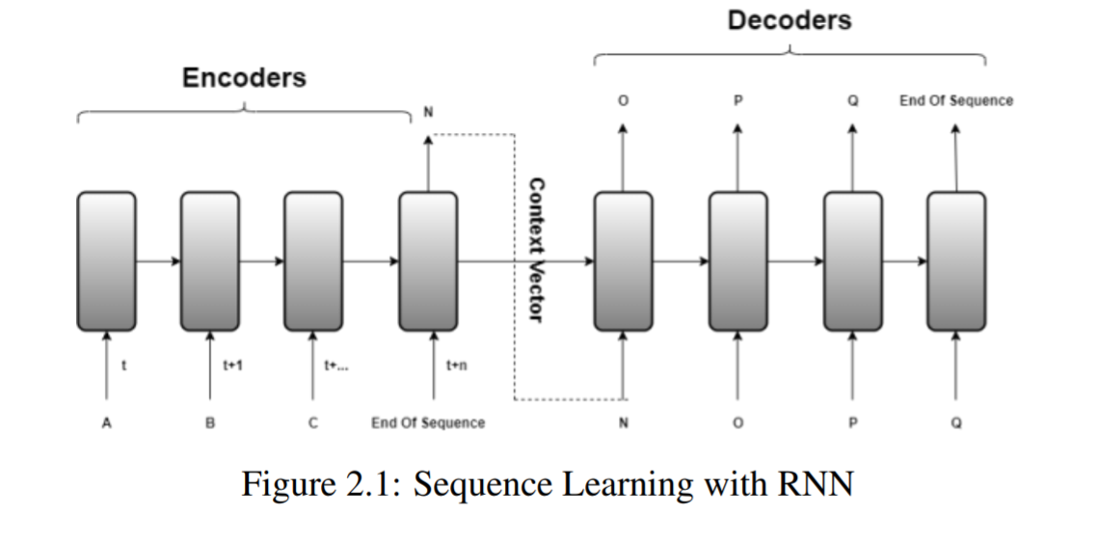

Slide 4
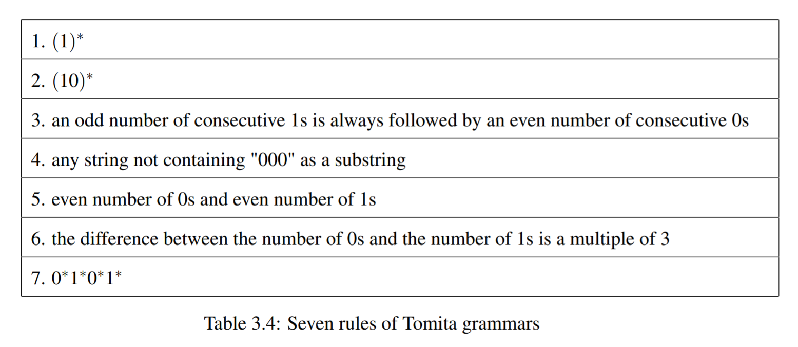

Slide 5
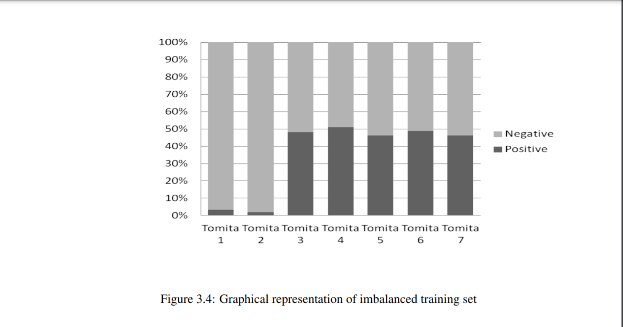

Slide 6
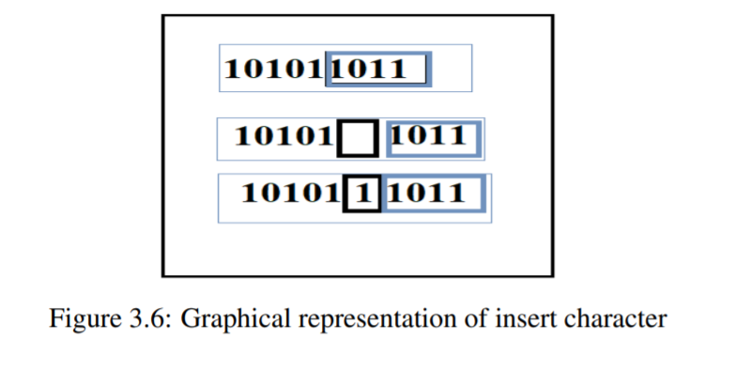
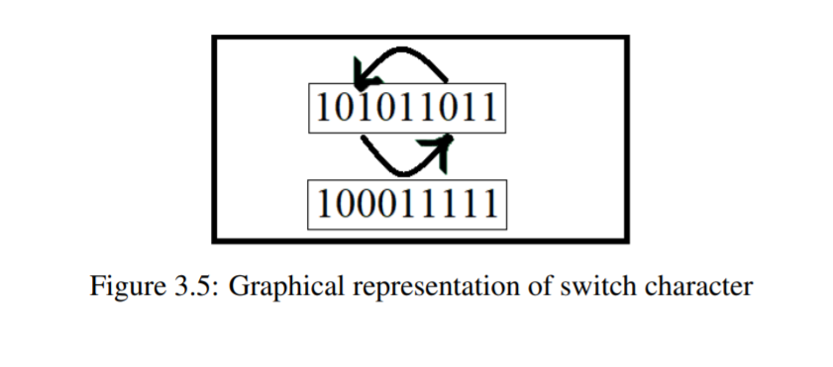
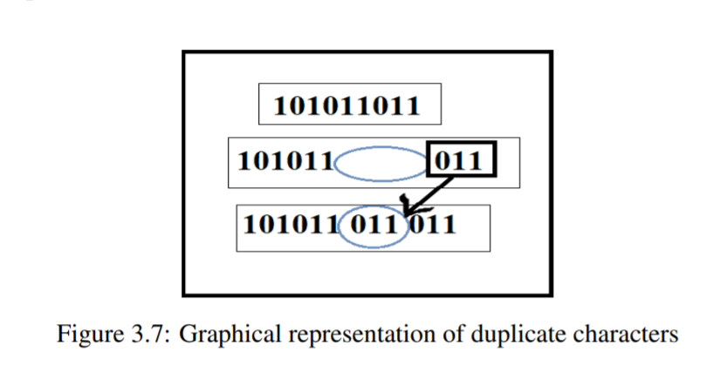
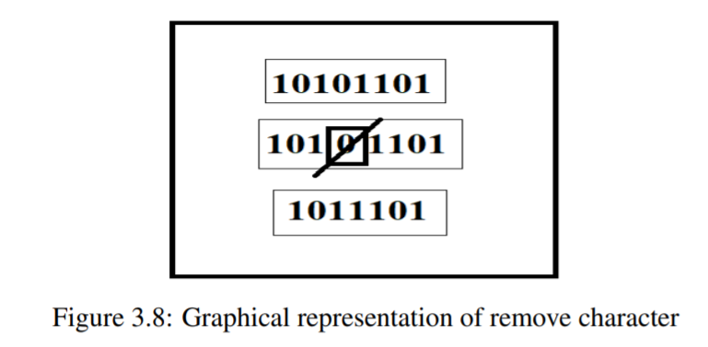
Modifying Data set:

Slide 7
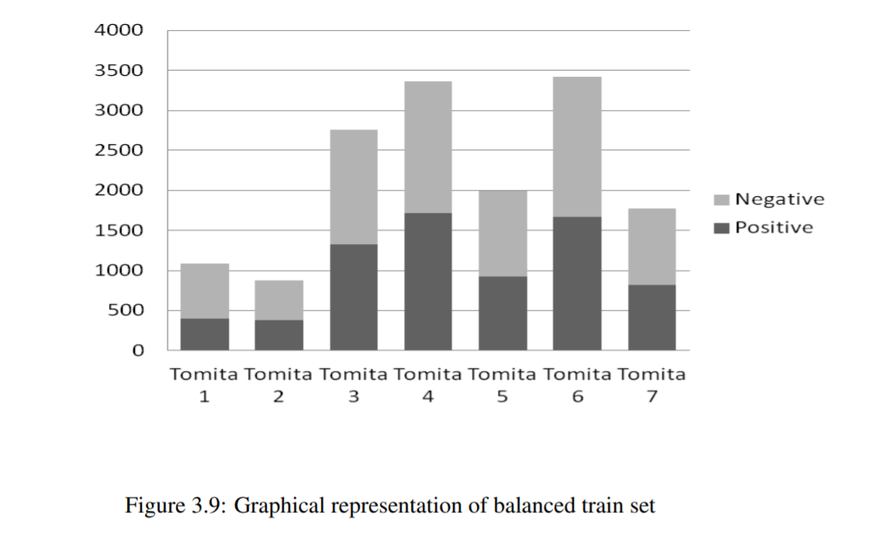

Slide 8
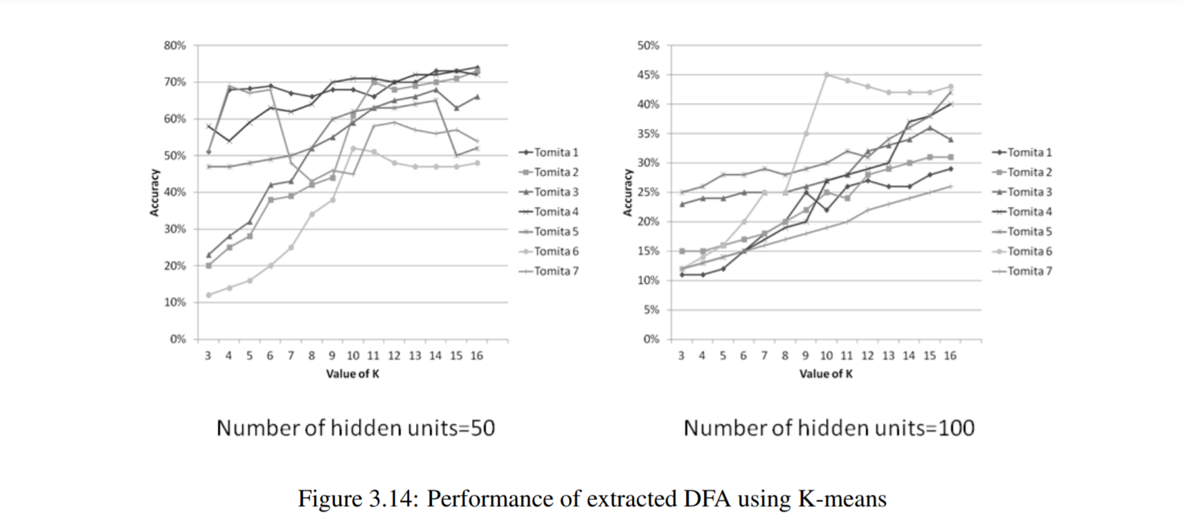

Slide 9
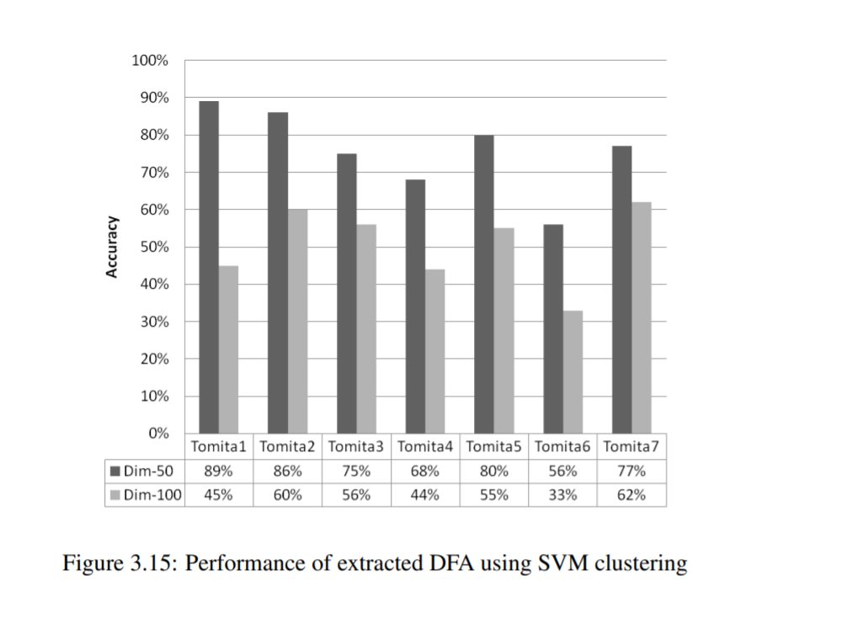

Slide 10
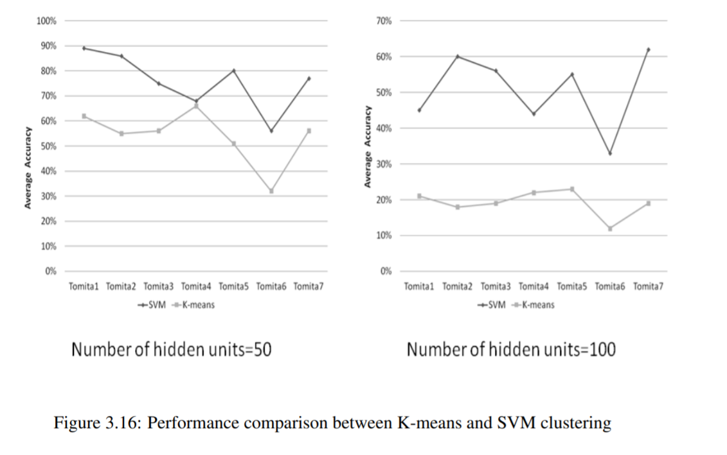

Slide 11
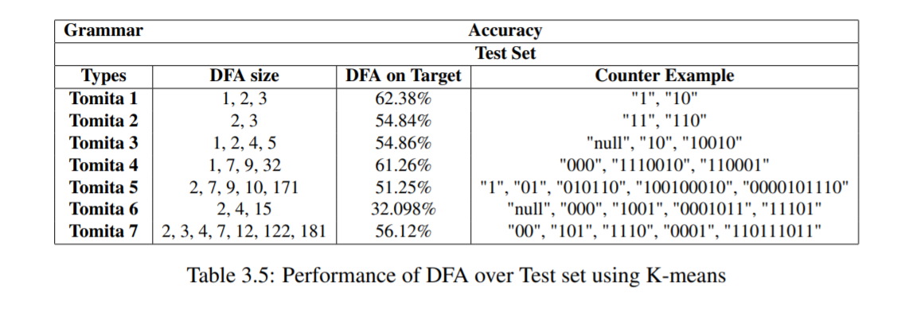
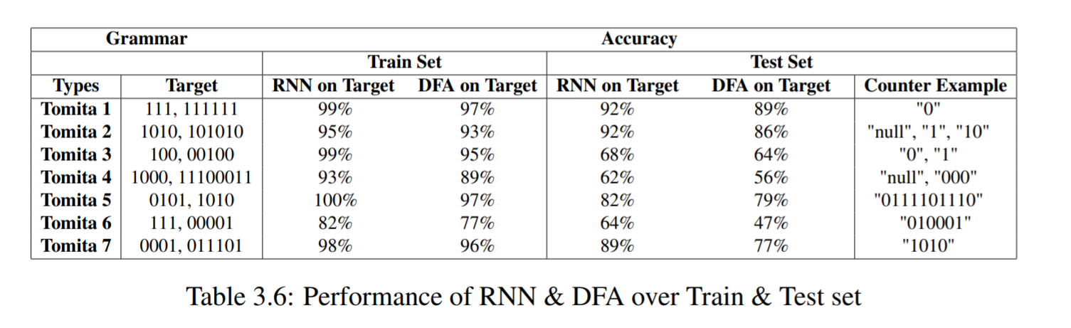

Slide 12
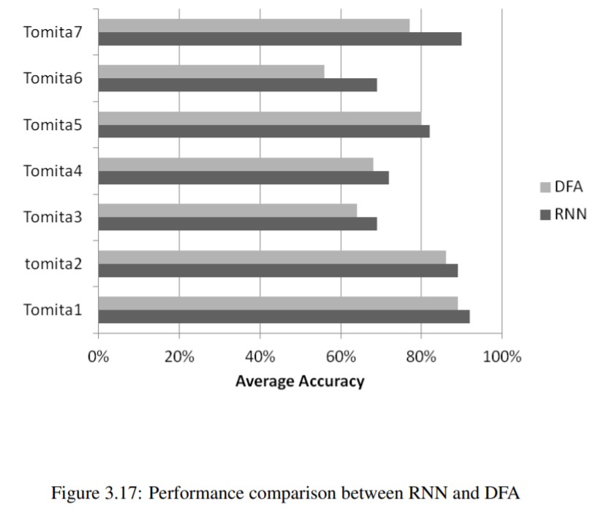

Slide 13
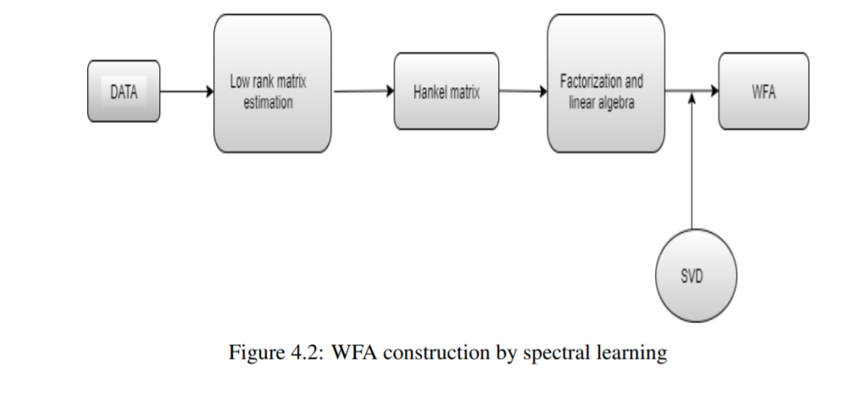
Extraction of WFA from Sequential Data

Slide 14
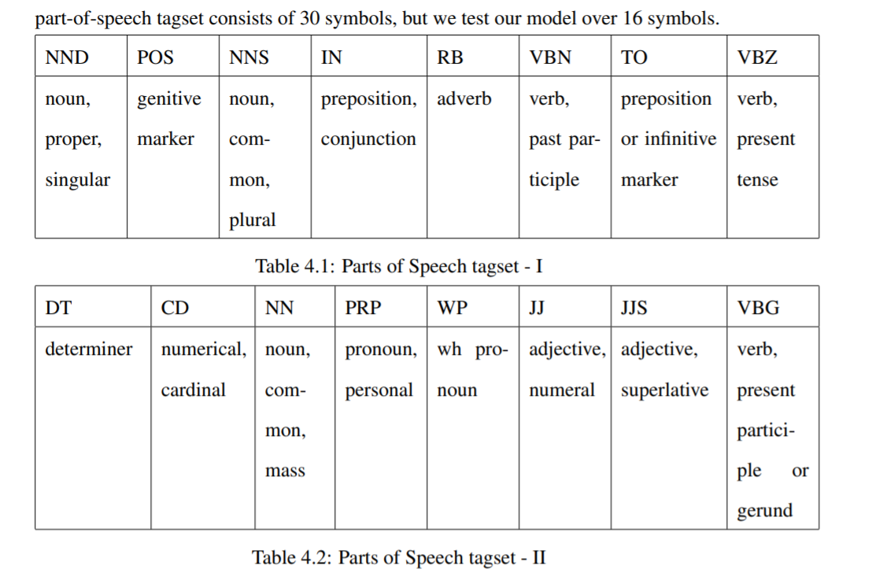
Parts-of-speech tagged dataset for tokenization

Slide 15
