Slide 1
IBM – Edunet project on - Data analytics

Slide 2
INDEX
Name : Dipankar kumar
Stu id : STU64233cb34f6161680030899
Mail id : dipankar543kumar@gmail.com
Internship Domain : Data Analytics
Internship start date : 12-06-2023
Internship end date : 24-07-2023

Slide 3
Analysis of superstore database
Introduction​
Working with dataset
Creating loss dataframe
Visualizations
Overall Analysis

Slide 4
Introduction
In this dataset, we have many features like ship mode, Segment, country, City, State, Postal code, Region, category, sub-category, sales, Quantity, discount, and the Dependent variable is profit. The remaining are independent variables.

Slide 5
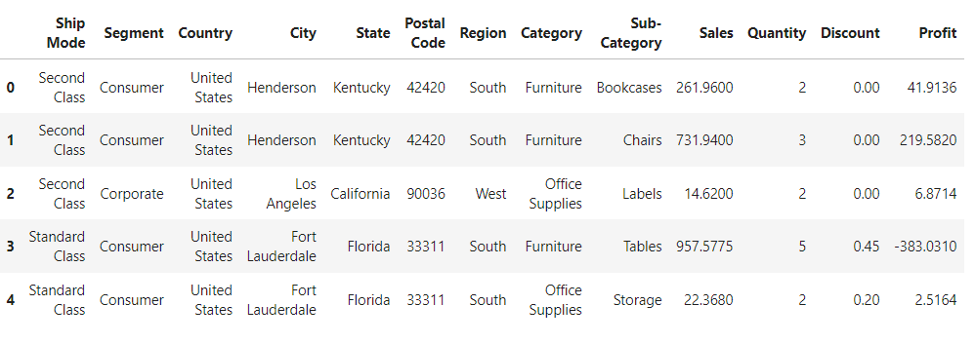
Working with dataset

Slide 6
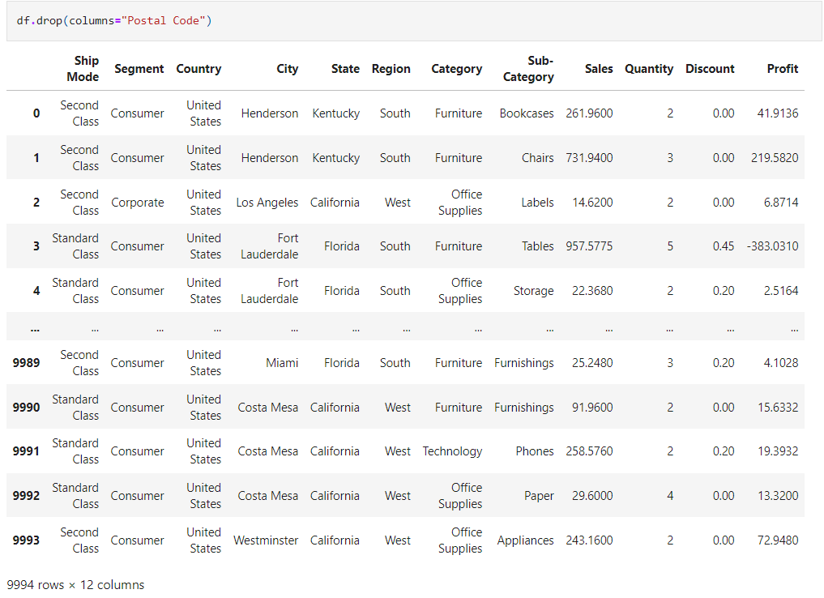

Slide 7
Creating loss dataframe
Now let’s divide the overall data to draw some more accurate conclusions. Create a new Dataframe, where profit is negative which means loss, and concentrate on these areas to improve.

Slide 8
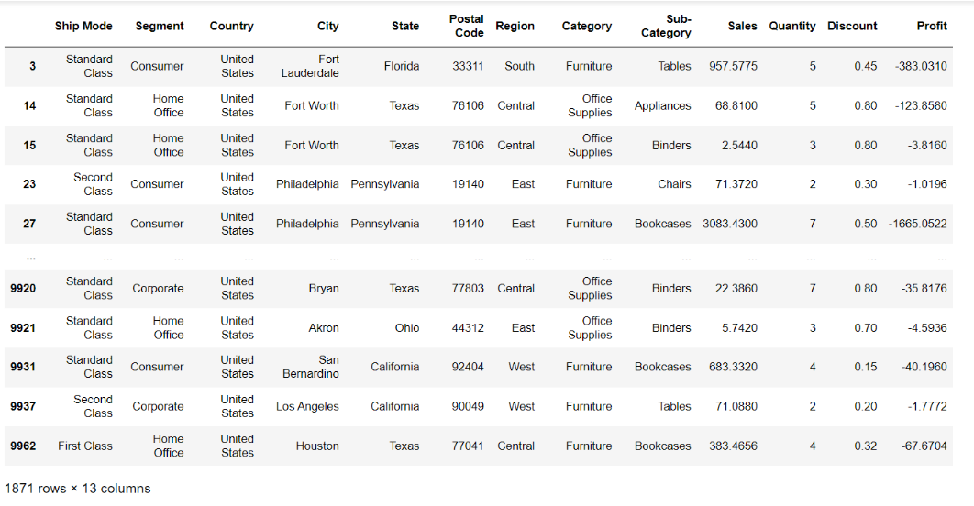
loss_df=superstore_df[superstore_df['Profit'] < 0]

Slide 9
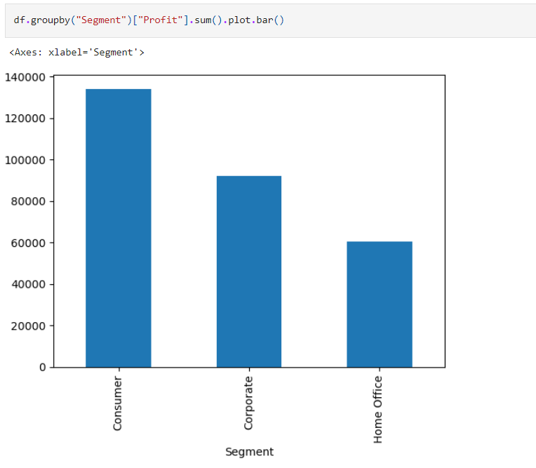
Visualizations

Slide 10
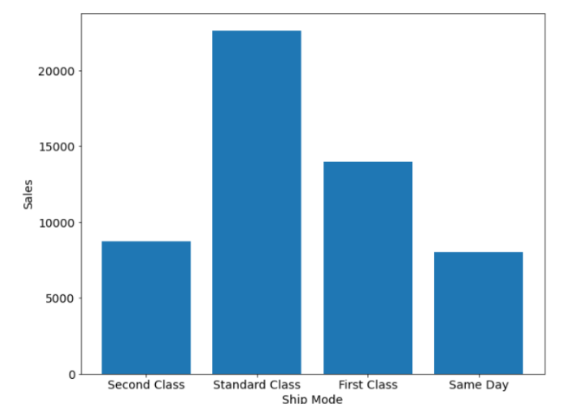
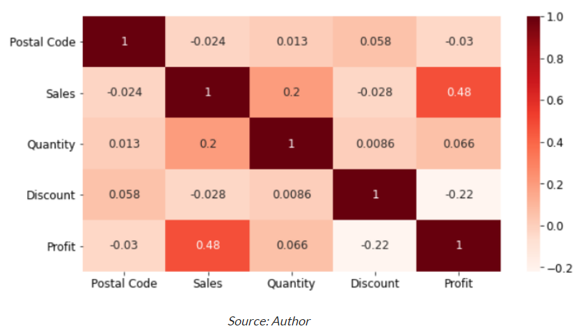

Slide 11
Overall analysis
The main reason which leads to loss is Discount as if some areas lead to loss due to more discounts, and some areas lead to fewer sales due to fewer discounts, hence it needs to be improved.
It is better to give more discounts during festival seasons, additionally, that will result in more sales.
The Home office segment needs better improvement.
Some cities have fewer sales, lack of awareness can be the reason for this, hence advertising in those cities might help in more sales.

Slide 12
Reference links
Github Link →
DataSet →

Slide 13
THANK YOU

