Slide 1
Real-time Monitoring and Analytics of Cars
Team – BitLords
Abhijeet Das
Dipankar Bahirvani

Slide 2

Use Case
Extract signals from the car.
Real-time Visualization and Alarming.
Platform for Data Analysis.

Slide 3

Tech Stack
Data
  Patch and Get API of signals every 1 second.
Technologies
  Kafka.
  Influx DB.
  Grafana.
  Hadoop.
  Python and R.

Slide 4
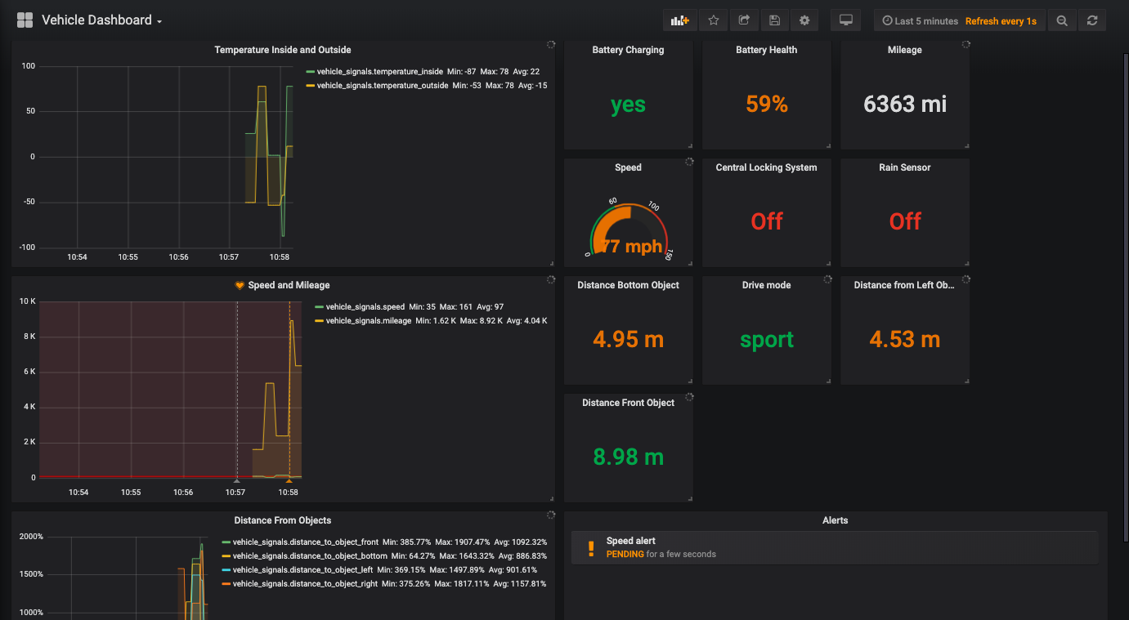
Dashboard

Slide 5
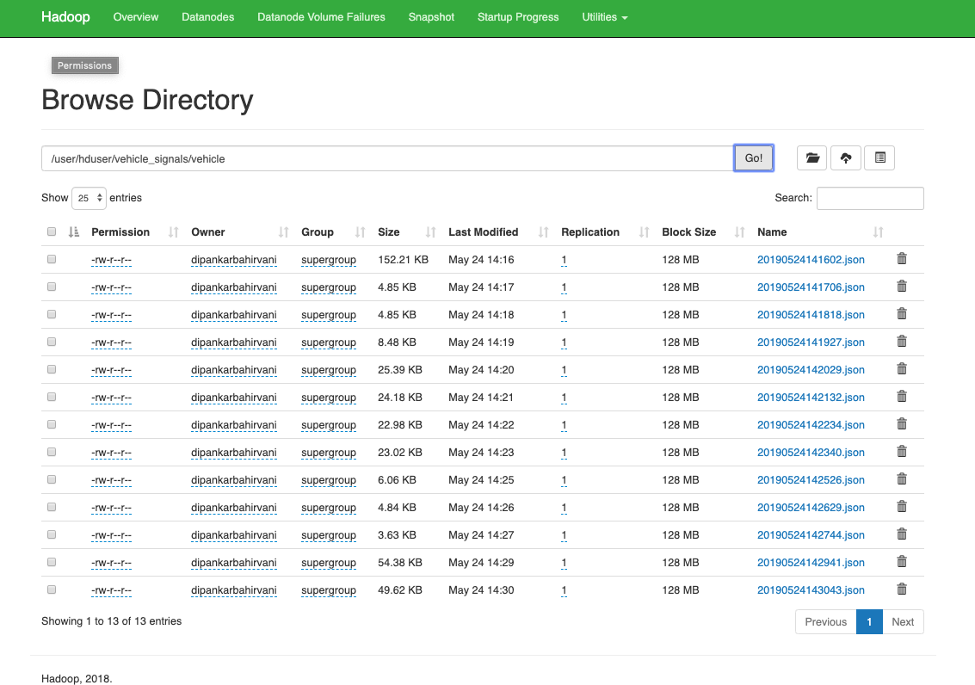
Hadoop Data Lake

Slide 6
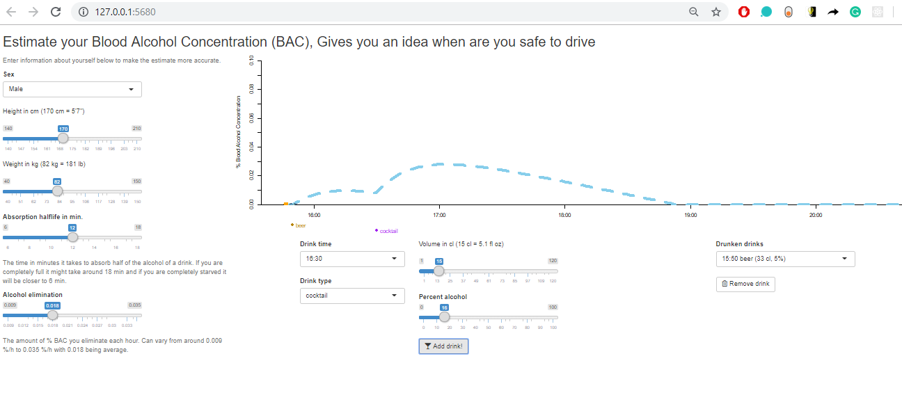
Data Analytics
Say NO to Drunken Driving

Slide 7
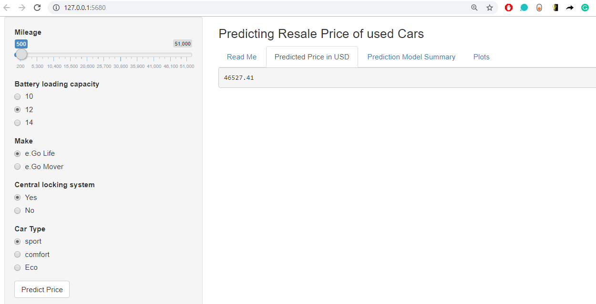
Data Analytics
Resale Cost Prediction

Slide 8
More possibilities
Prevention of Car accidents using Machine Learning.
Alarming Rash driving scenario.
Electric Vehicles charging optimizations.

Slide 9
THANK YOU

