Slide 1





Consumer
RPC#4
Goods:Provide
Insights–Adhoc RequestAnalyze
Created & Presented by Dipankar Raman

Slide 2

Agenda
01
Project Overview
02
Purpose & Responsibility
Explain company overview, Business Model &
Discuss the goal of this proect, what is the
Problem Statement
Role & Tasks are given
03
Data Processing
04
Result & Insights
Describe the Data Overview and show Data
Present the Query output as Results and
Model, implemented for this project
highlight the Insights for decesion-making

Slide 3

01
Project Overview

Slide 4

About Company
Atliq Hardware is a leading computer hardware company in Indiawith operations in other countries. They focus on making high-quality products but want to improve their use of data to make faster, smarter decisions.

Slide 5





Business Model
Sell Products
Atliq
Customer
Consumer
Platform
Channel
Brick &
Retailer
Product
Mortar
Division
Segment
Category
Variant
E-
Direct
Commerce
P & A
N & S
PC
Distributor

Slide 6


Problem Statement
Atliq’s management noticed they lack the insights needed for quick decision-making. To fix this, they plan to hire junior data analysts who are skilled in both technology and communication.
Tony Sharma, the Data Analytics Director, has set up a SQL
challenge to find the right candidates.

Slide 7

02
Purpose & Responsibility

Slide 8
Goal
The goal of this project is to provide clear and accurate insights for 10 specific
business questions from the ad hoc requests. These insights will be used by Executive as top management to improve decision-making.
Role
My role is to act as a Junior Data Analyst who is responsible
for analyzing business data using SQL and presenting actionableinsights to
help top-level management make informed decisions.
Task
Run SQL queries to answer the 10 ad hoc business requests.
Analyze the data and identify key insights that respond to the needs of the business.
Create a presentation that clearly shows these insights in a way that top-level
management can easily understand and use for decision-making.

Slide 9

03
Data Processing

Slide 10
Dataset Overview
A comprehensive overview of the tables found in the Atliq Hardware database.
dim_customer
contains customer-related data
dim_product
contains product-related data
fact_gross_price
contains gross price information for each product
fact_manufacturing_cost
fact_pre_invoice_deducti
contains the cost incurred in the production of each product
contains pre-invoice deductions information for each product
ons
fact_sales_monthly
contains monthly sales data for each product.
Data are available for Fiscal Year 2023 and 2024. At Atliq Hardware fiscal
year starts from September month of calendar year.
You can checkdetailed info:
Github Project Documenttion

Slide 11
Data Model

Slide 12

04
Result & Insights

Slide 13
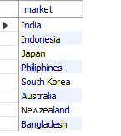
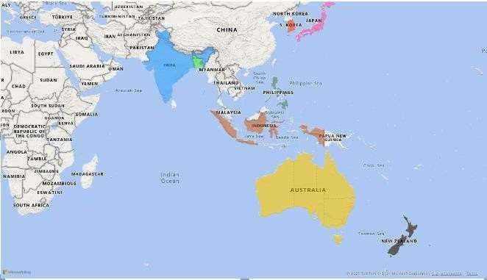
Request 1
Provide the list of markets in which customer Atliq Exclusive operates its business in the APAC region.
Insight
Broad Market Presence in APAC
Opportunities in Emerging
Markets
Potential for Market-Specific Strategies

Slide 14
Request 2
What is the percentage of unique product increase in 2024 vs. 2023?
Product Count
Insight
36.33 %
Atliq's product count grew by 36.33% from 245 in
FY 2023 to 334 in FY 2021.
indicating product expansion and potential market growth.
2020
2021

Slide 15
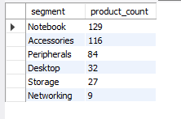
Request 3
Provide a report with all the unique product counts for each segment.
Product Count
Insight
Notebook
Prioritize Notebooks and Accessories, as they
Accessories
have the most products and likelythe most
Peripherals
customer demand.
Desktop
Consider adding more products in Storage and
Networking to capture more of the market in
Storage
Networking
these areas.

Slide 16
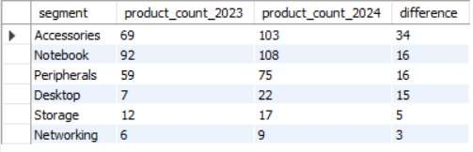
Request 4
Which segment had the most increase in unique products in 2024 vs 2023?
2023 2024 difference
Accessories Notebook Peripherals
Desktop
Storage
Networking
Insight
Strong growth in Accessories(+34)and consistent demand in Notebooks and Peripherals (+16 each) highlight these as high-
potential segments for further investment and development.
Desktop’s growth (+15) suggests rising interest, worth exploring. Meanwhile, reassess Storage and Networking for possible
optimization or cost-saving opportunities.

Slide 17



Request 5
Get the products that have the highest and lowest manufacturing costs
Insight
Consider evaluating high-cost products like AQ HOME Al in1 Gen 2 for possible cost-saving measures in manufacturing.
With a significant range in manufacturing costs, assess pricing strategies to ensure profitability across the product lineup.

Slide 18
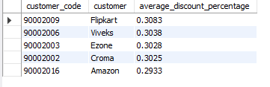
Request 6
Generate a report which contains the top 5 customers who received an average high Pre Invoice
Discount % for the fiscal year 2024 and in the Indian market
Avg Discount %
Flipkart Viveks Ezone Croma Amazon
Insight
Major customers like Flipkart, Viveks, and Ezone receive discounts over 30%. While this boostssales volume, we need to ensure it
doesn'thurt profitmargins too much.
Adjust discounts by linking them to sales performance or long-term contractswith top customers. This approach can help increase revenue while managing discounts better, especially for big clients like Amazon and Croma.

Slide 19
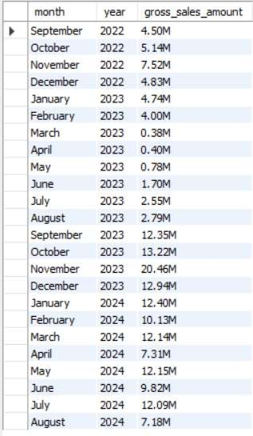
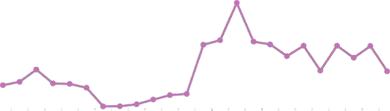
Request 7
Get the complete report of the Gross sales amount
for the customer Atliq Exclusive for each month.
Gross Sales
Linear (Gross Sales)
Sep-22
Oct-22
Nov-22 Dec-22 Jan-23 Feb-23 Mar-23 Apr-23 May-23 Jun-23 Jul-23 Aug-23 Sep-23 Oct-23 Nov-23 Dec-23 Jan-24 Feb-24 Mar-24 Apr-24 May-24 Jun-24 Jul-24 Aug-24
Insight
Atliq Exclusive achieved its peak sales in November 2023, with March 2023 marking
the lowest point in sales.
Nevertheless, there is a positive outlook as sales have steadily recovered post- pandemic, demonstrating resilience and surpassing the levels observed in 2023.
/dipankarraman

Slide 20
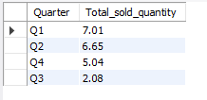
Request 8
In which quarter of 2023, got the maximum total sold quantity?
Sold Qty
Q1
Q2
Q3
Q4
Insight
 | Q1 | Q2 | Q3 | Q4
Month | September | December | March | June
 | October | January | April | July
 | November | Februay | May | August
The Q1 achieved the highest total sold quantity at 7.01 mil ion units, indicating strong sales performance at the beginning of the year.
Sales decreased in Q2, Q4, and dropped significantly in Q3, suggesting potentialchal enges like Economic uncertainty, Market Saturation, Retail and Distribution Chal enges affecting sales as the year progressed .This information is valuable for planning inventory and marketing strategies to align with seasonal demand.

Slide 21

Request 9
Which channel helped to bring more gross sales in the fiscal year 2024 and the percentage of contribution?
Retailer
Direct
Distributor
Insight
Theretailer channel generated $1,219.08 mil ion, contributing 73.23% of total gross sales, highlighting its crucial role in revenue
generation.
Strengthen relationships with retailers for better promotions while exploring ways to enhance sales through direct and distributor channels to improve overall contributions.

Slide 22
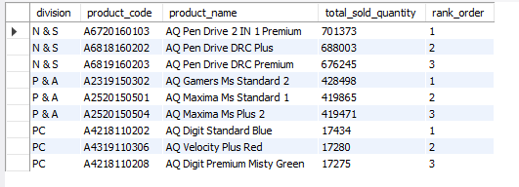
Request 10
Get the Top 3 products in each division that have a high total sold quantity in the fiscal year 2024?

Slide 23
Insights
N & S
P & A
PC
701.4K
428.5K
17434
688.0K
419.9K
419.5K
17280
17275
676.2K
AQ Pen Drive 2 AQ Pen Drive
AQ Pen Drive DRC Premium
AQ Digit Standard Blue
AQ Velocity Plus Red
AQ Digit
IN 1 Premium DRC Plus
AQ Gamers Ms Standard 2
AQ Maxima Ms
AQ Maxima Ms Plus 2
Premium Misty
Standard 1
Green
The top-sel ing products are pen drives and gaming mice, indicating a high consumer preference in these categories. This suggests opportunities to expand product offerings and marketing efforts in these areas.
Low sales in the PC division highlight the need for more variety and targeted marketing to meet consumer demand.

Slide 24

RECOMMENDATIONS FOR ENHANCING ATLIQ’S SALES PERFORMANCE
Ensure top-notch customer service to foster lasting relationships.
Deploy a robust marketing strategy across diverse channels.
Cultivate a distinctive brand identity and convey your unique value proposition.
Allocate resources to train the sales team for enhanced effectiveness.
Provide competitive pricing and appealing promotional offers.
Expand and improve product offerings to align with market demands.
Regularly collect customer feedback for continuous improvement.

Slide 25
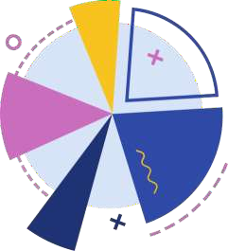

Thank You!
Feel free to share your feedback in the comment section
/dipankarraman
/dipankarraman
Data Analysis – SQL Project

