Slide 1
Review Spam Detection using supervised learning classifier
“Machine intelligence is the last invention that humanity will ever need to make.” ~Nick Bostrom

Slide 2
Review Spam Detection using supervised learning classifier
Student name- Dipankar Modak
Details of guide
Dr. Krishnamoorthi Makkithaya
Professor
Department of Computer Science

Slide 3
Introduction
Nowadays, more and more individuals and organizations have become accustomed to
consulting user generated reviews before
making purchases or online bookings.
Considering great commercial benefits, merchants, however, have tried to hire people to write undeserving positive reviews to promote their own products or services, and meanwhile to post malicious negative reviews to defame those of their competitors

Slide 4
Spam Filtering Algorithms
Company uses machine learning to filter out spam reviews.
Example Amazon uses Fake spot and Review meta data to detect spam reviews.
Still it is difficult to accurate predict spam reviews from the genuine .

Slide 5
Statistics related to Online reviews
The UK’s Competition and Markets Authority (CMA) estimates fake reviews potentially influence £23bn of UK customer spending each year.
61% of electronics reviews on Amazon are fake.
55,000 fake reviews are generated on Facebook per month.
One in seven Trip Advisor reviews could be fake

Slide 6
Literature review
The first method for review spam detection was proposed in 2007 by Jindal and Liu. The data was taken from amazon.com and included 5.18 million reviews and 2.14 million reviewers.
Review spam has been categorized into three groups, proposed by Dixit
i.e-Untruthful reviews,non reviews and reviews on brand.
Fei observed that using single word features alone proved inadequate for
supervised learning when learners were trained using synthetic fake reviews,
since the features being created were not present in real-world fake reviews.

Slide 7
Literature review
Li analyzed a range of disappointing indicators for detecting fake reviews. They also found that the combination of several features such as Bag of words and POS allows for greater accuracy in detection.
The techniques supervised like Liu used the Bayesian approach and laid out a clustering problem with opinion spam sensing. Mukherjee although used the Support Vector Machine (SVM) as a classification.

Slide 8
Objective
Extraction of useful review characteristics from the text.
Application of suitable machine learning algorithm on the extracted features to detect spam reviews.
Increase the accuracy of the machine learning model.

Slide 9
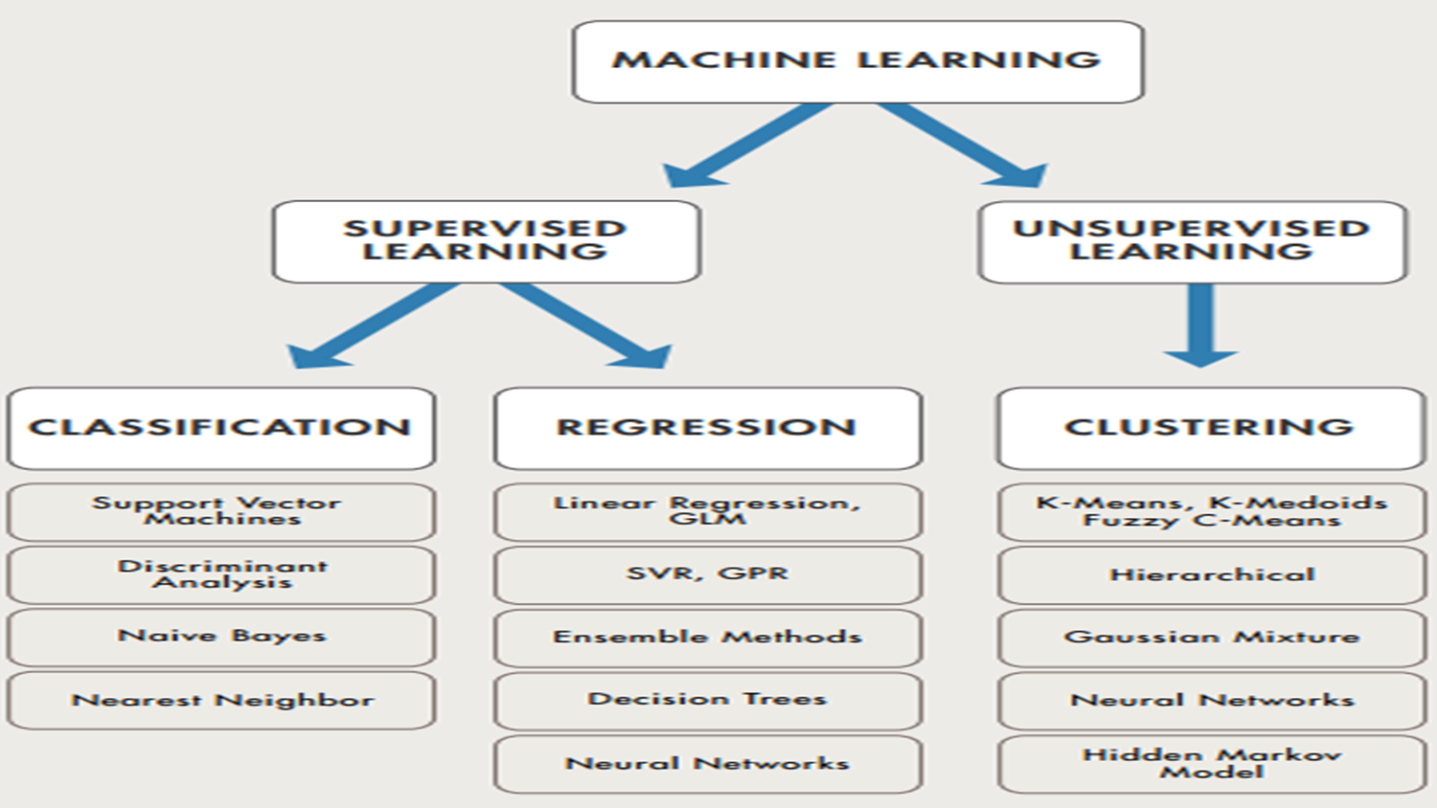
Types of Machine learning algorithm

Slide 10
Project Dataset
This dataset contains:
400 truthful positive reviews from Trip Advisor
400 deceptive positive reviews from Mechanical Turk
400 truthful negative reviews from Expedia, Hotels.com, Orbitz, Priceline, Trip Advisor and Yelp .
400 deceptive negative reviews from Mechanical Turk.

Slide 11
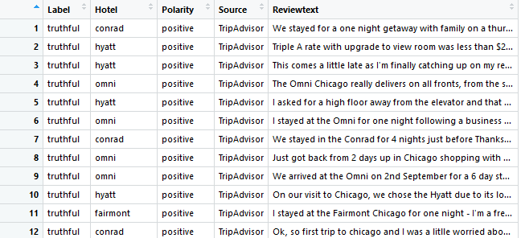
Screenshot of the data

Slide 12
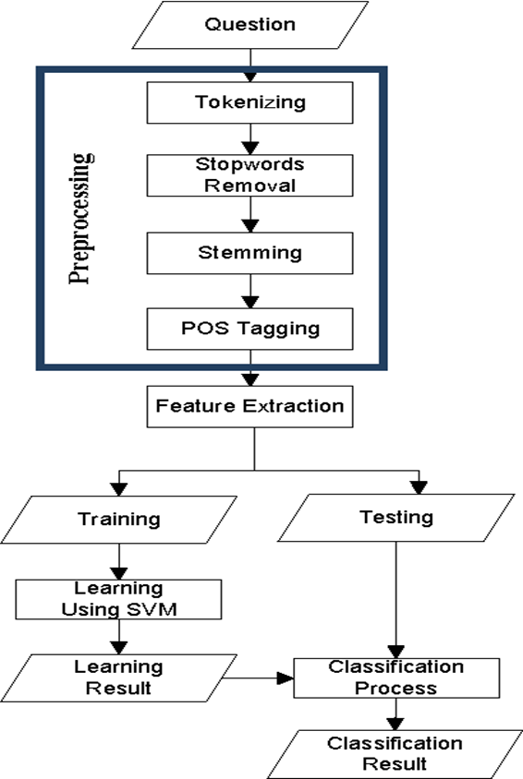
Methodology

Slide 13
Data Preprocessing

Slide 14
Data Preprocessing
Stop Words Removal
Stemming
Tokenization
Parts of speech
Removal of Number Punctuation

Slide 15
Features Extraction

Slide 16
Bag of Words
A bag-of-words model, or BoW for short, is a way of extracting features from text for use in modeling, such as with machine learning algorithms.
A bag-of-words is a representation of text that describes the occurrence of words within a document.

Slide 17
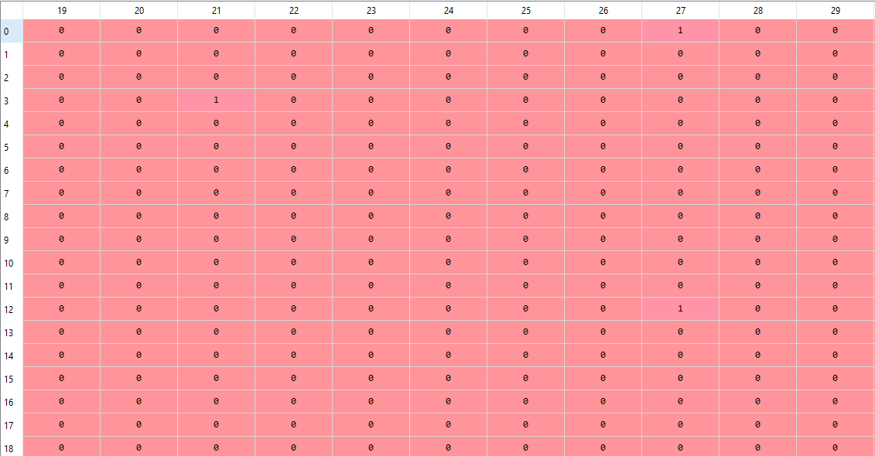
Bag of words model

Slide 18
Term Frequency Inverse Document Frequency
A TFIDF model provides information about a important a word is to a document in a corpus.
The TFIDF is the product of two statistics. Term frequency and inverse document frequency
Term frequency provides the number of times.
a term occurs in a document.
Inverse document frequency is a measure of how much
information the word provides i.e if its is common or
rare across all documents

Slide 19
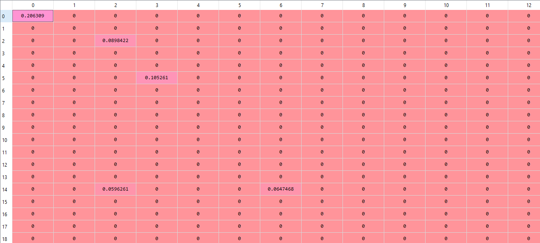
TFIDF model

Slide 20
Parts of speech count
According to research from Cornell University, online reviews that frequently use “I” and “me” are more likely to be fake than those that don’t — possibly because when people are lying they try to make themselves sound credible by using personal pronouns. Additionally, “deceivers use more verbs and truth-tellers use more nouns,” the research found.
In this model each parts of speech is represented as feature. Number of occurrences of each parts of speech in the document is recorded as the Feature vector.

Slide 21
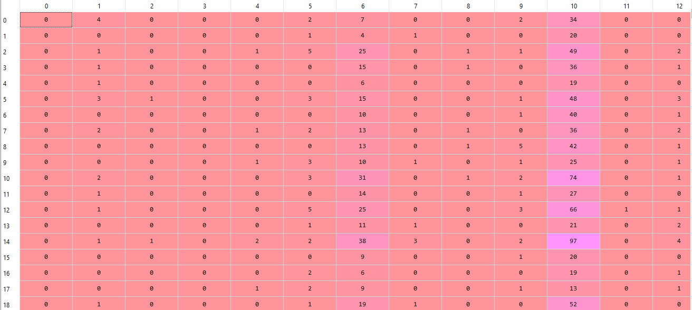
Parts of speech count

Slide 22
Review length
According to recent studies ,80% of spammers have reviews no longer than 135 words while more than 92% of reliable reviewers have review length of greater than 200 words.
Spammers don’t often have any personal experience to share unlike
genuine users. Therefore it is highly likely that their review length will
be short.

Slide 23
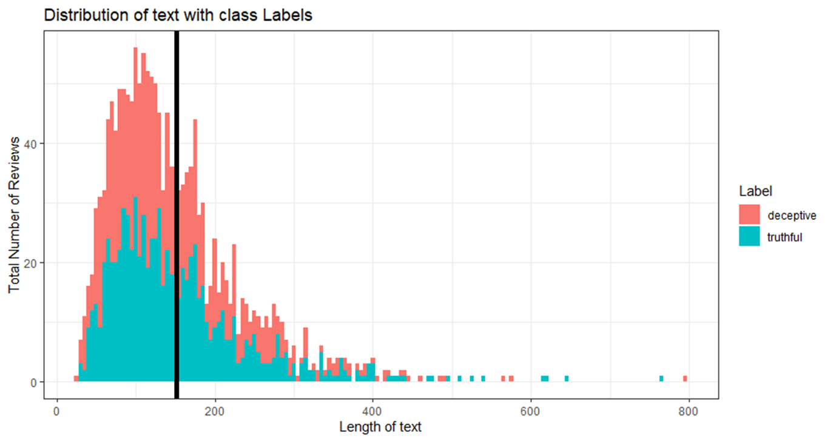

Slide 24
Sentiment polarity
It quite possible that too much positive or negative sentiment are likely to be non genuine and there must some hidden agenda behind it.
Python has a library function called Text Blob which gives the sentiment polarity of a review based on number of positive or negative words,
The range of polarity is from [-1,1] where -1 is highly negative sentiment and 1 is highly positive sentiment. 0 being neutral.

Slide 25
Edit Distance
Edit distance is a way to quantify how dissimilar two strings are are to one another by counting the minimum number of operations required to transform one string into the other. Basically it is minimum number of changes a given string has to be done to convert into a target string.
There are 3 operations in Edit Distance and each got an equal count (Removal,Insertion,Replacement)
This distance is also called Levenshtein Distance. Google uses it in recognizing spam emails.

Slide 26
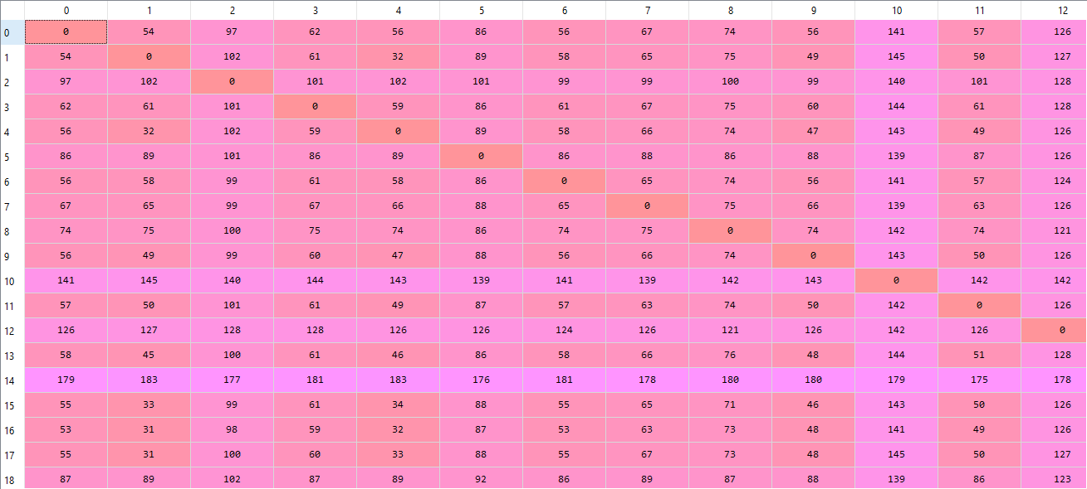
Edit Distance

Slide 27
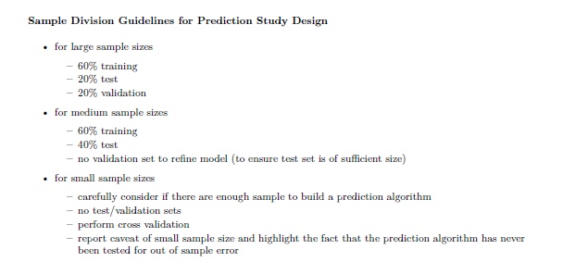
Splitting of Data into training and testing

Slide 28
Naïve Bayes algorithm
Naive Bayes classifier assumes that the features are independent of each other.
It is a generative learning model. It models the distribution of each class
Mathematically it is represented as

Slide 29

Logistic Regression
It is a discriminative learning model. It models the decision boundary between each class.
It used sigmoid function as it output.
The error of the model in the training set can be represented as cost function. The main aim should be to reduce the cost function and get the best parameters for our model.
The cost function is given by

Slide 30
Dimension Reduction
Not all the features in the training set is informative and the noise might reduce the overall performance of the model and increase processing time.
Therefore to get the most information from all the features certain dimensionality reduction techniques are used-Principal Component Analysis(PCA) or Linear Discriminant Analysis(LDA).This helps in reducing the noise and improves the model performance.

Slide 31
Results and Analysis

Slide 32
BOW model
Naïve Bayes
Logistic Regression

Slide 33
Bow+Tfidf model
Naïve Bayes
Logistic Regression

Slide 34
Bow+Tfidf+POS model
Naïve Bayes
Logistic Regression

Slide 35
Bow+Tfidf+POS+RL model
Naïve Bayes
Logistic Regression

Slide 36
Bow+Tfidf+POS+RL+SP model
Naïve Bayes
Logistic Regression

Slide 37
Bow+Tfidf+POS+RL+SP+ED model
Naïve Bayes
Logistic Regression

Slide 38
Model performance of Naïve Bayes
Accuracy of classifier increases with the training size.
Sensitivity first increase then decrease with increase in training size
Specificity first decreases then increase with increase in training features.

Slide 39
Model performance of Logistic Regression
Accuracy follows a wavy trajectory
Sensitivity fluctuates with the training size
Specificity decreases and then remains constant with training size

Slide 40
Model performance comparison
Since Bow already had more than 2000 features, Logistic Regression
performed better since its accuracy is higher when the training
size is large. Naïve Bayes works well on small dataset.

Slide 41
Linear Discriminant Analysis
Linear discriminant analysis is a dimension reduction technique where a new feature space is found out in order to maximize the class seperability in the data.
Accuracy of the model increases significantly to 98%
Sensitivity and Specificity are also 99 and 98 %

Slide 42
Conclusion
Logistic Regression learns from the training data taking into account all the possible correlations between features. While in Naïve Bayes there is a perquisite assumption that all the features act independently to each other. Therefore Logistic Regression is more prone to overfitting the data than Naïve Bayes. This is the reason why there is higher accuracy in case of the former than the latter.
TFIDF+BOW+POS+RL feature combination generates best model with Naïve Bayes algorithm .TFIDF+BOW feature combination generates best model with Logistic Regression.
Though accuracy should increase with increase in features, we have seen that adding sentiment polarity on both Naïve Bayes and Logistic regression algorithms reduced the model performance. It is a noise and doesn’t provide any meaningful information to our classifier irrespective of the classifier.
Dimension reduction such as LDA can be applied to generate a 1D feature vector from a large matrix. This generated feature can later be used for training models with Logistic Regression and Naïve Bayes thereby increasing the accuracy significantly.

Slide 43
References
Radovanović, Draško and Božo Krstajić. “Review spam detection using machine learning.” 2018 23rd International Scientific-Professional Conference on Information Technology (IT) (2018): 1-4.
Barbado, Rodrigo et al. “A framework for fake review detection in online consumer electronics retailers.” Inf. Process. Manag. 56 (2019): 1234-1244.
International Journal of Innovative Technology and Exploring Engineering (IJITEE) ISSN: 2278-3075, Volume-8 Issue-4, February 2019
N. Jindal and B. Liu. Analysing and Detecting Review Spam.ICDM2007.
Sun, Chengai and Du, Qiaolin and Tian, Gang, Exploiting product
related review features for fake review detection,
MathematicalProblems in Engineering, (2016).

