Slide 1
CSE431
Individual Submission-2
Counterfactually Augmented Data and Unintended Bias: The Case of Sexism and Hate Speech Detection
Name- Dipannita Baidya
ID-23341069
Section-2
Team-9
Student Tutor (ST) : Ehsanur Rahman Rhythm
Research Assistants (RA) : Humaion Kabir Mehedi and Sania Azhmee Bhuiyan

Slide 2
INTRODUCTION-
In today's world, one area where Unintended bias is particularly pressing is in the realm of sexism and hate speech detection. Unintended bias in the identification of sexism and hate speech is a complicated problem that needs careful examination. As we'll discuss in this presentation, the algorithms used for these tasks can be prone to unintentional bias, which can have serious negative consequences for marginalized groups. In this case the hope is- by using counterfactually augmented data, we can mitigate this bias and create more equitable systems.

Slide 3
What is basically Counterfactually augmented data?
Counterfactually augmented data is a technique used in machine learning to mitigate unintended bias. It involves creating hypothetical examples of the data that could have been observed, but were not.
By comparing the predictions made on the actual data with those made on the counterfactual data, we can identify and correct for biases in the model.

Slide 4
CAD CATEGORIES-
Counterfactually augmented data has Two categories:
(1) Construct-driven CAD- belong to address specific biases
(2)Construct-agnostic CAD- doesn’t belong to any particular bias.

Slide 5
LOGISTIC REGRESSION-
Logistic Regression with a TF-IDF bag-of-words representation can be used to identify patterns in language that may perpetuate unintended bias.
FINETUNED-BERT-
Finetuned-BERT is a state-of-the-art natural language processing model.
This makes it possible to make extremely accurate forecasts and effectively reduce unintentional bias.

Slide 6
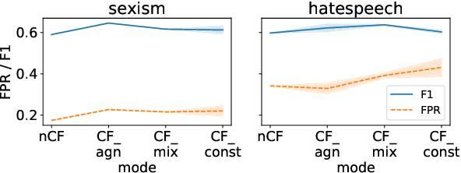
Results-
(1)CF models were more proficient in recognizing positive sentiment towards minorities.
(2)CAD types minimize unintended bias without sacrificing F1 score, avoiding confounding identity words and hate speech.

Slide 7
Conclusion-
Trained models have higher false positive rates compared to non-CAD models and there comes the role of CAD which is helpful in removing model robustness.

Slide 8
THANK YOU!

