Slide 1

PYTHON

Slide 2

3 major benefits
Easy to code
Free to use
Scripting / OOPS

Slide 3
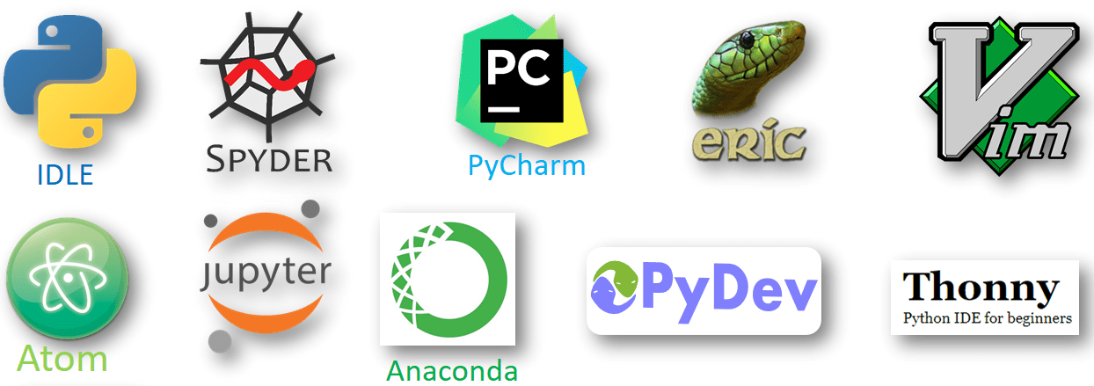

Slide 4
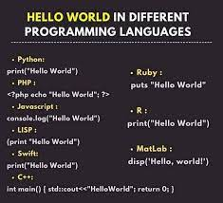
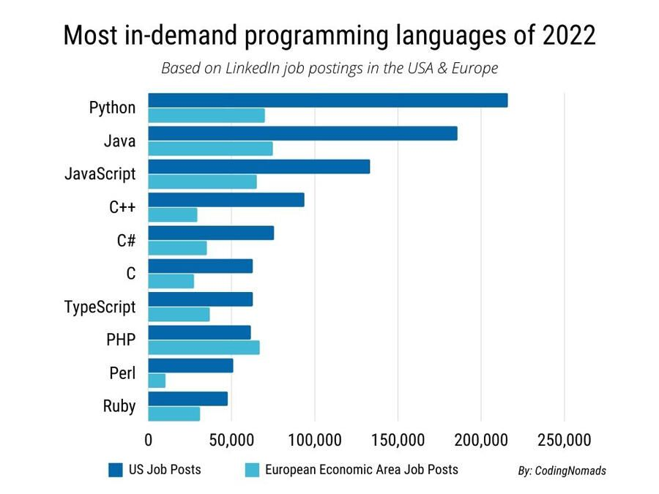
Different languages Executing “Python World”

Slide 5
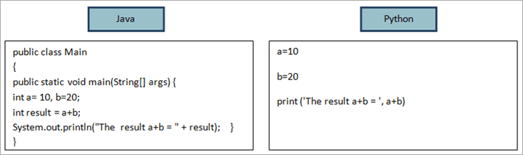
Executing same output

Slide 6
Python is both compiled as well as an interpreted language
It supports multiple operating system
Python relies on identation, whitespace, punctuation buts its quite limited and easy then other language.
Python can connect to database system,it can read and modify the files.
Python can be used to handle big data and perform complex mathematics.
It find easy to learn to all non- technical person
It has in built libraries and installition finds easy.

Slide 7
Used in many industries:
Finance and trading
Scientific and mathematical computing
Web development
System automation and administration
Computer graphics
Basic game development
Security and penetration testing
General and application-specific scripting
Mapping and geography (GIS software)

Slide 8
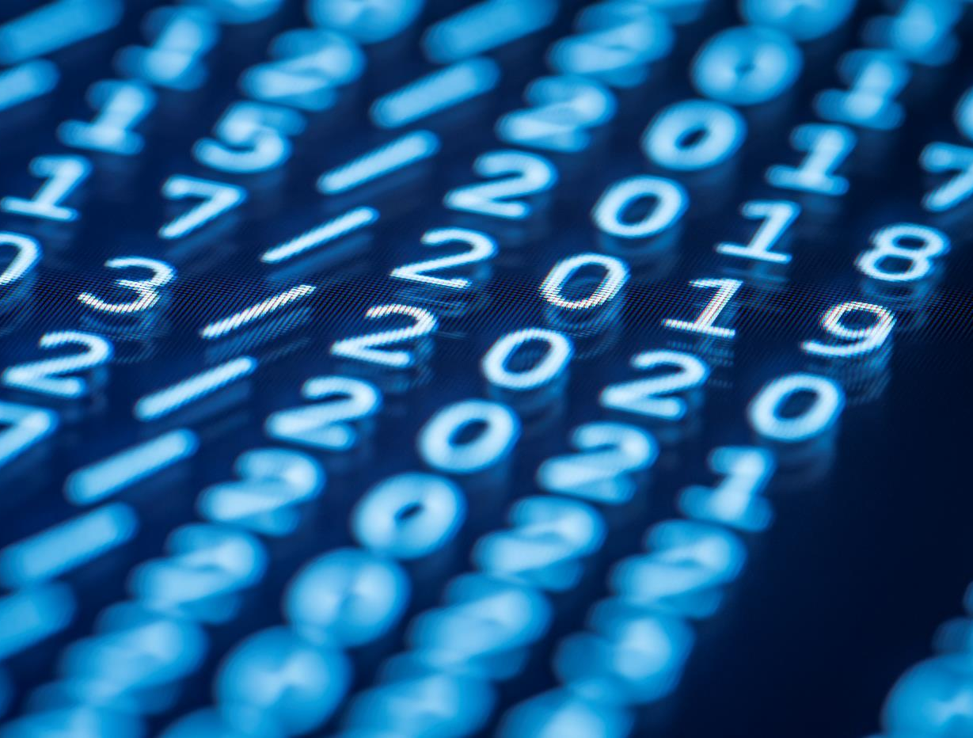
Thank You

