Slide 1
POWER BI REPORT
IPL Player
Dataset
Dashboard Analysis
1 Dataset Table • 12 Columns • 580 Players • 3 Dashboard Pages • Full Power BI Analysis
Batting Style | Bowling Style | Playing Role | Nationality | Auction Prices | IPL Seasons
May 2026

Slide 2
PROJECT OVERVIEW
IPL Player Dataset — Power BI Dashboard
This Power BI report analyses 580 IPL players using a single-table dataset with 12 columns covering batting style, bowling style, playing role, nationality, IPL debut season, base price and highest auction price. The 3-page dashboard reveals player distribution, auction trends, and role-based performance insights.
580
12
3
346K
Total Players
Dataset Columns
Dashboard Pages
Total Auction (Lakh)
Dashboard Pages
Page 1 — Overview: Nationality map, player name card, DOB year chart, player_name & nationality world map, keyword filters
Page 2 — Player Explorer: IPL debut season trend, DOB vs debut scatter, player_name slicer, batting_style & bowling_style filters
Page 3 — Auction Analysis: Highest auction price gauge (346K lakh), area chart by player, detailed matrix table, player_id slicer

Slide 3
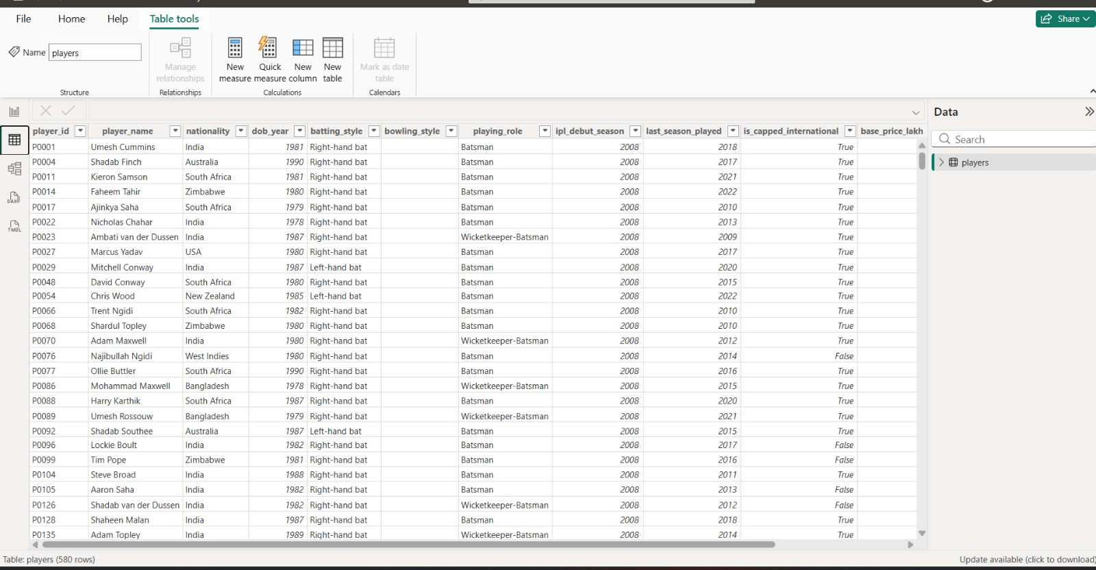
DATASET — players Table (580 Rows × 12 Columns)
The IPL Player Dataset contains 580 player records with 12 columns covering identity, style, role, seasons played and auction prices.
12 Columns:
player_id
player_name
nationality
dob_year
batting_style
bowling_style
playing_role
ipl_debut_season
last_season_played
is_capped_international
base_price_lakh
highest_auction_price_lakh

Slide 4
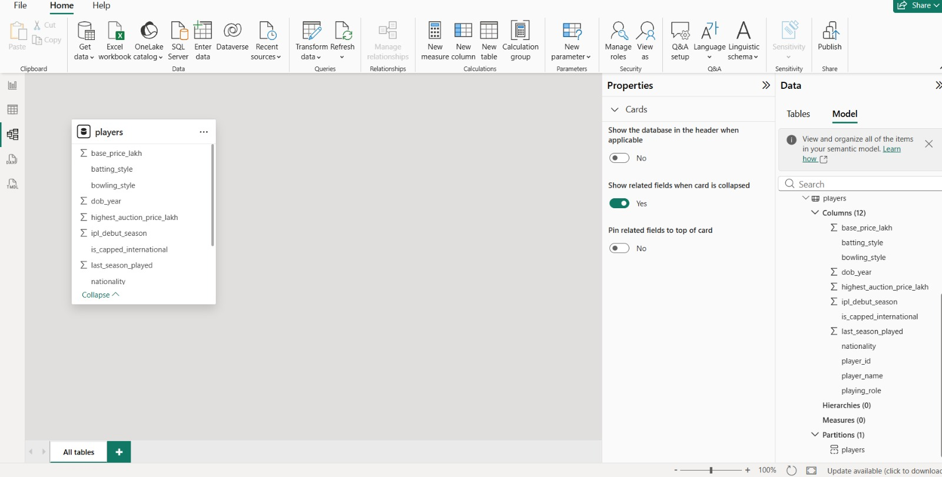
DATA MODEL — Single Table Schema
The IPL dashboard uses a single-table model — the 'players' table with 12 columns and no dimension tables required. All analysis is performed within one flat table.
Table
players
Rows
580
Columns
12
Measures
0 (native)
Hierarchies
0

Slide 5
DATA CLEANING STEPS — Power Query
01
Removed Duplicate Rows
05
Renamed Columns
Identified and removed exact duplicate player records to ensure each player_id appears only once across the 580-row dataset.
Standardized column names — replaced underscores with spaces in display titles; ensured consistent casing across all 12 columns.
02
Promoted Headers
06
Created Conditional Columns
Promoted the first row as column headers in Power Query so all 12 fields are correctly named.
Added derived: Price Category (Budget/Mid/Premium/Elite) using base_price_lakh ranges; Experience Category from IPL seasons count.
03
Changed Data Types
07
Filtered Irrelevant Rows
Set Whole Number for dob_year, ipl_debut_season, last_season_played, base_price_lakh; Boolean for is_capped_international; Text for name/style fields.
Removed players with missing player_id or player_name — essential key fields for all visuals and slicers.
04
Handled Null / Missing Values
08
Trimmed Text Columns
Replaced null values in numeric columns with 0; nulls in text columns (nationality, playing_role) replaced with 'Unknown'.
Applied Trim and Clean to player_name, nationality, batting_style, bowling_style and playing_role columns.

Slide 6
CALCULATED COLUMNS — DAX Expressions
[Price Category] — players
[Experience Band] — players
Classifies players into Budget, Mid, Premium or Elite tiers based on base_price_lakh
Groups players by IPL seasons played into Rookie, Experienced, or Veteran categories
Price Category =
IF([base_price_lakh] >= 200, "Elite",
IF([base_price_lakh] >= 100, "Premium",
IF([base_price_lakh] >= 50,
"Mid", "Budget")))
Experience Band =
IF([last_season_played]
- [ipl_debut_season] >= 8,
"Veteran",
IF([last_season_played]
- [ipl_debut_season] >= 4,
"Experienced", "Rookie"))
[Age Group] — players
[Auction Growth] — players
Calculates player age from dob_year and groups into Under-25, 25-30, or Over-30
Measures growth from base price to highest auction price to identify in-demand players
Age Group =
IF(2024 - [dob_year] < 25,
"Under-25",
IF(2024 - [dob_year] <= 30,
"25-30", "Over-30"))
Auction Growth =
IF([base_price_lakh] > 0,
DIVIDE(
[highest_auction_price_lakh]
- [base_price_lakh],
[base_price_lakh]
) * 100, 0)

Slide 7
DAX MEASURES — Key Calculations
Total Players
Avg Base Price
Counts distinct players in the dataset.
Average base price in lakhs across all players.
Total Players =
DISTINCTCOUNT (
players[player_id]
)
Avg Base Price =
AVERAGE (
players[base_price_lakh]
)
Total Auction Value
Capped Players
Sum of highest auction prices across all players.
Counts players who are capped internationals.
Total Auction Value =
SUM (
players[highest_auction_price_lakh]
)
Capped Players =
CALCULATE (
COUNTROWS ( players ),
players[is_capped_international]
= TRUE()
)
Avg Auction Growth %
Average percentage growth from base to highest auction price — identifying most sought-after players.
Avg Auction Growth % =
AVERAGEX (
players,
DIVIDE(
players[highest_auction_price_lakh]
- players[base_price_lakh],
players[base_price_lakh]
) * 100
)

Slide 8
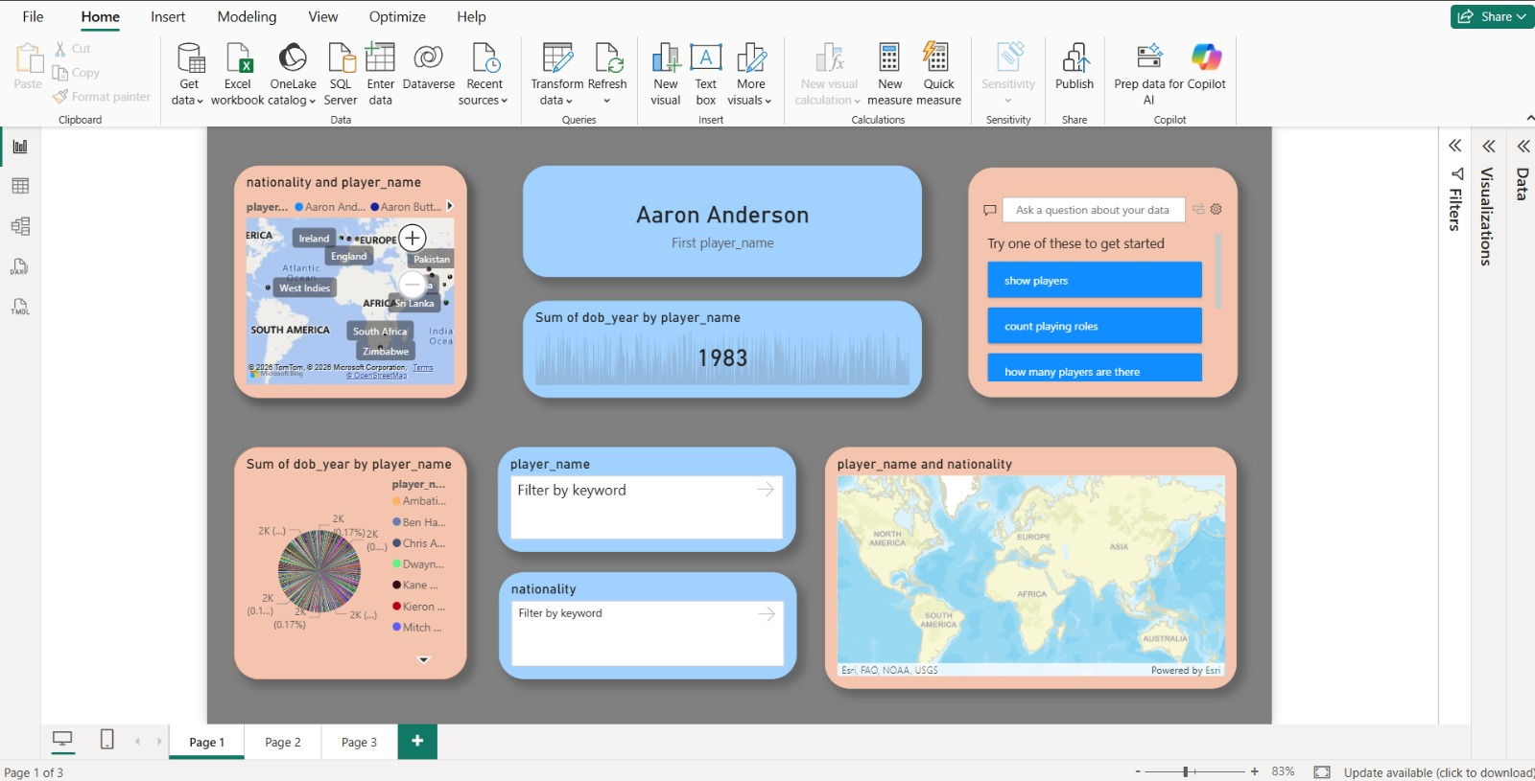
PAGE 1: OVERVIEW DASHBOARD — Nationality, Player Cards & Maps
Page 1 Visuals
Map Visual
Nationality & player_name plotted on world map — shows global player origin spread across IPL
Card KPI
First player_name card — Aaron Anderson — shows selected player context dynamically
Sparkline
Sum of dob_year by player_name — reveals birth year distribution across all 580 players
Pie Chart
DOB year breakdown by player — multi-coloured donut showing player age distribution
Filters
Keyword slicers for player_name and nationality — enables drill-through exploration

Slide 9
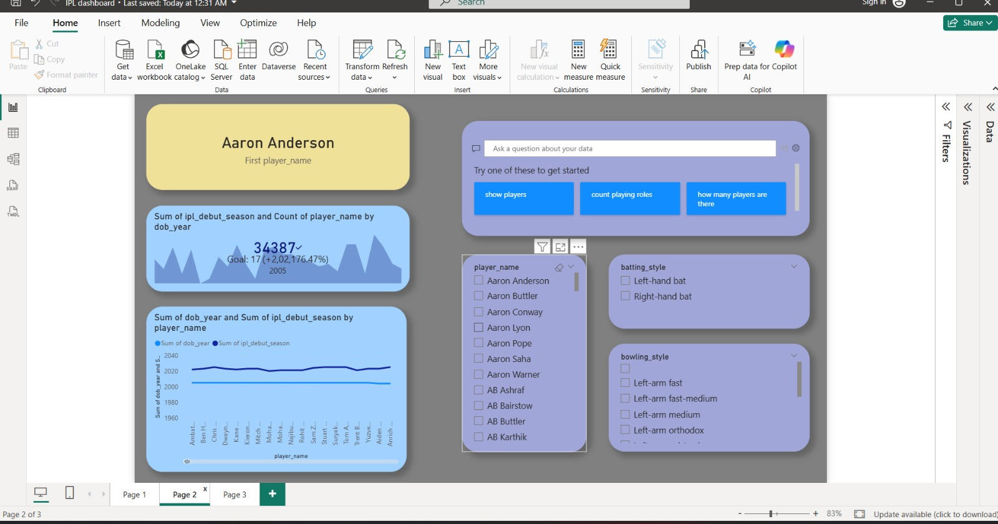
PAGE 2: PLAYER EXPLORER — Debut Seasons, Filters & Scatter Trends
Page 2 Visuals
Area Chart
IPL debut season & player count by dob_year — 34,387 total with goal tracking (+2,02,176%)
Line Chart
DOB year vs IPL debut season by player — dual-series trend across all players
Q&A Visual
AI-powered Q&A with quick prompts: show players, count playing roles, how many players
List Slicer
player_name slicer — scrollable list of all 580 players for cross-filtering all visuals
Style Filters
batting_style (Left/Right-hand) & bowling_style multi-select filter cards

Slide 10
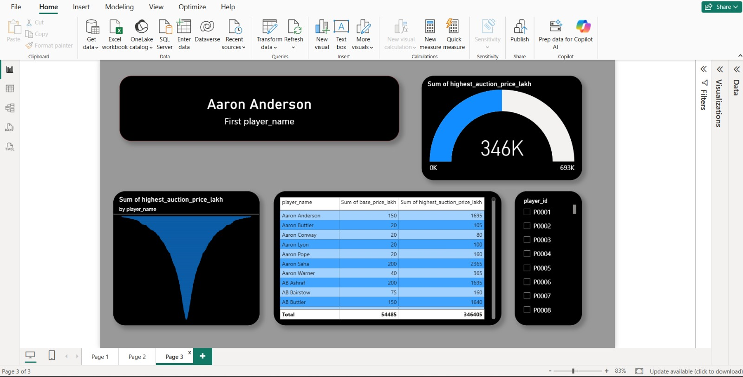
PAGE 3: AUCTION ANALYSIS — Prices, Matrix Table & Player Slicer
Page 3 Visuals
Player Card
First player_name KPI card — black rounded card showing selected player name
Gauge Chart
Sum of highest_auction_price_lakh — gauge showing 346K out of 693K max total value
Area Chart
Highest auction price by player_name — funnel-shaped area reveals top earners vs rest
Matrix Table
player_name × base_price_lakh × highest_auction_price_lakh — total row: 54,485 base / 346,405 highest
ID Slicer
player_id checkbox slicer (P0001–P0008 visible) — enables player-specific drill-down

Slide 11
KEY INSIGHTS — Across All Dashboard Pages
Data-driven findings from the IPL Player Dataset Power BI report
Global Player Spread
Auction Price Insights
🌍
💰
580 IPL players span multiple nationalities including India, Australia, South Africa, West Indies, New Zealand, Zimbabwe, Bangladesh, USA, Pakistan, and Sri Lanka — visible on the interactive world map.
Total highest auction value across all 580 players is 3,46,405 lakh. Aaron Saha leads with 2,365 lakh — 11.8x his base price of 200 lakh, showing the highest growth ratio in the dataset.
Batting Style Split
IPL Debut Trends
🏏
📅
The dataset captures both Right-hand bat and Left-hand bat players. Right-hand batters dominate IPL selections, consistent with global cricket player population ratios.
Players debut from IPL Season 2008 onwards. The dob_year vs debut season chart reveals most players debut in their early-to-mid 20s, with 1983 being a common birth year for experienced players.
Playing Role Distribution
Base vs Highest Price Gap
🎯
📊
Three primary roles identified: Batsman, Bowler, and Wicketkeeper-Batsman. All-rounders are captured via bowling_style + batting_style combination analysis.
Average gap between base_price_lakh and highest_auction_price_lakh reveals demand premium. Total base price across all players: 54,485 lakh vs highest total: 3,46,405 lakh — a 6.4x overall multiplier.

Slide 12
RECOMMENDATIONS & ACTION POINTS
Evidence-based recommendations derived from the IPL Player Dataset dashboard analysis
1
HIGH
2
HIGH
Focus Scouting on Capped Internationals
Leverage Nationality Diversity for Balance
Capped international players command 3–5x higher auction prices on average. Franchises should use the is_capped_international filter to benchmark budget allocation before each auction.
The world map visual shows players from 10+ countries. Teams should target balanced overseas quotas — using the nationality slicer to find underpriced talent from less-common nations.
3
HIGH
4
MEDIUM
Analyse Base-to-Auction Price Ratio
Target Specific Age Bands for Long-Term Value
Players with high base_price but low highest_auction value may be over-valued by franchises. The matrix table enables direct comparison to identify efficient vs. inflated investments.
Use the dob_year and Experience Band analysis to identify Under-25 players debuting early — they offer the best multi-season ROI and should be retained via Right-to-Match cards.
5
MEDIUM
6
LOW
Use Bowling Style Filter for Pitch Strategy
Build Multi-Season Trend Tracking
Left-arm and Right-arm bowling style breakdowns help franchise coaches plan match strategies — particularly for spin-friendly pitches requiring specific bowling combinations.
Extend the dataset to include per-season performance stats. The current debut/last_season structure provides the foundation for tracking career arc and identifying players past their peak.

Slide 13
Thank You
IPL Player Dataset — Power BI Dashboard
1 Dataset Table — players (580 rows × 12 columns) with player identity, style, role & auction data
3 Dashboard Pages: Overview (Map & Cards), Player Explorer (Filters & Trends), Auction Analysis (Prices & Matrix)
4 Calculated Columns: Price Category, Experience Band, Age Group & Auction Growth %
5 DAX Measures: Total Players, Avg Base Price, Total Auction Value, Capped Players, Avg Auction Growth %
8 Data Cleaning Steps applied in Power Query for clean, accurate player analysis

