Slide 1

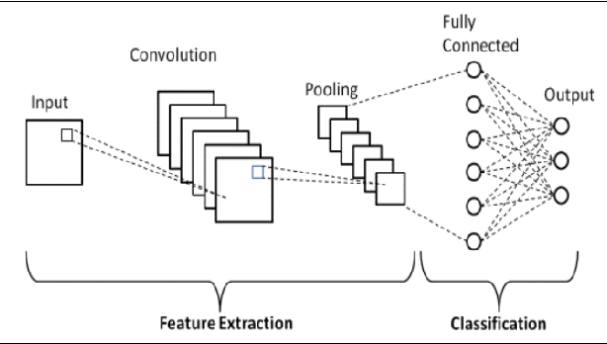
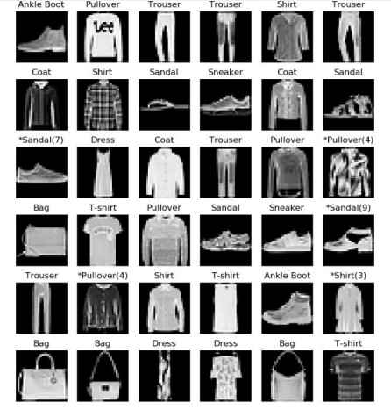

Capstone Project
Fashion MNIST Using Deep Learning
by
Team No.:23
Abhinav Sharma(E23MCAG0002), Dipanshu Chaudhary(E23MCAG0009),
Shashwat Sharma(E23MCAG0083) and Sakshi Tomar(E23MCAG0053)
Department of computer Science Engineering, Bennett University
Abstract
Experimental Results and Discussion
Recognizing and classifying images is a significant research topic in the widely Computing technology nowadays. In this project, Convolutional Neural Network were used to train images of different fashion styles which is in the form of gray scale images to be predicted with a high accuracy. Deep Learning has been widely used in a variety of fields. When we are going to tackle with real world situations then, CNN which is a Deep Neural Network plays an important role to deliver the most accurate solutions. E-Commerce businesses have used CNN to solve many problems such a s clothes recognition, search and recommendation.
Keywords: Convolutional Neural Network. Image Classification, Model
Comparison, Deep Neural Network
Introduction
Fashion MNIST, is a dataset of fashion items, i.e., represented in the form of Gray scale images which are commonly used with Convolutional Neural Network(CNN) for image classification. It consists of 50,000 Gray scale images. Which is of different fashion items that is categorized into 10 different classes. Image classification is an important part of Artificial intelligence.
CNN Architecture
DATA SET LOADING
Models | Losses | Accuracy
Model1 | 0.5417782068252563 | 0.8008000254631042
Model 2 (Retraining Model) | 0.4538656175136566 | 0.8395000100135803
Model 3 (Using Sigmoid Function) | 0.465987890958786 | 0.838699996471405
MODEL CREATION
MODEL TRAINING
MODEL ANALYSIS
To train this model we use many models and techniques to train and test the model by which we get the accuracy with lost images we get 0.54 loss and 0.80 matched accuracy.
After train the model1 we retrain the model and in this we get 0.45 loss data and 0.83 matched accuracy which is better than model1.
After retrain the model, we use the sigmoid function to train the model effectively and we get better and most accurate results as previous ones.
IMAGE TESTING
Flow Chart
Used Dataset
Conclusions
It contains a total 70,000 images of 28x28 pixels. In Fashion MNIST dataset, 60000 train images and 10000 test images exists. These images are divided into 10 different categories/classes.
This study shows how to successfully create a Fashion MNIST Model using deep learning techniques, with an incredible 83.95% accuracy after tuning the parameters. This achievement demonstrates how well deep learning techniques work for complex image classification tasks. These developments demonstrate the possibility for precise and effective pattern recognition in the field of computer vision, which could improve applications related to fashion.
Proposed Method
References
Import Libraries
Getting the grayscale image dataset from Kaggle is the first step in creating the model. Next, the pixel values are loaded, reshaped, and normalized to a range of 0 to 1.
Sigmoid activation for the hidden layers is used to build a sequential neural network architecture with two hidden layers and a SoftMax-activated output layer. During training, the training dataset is used with predetermined batch sizes and epochs.
The model's accuracy and test loss are displayed once it has been evaluated on test data. Using this all-inclusive methodology, Fashion MNIST classification tasks are covered from data handling to model evaluation.
1. Ciresan, D., Meier, U., Schmidhuber, J.: Multi-column deep neural networks for image classification. In: Computer Vision and Pattern Recognition (CVPR), 2012 IEEE Conference on. pp. 3642–3649. IEEE (2012)
2. Abdel-Hamid, O., Mohamed, A. R., Jiang, H., Deng, L., Penn, G., & Yu, D. (2014). Convolutional neural networks for speech recognition. IEEE/ACM Transactions on audio, speech, and language processing, 22(10), 1533-
1545.
3. Belongie, S., Malik, J., & Puzicha, J. (2001, July). Matching shapes. In Proceedings Eighth IEEE International Conference on Computer Vision. ICCV 2001 (Vol. 1, pp. 454-461). IEEE.
Load and preprocess the data
Build the CNN Model
Compile the Model
Train the Model
Evaluate the Model
Methodology
Team No. - 23

