Slide 1
GlucoTwin
India
An adaptive patient twin
for glucose forecasting
Dipanshu Raj · Team product
Indian Institute of Technology Kanpur
Digital Twin Challenge 2026 · Research proof-of-concept
TEAM PRODUCT / IIT KANPUR
01
Notes:
Welcome to GlucoTwin India, an adaptive partial digital twin for glucose forecasting. This project is submitted by Dipanshu Raj, Team product, from the Indian Institute of Technology Kanpur, for the Digital Twin Challenge 2026. The prototype joins the same study participant's baseline clinical profile with a replay of their glucose, activity and recorded meal data. It maintains an evolving patient state, generates forecasts, and makes its uncertainty and limitations visible. In this demonstration, we will examine the clinical question, the data, the architecture, the evaluation and the working dashboard. The results come from real, openly available research data. The narration in this version is synthesized. This is a research demonstration, not a clinically validated medical device. Its strongest measured result is improved glucose forecasting; its exploratory event alerts still require substantial improvement.
Sources: CGMacros v1.0.0 https://doi.org/10.13026/3z8q-x658; project results/summary.json and results/forecast_metrics.csv. Clinical ranges: https://pubmed.ncbi.nlm.nih.gov/31177185/. Research prototype; no clinical validation.

Slide 2
A focused clinical question
Forecast a measurable outcome
Glucose at 30, 60 and 120 minutes
Primary benchmark: 60-minute mean absolute error
Exploratory adverse-event endpoint
New onset above 180 mg/dL for three five-minute bins, all inside the next hour.
Intended user
A clinician reviewing a patient trajectory, uncertainty and data quality.
A forecast horizon is not the same as achieved warning lead time.
TEAM PRODUCT / IIT KANPUR
02
Notes:
The intended use case is a clinician reviewing an adult with Type 2 diabetes between periodic consultations. The narrow question is whether clinical context and recent sensor history can improve the forecast of glucose in the next hour. We also evaluate thirty-minute and two-hour horizons. A forecast horizon is the time between issuing a prediction and the value being predicted. It must not be confused with the amount of advance warning actually achieved before an event. Our exploratory event definition requires a new crossing above one hundred eighty milligrams per deciliter, followed by three consecutive five-minute bins above that threshold. The whole event must fit inside the next sixty minutes. This persistence rule is an engineering endpoint for the experiment. It is not an emergency diagnosis or an individualized treatment target. The prototype outputs information for review. It does not prescribe insulin, change medication, or claim that a forecast will prevent a complication. Keeping the question narrow makes the result testable and keeps the demonstration aligned with the challenge's requirement for one localized health outcome.
Sources: CGMacros v1.0.0 https://doi.org/10.13026/3z8q-x658; project results/summary.json and results/forecast_metrics.csv. Clinical ranges: https://pubmed.ncbi.nlm.nih.gov/31177185/. Research prototype; no clinical validation.

Slide 3
Two streams, one participant
45
14
US cohort
study participants
in the T2D cohort
Indian validation still required
Stream | Fields used | Linkage
Clinical profile | Age, sex, BMI, HbA1c, fasting glucose | Same participant ID
Dynamic observations | Glucose, heart rate, activity METs | Same participant ID
Recorded context | Meal carbohydrate, protein and fat | Same participant ID
CGMacros v1.0.0 · CC BY-NC-SA 4.0 · EHR-like records; no hospital integration
TEAM PRODUCT / IIT KANPUR
03
Notes:
Our primary source is the openly available CGMacros version one dataset from PhysioNet. It contains forty-five participants, including fourteen in the study's Type 2 diabetes group. Baseline demographics and laboratory measurements are joined to glucose, wearable activity and meal information using the same participant identifier. We represent the baseline fields as an EHR-like clinical record. We do not claim a working connection to a hospital EHR. We also do not attach an unrelated synthetic medical record to a real sensor trace. That would demonstrate a software join, but it would not establish a meaningful patient-level relationship. The source study was conducted in the United States, so the intended Indian application remains unvalidated. The dataset is licensed under Creative Commons Attribution, NonCommercial, ShareAlike four point zero. Source files, processed derivatives, citations and license notices are included in the repository. Meal photographs and microbiome data are excluded because this implementation does not use them. The package preserves the forty-five participant CSV files and the baseline table, together with source checksums, so an evaluator can rebuild the processed data.
Sources: CGMacros v1.0.0 https://doi.org/10.13026/3z8q-x658; project results/summary.json and results/forecast_metrics.csv. Clinical ranges: https://pubmed.ncbi.nlm.nih.gov/31177185/. Research prototype; no clinical validation.

Slide 4
Architecture and update loop
Direct forecasts
30 / 60 / 120 min
Baseline clinical
profile
Causal features
+ patient state
15-min input delay
Data-quality gate
Episode ranking
+ uncertainty
Sensor + meal
replay
Clinician
research dashboard
Paired identity
Matured errors
update residual memory
Scenario sandbox is separate from evaluated forecasts.
TEAM PRODUCT / IIT KANPUR
04
Notes:
The architecture begins with two patient-linked inputs. The static branch contains age, recorded sex, body mass index, glycated hemoglobin and fasting glucose. The dynamic branch contains glucose history, heart rate, activity intensity and recorded meal macronutrients. The preparation stage aligns timestamps, records missingness, and applies the conservative input timing policy. Causal feature construction then creates rolling glucose summaries, trends, decaying meal states and activity summaries. A separate direct regression model predicts each forecast horizon. The patient-specific residual state is updated only when the outcome of an earlier prediction has become observable. This feedback loop is the adaptive part of the twin. Independent calibration data supply residual interval widths. A separate classifier supplies an exploratory event ranking score. A data-quality gate determines whether the dashboard is allowed to show a forecast. The frontend presents the profile, the trace, the forecast, the interval and the review state. A separate scenario sandbox illustrates hypothetical response assumptions. It is outside the evaluated forecasting pathway and cannot change the published results.
Sources: CGMacros v1.0.0 https://doi.org/10.13026/3z8q-x658; project results/summary.json and results/forecast_metrics.csv. Clinical ranges: https://pubmed.ncbi.nlm.nih.gov/31177185/. Research prototype; no clinical validation.

Slide 5
Adapt only from the observable past
Issue forecast
at time t
Target occurs
at t + horizon
Outcome is available
at t + horizon + 15 min
No future feedback
A 60-minute forecast can update memory only after 75 minutes.
Prefix-invariance tests
Changing the future must not change earlier features or forecasts.
Source limitation remains
Upstream interpolation cannot be fully undone without native device exports.
TEAM PRODUCT / IIT KANPUR
05
Notes:
Time ordering is central to this project. The source data already contain glucose values interpolated to one-minute intervals. Treating all of those values as independent real-time observations would overstate what was available at a prediction timestamp. We therefore retain readings compatible with the initial five-minute Dexcom phase, discard fractional values, and avoid adding any backward interpolation. All dynamic inputs are delayed by fifteen minutes. A single missing input bin may be carried forward, but target values are not filled. This policy is conservative, yet it cannot fully reconstruct the unavailable native device exports. That remaining limitation is stated throughout the submission. For personalization, consider a forecast issued for sixty minutes ahead. With a fifteen-minute observation delay, its error becomes usable seventy-five minutes later. The model must wait until that time before updating its residual memory. Our correction uses a fixed, bounded, exponentially weighted state. Unit tests check that changing future inputs cannot alter earlier features, and that forecasts recomputed from a prefix agree with the corresponding portion of a whole-trace computation. These tests support the implementation's causal timing; they do not certify the upstream dataset.
Sources: CGMacros v1.0.0 https://doi.org/10.13026/3z8q-x658; project results/summary.json and results/forecast_metrics.csv. Clinical ranges: https://pubmed.ncbi.nlm.nih.gov/31177185/. Research prototype; no clinical validation.

Slide 6
Evaluation before presentation
Partition | Participants | Purpose
Training | 36 | Fit population models
Validation | 3 T2D | Select variants and alert threshold
Calibration | 3 T2D | Estimate residual interval widths
Final test | 3 T2D | Report held-out performance
24-hour warm-up
Patient-macro metrics
Earlier observations may personalize the twin; future observations cannot.
Each test participant contributes equally to headline forecast errors.
TEAM PRODUCT / IIT KANPUR
06
Notes:
The evaluation uses four disjoint participant partitions. Thirty-six participants are used for training. Three different Type 2 diabetes participants are used for validation, three for interval calibration, and three for final testing. The split uses a fixed random seed and its exact identifiers are published. Validation selects between the fused and adaptive variants and determines the alert threshold. Calibration determines the empirical residual interval widths. The test participants do not select the models, the thresholds or the interval widths. The first twenty-four hours of each trace are treated as warm-up and excluded from scored windows. Earlier test-patient observations may update the patient state, but future observations cannot. We compare persistence, a sensor-only model, a fused clinical and sensor model, and the adaptive variant. Persistence simply carries the most recent available glucose forward and is a meaningful baseline. Headline errors average each patient's result equally. This avoids allowing a longer trace to dominate the result. Overlapping windows remain temporally dependent, and the final test contains only three people, so the results support feasibility rather than broad clinical generalization.
Sources: CGMacros v1.0.0 https://doi.org/10.13026/3z8q-x658; project results/summary.json and results/forecast_metrics.csv. Clinical ranges: https://pubmed.ncbi.nlm.nih.gov/31177185/. Research prototype; no clinical validation.

Slide 7
Measured forecast performance
9.6%
lower MAE at 60 min
17.7%
lower MAE at 120 min
MAE, mg/dL · 3 held-out T2D participants · Fused alone does not win at every horizon
TEAM PRODUCT / IIT KANPUR
07
Notes:
The chart shows measured mean absolute error in milligrams per deciliter on the held-out test participants. At thirty minutes, persistence has an error of nineteen point seven four and the adaptive twin has eighteen point four eight. At sixty minutes, the error decreases from twenty-six point six seven to twenty-four point one two, an improvement of approximately nine point six percent. At one hundred twenty minutes, it decreases from thirty-five point two six to twenty-nine point zero zero, an improvement of approximately seventeen point seven percent. These are relative reductions in mean absolute error, not classification accuracy and not demonstrated patient benefit. The fused model without adaptation does not outperform persistence at every horizon. We publish that result rather than attribute every improvement to clinical features. The strongest variant in this experiment combines fused forecasting with delayed residual adaptation. At the sixty-minute horizon, intervals designed for nominal ninety percent coverage achieved approximately eighty-nine point eight percent patient-macro test coverage. Their typical width is substantial, which is important for interpreting any individual forecast. All per-patient values and the other baselines remain available in the results files.
Sources: CGMacros v1.0.0 https://doi.org/10.13026/3z8q-x658; project results/summary.json and results/forecast_metrics.csv. Clinical ranges: https://pubmed.ncbi.nlm.nih.gov/31177185/. Research prototype; no clinical validation.

Slide 8
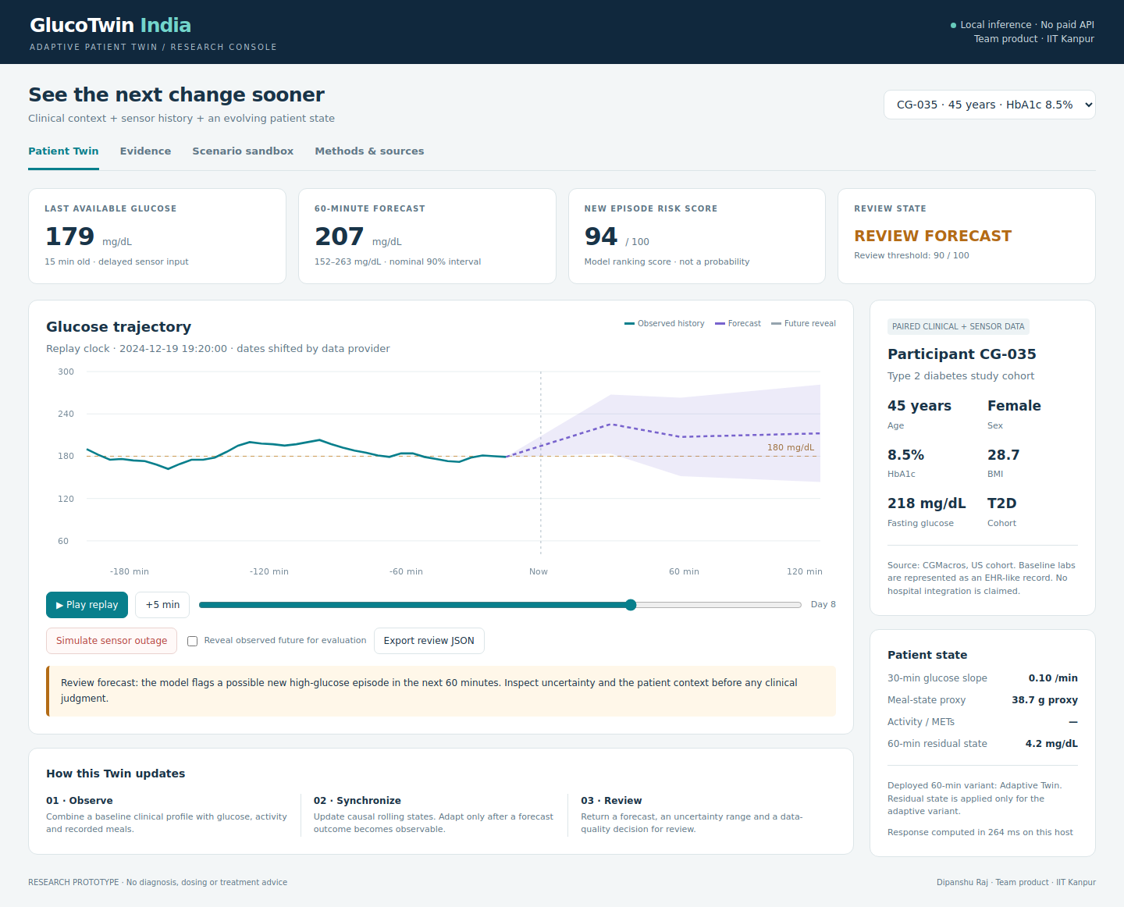
Working prototype walkthrough
Replay
Step through observations.
Review
Forecast + uncertainty + data age.
Inspect
Reveal future only for evaluation.
TEAM PRODUCT / IIT KANPUR
08
Notes:
We now examine the working local dashboard. The participant selector changes both the clinical profile and the sensor stream. These are held-out study participants with anonymized identifiers, not invented patient identities. The first value is the latest available glucose, together with its age. The second is the sixty-minute forecast and its estimated interval. The third is the event model's ranking score. Because the classifier was trained with class balancing, this score is explicitly not presented as a clinical probability. The review state describes whether the data are sufficient and whether the score crosses the validation-selected review threshold. In the trajectory chart, the observed history is shown in teal. Forecast points are shown in purple, with a shaded uncertainty region. The vertical line marks the forecast issue time. The latest input is intentionally earlier because of the observation delay. Pressing the step control advances the replay by five minutes; the play control repeatedly advances it. The patient state and forecasts are recomputed as the replay advances. The observed future is hidden by default. Enabling the reveal control overlays the subsequently observed trace for retrospective evaluation. This is a demonstration aid, not information supplied to the prediction model. The export button creates a JSON review record containing the displayed context, forecast, interval and quality state. The following sequence records real interactions with this prototype. Aggregate evaluation is reported separately, because a selected demonstration example cannot establish model performance.
Sources: CGMacros v1.0.0 https://doi.org/10.13026/3z8q-x658; project results/summary.json and results/forecast_metrics.csv. Clinical ranges: https://pubmed.ncbi.nlm.nih.gov/31177185/. Research prototype; no clinical validation.

Slide 9
The alert experiment needs improvement
14 / 66
observable onsets detected
15 min
median matched warning
21.9% precision · 21.2% recall · 1.87 false alerts / eligible patient-day
Exploratory review flag. These results do not support clinical reliance.
TEAM PRODUCT / IIT KANPUR
09
Notes:
The episode-alert results are intentionally shown separately from glucose forecasting. On the final test set, sixty-four alerts were issued under the defined cooldown policy. Fourteen matched an upcoming observable onset, and fifty were false alerts. Fourteen of sixty-six observable onsets were detected. This corresponds to approximately twenty-one point nine percent precision and twenty-one point two percent recall. False alerts occurred at approximately one point eight seven per eligible patient-day. The median observed advance warning among matched alerts was fifteen minutes. These numbers show that the current event-ranking module is not ready for clinical reliance. They also explain why we do not advertise reliable two-hour event prediction. The two-hour model forecasts a glucose value; the alert experiment has a different endpoint and a shorter observed warning. An alert is matched to at most one onset, repeated alerts are limited by a sixty-minute cooldown, and the full three-bin event must fit in the prediction window. The denominator for false alerts is eligible monitored time. Publishing these definitions makes the result auditable and prevents an attractive dashboard from concealing an immature alarm system.
Sources: CGMacros v1.0.0 https://doi.org/10.13026/3z8q-x658; project results/summary.json and results/forecast_metrics.csv. Clinical ranges: https://pubmed.ncbi.nlm.nih.gov/31177185/. Research prototype; no clinical validation.

Slide 10
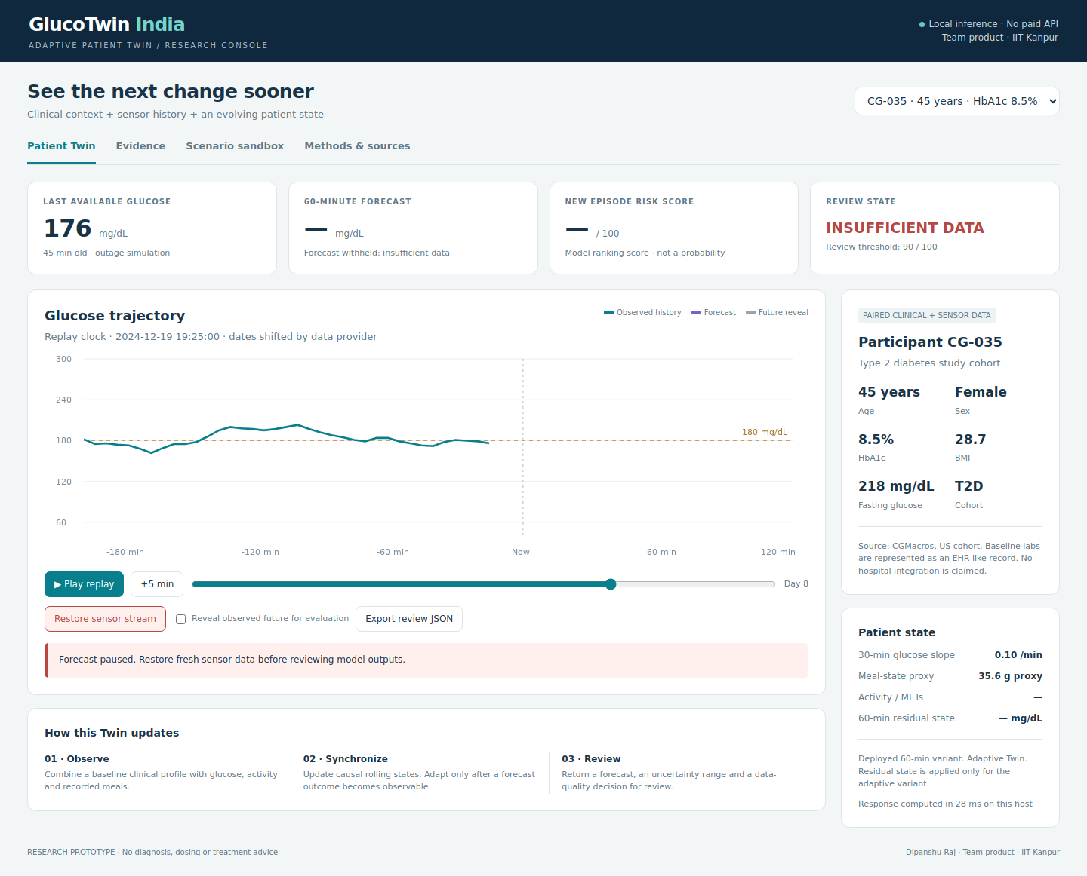
Failure handling is part of the prototype
Withhold
No forecast when inputs are inadequate.
Show age
Historical values stay labeled as stale.
Recover
Restore outputs when quality conditions pass.
TEAM PRODUCT / IIT KANPUR
10
Notes:
A useful research dashboard must show when the model should not produce an answer. Here we activate the sensor-outage control. The forecast and event score are withheld, the review state changes to insufficient data, and the interface asks for fresh sensor information. This is a deterministic stress demonstration of the quality gate, not a real connection being disconnected. In the underlying pipeline, forecasts are suppressed when the latest glucose is missing, the sensor is too stale, there is insufficient recent history, or the warm-up period is incomplete. The last observed value can still be displayed as historical context, but it is not represented as a fresh measurement. Restoring the stream makes the forecast available again when the quality conditions are satisfied. Other controls separate retrospective future reveal from normal review and label an already high observed glucose differently from a predicted future onset. These distinctions matter: a current-state flag must not be counted as an advance warning. The unit tests cover output suppression, future-data hiding, invalid participant selection and prediction-prefix consistency. Browser checks also exercise replay, tabs, scenario controls, participant switching and mobile layout.
Sources: CGMacros v1.0.0 https://doi.org/10.13026/3z8q-x658; project results/summary.json and results/forecast_metrics.csv. Clinical ranges: https://pubmed.ncbi.nlm.nih.gov/31177185/. Research prototype; no clinical validation.

Slide 11
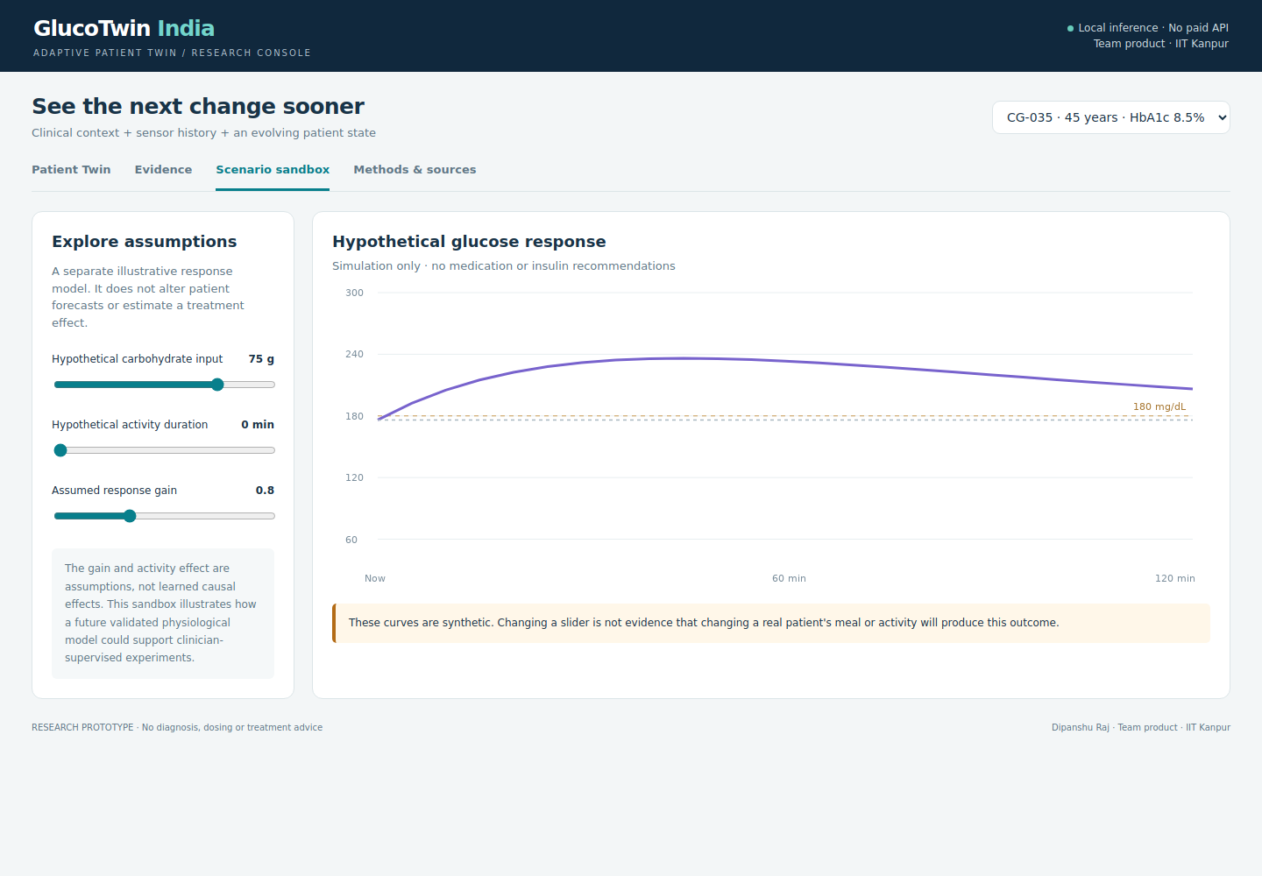
A clearly labeled scenario sandbox
Assumptions,
not treatment effects
Carbohydrate input
Activity duration
Response gain
Synthetic curves are excluded from the real-data evaluation.
TEAM PRODUCT / IIT KANPUR
11
Notes:
The scenario page is an illustration of what a future validated physiological twin could support. It is deliberately separate from the forecasting models. The user can change a hypothetical carbohydrate amount, an activity duration, and an assumed response gain. A simple impulse-response equation then generates a synthetic curve. These coefficients are assumptions. They are not estimated causal effects of food or exercise for the selected participant. Changing a slider therefore cannot justify a recommendation to change that person's meal, activity, insulin or medication. The comparison is useful for explaining model assumptions and for testing interface behavior. It is not evidence of treatment efficacy. The scenario does not modify the patient's stored history, the trained forecasting models or the evaluation results. A future clinical version would need an independently validated physiological model, intervention data, safeguards and clinician supervision before presenting treatment comparisons. For this challenge submission, the sandbox provides a transparent conceptual interaction while the real-data forecasting experiment remains the evidence-bearing component. This boundary is visible on the page, in the model card and in the technical report.
Sources: CGMacros v1.0.0 https://doi.org/10.13026/3z8q-x658; project results/summary.json and results/forecast_metrics.csv. Clinical ranges: https://pubmed.ncbi.nlm.nih.gov/31177185/. Research prototype; no clinical validation.

Slide 12
India deployment is a validation pathway
01 Native data
Obtain appropriately governed CGM exports and matched Indian clinical records.
02 External validation
Preregister endpoints; evaluate subgroup performance, sensors and missingness.
03 Better event risk
Improve discrimination, calibrate scores and agree on an acceptable alert burden.
04 Prospective silent study
Evaluate before changing care; assess safety and regulatory requirements.
TEAM PRODUCT / IIT KANPUR
12
Notes:
India is the intended healthcare context, but the current data are from a small United States study. We therefore describe a deployment pathway rather than claim Indian clinical performance. The first step is access to appropriately governed native glucose and clinical records from representative Indian participants. The next step is a preregistered external evaluation, including local meal patterns, sensor availability, missingness, age and other relevant subgroups. Event risk would need better discrimination and probability calibration. Clinicians would need to help define useful review thresholds and acceptable alert burden. A prospective silent evaluation should come before visible clinical alerts, so that performance can be measured without changing treatment. Only after those steps would a larger pilot and applicable regulatory assessment be appropriate. The local prototype has no paid model API dependency and can run after setup without a network connection. That is an engineering property, not proof that continuous glucose monitoring is affordable or universally available. No cost savings, improved clinical outcomes or regulatory compliance certification is claimed. The research package makes the remaining work explicit so the next stage can evaluate a concrete and realistic development plan.
Sources: CGMacros v1.0.0 https://doi.org/10.13026/3z8q-x658; project results/summary.json and results/forecast_metrics.csv. Clinical ranges: https://pubmed.ncbi.nlm.nih.gov/31177185/. Research prototype; no clinical validation.

Slide 13
A compact, reproducible implementation
No GPU. No paid API.
Component | Implementation
Forecasting | Python + scikit-learn histogram gradient boosting
State update | Causal rolling features + delayed residual memory
Interface | Local Python server + HTML/CSS/JavaScript
Reproduction | Source CSVs, trained model, exact splits and tests
12 core tests passed
Desktop and mobile interactions checked
Training: 26.8 seconds on the build host; timing is hardware-dependent.
TEAM PRODUCT / IIT KANPUR
13
Notes:
The implementation uses Python, NumPy, pandas, SciPy and scikit-learn. The browser frontend uses plain HTML, CSS and JavaScript, with no external runtime scripts. A standard-library server binds to localhost. The package includes the source CSV subset, processed data, the pretrained model, exact participant splits, evaluation outputs and twelve tests. First-time installation requires internet for dependencies, but the demonstration then runs locally without an API key or GPU. Training took approximately twenty-seven seconds on the build host with two OpenMP threads; this is a host-specific measurement rather than a promise for every computer. Evaluators can rebuild the data, retrain the model, rerun the tests and compare the resulting metrics. The repository also includes an architecture document, editable presentation, technical report, data notices, model card, video script and jury questions. Original application code uses the MIT license. Data and model artifacts have separate noncommercial attribution and share-alike terms. The leader should review and understand the implementation before presenting it.
Sources: CGMacros v1.0.0 https://doi.org/10.13026/3z8q-x658; project results/summary.json and results/forecast_metrics.csv. Clinical ranges: https://pubmed.ncbi.nlm.nih.gov/31177185/. Research prototype; no clinical validation.

Slide 14
What this submission establishes
A working twin.
An auditable experiment.
Paired data · Evolving state · Measured forecasts
Visible uncertainty · Explicit failure handling
Next: larger Indian validation and stronger event modeling
Dipanshu Raj · Team product · IIT Kanpur
TEAM PRODUCT / IIT KANPUR
14
Notes:
GlucoTwin India demonstrates the fusion of paired clinical and sensor streams, an evolving patient-specific state, working glucose forecasts, uncertainty reporting and a clinician research dashboard. The held-out experiment shows a modest forecast-error improvement from adaptation on three Type 2 diabetes participants. It also shows that the event alerts remain weak and that clinical validation is still required. The contribution is a functioning and auditable prototype with clear boundaries, rather than an unsupported claim of medical readiness. The next stage should prioritize native data, a larger Indian cohort, improved event modeling and prospective evaluation. Thank you for reviewing the project from Dipanshu Raj, Team product, IIT Kanpur. The code, results, sources and limitations are included in the submission package.
Sources: CGMacros v1.0.0 https://doi.org/10.13026/3z8q-x658; project results/summary.json and results/forecast_metrics.csv. Clinical ranges: https://pubmed.ncbi.nlm.nih.gov/31177185/. Research prototype; no clinical validation.

