Slide 1
EcoQuest: Your Journey to a Sustainable Future
Subtitle: A Climate Change Awareness Web App
Dipanwita Kundu & Sourav Mukhopadhyay

Slide 2
Introduction
Overview of Climate Change
Climate change poses significant risks to our planet, affecting weather patterns, sea levels, and biodiversity.
Increasing awareness and understanding of climate issues is crucial for fostering action.
Introduction to EcoQuest
EcoQuest is designed to educate users about climate change, greenhouse gas emissions, and sustainable practices.

Slide 3
Project Objectives
Key Objectives:Raise awareness about greenhouse gas emissions.
Educate users on personal carbon footprints.
Encourage sustainable practices and community engagement.

Slide 4
Features of EcoQuest
Key Features:AI-Powered Data Insights: Real-time data analysis and responses to user queries.
Interactive Climate Simulation Games: Fun, engaging mini-games to teach sustainability.
Personal Carbon Footprint Calculator: Personalized feedback on user emissions.
Dynamic Visualizations: Interactive representations of emissions data and progress.

Slide 5
Impact and Importance
Why EcoQuest Matters:
Education: Empowers users with knowledge about climate change.
Engagement: Gamification keeps users motivated and interested.
Community Building: Encourages users to share experiences and progress.
Long-term Goals:
Inspire sustainable habits and contribute to a healthier planet.

Slide 6
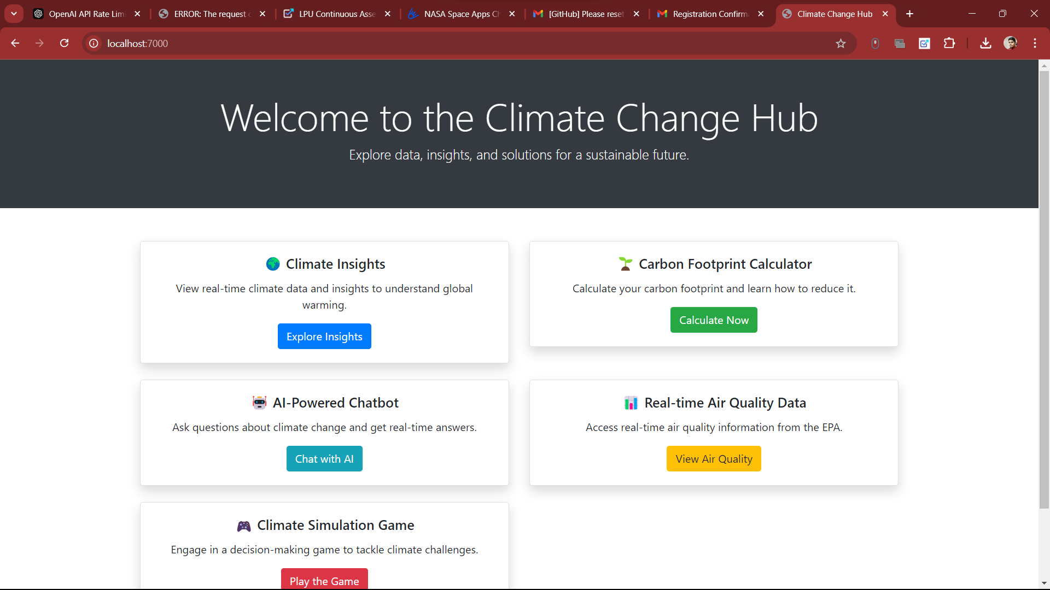
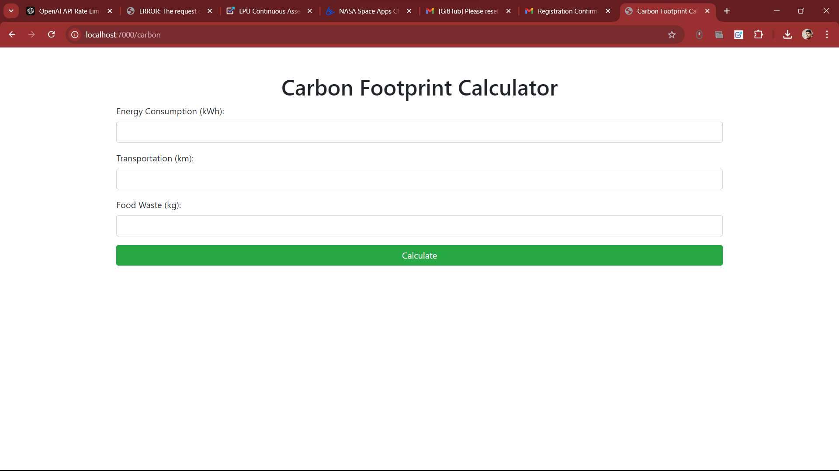
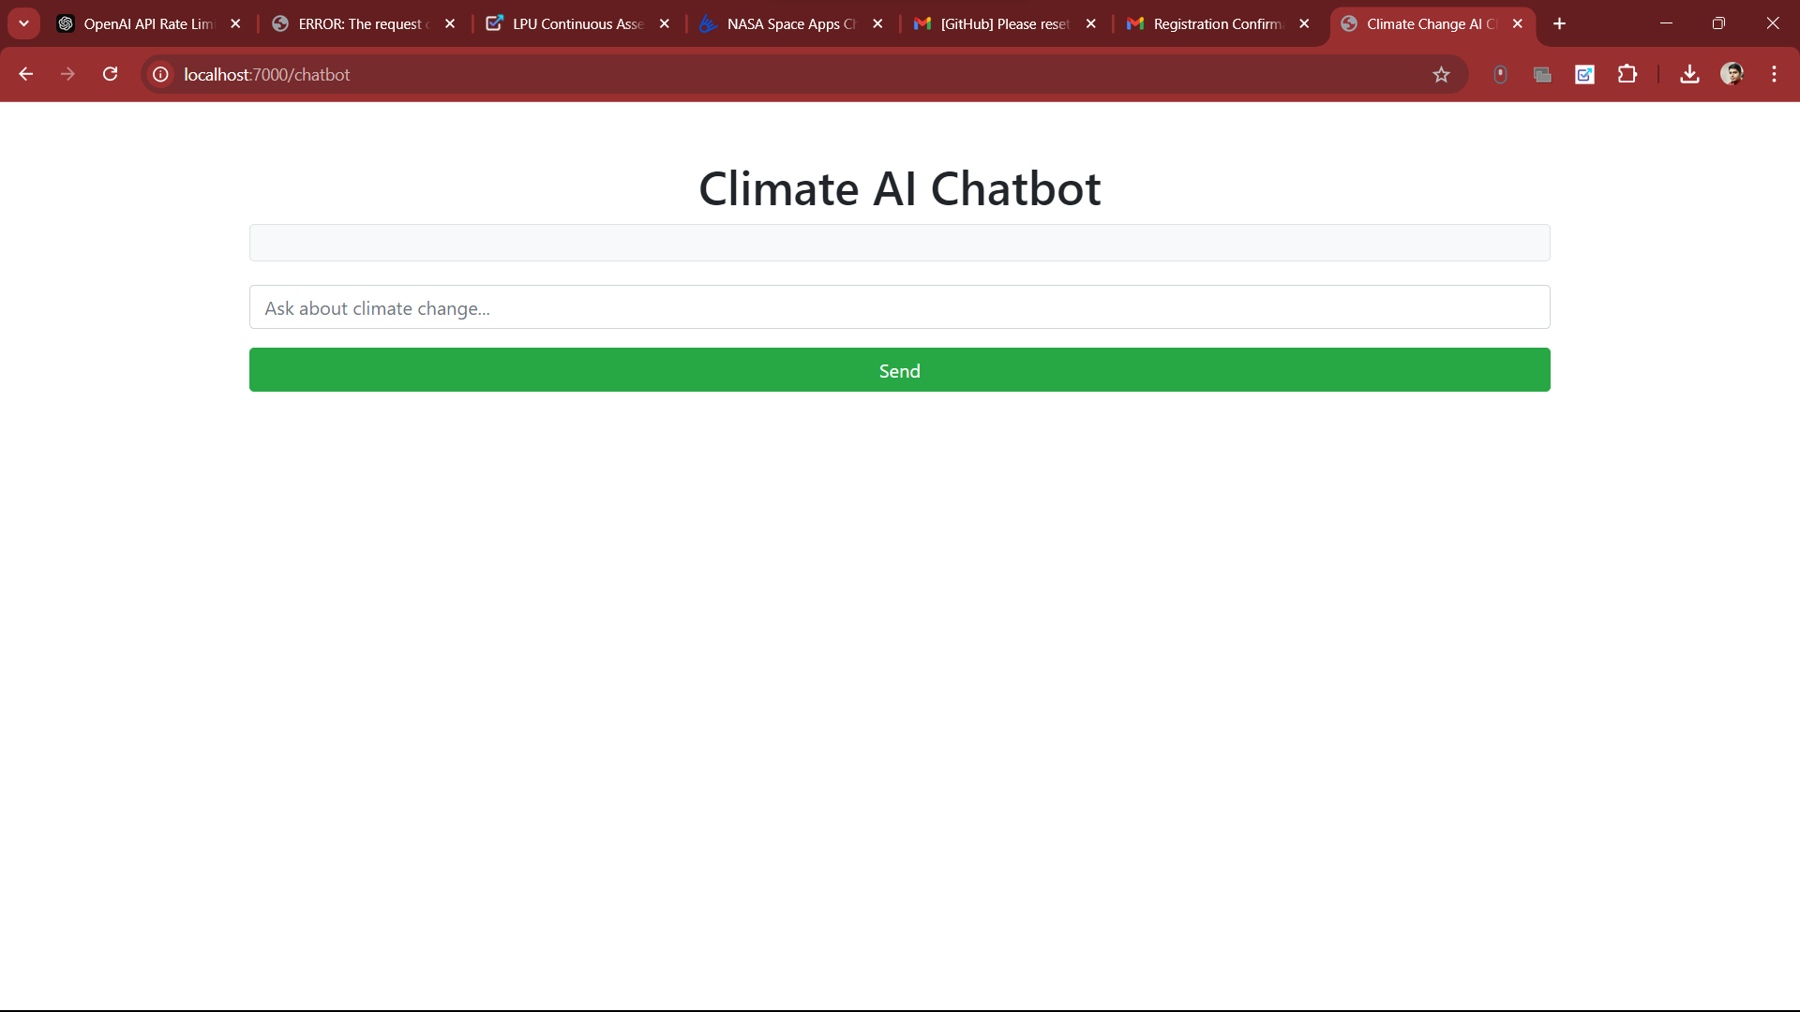
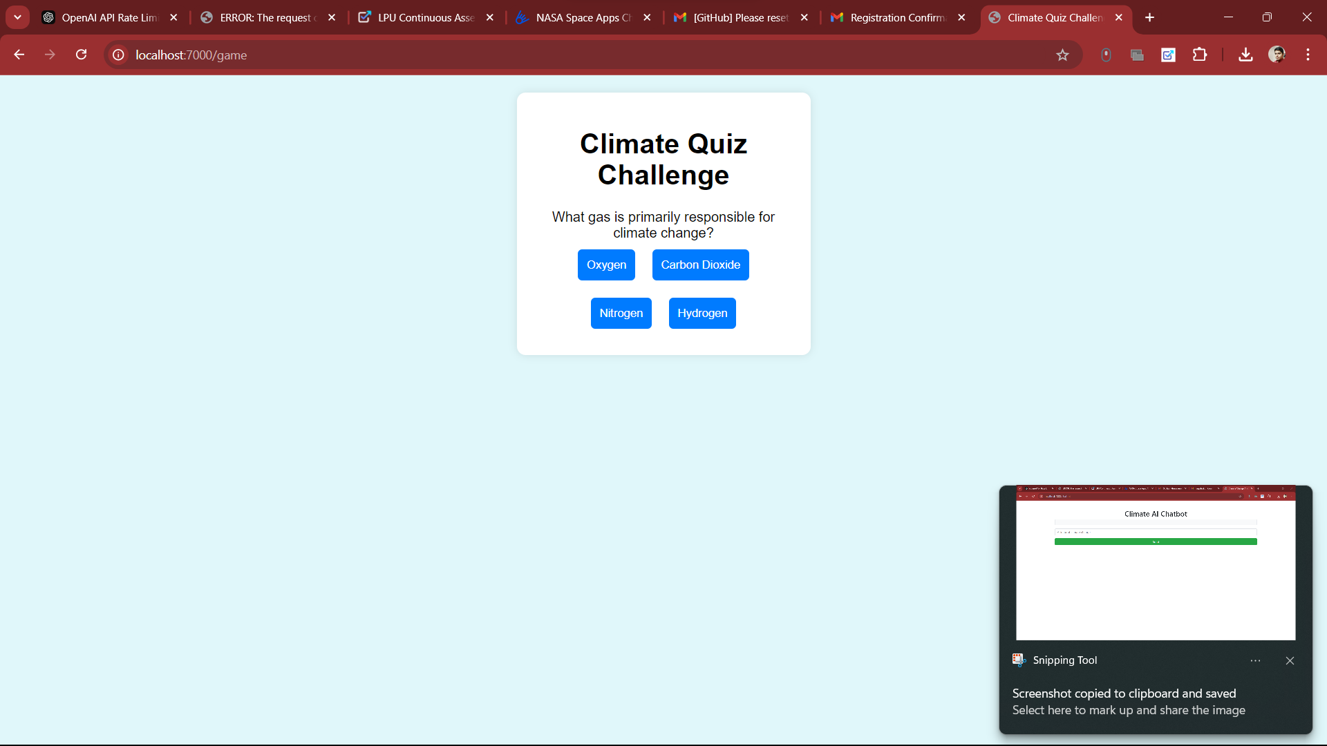
Project ui designs

