Slide 1
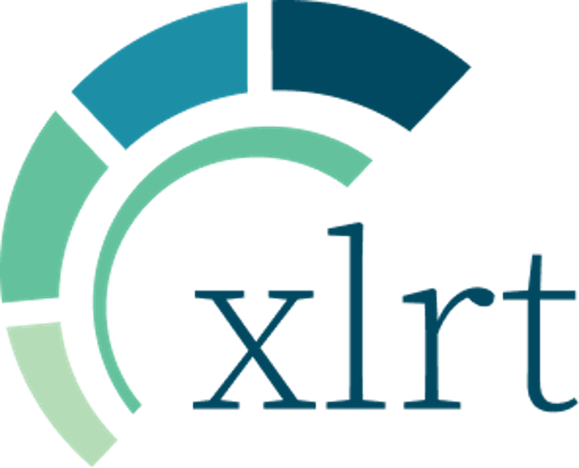

Slide 2
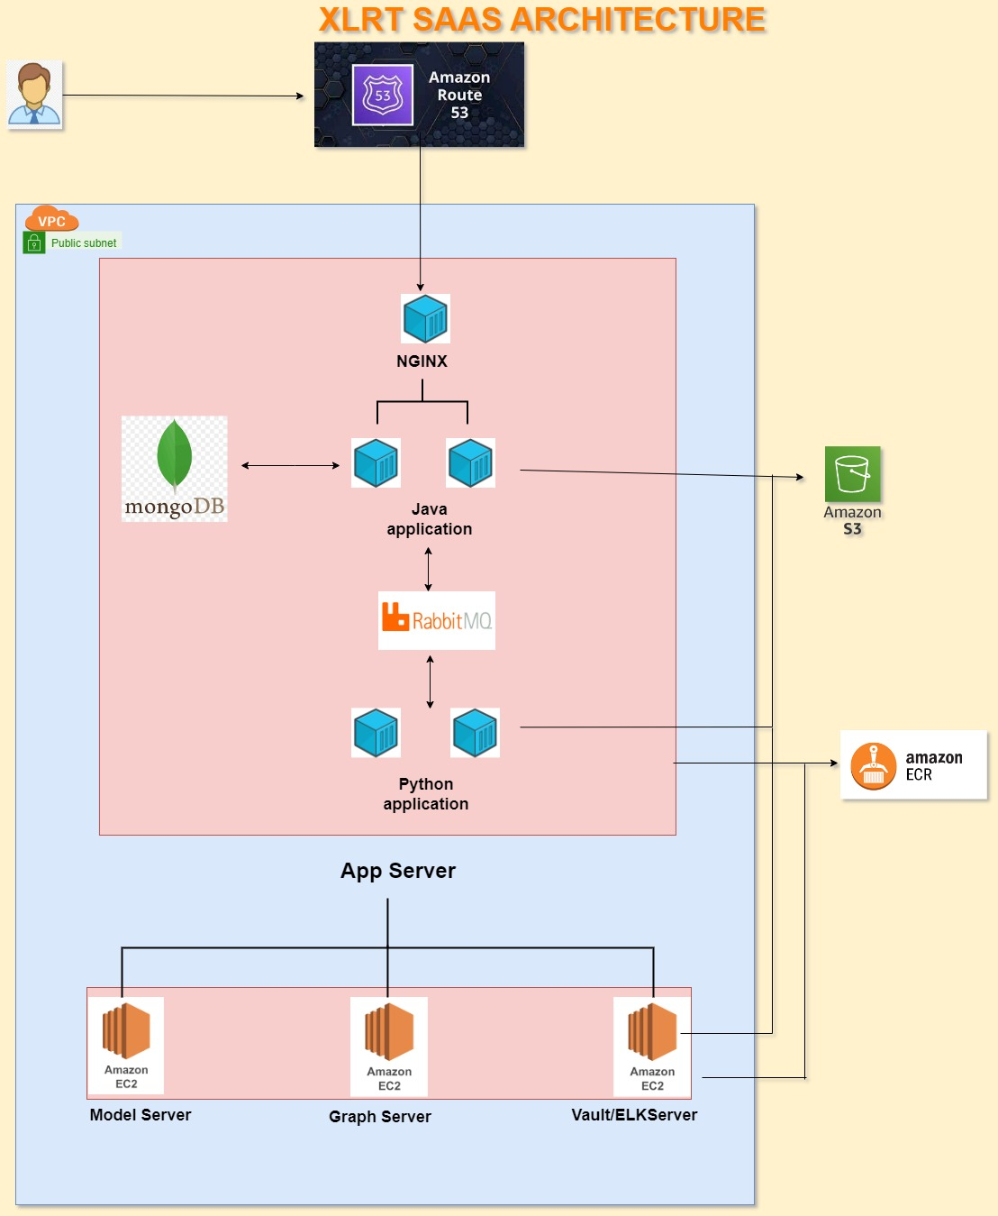
XLRT ARCHITECTURE DIAGRAM

Slide 3
SERVER DETAILS
XLRT primarily operates four servers (EC2 instances) for its business operations:
1) Application Server:
The application server comprises Java and Python services, rabbitmq, database along with the Nginx component.
Instance type: r5a.2xlarge(8 vCPU 64 GiB RAM )
2) Model Server:
The model server encompasses custom trained cognitive models.
Instance type: r5.2xlarge (8 vCPU 64 GiB RAM )
3) Graph Server:
The graph server is comprised of the Neo4j graph database container and python wrapper service container.
Instance type: r5a.large (2 vCPU 16 GiB RAM )
4) Vault/ELK Server:
The vault server is composed of HashiCorp Vault for securely storing confidential information (like database credentials,rabbitmq
credentials , aws access key, secret key etc.) and EFK(Elasticsearch, Fluentbit, and Kibana) for monitoring and analyzing logs.
Instance type: r5a.large (2 vCPU 16 GiB RAM )
All the servers are present in a single VPC within the public subnet.

Slide 4
AWS COMPONENTS
XLRT leverages AWS Route 53 to seamlessly manage DNS resolution for our URLs and precisely direct incoming requests to their designated instances.
XLRT utilizes Amazon S3 buckets as a reliable solution for storing all our PDF files, backend images, templates and archived logs. Client specific S3 bucket is used for user data storage which has public access blocked and also have a client specific lifecycle policy. This robust storage system ensures the security and accessibility of our essential data assets.
We adopt a streamlined process for our image management. All images are constructed and pushed to XLRT Amazon Elastic Container Registry (ECR) in a specific repository designated for each client separately and only the necessary images are pulled when needed to ensure the seamless operation of our containers. This approach enhances the efficiency and flexibility of our containerized applications.

Slide 5
NETWORK COMMUNICATION SECURITY AND WHITELISTING
All of our servers communicate exclusively using private IP addresses within same VPC, with no public access granted to any server. This stringent security measure ensures that our internal network remains isolated from external connections, safeguarding our sensitive data and maintaining a high level of data protection.
For the application server, we have implemented a security policy where only port 443 needs to be globally accessible to receive internet traffic. This ensures a secure and controlled access point for our application. Additionally, port 8080 can be opened if needed for configuring Jenkins on the application server, allowing us to manage our continuous integration and deployment processes efficiently.
For the ELK server , port 5601 needs to be opened for accessing the Kibana dashboard for monitoring the logs depending on the client’s policy to access the logs.
In order to successfully pull all Docker images from XLRT's AWS ECR private registry, it is essential to whitelist XLRT's AWS ECR registry URL. This whitelist inclusion ensures smooth access to our container images.
For various deployment templates and scripts, it is equally important to whitelist either our private Bitbucket account URL or specifically, XLRT.
If the client wishes to grant access to XLRT Jenkins server for the deployment it is necessary to whitelist the provided IP address of XLRT's Jenkins server within the client's account. This step ensures a secure and controlled connection between our teams, facilitating collaborative work and streamlined processes.

Slide 6
WHAT MORE XLRT CAN PROVIDE FOR BETTER SECUIRITY?
XLRT offers static website hosting for our user interface (UI) in amazon S3, ensuring that the UI is not co-located with the database within the same instance. This separation enhances security measures, safeguarding sensitive data and enhancing the overall integrity of our system architecture.
XLRT enhances accessibility and performance by leveraging Amazon CloudFront in conjunction with our S3-hosted static website. This strategic combination ensures optimal user experiences across all edge locations, delivering faster load times and improved reliability for our clients.
XLRT employs AWS Web Application Firewall (WAF) in conjunction with Amazon CloudFront to proactively safeguard our URLs against unusual or malicious requests. This security measure ensures the integrity and availability of our web resources, providing an enhanced level of protection for our online presence.
XLRT strategically utilizes managed services for both MongoDB(MongoDB Cluster) and RabbitMQ(Cloud AMQP), rather than relying on a single container, to mitigate the risk of a single point of failure in our infrastructure. The communication can be done between the app server / client’s aws servers and managed cluster either using NAT gateway , VPC private link or VPC peering . This approach enhances the reliability and scalability of our database and messaging systems, ensuring seamless operations and robust data management for our business processes.

