Slide 1

Python-Connected MySQL Database: Library System
Presented by-
Dipanwita Mondal

Slide 2
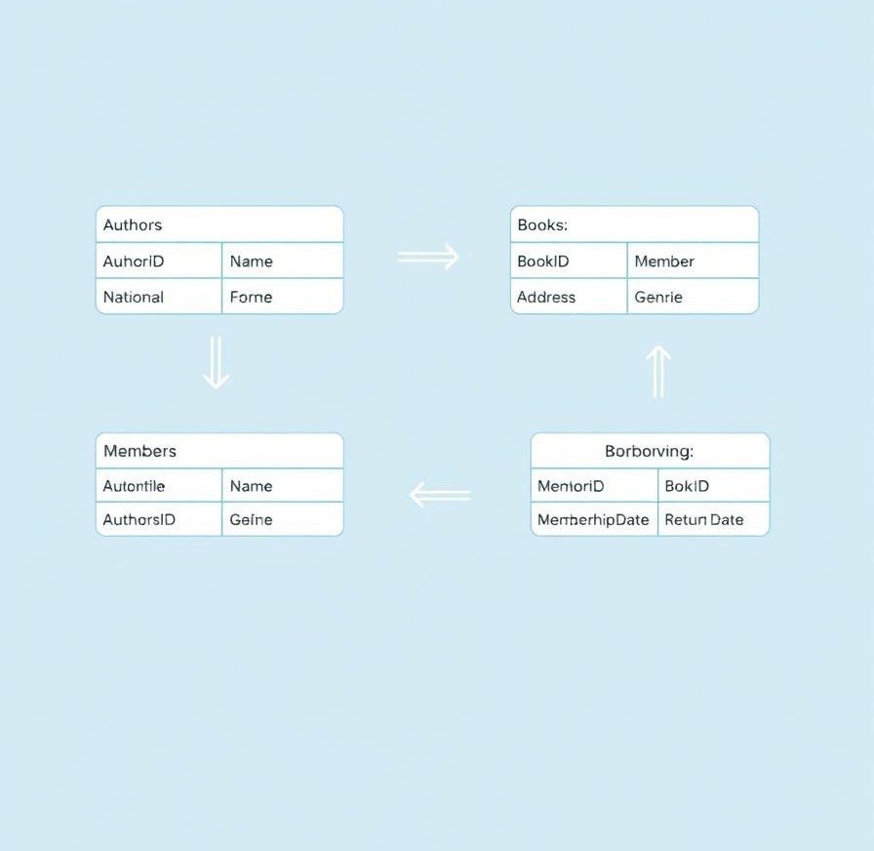
Database Schema Overview
Authors Table
Stores details of book authors with unique IDs
Books Table
Contains book information linked to authors
Members Table
Stores library member information
Borrowing Table
Tracks book loans and borrower details

Slide 3




Example Queries
Find Books by Author
SELECT * FROM Books WHERE author_id = %s
Check Overdue Books
SELECT * FROM Borrowing WHERE return_date < CURDATE()
List Members Borrowing a Book
SELECT m.name FROM Members m JOIN Borrowing b ON m.member_id = b.member_id WHERE b.book_id = %s

Slide 4

Python Connectivity
1
Setup
2
Operations
Uses mysql.connector library for MySQL connection
Connect, execute queries, fetch results

Slide 5




Potential Applications
Library Management
Book Recommendations
1
Full tracking of books, author, members, borrowing
Suggest books based on borrowing patterns
2
Connection to Python
4
Analytics
Python used to connect to and interact with a MySQL database.
3
Analyze borrowing trends and member activity

Slide 6

Summary & Next Steps
Finalize Database
Ensure robust design and relationships
Optimize Queries
Improve efficiency and speed
Create User Interface
Build accessible and intuitive app front-end

Slide 7
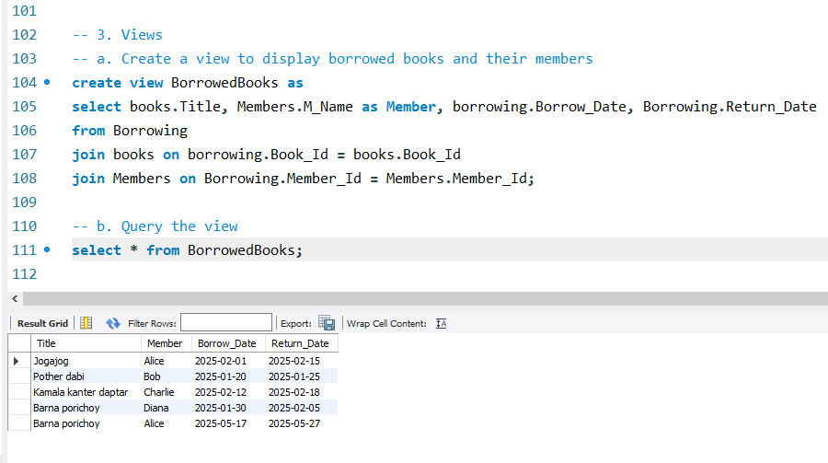
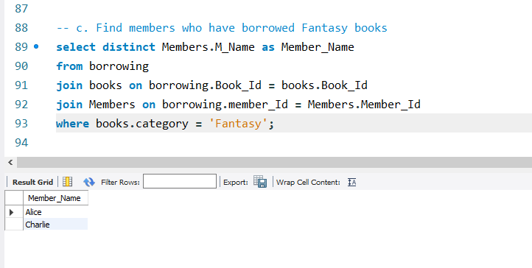
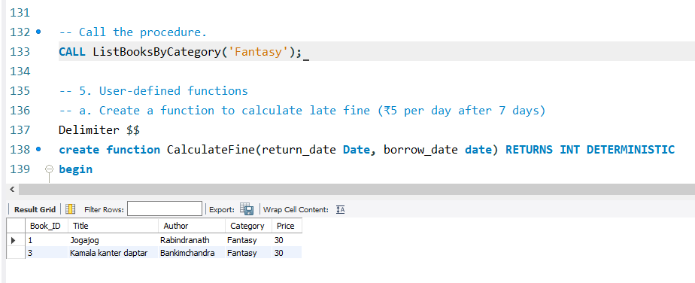
Queries

Slide 8
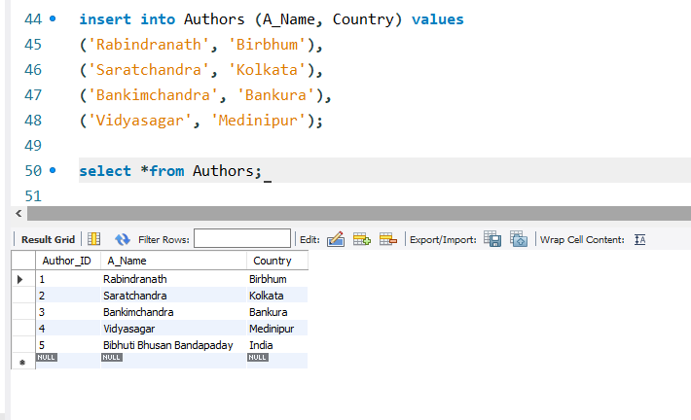
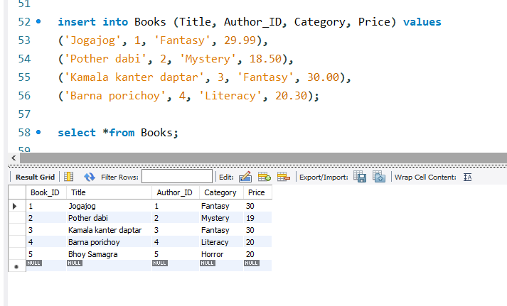
Output

Slide 9
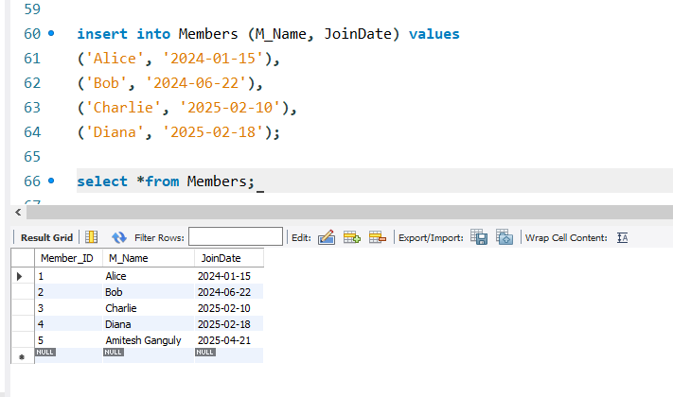
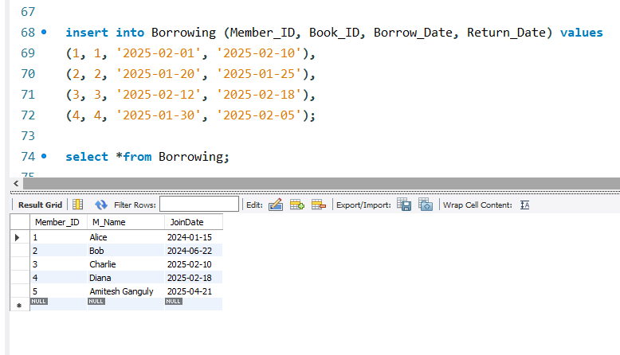
Output

Slide 10
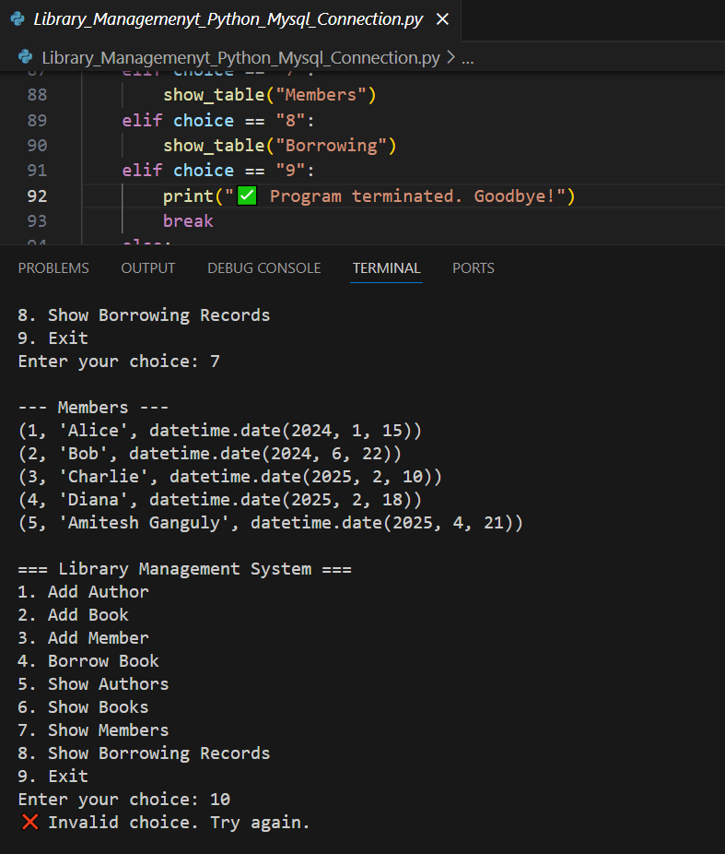
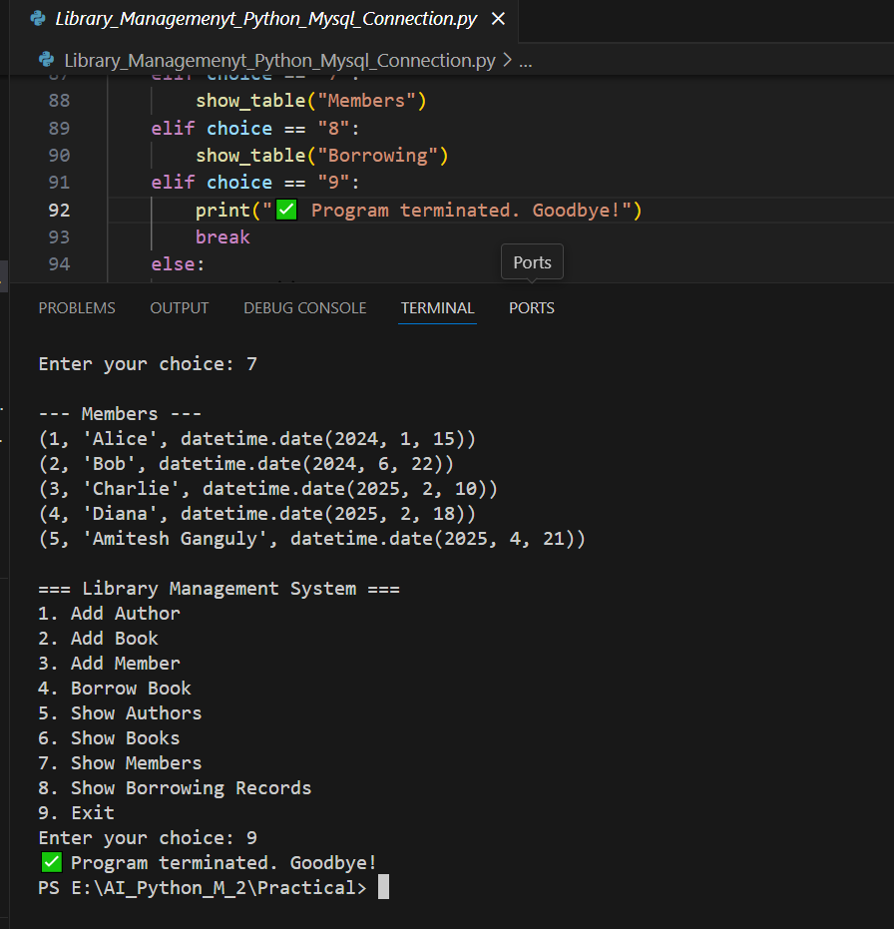
Screenshot

Slide 11
Challenges & Learnings Outcomes
Challenges
Writing efficient SQL queries.
Properly managing relationships.
Connecting MySQL to Python.
Learnings Outcomes
Writing SQL statements.
Using JOINs to combine data from multiple tables.
Understanding how to structure data logically.

Slide 12
Thank You

