Slide 1
Bellabeat Marketing Strategy
Dipali Patil
3rd oct 2022

Slide 2
Senario
Analyze Fitbit fitness data to unlock new growth opportunities for Bellabeat. We are focusing on the ‘Time’ product of Bellabeat.
Goals :
Unlock the new growth opportunities.
Increase revenue
Better service for women
Improve health and habits
Become a larger player in the global smart device market.

Slide 3
Business Task
Let’s add new features to our product ‘Time’ in order to increase our revenue and help women to be aware of health and fitness.

Slide 4
Analysis from Fitbit users data

Slide 5
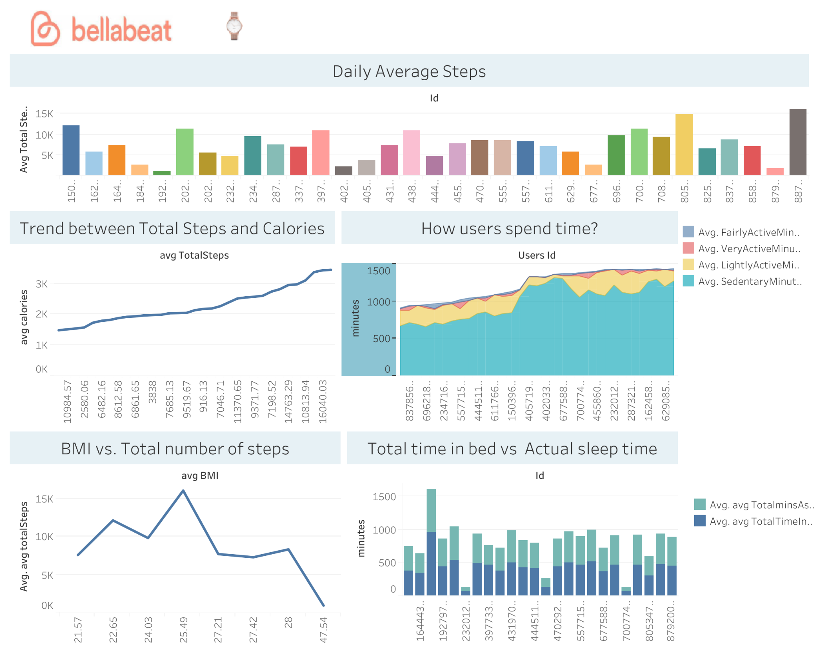

Slide 6
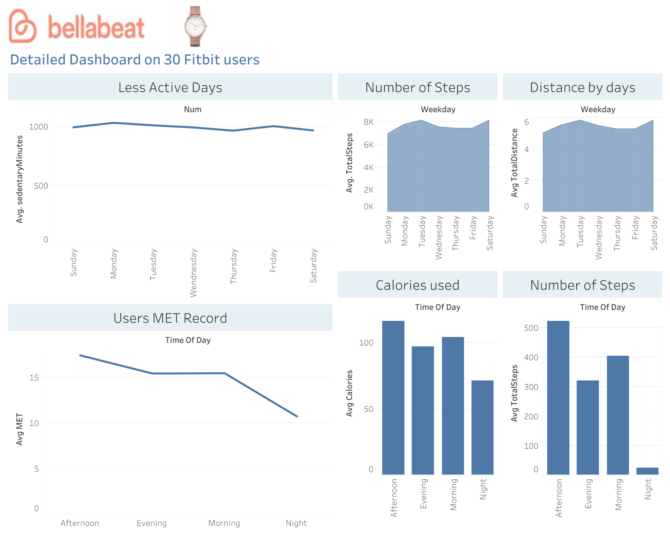

Slide 7
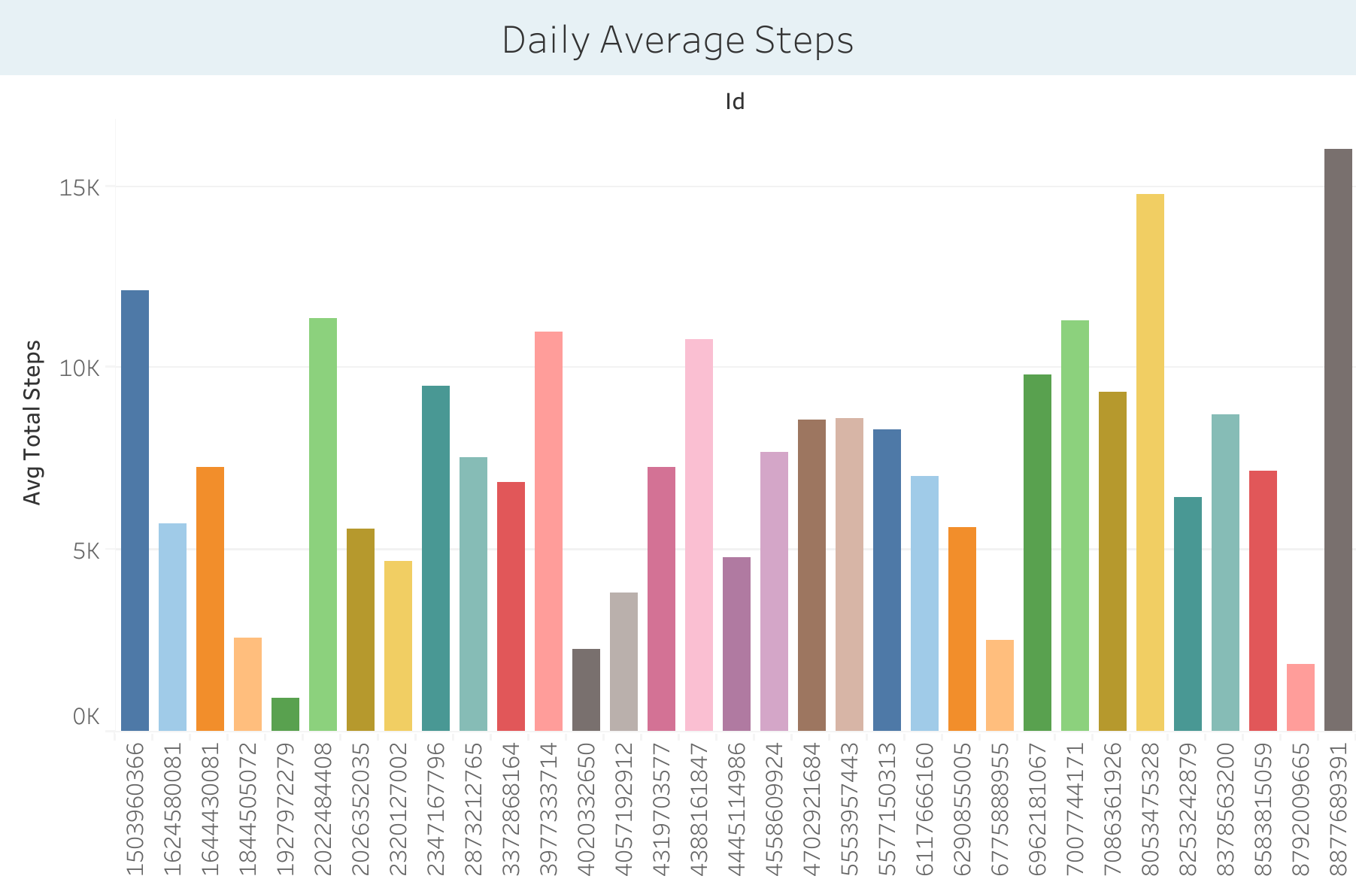
Total daily recommended steps by CDC is 10,000 and in fitbit user dataset approximately average total daily steps are 7500.

Slide 8
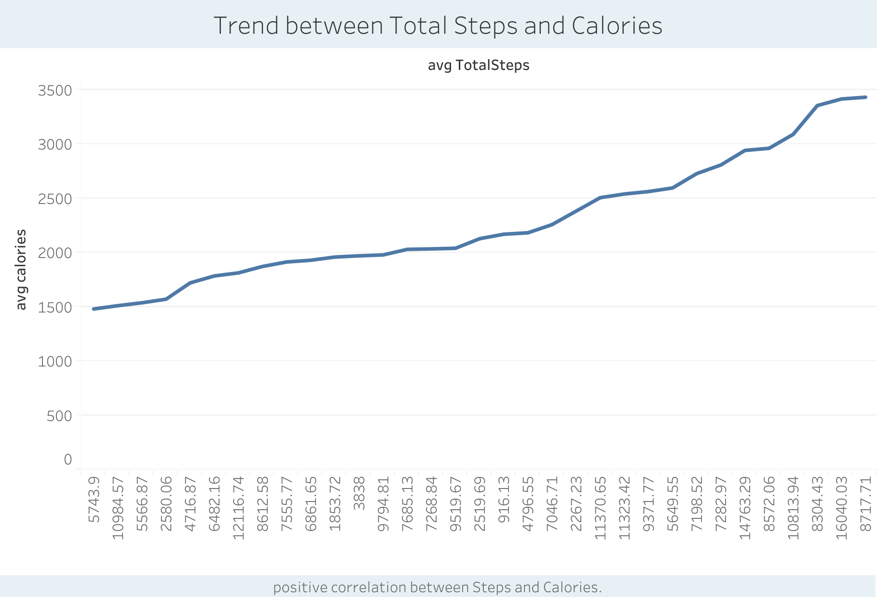
2. Steps and Calories have positive correlation.

Slide 9
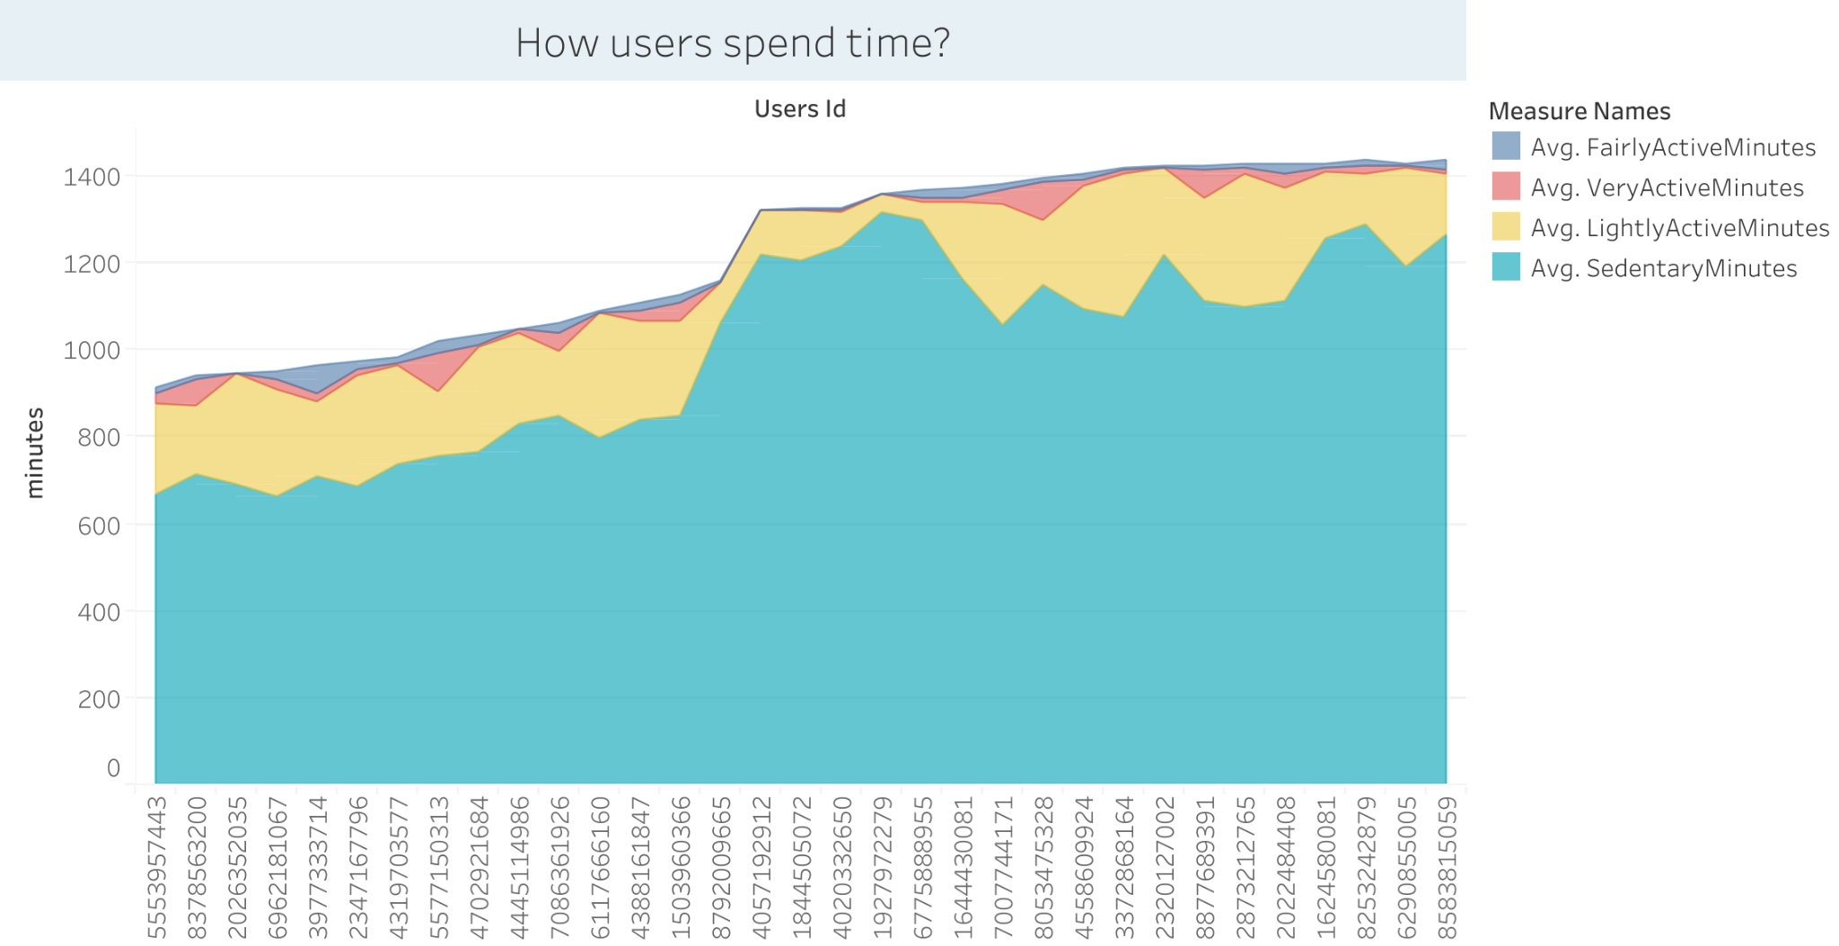
3. How users spend time?

Slide 10
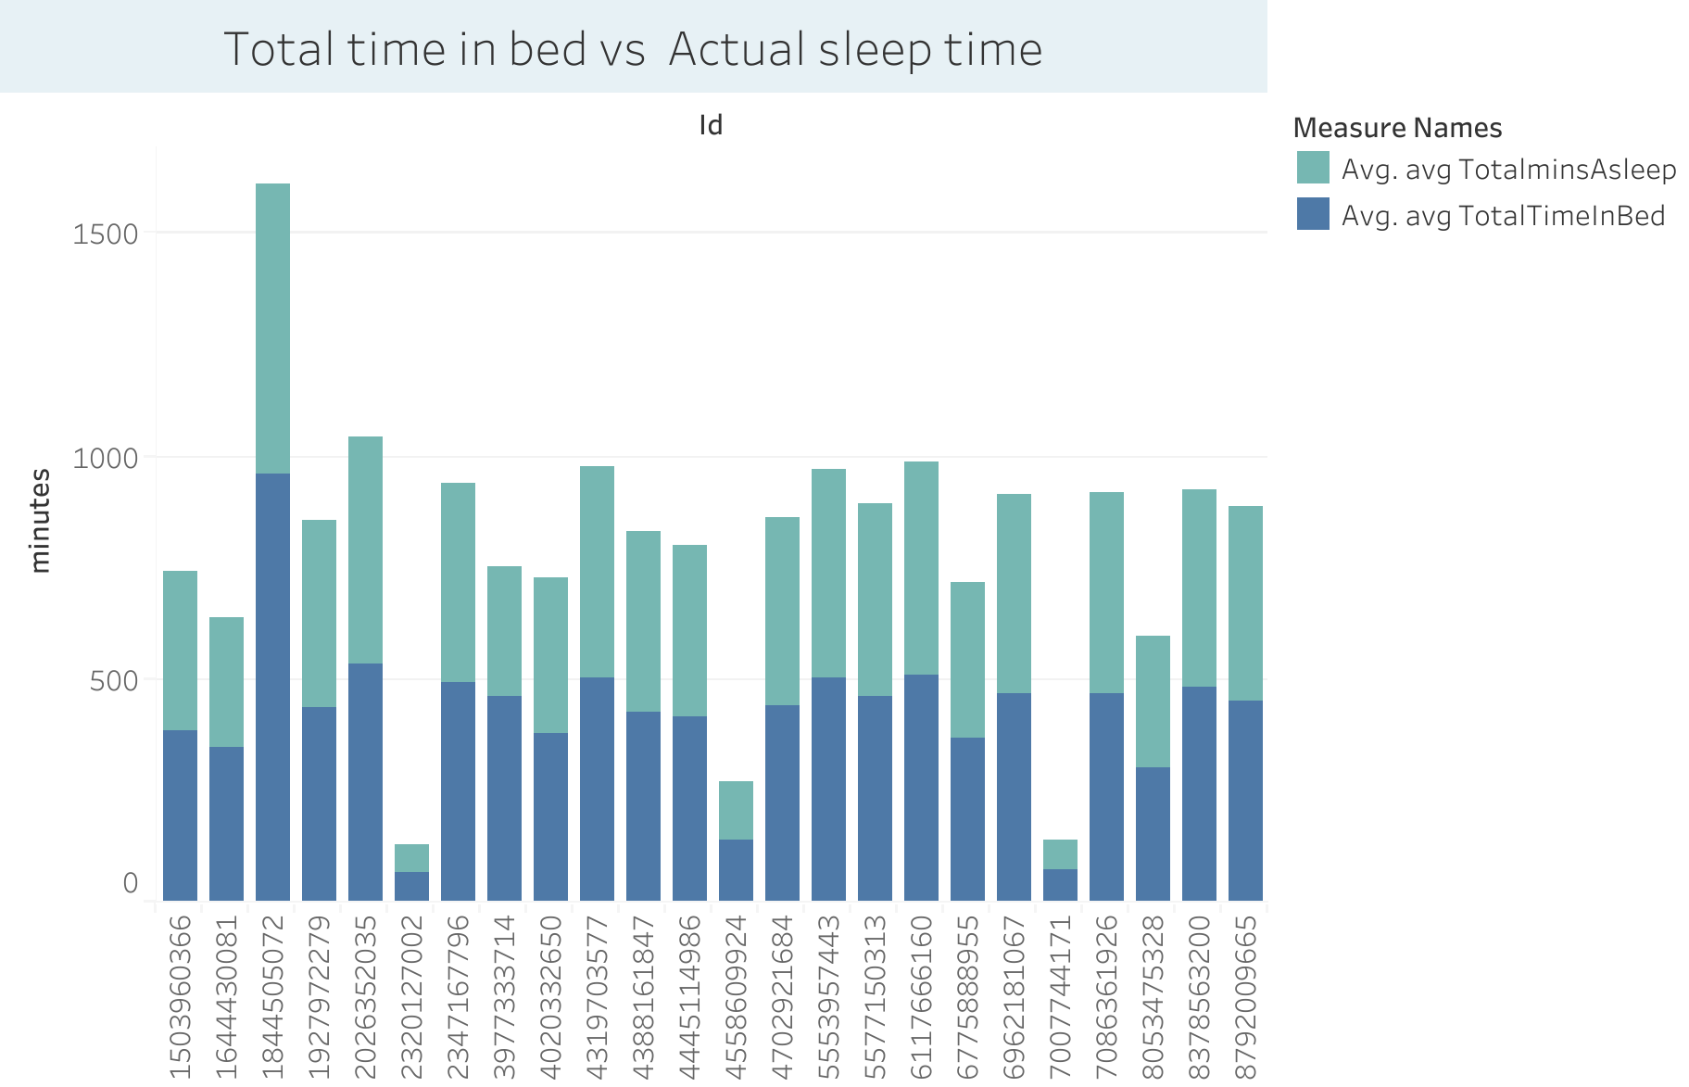
4. Actual sleep time vs. total time in bed

Slide 11
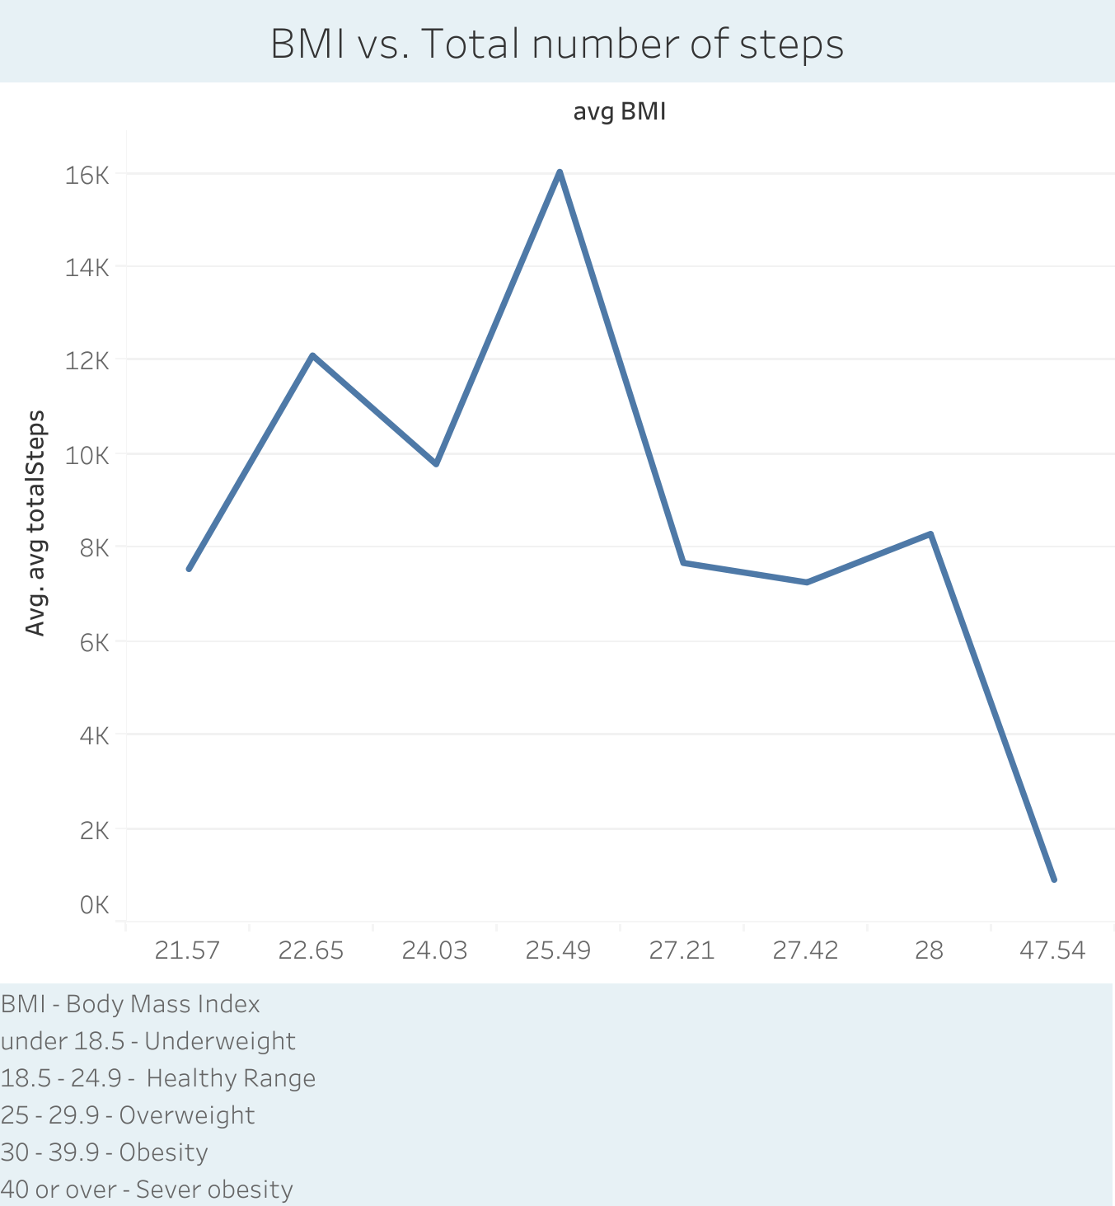
5. BMI : healthy range of BMI users are more active than overweight users. As the BMI increases Activity decreases.

Slide 12
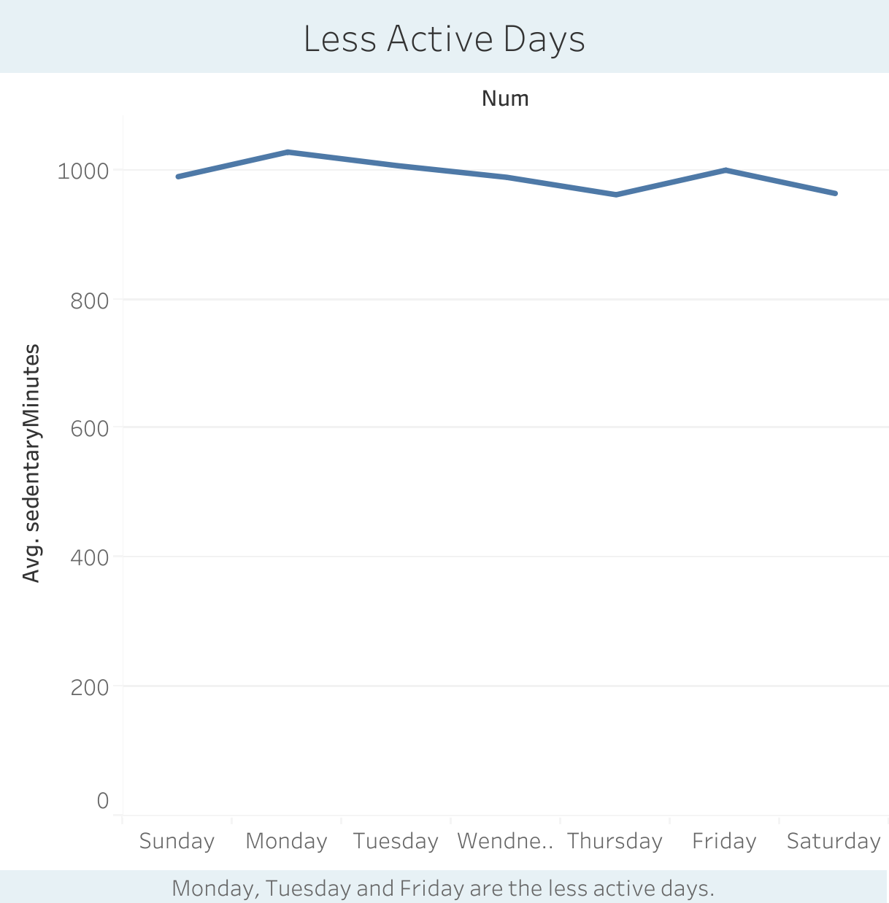
6. Users are less active on Monday and Friday

Slide 13
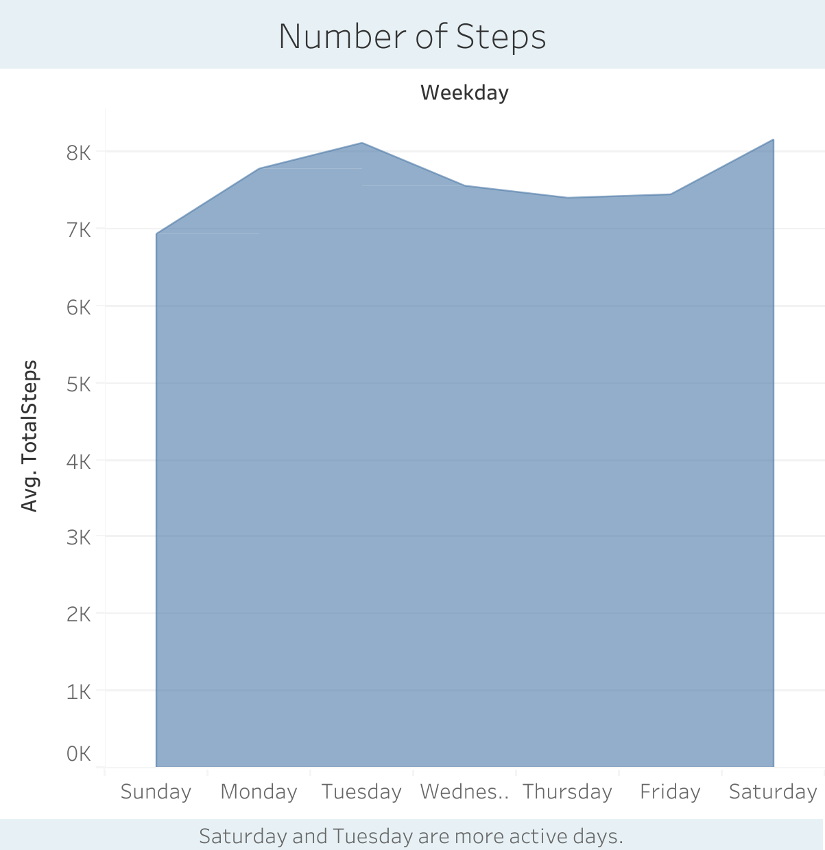
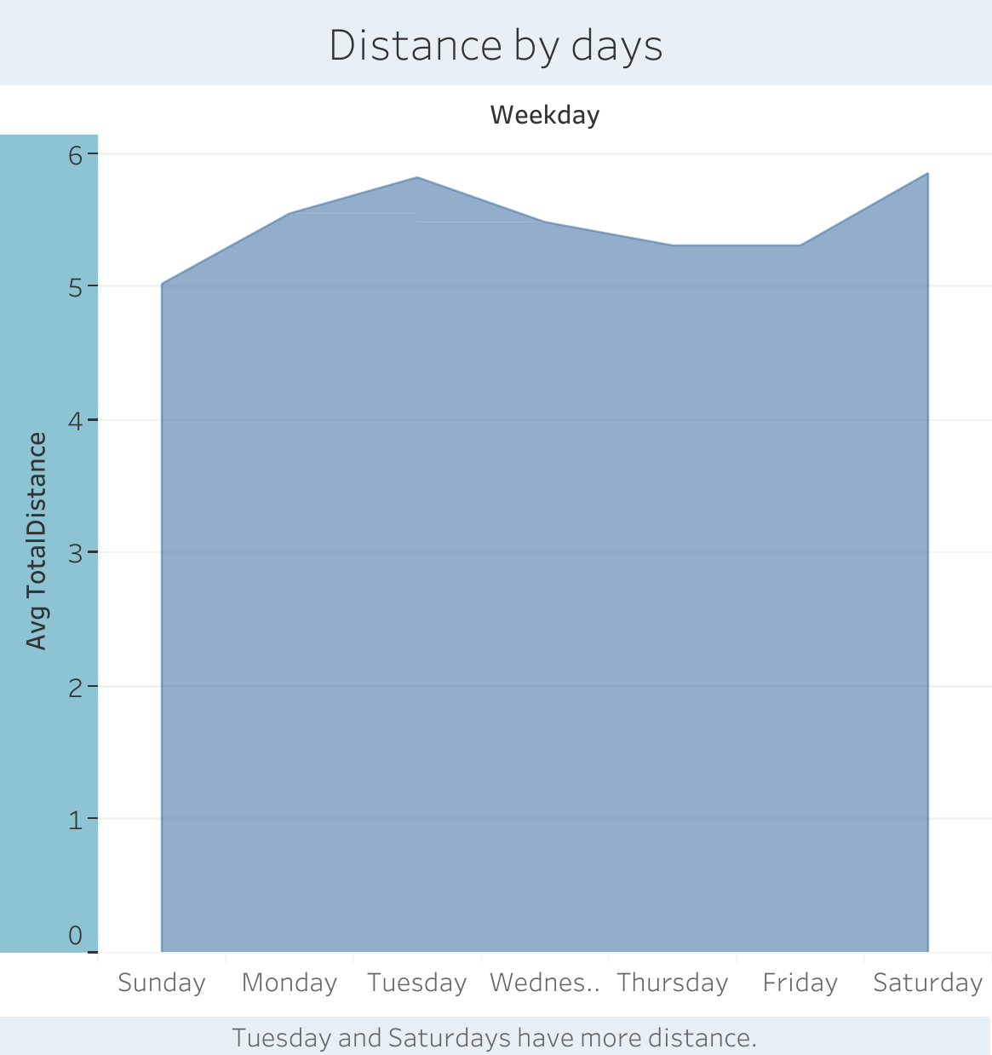
7. Saturday and Tuesday are more active days

Slide 14
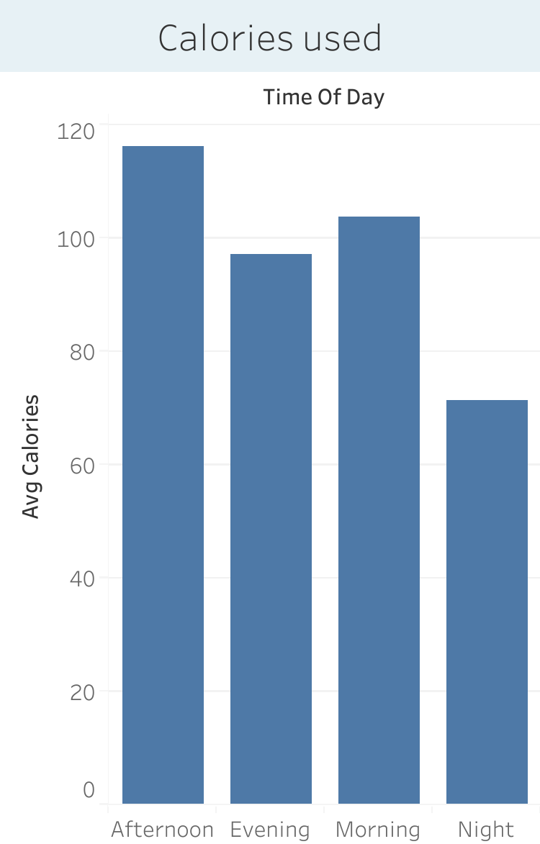
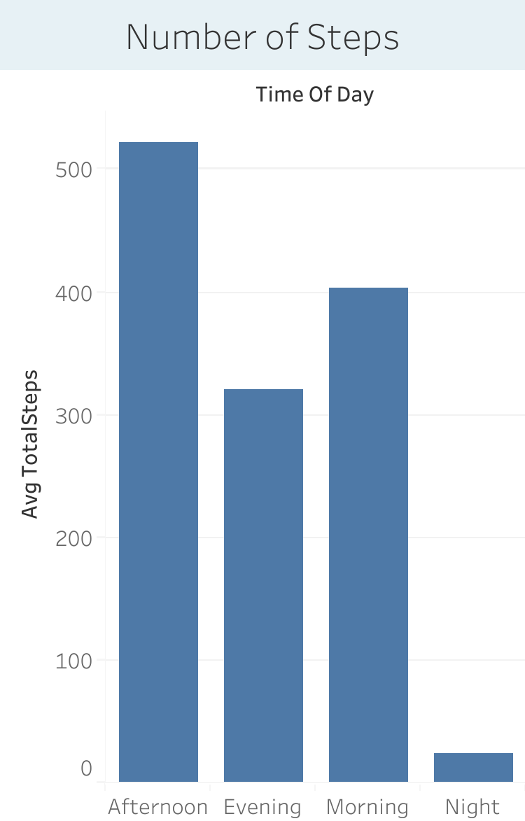
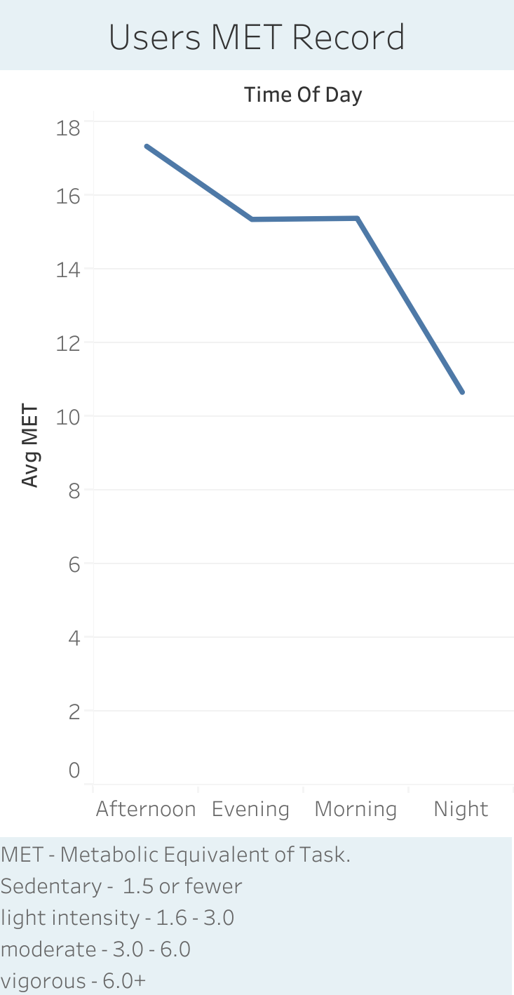
8. At what time of day users are more active

Slide 15
Recommendations
offer membership discounts
Introduce new features like to track calories, heart rate, suggest exercise according to BMI.
Hourly reminder popup to encourage users to be active.
add reminder to less active days.
add health tips option.
Before sleep, encourage users to avoid screen time and do meditation.
Allow user to choose features from bellabeat app.
If exercise target is completed then praising words should pop up. Like congratulations, great work to encourage.
After adding features surveys should be done.

Slide 16
Thank you

