Slide 1
Fraud Detection MLOps Pipeline Architecture
Batch Processing • Prediction Studio • Alert System

Slide 2
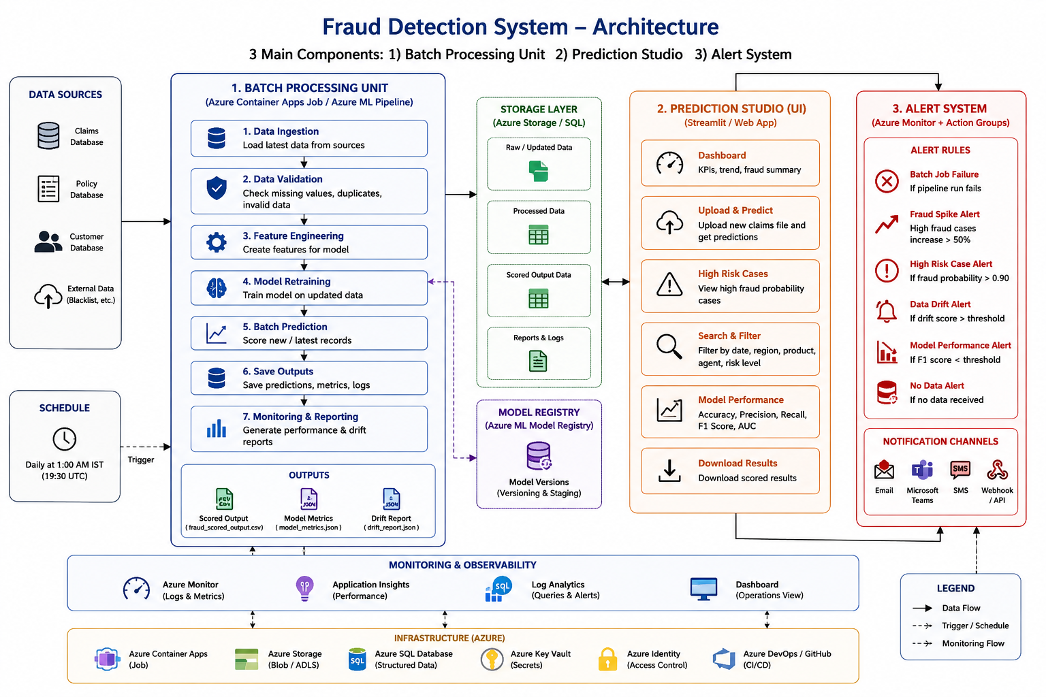
End-to-End Fraud Detection Architecture

Slide 3
Detailed Pipeline Flow
1. Pipeline Trigger (Daily 1 AM Scheduler)
2. Data Ingestion from Claims, Policy, Customer & External Sources
3. Data Validation (schema, duplicates, missing values)
4. Feature Engineering for fraud indicators
5. Model Retraining on updated labelled data
6. Model Evaluation (Precision, Recall, F1, ROC-AUC)
7. Model Registry & Versioning
8. Batch Prediction & Fraud Scoring
9. Save Results to SQL / Blob / Data Lake
10. Prediction Studio (Streamlit Dashboard)
11. Alert System for failures and fraud spikes
12. Monitoring & Feedback Loop

Slide 4
1. Batch Processing Unit
Scheduled daily at 1 AM IST
Loads updated fraud and claims data
Runs validation checks
Creates engineered features
Retrains fraud model
Runs batch scoring
Stores outputs and metrics

Slide 5
2. Prediction Studio
Streamlit-based fraud analytics dashboard
Upload & Predict functionality
High-risk case analysis
Fraud trend monitoring
Model performance tracking
Download scored results

Slide 6
3. Alert System
Batch job failure alerts
Fraud spike alerts
High-risk fraud alerts
Data drift alerts
Low model performance alerts
Email / Teams / Webhook notifications

Slide 7
Recommended Azure Services
Azure Container Apps Job → Daily scheduled pipeline
Azure Blob Storage / Azure SQL → Output storage
Azure ML / MLflow → Model Registry
Azure Monitor → Logs & Metrics
Azure Action Groups → Notifications
Azure App Service → Streamlit Hosting

Slide 8
Executive Summary
The fraud detection system operates as a scheduled batch MLOps pipeline. Every day at 1 AM, updated data is ingested, validated, transformed, and used to retrain the fraud model. The system performs batch scoring on new claims, stores outputs centrally, exposes insights through the Prediction Studio, and generates alerts for failures, fraud spikes, drift, and performance degradation.

