Slide 1
Functions in C
Dr Bhanu

Slide 2
Function
A function is a block of code that performs a specific task.
There are two types of function in C programming:
Standard library functions
User-defined functions
The standard library functions are built-in functions in C programming.
These functions are defined in header files.
The printf() is a standard library function used to display output on the screen. This function is defined in the stdio.h header file. Hence, to use the printf()function, we need to include the stdio.h header file using #include <stdio.h>.
The sqrt() function calculates the square root of a number. The function is defined in the math.h header file.

Slide 3
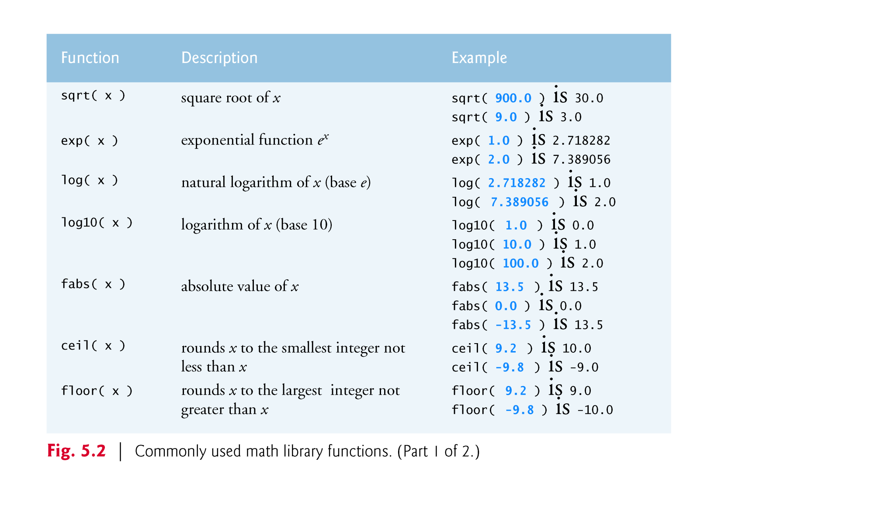

Slide 4
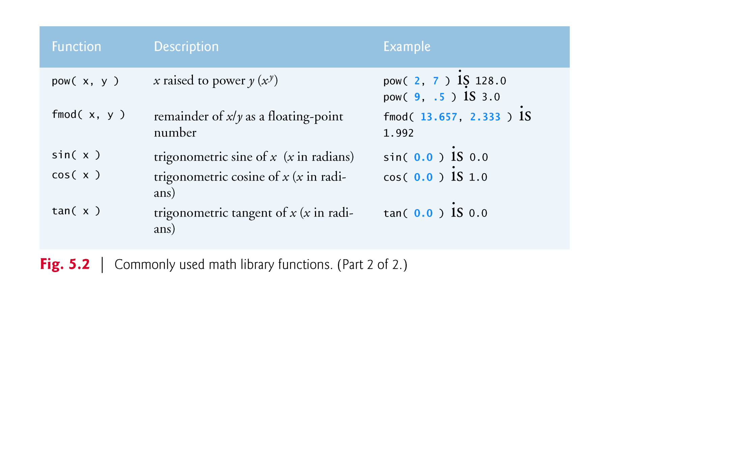
Note : All functions in the math library that return floating point values return the data type double.

Slide 5
Example
int p = -35, q;
double x = -234.34, y;
q = abs(p);
printf("q is : %d\n", q);
y = fabs(x);
printf("y is : %f", y);
Function arguments may be constants, variables, or expressions.
If c1 = 13.0, d = 3.0 and f = 4.0, then the statement
printf( "%.2f", sqrt( c1 + d * f ) );
calculates and prints the square root of 13.0 + 3.0 * 4.0 = 25.0, namely 5.00.

Slide 6
C Standard Library functions
C programs are typically written by combining new functions you write with “prepackaged” functions available in the C Standard Library.
The C Standard Library provides a rich collection of functions for performing common mathematical calculations, string manipulations, character manipulations, input/output, and many other useful operations.
To see the List of Standard Library Functions and corresponding header files……
https://www.ibm.com/support/knowledgecenter/en/ssw_ibm_i_72/rtref/stalib.htm

Slide 7



User Defined Functions
C allows you to define functions according to your need. These functions are known as user-defined functions.
Functions created by the user are known as user-defined functions.
$e^{x}=1+\frac{x}{1!}+\frac{x^{2}}{2!}+ \frac{x^{3}}{3!}+\frac{x^{4}}{4!}…$. =

Slide 8
Example
#include <stdio.h>
int factorial(int); // function prototype
int main()
{
int num;
printf("Enter the number to find factorial\n");
scanf("%d",&num);
factorial(num); // function call
return 0;
}
int factorial(num) // function definition
{
int i,fact=1;
for(i=1; i<=num; i++)
{
fact=fact*i;
}
printf("Factorial of given number is: %d\n",fact); return fact;
}

Slide 9
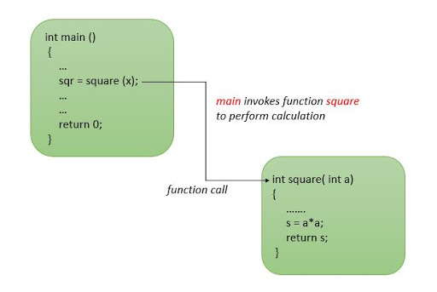

Slide 10
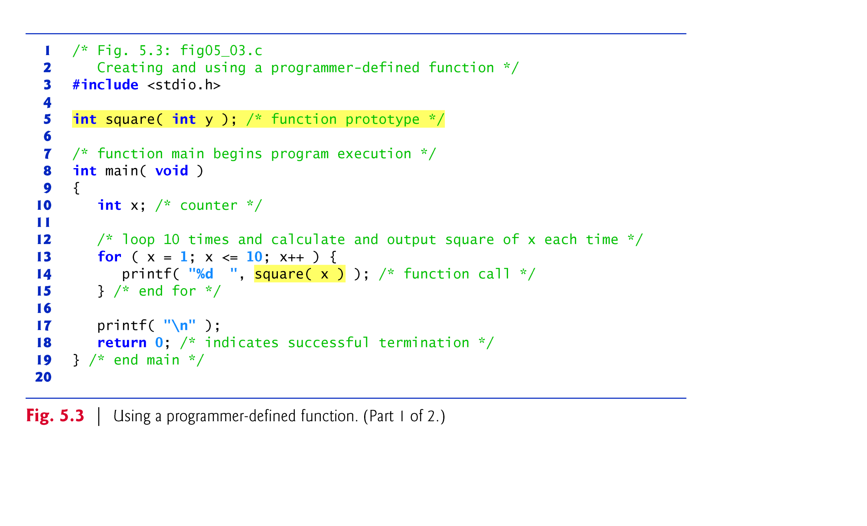

Slide 11
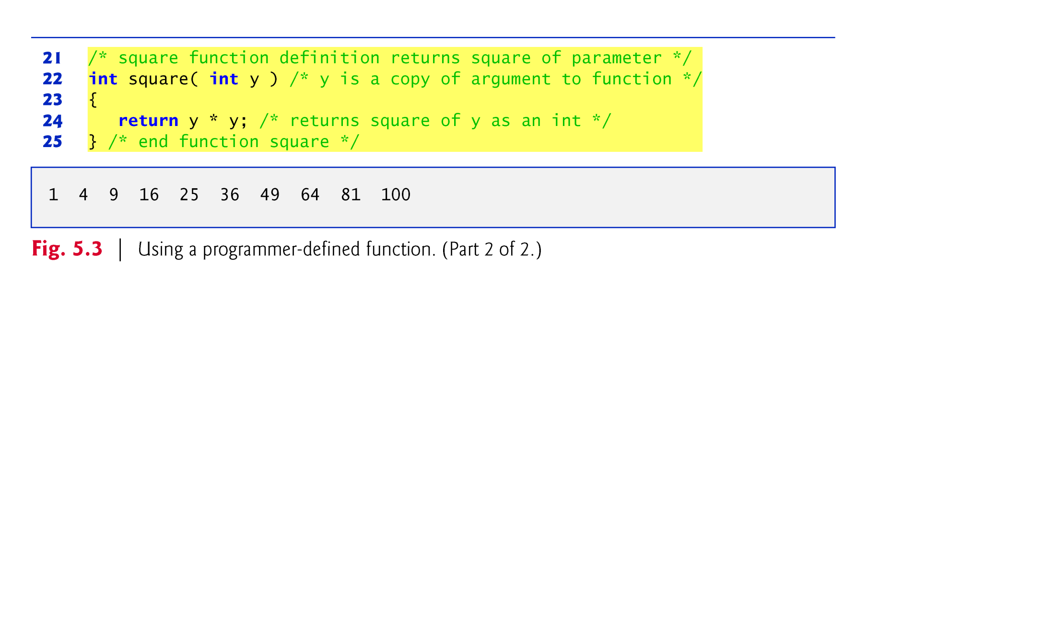

Slide 12
Function Definitions
Function square is invoked or called in main within the printf statement (line 14)
printf( "%d ", square( x ) ); /* function call */
Function square receives a copy of the value of x in the parameter y (line 22).
Then square calculates y * y (line 24).
The result is passed back to function printf in main where square was invoked (line 14), and printf displays the result.
This process is repeated 10 times using the for repetition statement.

Slide 13
Function Definitions
The definition of function square shows that square expects an integer parameter y.
The keyword int preceding the function name (line 22) indicates that square returns an integer result.
The return statement in square passes the result of the calculation back to the calling function.
Line 5
int square( int y ); /* function prototype */
is a function prototype.
The int in parentheses informs the compiler that square expects to receive an integer value from the caller.

Slide 14
Function Definitions
The int to the left of the function name square informs the compiler that square returns an integer result to the caller.
The compiler refers to the function prototype to check that calls to square (line 14) contain the correct return type, the correct number of arguments, the correct argument types, and that the arguments are in the correct order.
The format of a function definition is
return-value-type function-name( parameter-list ) { definitions statements }

Slide 15
Function Definitions
The function-name is any valid identifier.
The return-value-type is the data type of the result returned to the caller.
The return-value-type void indicates that a function does not return a value.
Together, the return-value-type, function-name and parameter-list are sometimes referred to as the function header.

Slide 16
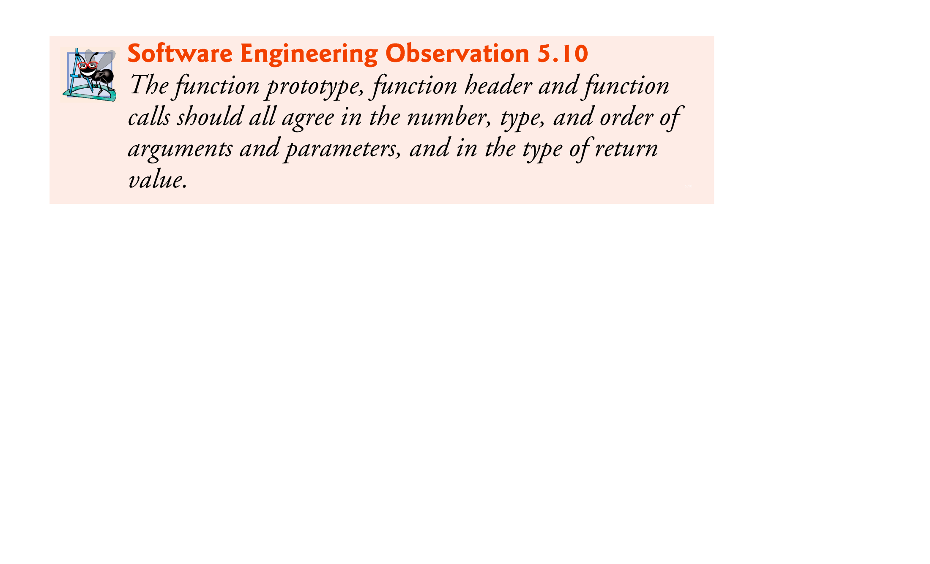

Slide 17
Why to use Functions?
Why is it useful for C programmers to divide their programs into functions? Why not write every program as one big ``chunk'' of statements?
Allows divide and conquer strategy : When developing moderately sized program it’s difficult, not impossible, to write entire program under single large main() in C program. These programs are difficult to test and debug. Therefore the task to be performed is normally divided into several independent sub tasks thereby reducing overall complexity. We can further divide sub tasks into smaller sub tasks reducing complexity further.

Slide 18
Why to use Functions?
Avoid Duplication : Function avoids efforts for duplication of same code. If we want to use same code more than once in program then we can create function for such code. This will reduce the size of source program as well as executable file. This will also reduce the time to test and debug the code.
Hide the implementation details : Functions enable us to hide the implementation details. For example, we use sqrt(), log(), sin() etc. without knowing their implementation. Although we need to know the implementation details of user defined functions, once this function is tested then we can use it without going into implementation details. By hiding the implementation ,the readability of program is improved.

Slide 19
Why to use Functions?
The divide and conquer approach allows the parts of program to be tested and debugged independently and possibly concurrently by the programming team. This will reduce overall development time for project.
The function developed for one program can be reused by another with small or no modification. This further leads to reduction in development time and cost of program.

Slide 20
Designing Structured Programs
The principles of top–down design and structured programming dictate that a program should be divided into a main module and its related modules. Each module should also be divided into submodules according to software engineering principles.

Slide 21
Functions in C
In C, the idea of top–down design is done using functions. A C program is made of one or more functions, one and only one of which must be named
main.
In general, the purpose of a function is to receive zero or more pieces of data, operate on them, and return at most one piece of data.

Slide 22
FIGURE 4-3 Structure Chart for a C Program

Slide 23
Functions
Functions allow you to modularize a program.
All variables defined in function definitions are local variables—they’re known only in the function in which they’re defined.
Most functions have a list of parameters that provide the means for communicating information between functions.
A function’s parameters are also local variables of that function.
Each function should be limited to performing a single, well-defined task and the function name should express that task.

Slide 24
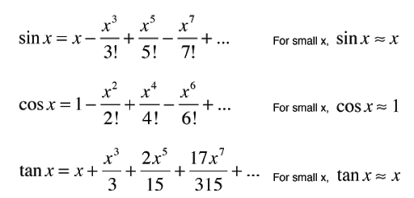
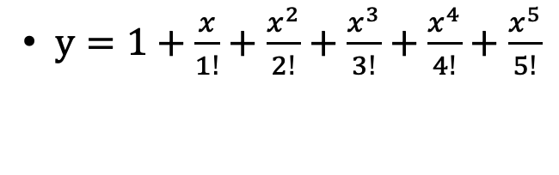
Use functions here?
$y=1+\frac{x}{1!}+\frac{x^{2}}{2!}+\frac{x^{3}}{3!}+\frac{x^{4}}{4!}+\frac{x^{5}}{5!}$

Slide 25
5.5 Function Definitions (Cont.)
The parameter-list is a comma-separated list that specifies the parameters received by the function when it’s called.
If a function does not receive any values, parameter-list is void.
A type must be listed explicitly for each parameter.

Slide 26
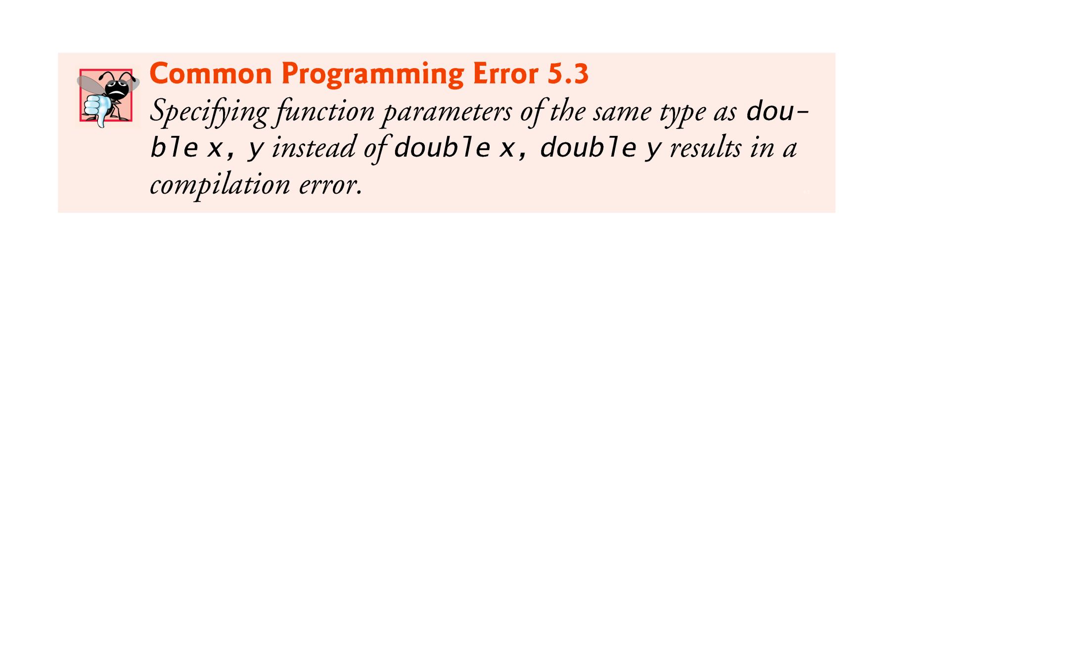

Slide 27


Slide 28
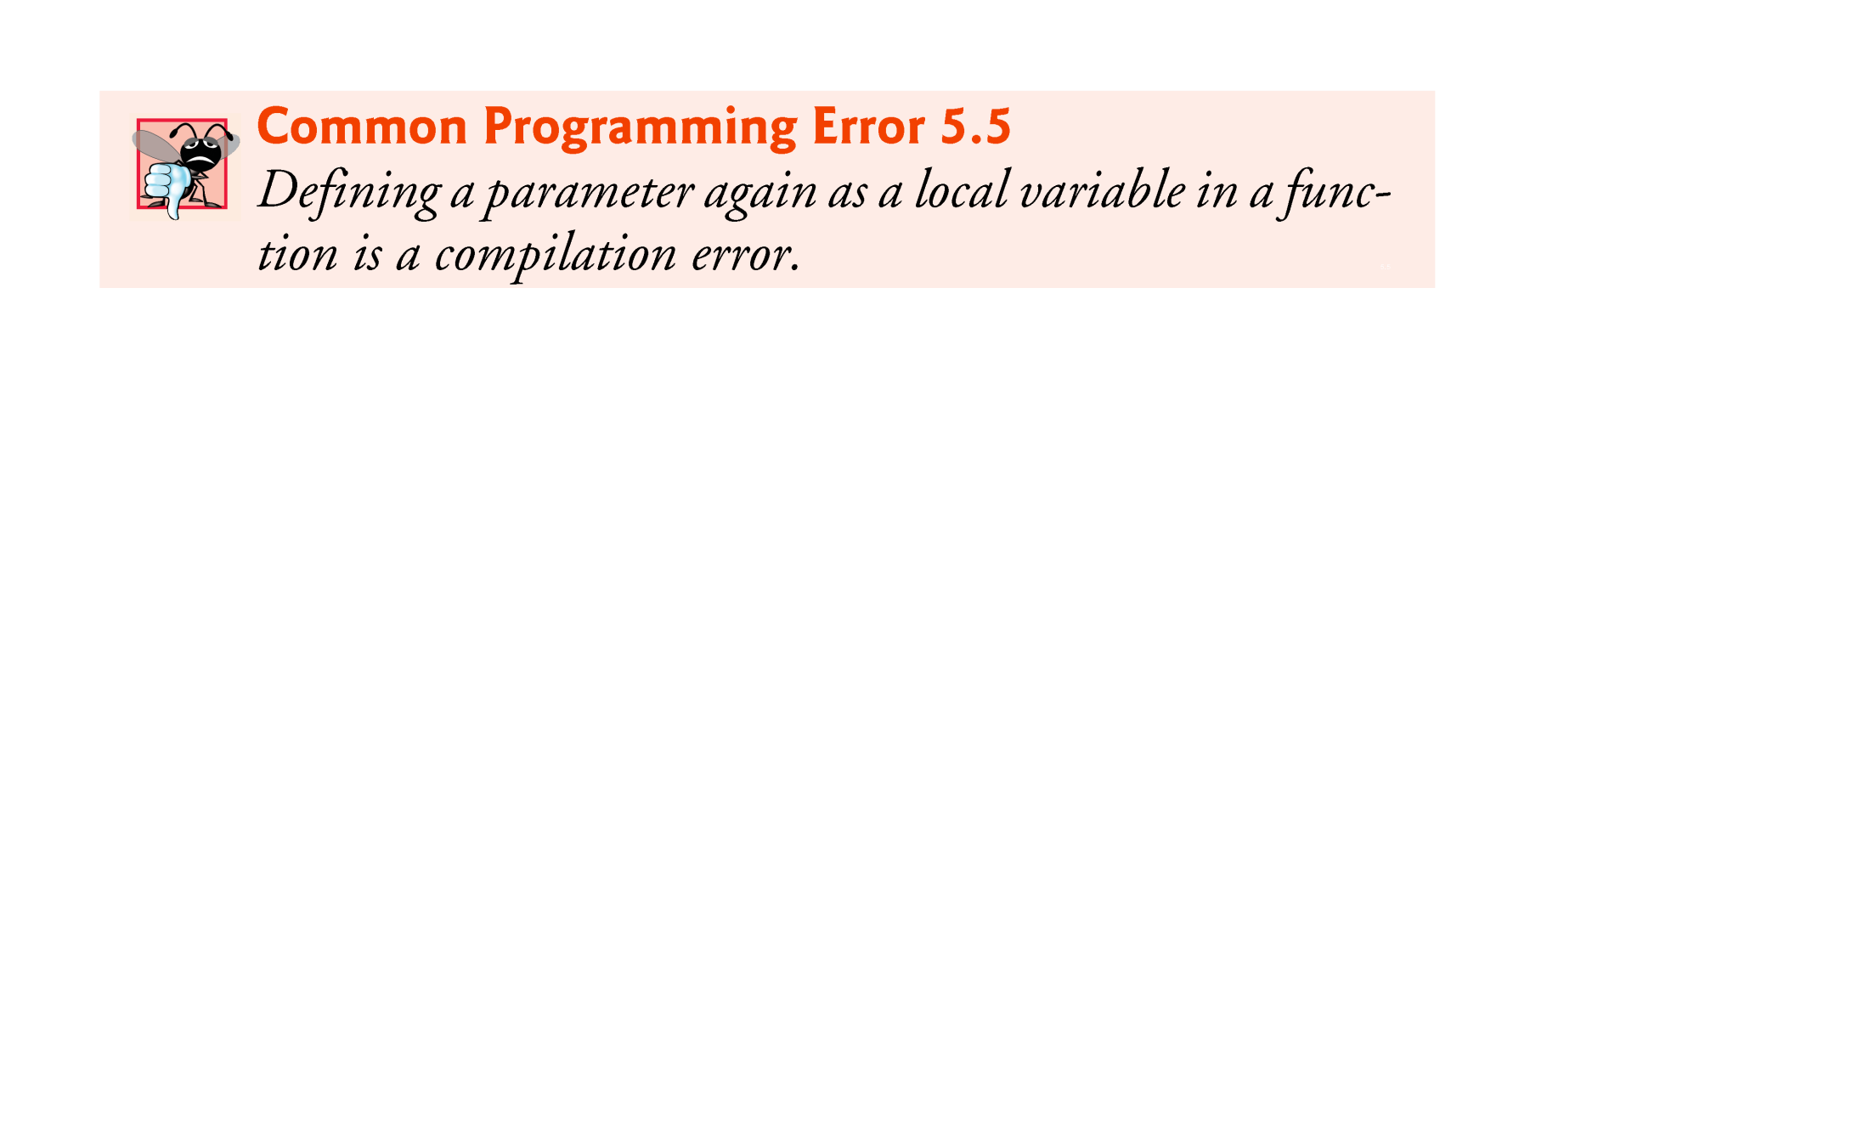

Slide 29
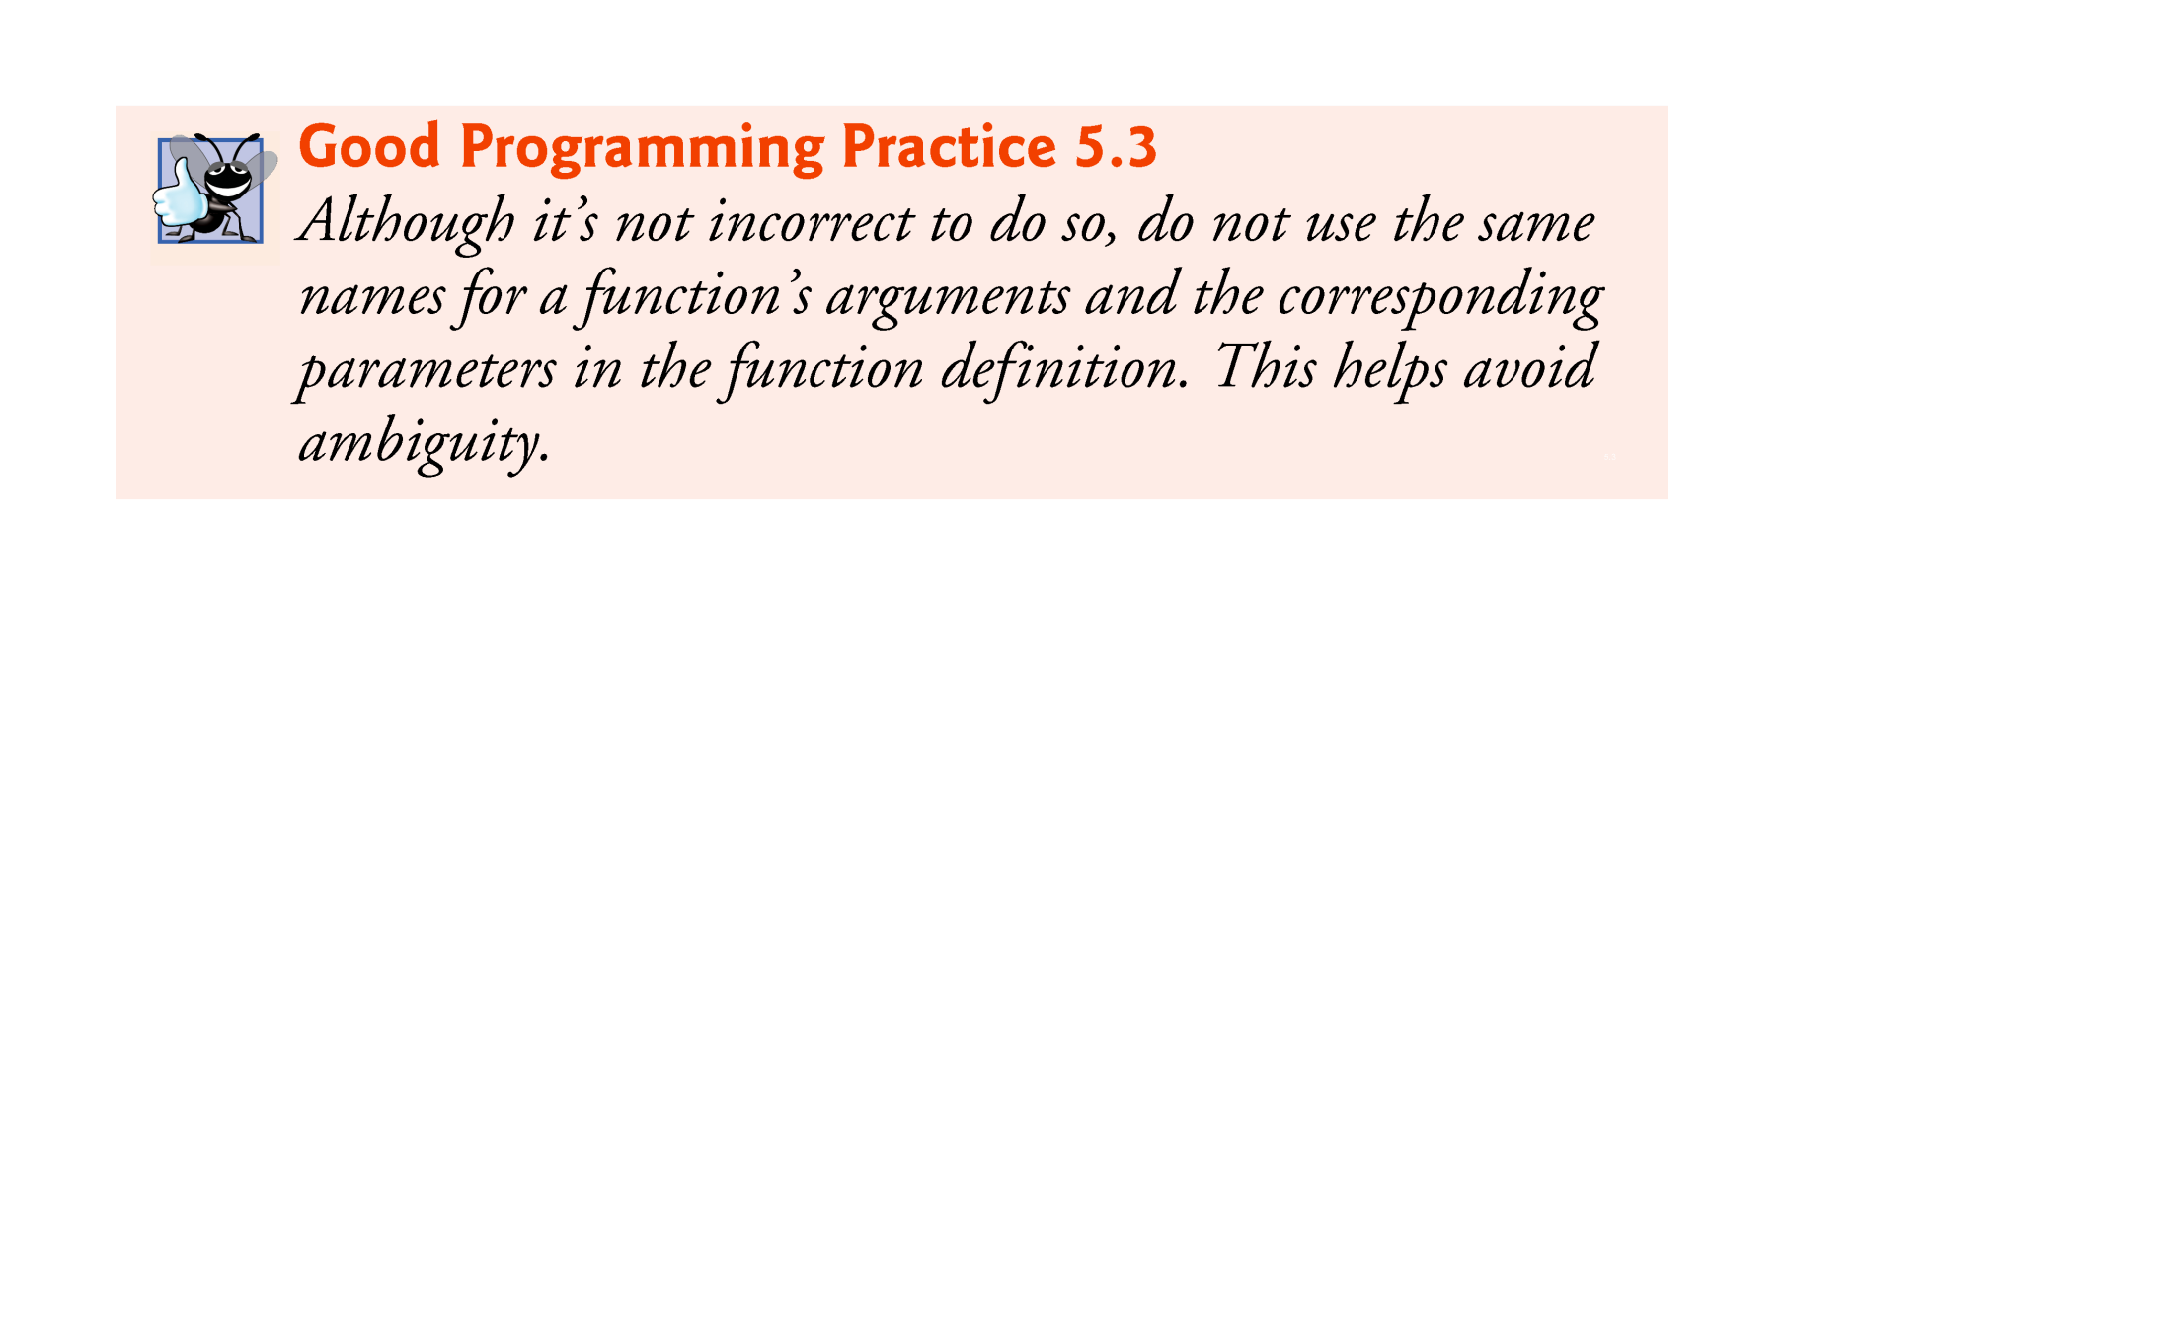

Slide 30
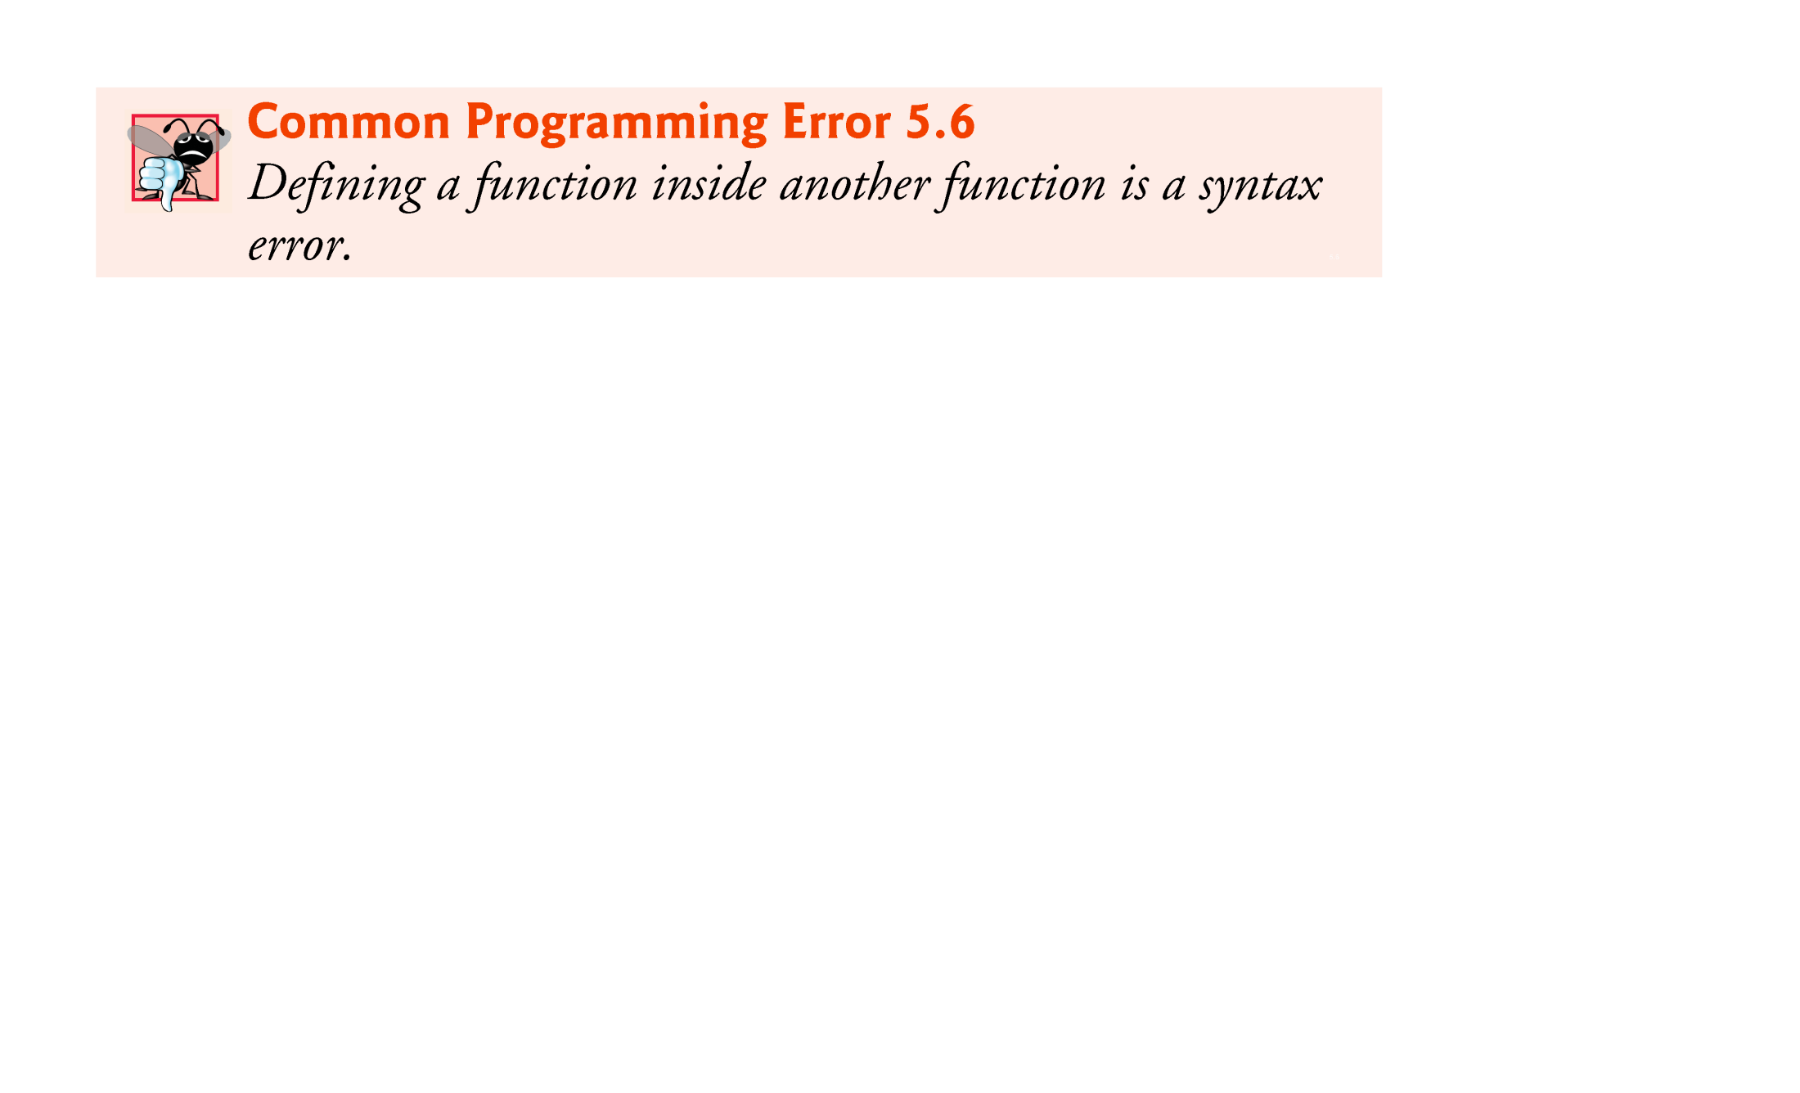

Slide 31
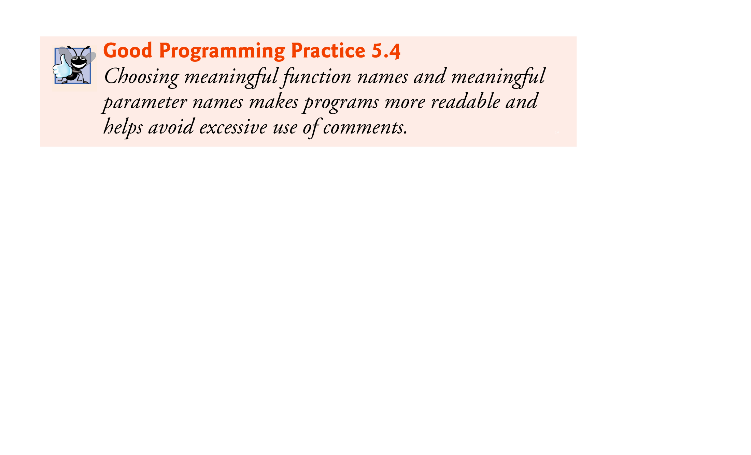

Slide 32


Slide 33
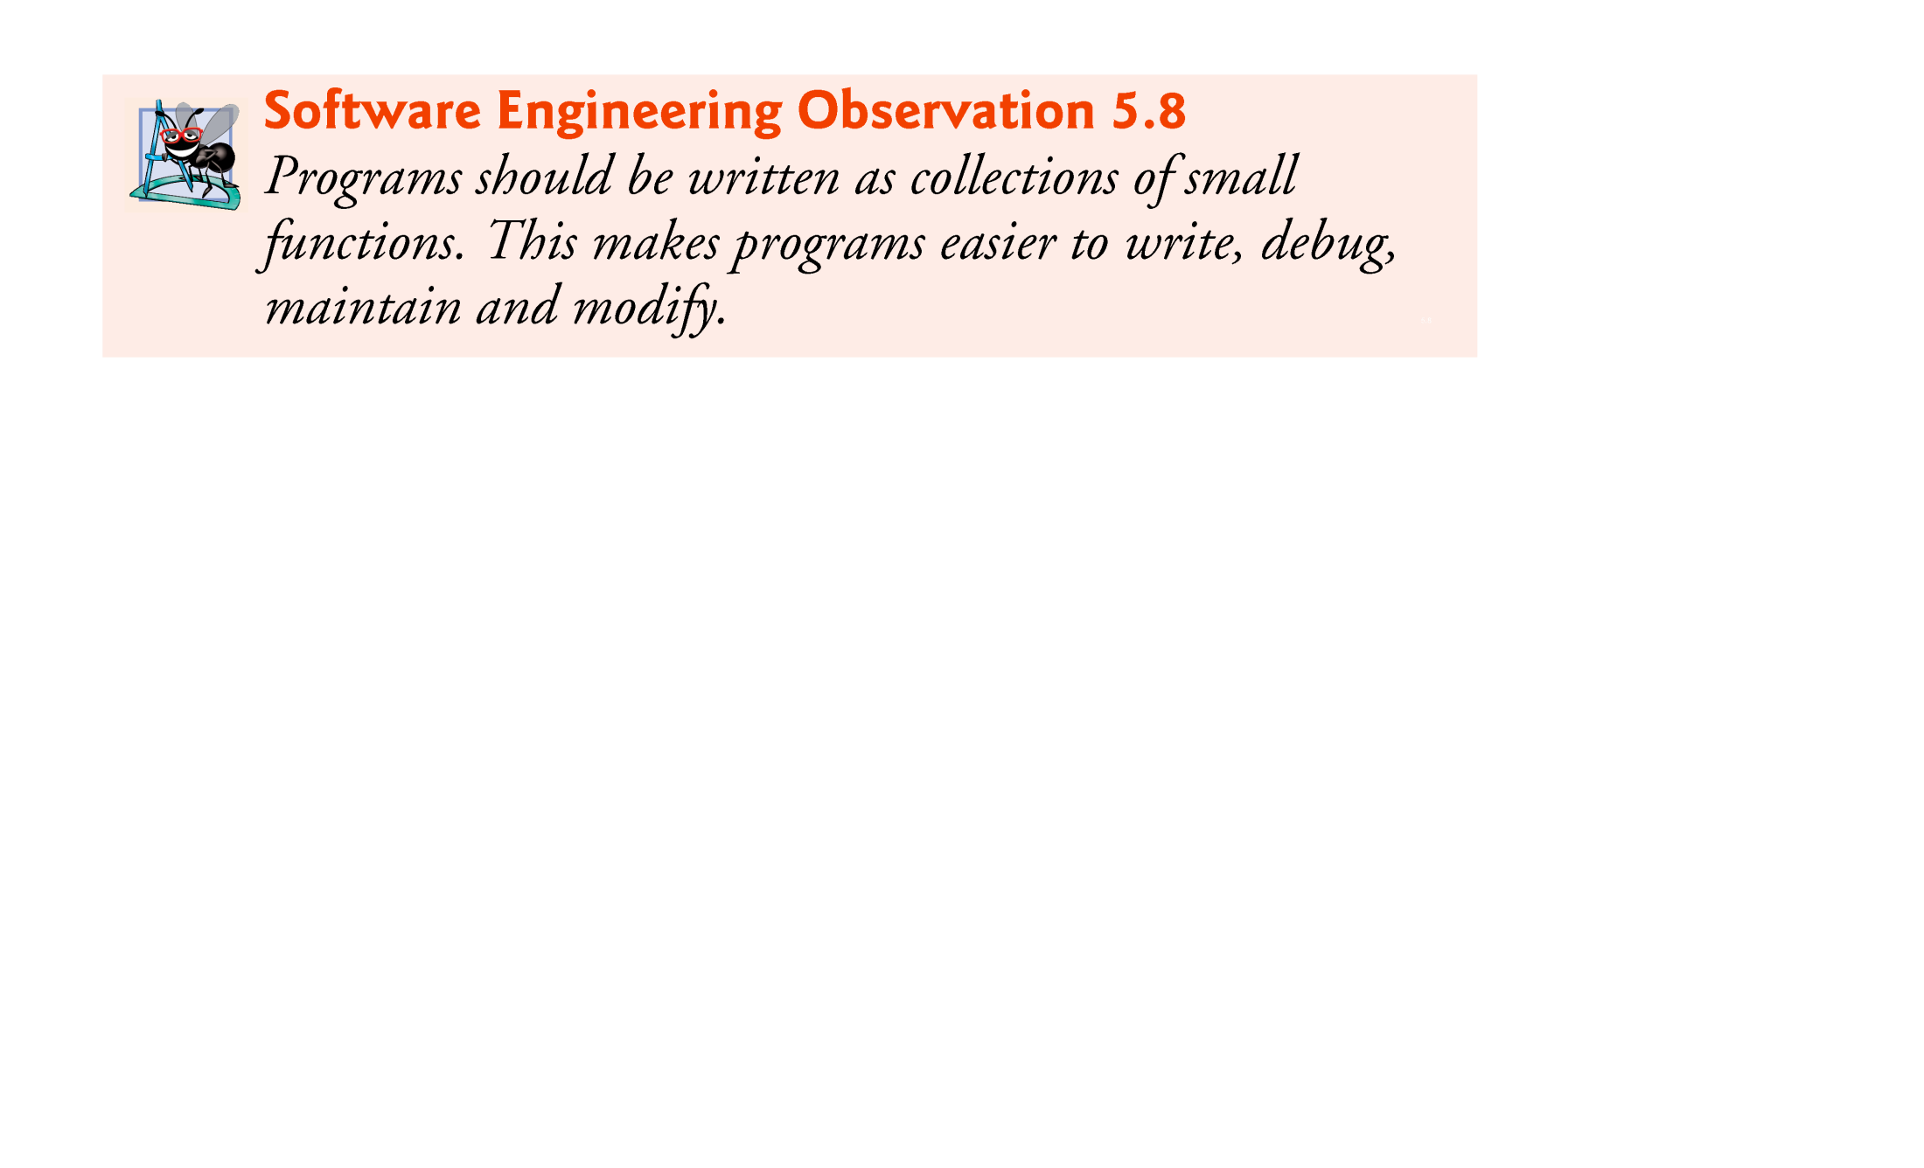

Slide 34
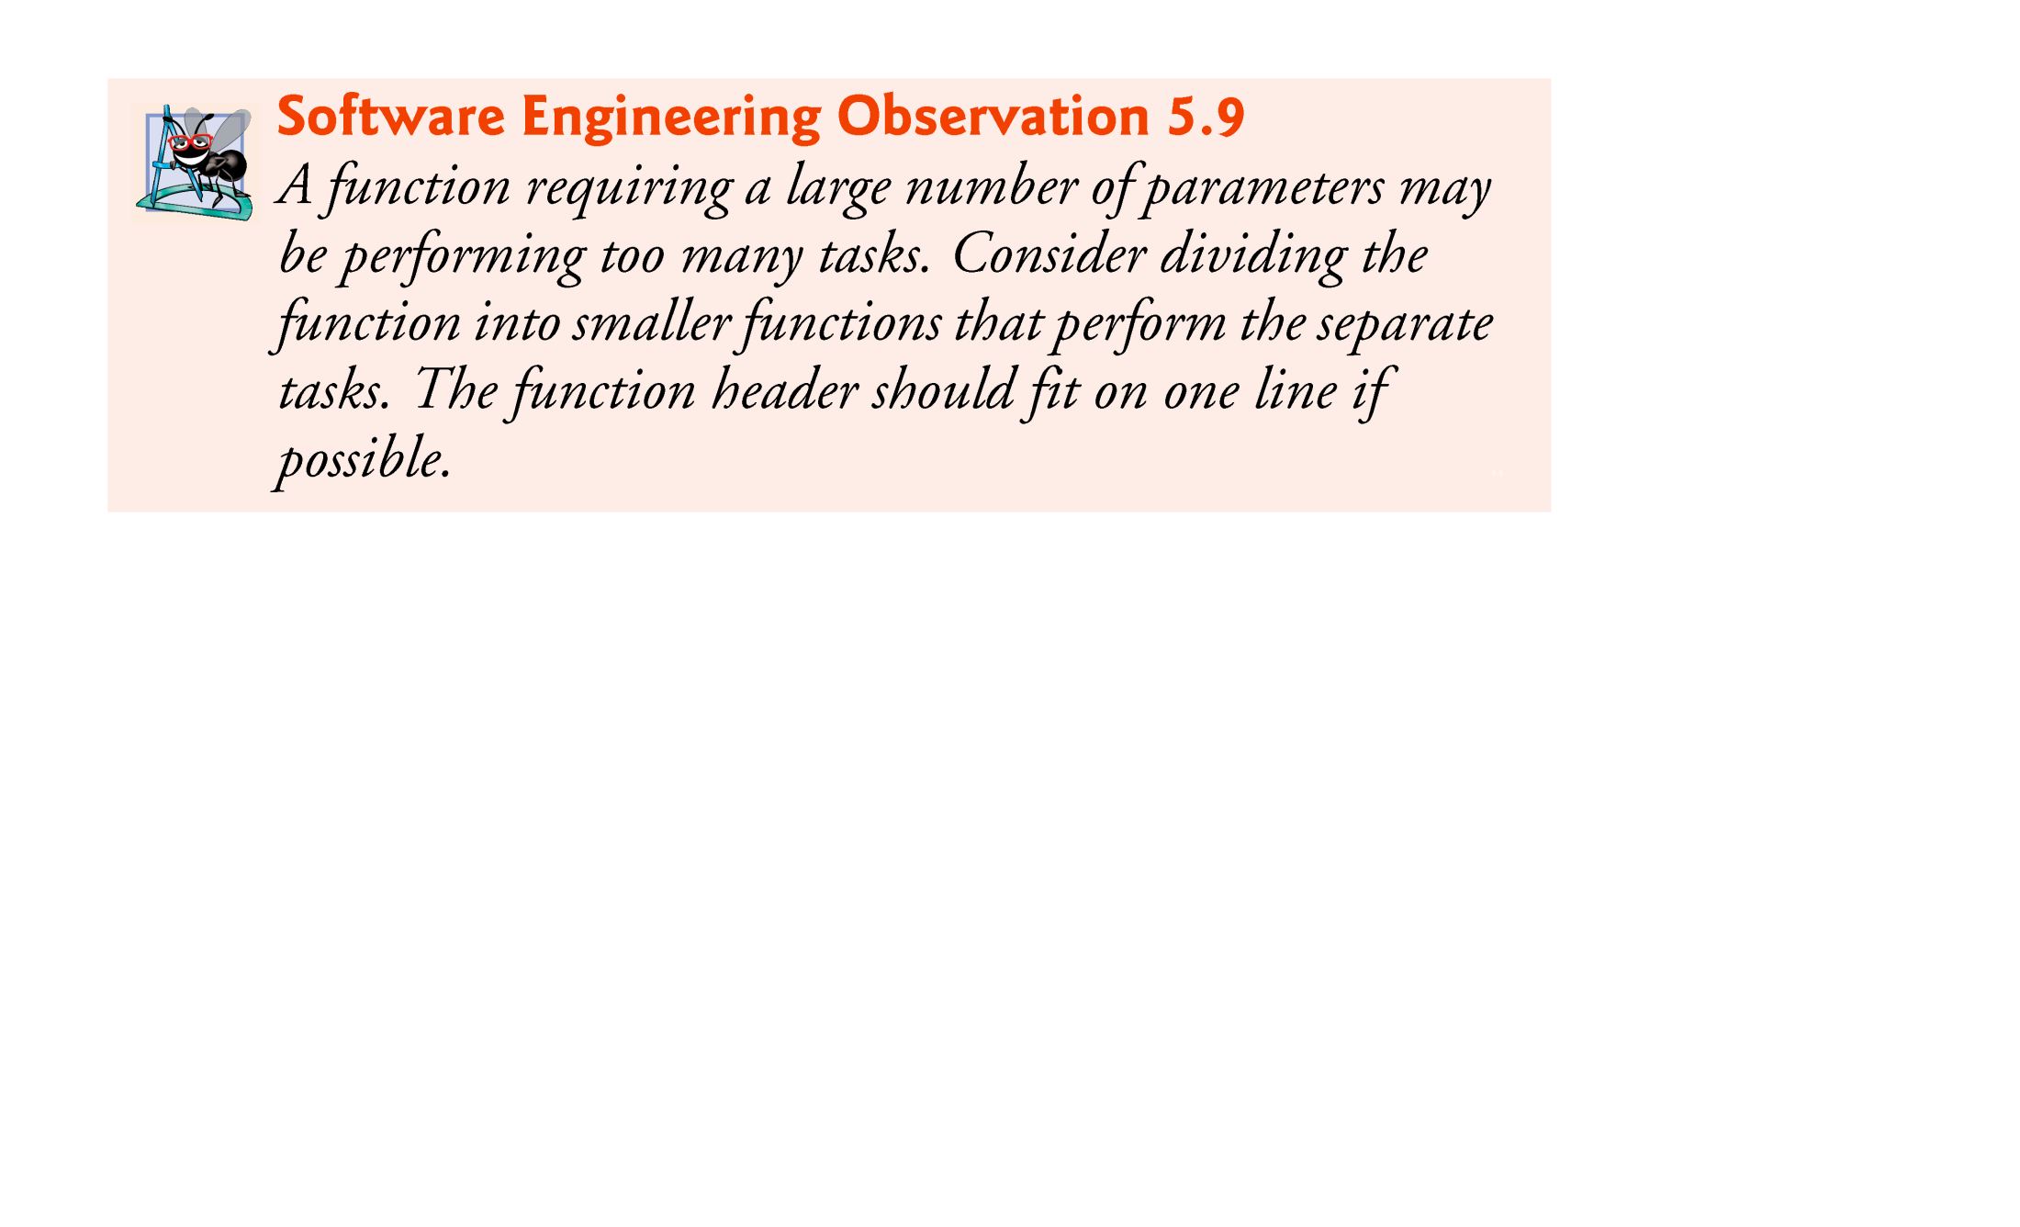

Slide 36
Function Definitions
There are three ways to return control from a called function to the point at which a function was invoked.
If the function does not return a result, control is returned simply when the function-ending right brace is reached, or by executing the statement
return;
If the function does return a result, the statement
return expression;
returns the value of expression to the caller.

Slide 37
Function Prototypes
One of the most important features of C is the function prototype.
This feature was borrowed by the C standard committee from the developers of C++.
A function prototype tells the compiler the type of data returned by the function, the number of parameters the function expects to receive, the types of the parameters, and the order in which these parameters are expected.
The compiler uses function prototypes to validate function calls.

Slide 38
Function Prototypes
Previous versions of C did not perform this kind of checking, so it was possible to call functions improperly without the compiler detecting the errors.
Such calls could result in fatal execution-time errors or nonfatal errors that caused subtle, difficult-to-detect logic errors.
A function call that does not match the function prototype is a compilation error.
An error is also generated if the function prototype and the function definition disagree.

Slide 39
Function Prototypes
If there is no function prototype for a function, the compiler forms its own function prototype using the first occurrence of the function—either the function definition or a call to the function.
This typically leads to warnings or errors, depending on the compiler.

Slide 40
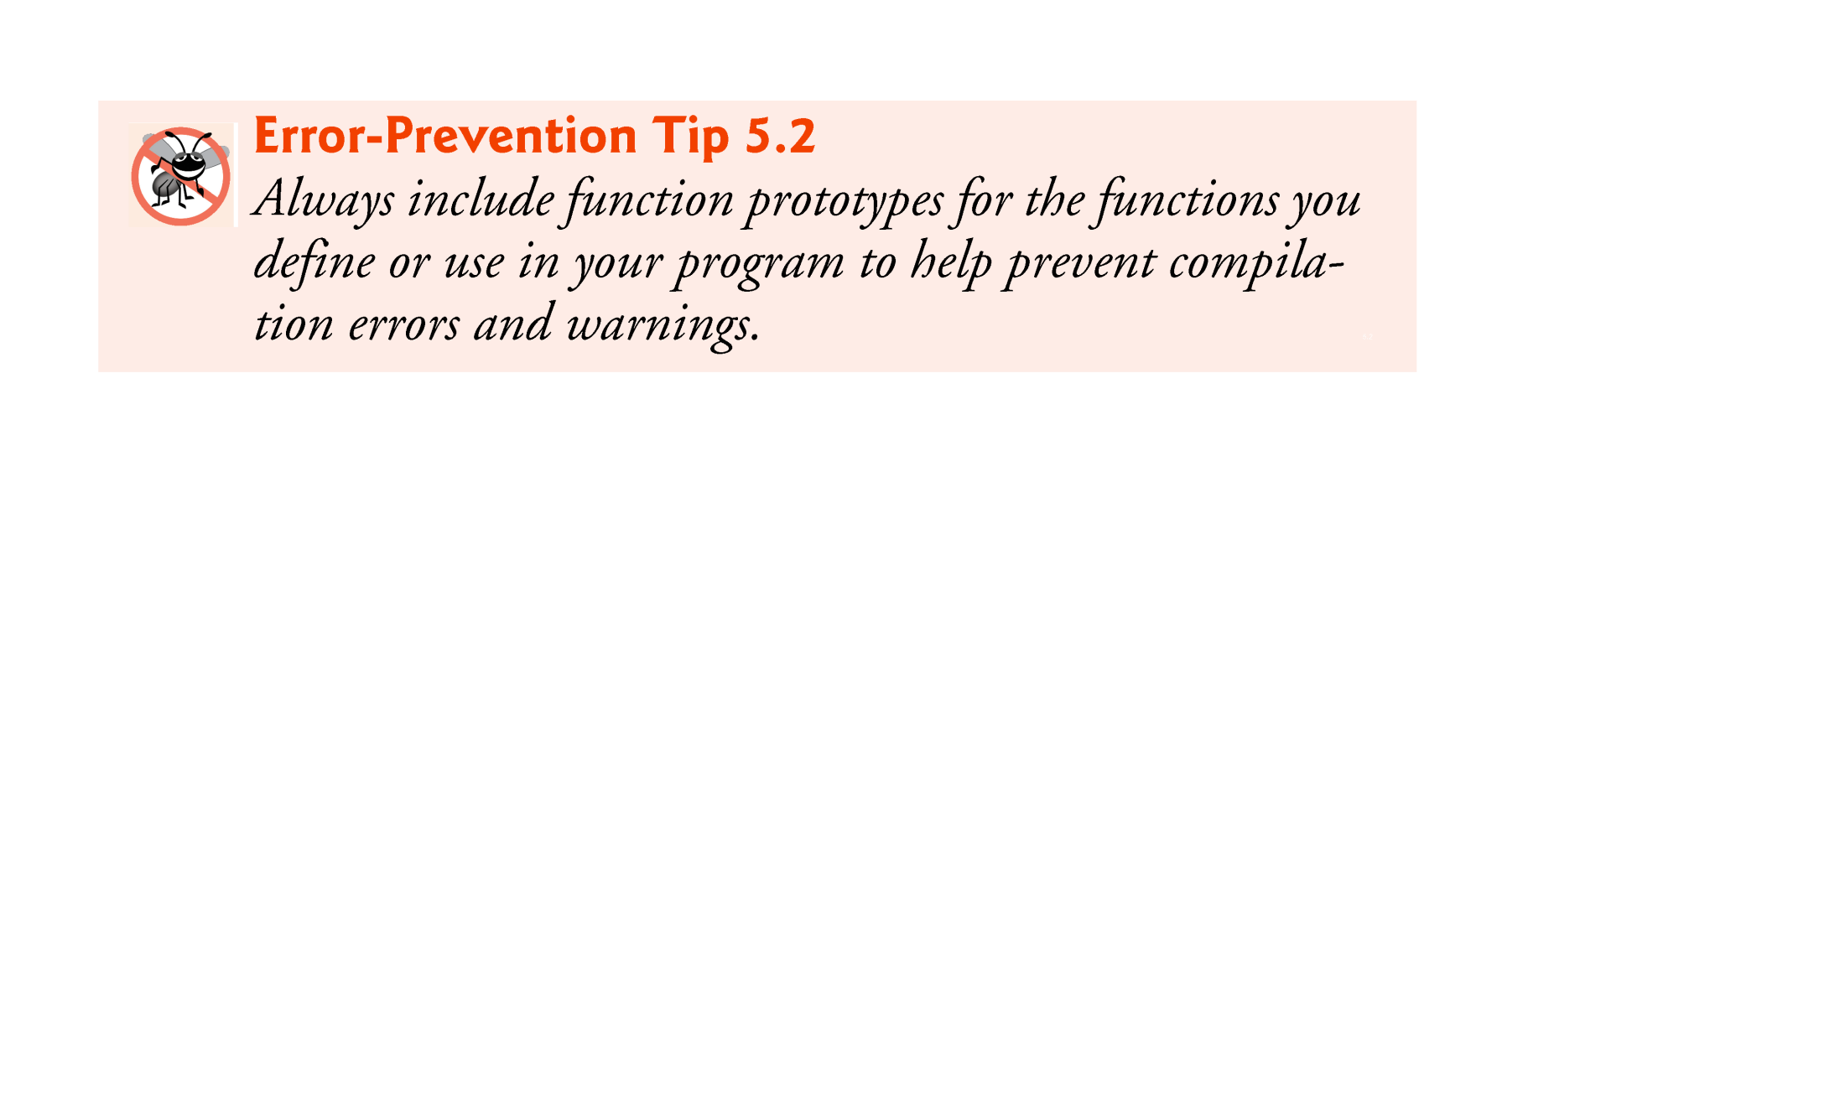

Slide 41
Calling a Function
To use a function, you will have to call or invoke that function.
When a program calls a function, program control is transferred to the called function. A called function performs defined task and when its return statement is executed or when its function-ending closing brace is reached, it returns program control back to the main program.
To call a function, you simply need to pass the required parameters along with function name, and if function returns a value, then you can store returned value.

Slide 42
Function Call & Return - Stack
To understand how C performs function calls, we first need to consider a data structure (i.e., collection of related data items) known as a stack.
Think of a stack as analogous to a pile of books.
When a book is placed on the pile, it’s normally placed at the top (referred to as pushing the book onto the stack).
Similarly, when a book is removed from the pile, it’s always removed from the top (referred to as popping the book off the stack).
Stacks are known as last-in, first-out (LIFO) data structures—the last item pushed (inserted) on the stack is the first item popped (removed) from the stack.

Slide 43
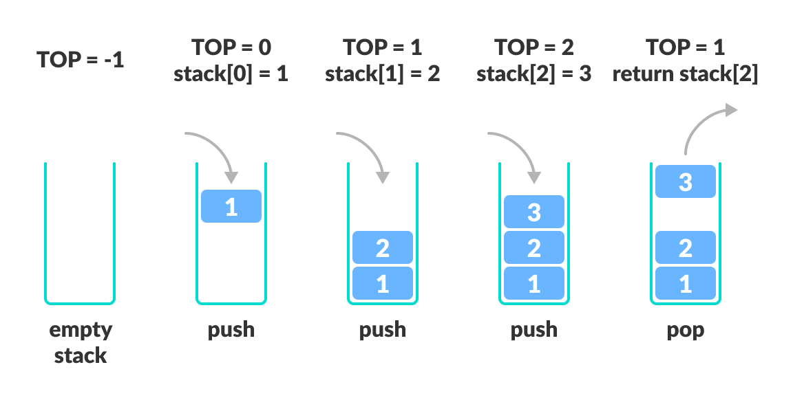

Slide 44
Function Call & Return - Stack
When a program calls a function, the called function must know how to return to its caller, so the return address of the calling function is pushed onto the program execution stack (sometimes referred to as the function call stack).
If a series of function calls occurs, the successive return addresses are pushed onto the stack in last-in, first-out order so that each function can return to its caller.

Slide 45
Function Arguments
If a function is to use arguments, it must declare variables that accept the values of the arguments. These variables are called the formal parameters of the function.
The formal parameters behave like other local variables inside the function and are created upon entry into the function and destroyed upon exit.
While calling a function, there are two ways that arguments can be passed to a function:
Call by Value
Call by Reference

Slide 46
Function Arguments
Call by value
This method copies the actual value of an argument into the formal parameter of the function. In this case, changes made to the parameter inside the function have no effect on the argument.
Call by reference
This method copies the reference of an argument into the formal parameter. Inside the function, the reference is used to access the actual argument used in the call. This means that changes made to the parameter affect the argument.

Slide 47
Function Arguments
When arguments are passed by value, a copy of the argument’s value is made and passed to the called function.
Changes to the copy do not affect an original variable’s value in the caller.
When an argument is passed by reference, the caller allows the called function to modify the original variable’s value.
Call-by-value should be used whenever the called function does not need to modify the value of the caller’s original variable.
Arrays are automatically passed by reference.

