Slide 1








FOREIGN DIRECT INVESTMENT
IN INDIA
In Depth Analysis
by
DIPEAN DASGUPTA
UMIP 4841

Slide 2

Introduction
03
Data Overview
04
Table of Content
Analysis
05
Predictions
09
Conclusion
10

Slide 3


Introduction
Foreign Direct Investment (FDI) plays a pivotal role in India’s economic landscape, driving growth, innovation, and job creation. Over the years, India has emerged as a prime destination for foreign investors, attracted by its large market, favorable policies, and robust economic fundamentals. This presentation will explore the trends, impacts, and future prospects of FDI in India, providing a comprehensive overview of how foreign investments are shaping the nation’s economic trajectory and identifying key opportunities for future growth. Let’s dive into the world of FDI in India.

Slide 4


Data Overview
File Info: Data on the foreign direct investment amount.
Country: India
Currency: Rupees
Timespan: 2000-2001 to 2016-2017(17Y)
Notable Sectors:
METALLURGICAL INDUSTRIES, MINING, POWER, COAL PRODUCTION
PETROLEUM & NATURAL GAS,ELECTRICAL EQUIPMENTS
COMPUTER SOFTWARE & HARDWARE, ELECTRONICS, TELECOMMUNICATIONS
AUTOMOBILE INDUSTRY, AIR TRANSPORT (INCLUDING AIR FREIGHT), SEA TRANSPORT,PORTS
INDUSTRIAL MACHINERY, MACHINE TOOLS, AGRICULTURAL MACHINERY, EARTH-MOVING MACHINERY
MEDICAL AND SURGICAL APPLIANCES, SCIENTIFIC INSTRUMENTS,
TEXTILES (INCLUDING DYED,PRINTED), SUGAR, GLASS, CERAMICS,
DEFENCE INDUSTRIES,CONSULTANCY SERVICES,SERVICES SECTOR
TRADING, RETAIL TRADING
CONSTRUCTION (INFRASTRUCTURE) ACTIVITIES, CONSTRUCTION DEVELOPMENT

Slide 5
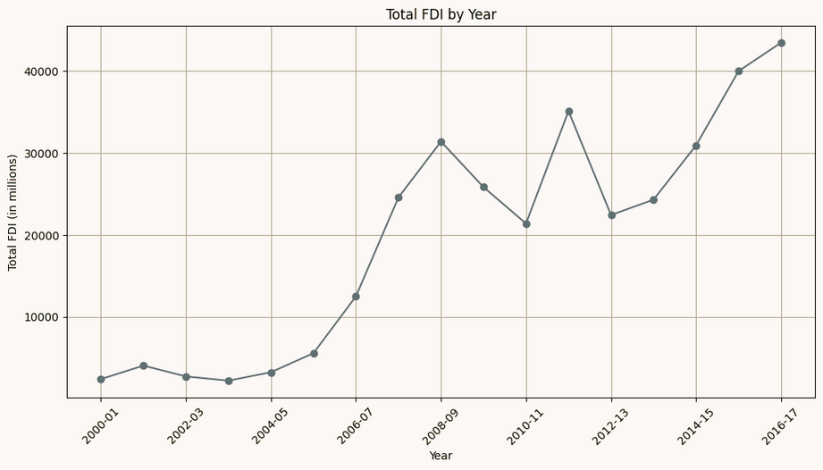

Yearly Total FDI
The line graph depicts that India had a steady growth in terms of investment from foreign sources over the years. In between the growth stumbled a bit but overall a gradual increase is seen.
Key Information
Lowest Investment:
Year: 2000-01
Amount:2378 million INR
Highest Investment:
Year: 2016-17
Amount:43478 million INR
After the worldwide recession in 2008-09s, FDi in India came down from 31395 million to 25834 million INR. The investment again had a sharp decrease 2012-13 where it came at 22423 million. After that till now there has been a steady increase.

Slide 6

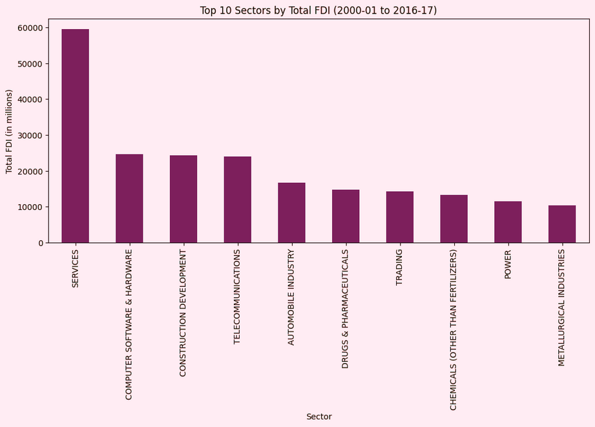



Top 10 Sectors
Now let’s see the top 10 contributor sectors in the total Foreign Direct Investment.
Top 10 sectors:
SERVICES
COMPUTER SOFTWARE & HARDWARE
CONSTRUCTION DEVELOPMENT
TELECOMMUNICATIONS
AUTOMOBILE INDUSTRY
DRUGS & PHARMACEUTICALS
TRADING
CHEMICALS (OTHER THAN FERTILIZERS)
POWER
METALLURGICAL INDUSTRIES
Services sectors has pulled out 59476 million INR worth invetment in the last 17 years. Computer software and hardware holds 2nd positon with around 24000 million INR. Construction and Telecom industries hold the 3rd and 4th positions recpectively.

Slide 7
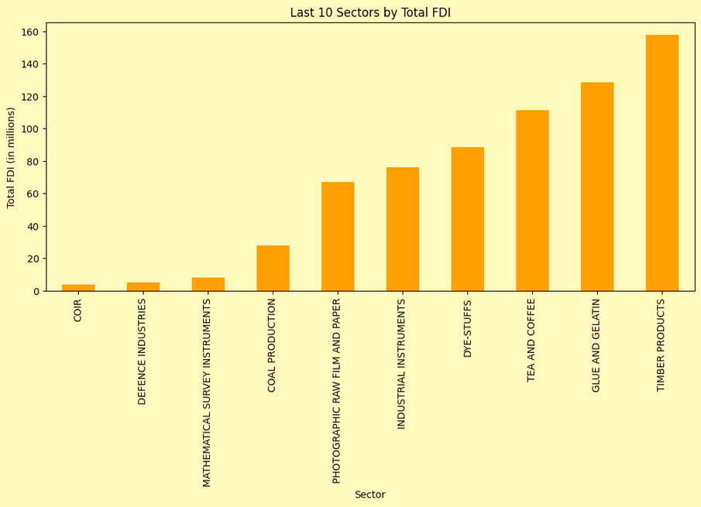
Least 10 Sectors
Now let’s see the least 10 contributor sectors in the total Foreign Direct Investment.
Last 10 sectors:
COIR
DEFENCE INDUSTRIES
MATHEMATICAL SURVEY INSTRUMENTS
COAL PRODUCTION
PHOTOGRAPHIC RAW FILM AND PAPER
INDUSTRIAL INSTRUMENTS
DYE-STUFFS
TEA AND COFFEE
GLUE AND GELATIN
TIMBER PRODUCTS
COIR sector has pulled out only 4.6 million INR worth investment in the last 17 years. Defence Industries holds 2nd last positon with around 5.12 million INR. Survey instruments and coal sector hold the 3rd and 4th least contributors recpectively.

Slide 8

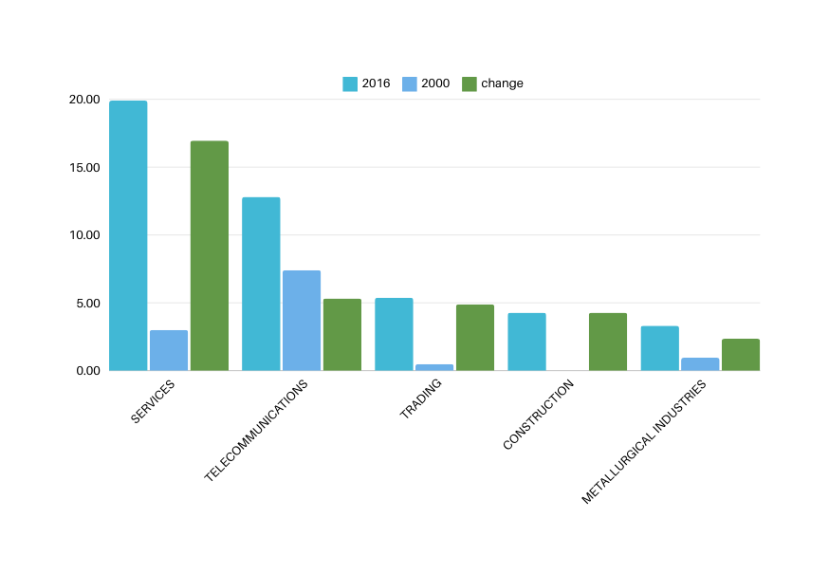
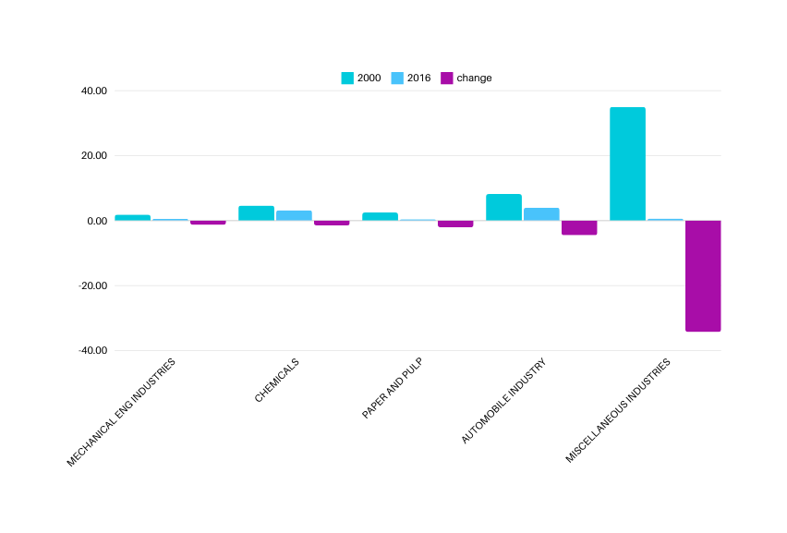

Sectoral Shifts In FDI share
The sectors having positive shift with
increase in share are:
SERVICES
TELECOMMUNICATIONS
TRADING
CONSTRUCTION (INFRASTRUCTURE) ACTIVITIES
METALLURGICAL INDUSTRIES
The sectors having negative shift with
decrease in share are:
MISCELLANEOUS MECHANICAL & ENGINEERING INDUSTRIES
CHEMICALS (OTHER THAN FERTILIZERS)
PAPER AND PULP (INCLUDING PAPER PRODUCTS)
AUTOMOBILE INDUSTRY
MISCELLANEOUS INDUSTRIES

Slide 9

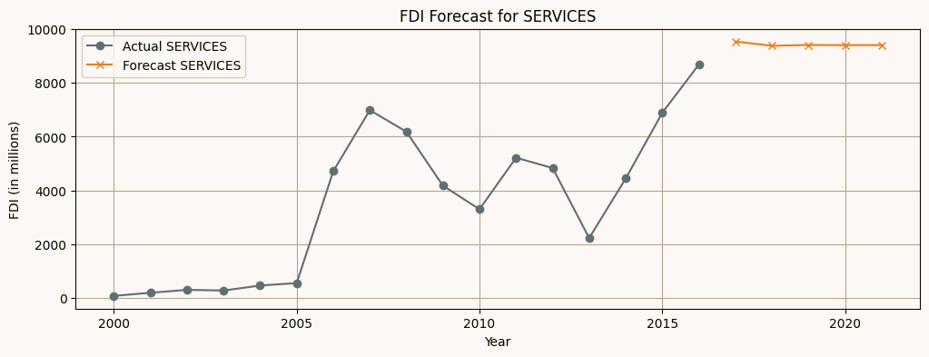
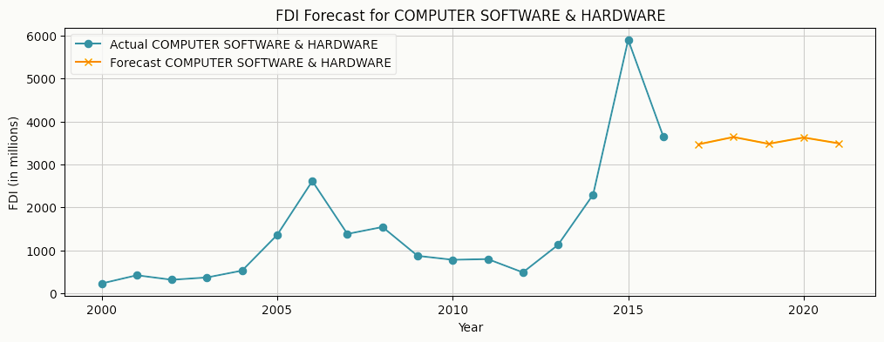
FDI PREDICTIONS
The top 2 sectors Services and Computer Software and hardware ‘s FDI for next 3-4 years are predicted
As per the Time series forecasting, In the next 4 years, the investment amount will further increase upto 10000 million INR in a year for the services sector
As per the Time series forecasting, In the next 4 years, the investment amount will remain steady around 3500 million INR in a year for computer software and hardware sector.

Slide 10










Thank You
DIPEAN DASGUPTA
+91 7778992530
dipeandasgupta@gmail.com
https://github.com/DipeanDas/UM_InternshipProjects/tree/main/ForeignDirectInvestmentAnalysis
Gandhinagar,Gujarat

