Slide 1



Employee
Attrition Analysis
DIPEAN DASGUPTA
UMIP 4841

Slide 2
Introduction
Employee attrition analysis is a critical process that examines the patterns and causes of employee turnover within an organization. This report provides a comprehensive overview of attrition rates, identifying key factors that contribute to employee departures. By analyzing data on employee demographics, job roles, tenure, and exit reasons, the report aims to uncover trends and highlight potential areas for improvement. Understanding these dynamics not only helps in mitigating the negative impacts of attrition, such as reduced productivity and increased recruitment costs, but also aids in developing effective retention strategies to foster a more stable and motivated workforce.

Slide 3
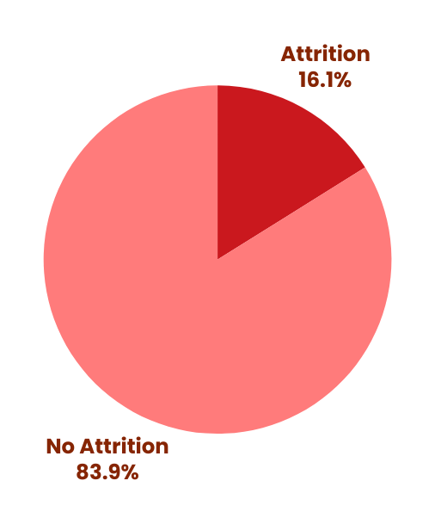
Data Overview
Number of Employees studied : 4410
Number fo Factors considered : 27
Attrition Rate
Attrition(%)
No 83.87
Yes 16.12

Slide 4
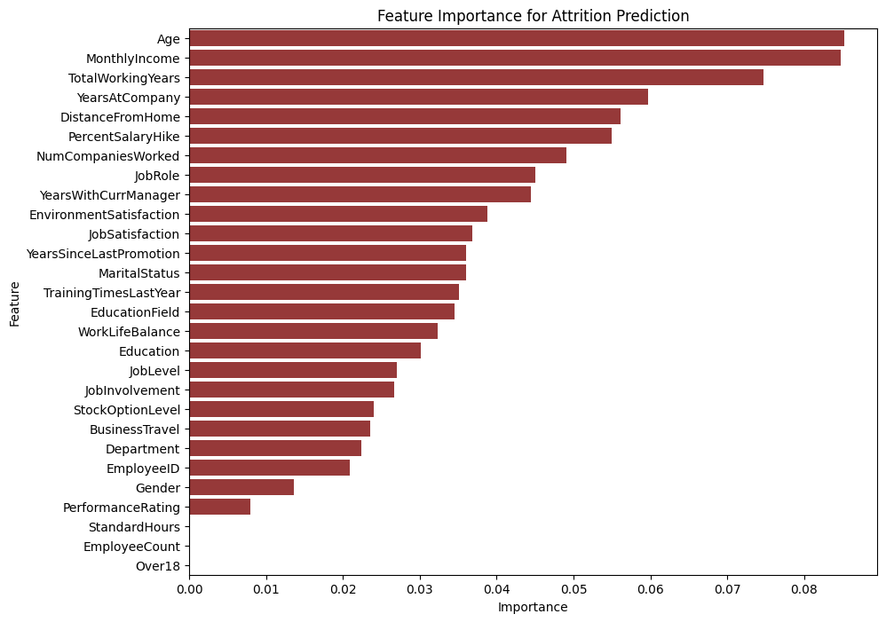
Key Factors
From the feature importance analysis, the key factors are:
Monthly Income
Age
Total Working Hours
Years at company
Distance from home
Salary Hike percentage
Number of companies worked
Job role
Environment Satisfaction
Job Satisfaction

Slide 5
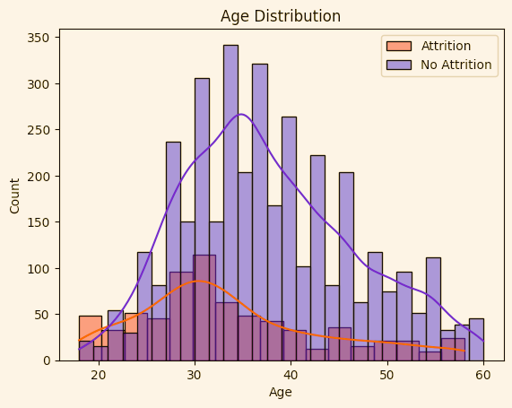
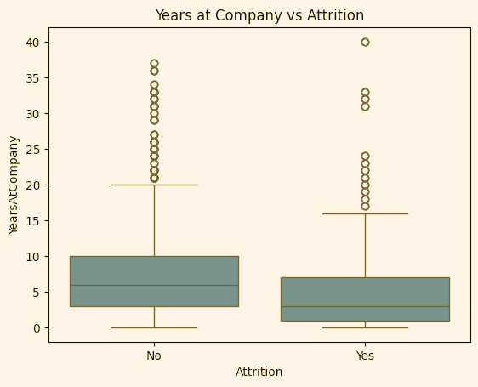
Age wise Attrition and Years at Company
From the age distribution graph, it can be depicted that
most of the attritions is by employee of age range under 30 to 35 approximately. This might be young employees switching jobs to find their suitable career.
Among the employees who changed job , the average duration of their stay was less than 10 years. To be more accurate around 3-5 years. Small amount of employees also left job after stay of around 20-30 years.

Slide 6
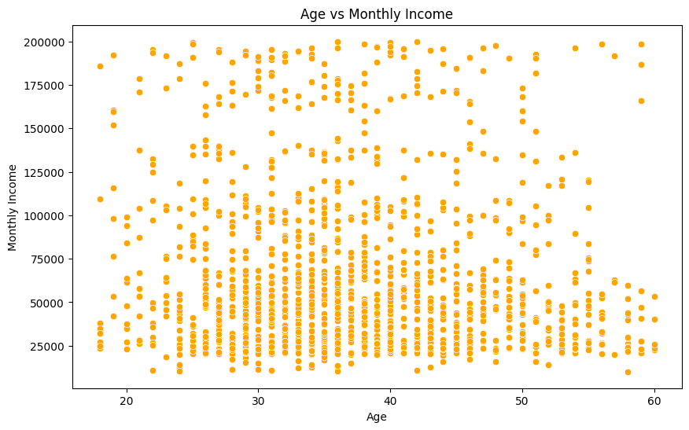
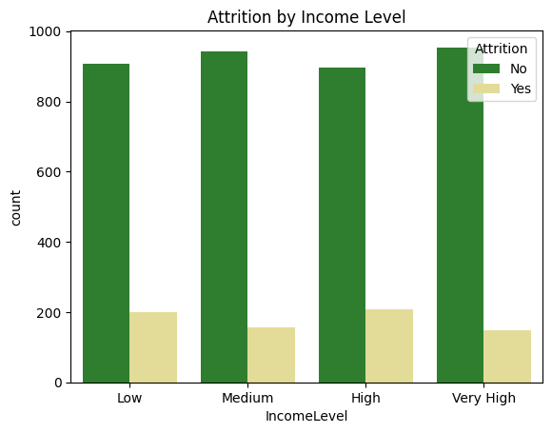
Attrition by MonthlyIncome and Level
It is seen that during 20-30s employees having mediocore or midlow level salary; Income gets higher at 40s and 50s. In case of attrition, we can depict that attrition is more seen in employees with low and high income with compared to middle and very high income.

Slide 7
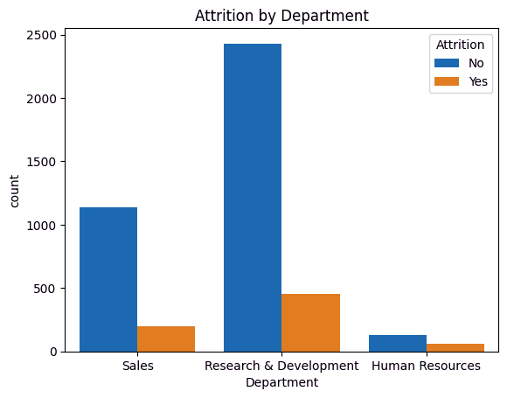
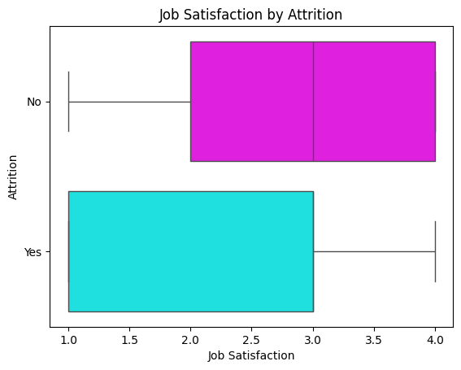
Attrition by Department & Job Satisfaction
In case of attrition by department, it is seen that a significant portion of employee who left job was from research and development Department. Sales hold the 2nd position in attrition followed by Human Resource(HR) Department.
The boxplot plotted for attrition by job satisfaction provides the
information that most the employee who left the job had job satisfaction in the range of 1-3 on the scale of 5. Poor job satisfaction is one the causes for employee attrition.

Slide 8
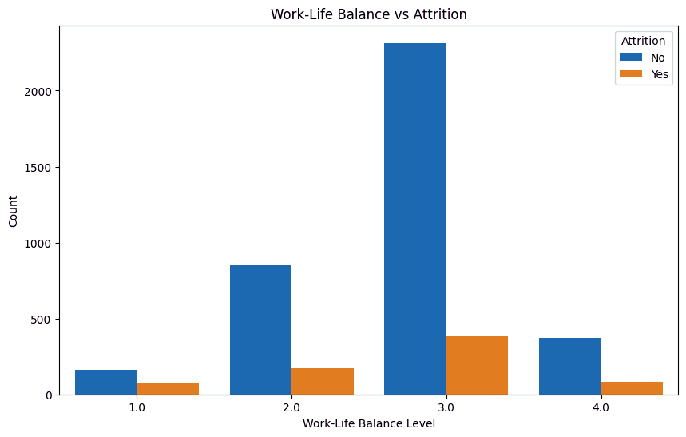
Attrition vs Work-Life Balance
Coming to Work Life balance vs attrition,it is
seen that on the scale of 4, attrition rate is more in employee with a rating of 2 and 3. But if we consider as percentage then, attrition is more with employees with score 1 out of 4.
So, hamper in work life balance is forcing employees to leave job or change job.

Slide 9
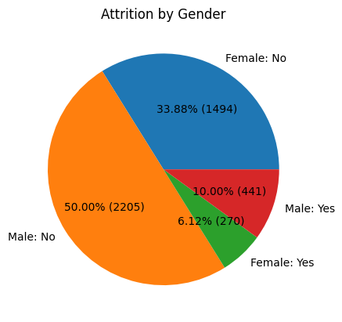
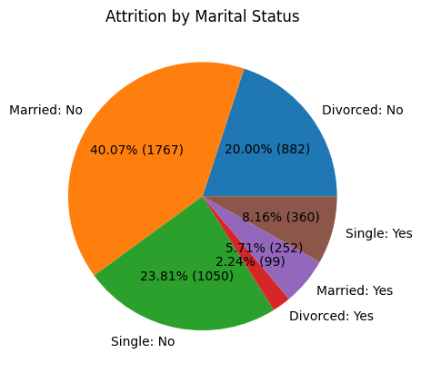
Attrition by Gender and Marital Status
From the piechart, attrition is relatively more in men than women.,this might be due to less number of females in employment. On the other hand, more attrition is seen among single people followed by married people. Divorced employees are the least in attrition.

Slide 10




THANK YOU
DIPEAN DASGUPTA
+91 7778992530
dipeandasgupta@gmail.com
https://github.com/DipeanDas/UM_InternshipProjects/tree/main/Employee_Attrition_Analysis
Gandhinagar,Gujarat

