Slide 1

BIRD STRIKES 2000-2011
DATA ANALYSIS
DIPEAN DASGUPTA
UMIP4841

Slide 2


CONTENT
01
INTRODUCTION
02
DATA OVERVIEW
03
ANALYSIS
04
DASHBOARD
05
CONCLUSION

Slide 3

INTRODUCTION
The Bird Strikes 2000-2011 Data Analysis Report provides a detailed examination of avian collisions with aircraft in the US and Canada over an 11-year period. This analysis focuses on identifying patterns, trends, and key factors associated with bird strikes, which pose significant risks to aviation safety. By exploring data on bird strike frequency, geographical distribution, aircraft types involved, and the impact on flight operations, this report aims to offer valuable insights into mitigating these incidents. Understanding the dynamics of bird strikes helps in developing effective prevention strategies and enhancing safety measures for both wildlife and the aviation industry, ensuring safer skies for all.

Slide 4

DATA OVERVIEW
File Info: Data on Bird Strikes with air planes
Number of Cases:25558
Country: United States of America, Canada
Timespan: 2000-2011
Strike Factors: 24

Slide 5

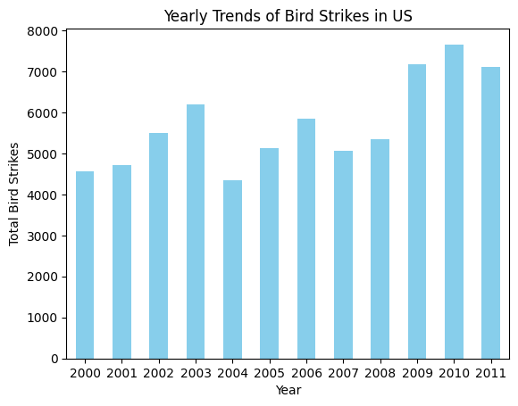
ANALYSIS
Yearly Trend
From the bar graph of BIrd Strikes Data of timespan 2000-2011, it is seen that for all the years there were more than 4000 cases in average. Among the years,2010 is the year with most number of bird strikes. 2009 and 2011 hold the 2nd and 3rd postion respectively.
2004 had the least number of cases according to the graph. Years 2000-2003 and 2005-2008 had seen cases ranging from 4000 to 6000.

Slide 6
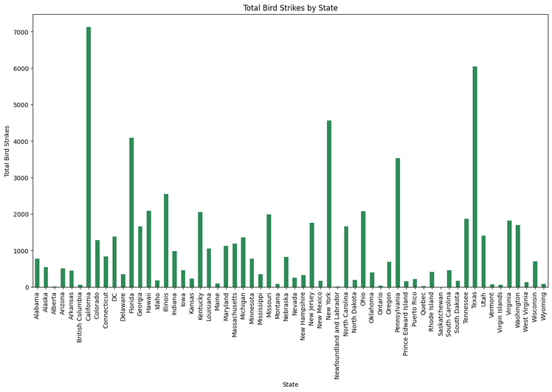
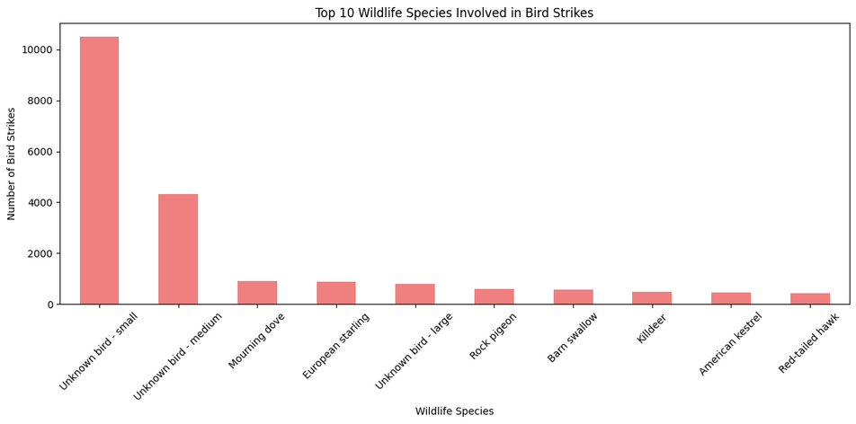
ANALYSIS
The state with most number of bird strike cases is California with around 7000 cases. Next in the list is Texas and New York respectively. All these states are in the US.
The state with the least number of cases is Alberta followed by Saskatchewan, Newfoundland, Quebec and ontario. These are all located in Canada. strikes in those states of Canada are less than 100.
The birds which are victim of the collision or strike are mostly unknown and small in size. As per the graph, unknown small birds are the most struck followed by unknown medium birds. Morning Dove and European starling holds 3rd and 4th position in the list respectively. Red tailed hawk has been the least struck bird in the list.

Slide 7
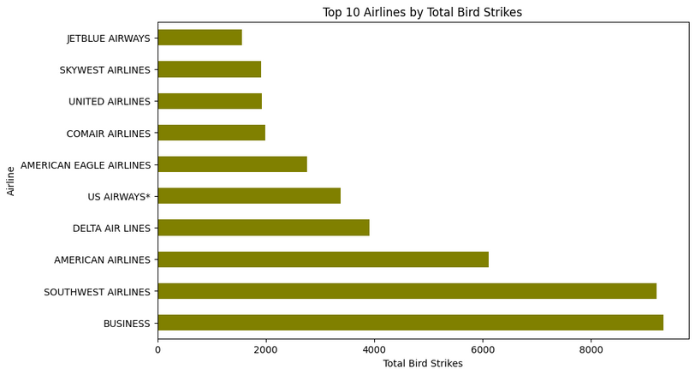
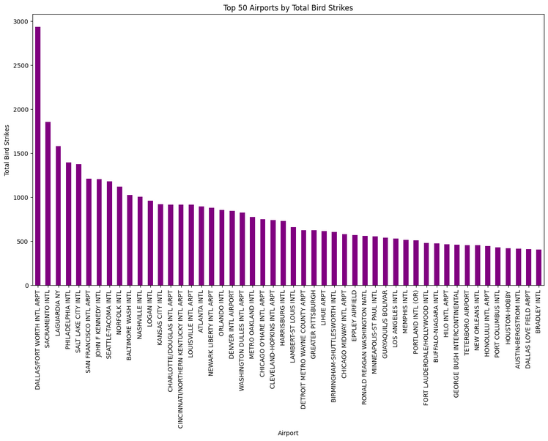
ANALYSIS
The Airlines which was most affected by bird strike in those 11 years is Business with more than 8000 cases followed by Southwest airlines and American Airlines.
On the other hand, Jetblue, Skywest, United and Comair airlines had been affected in less than 2000 cases.
Dallas Airport had seen the most bird strike cases which is almost 3000 in count. Sacramento, Laguardia, Philadelphia, Salt lake city and San Francisco airport are the next in the list with more than 1500 cases. All these are in the state of Texas, California and New York.
Bradley Airport is the last in the list with less than 500 strike cases.

Slide 8
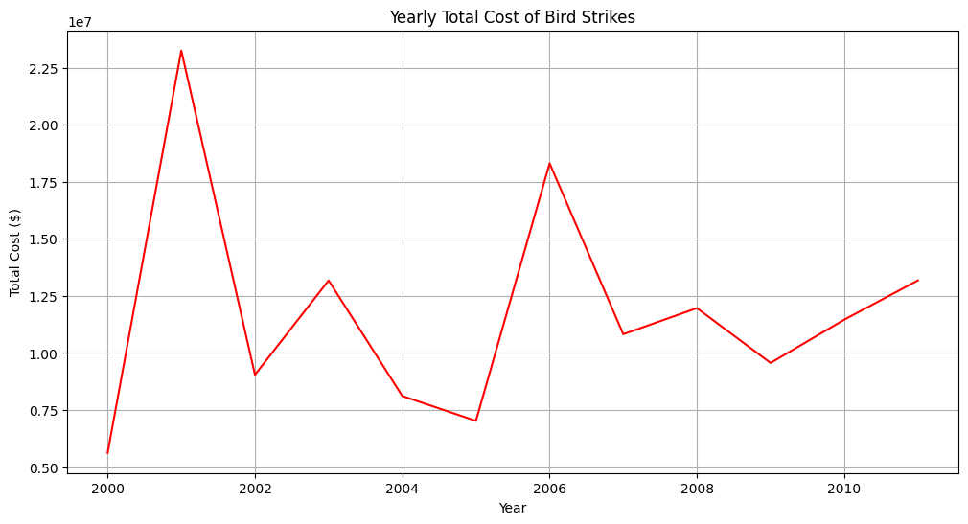
ANALYSIS
If we look into the yearly costs incurred to airlines due to bird strike, the highest was in 2001 and the estimated amount was around 225 million. In the years from 2002 to 2011, yearly loss was more than 100 million.

Slide 9
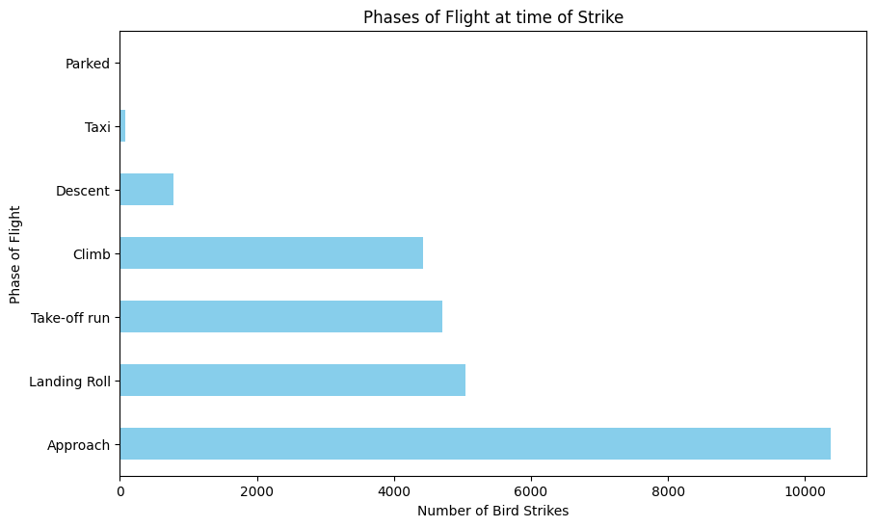
ANALYSIS
Most of the bird strikes has taken place while the aircraft was in approach and in landing roll phase followed by takeoff stage. No events of strike was there while the aircrafts were in parked mode.

Slide 10
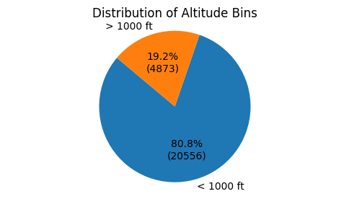
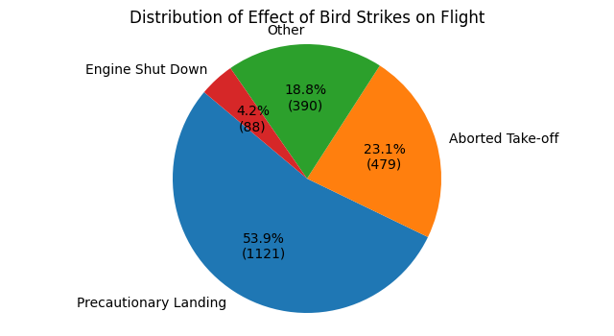
ANALYSIS
Of all the cases, in around 20556 cases, bird strike incident took place when the aircraft was crusing below 1000ft.In 80% of cases strike was below 100 ft and in 20% of cases strike occured above 1000ft.
Effects of bird strike include precautionary landing, engine shut down, aborted take-off and other. Among then in around 53% of cases aircraft had to do precautionary landing followed by aborting take-off at 23.1 %. In less than 100 cases plane engine was shut down.

Slide 11
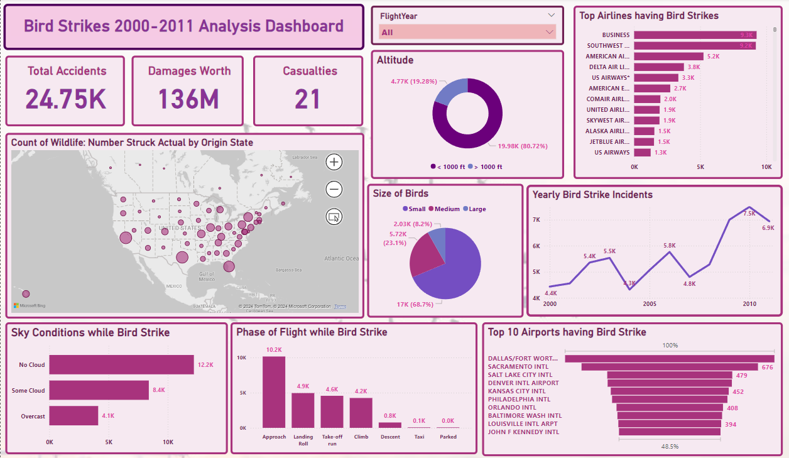
ANALYSIS DASHBOARD

Slide 12
CONCLUSION
The Bird Strike Analysis for the US and Canada from 2000 to 2011 highlighted the critical need for improved wildlife management and aviation safety measures. The data revealed significant patterns in bird strike incidents, pointing to peak occurrences during migration seasons and in specific geographical regions. By understanding these trends and the associated risk factors, aviation authorities and wildlife agencies can enhance preventive strategies, such as habitat management and advanced detection systems. This analysis underscored the importance of ongoing monitoring and collaboration between aviation and environmental sectors to mitigate the risks, ensuring safer skies and protecting both aircraft and avian populations.

Slide 13




THANK'S FOR WATCHING
DIPEAN DASGUPTA
+91 7778992530
dipeandasgupta@gmail.com
https://github.com/DipeanDas/UM_InternshipProjects/tree/main/Bird_Strikes_Analysis
Gandhinagar,Gujarat

