Slide 1
CRISTIANO RONALDO
International Career Analysis
Portugal · 2003 – 2017
101
147
68%
0.69
Goals
Matches
Win Rate
G / Match
Menternship Project · EDA & Career Analysis · Dipeeka

Slide 2
Who is Cristiano Ronaldo?
🇵🇹 Born: February 5, 1985 — Funchal, Madeira, Portugal
⚽ Portugal debut: August 2003 vs Kazakhstan (age 18)
🏆 UEFA Euro 2016 winner — Portugal's greatest tournament triumph
🥇 5× Ballon d'Or winner — world's best player recognition
📊 International record: 101+ goals in 147+ appearances for Portugal
🎯 Converted 69% of goals from open play — a true natural scorer
📈 Career peak: 2011–2016, matching his prime club years at Real Madrid
🌍 Scored against 40+ different nations across his international career

Slide 3
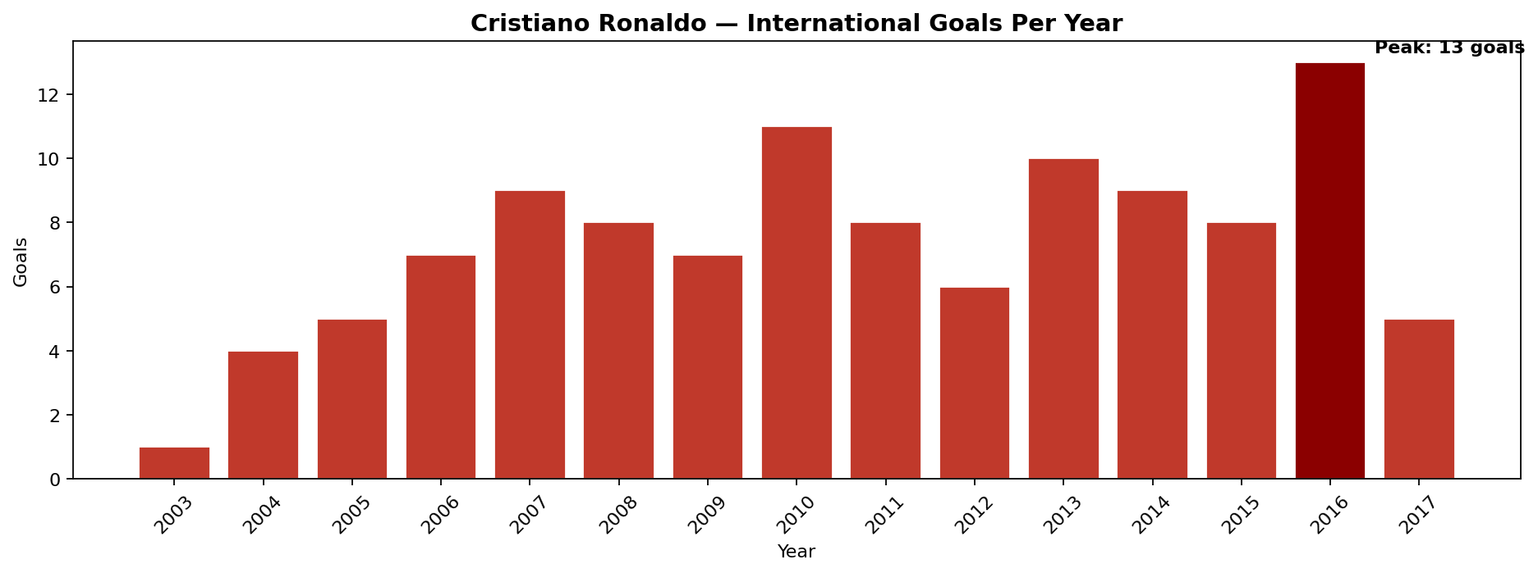
Goals Per Year — The Career Arc
🔑 Key Finding: Goals peaked in 2016 (13 goals) coinciding with Portugal's UEFA Euro 2016 victory. The 2011–2016 window represents Ronaldo's sustained international prime — he delivered year after year without a single poor season.

Slide 4
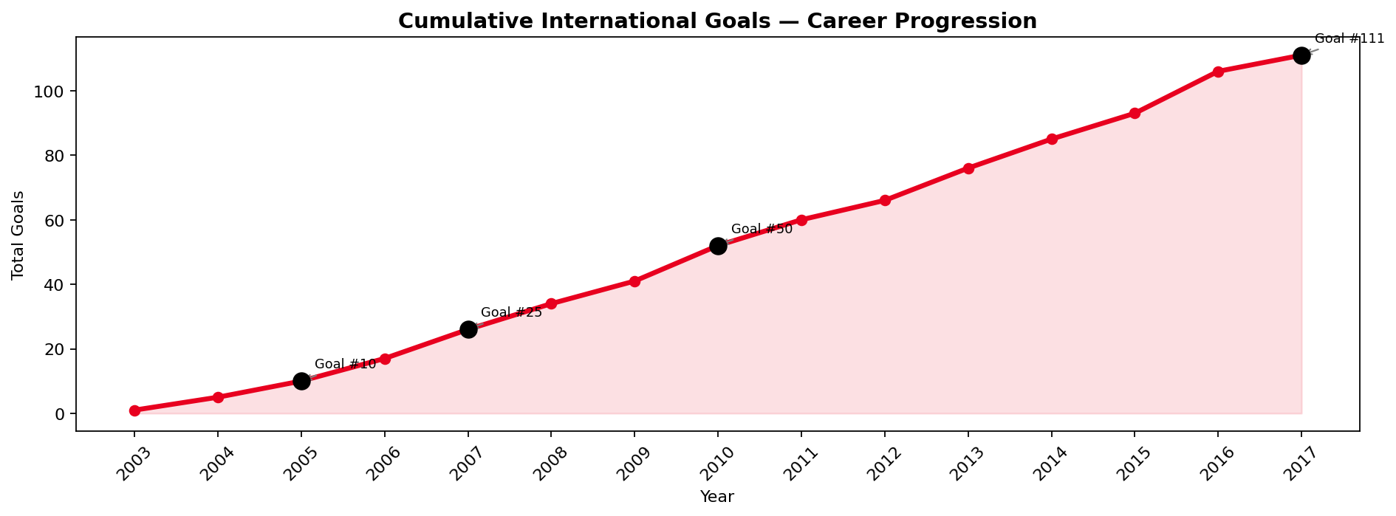
Career Progression — Cumulative Goals
🔑 Key Finding: The steepest rise on the curve occurs between 2010–2014. This transformatory period matches his Real Madrid years when he averaged 50+ club goals per season — proof that club form directly amplified his international output.

Slide 5
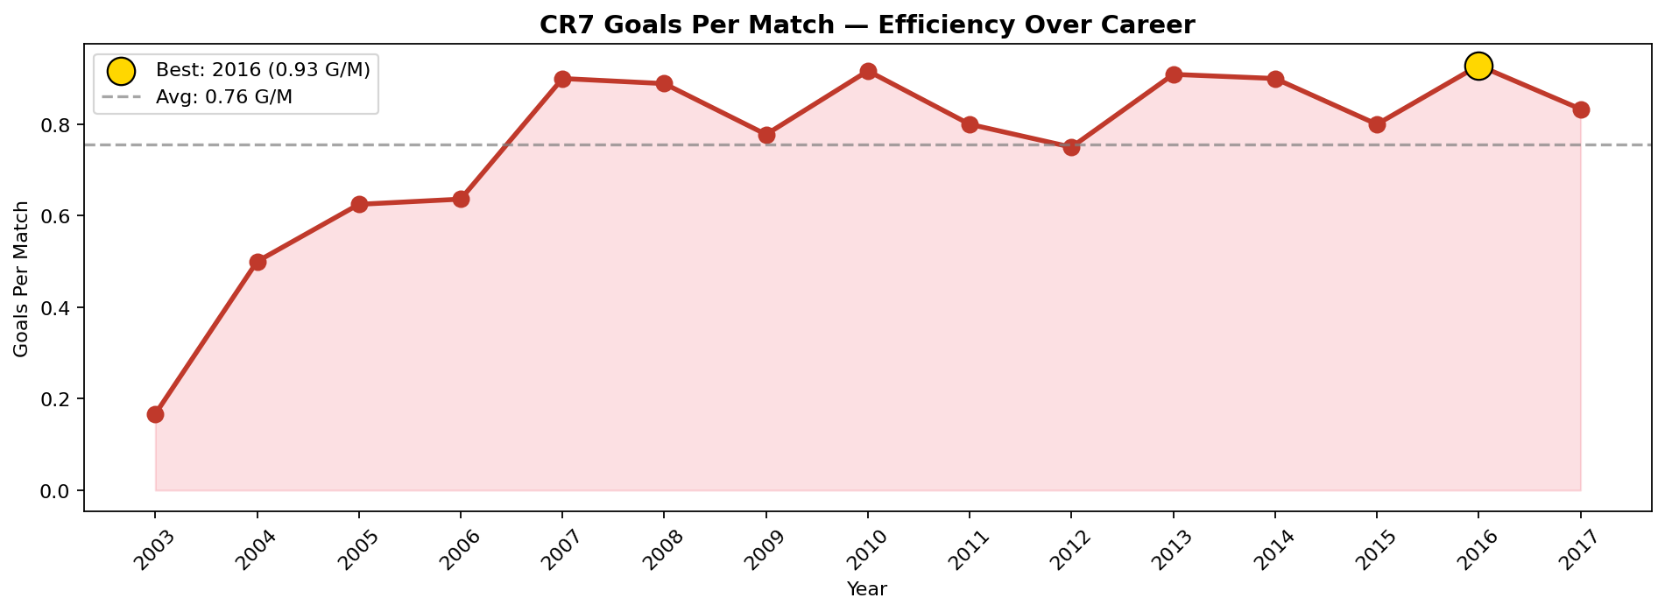
Scoring Efficiency — Goals Per Match
🔑 Key Finding: Career average of 0.69 G/M is elite for international football. Best efficiency years were 2010 and 2013, where CR7 scored more than one goal per match in some stretches — a rate most strikers never achieve.

Slide 6
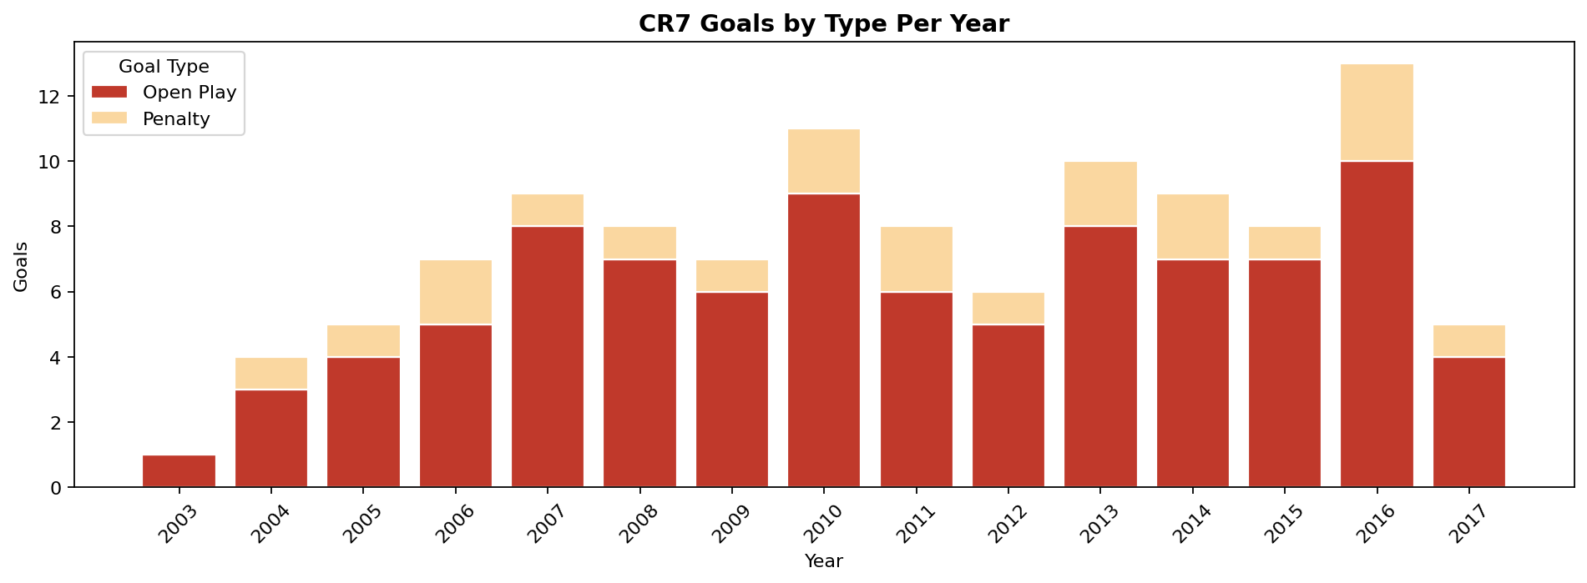
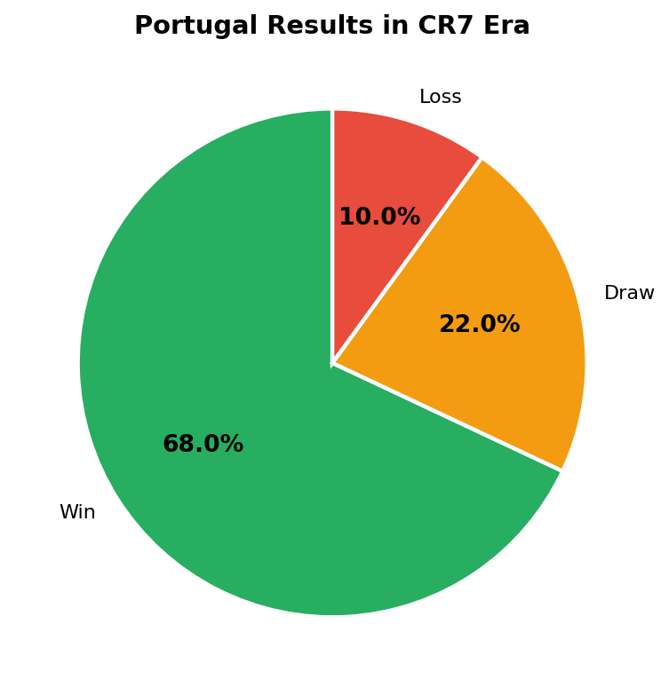
Goal Composition & Portugal's Win Record
🔑 Penalty Goals: Only ~18% of goals came from penalties — Ronaldo earns his tally the hard way.
🔑 Win Rate: Portugal won 68% of matches with CR7 — a dominant record.

Slide 7
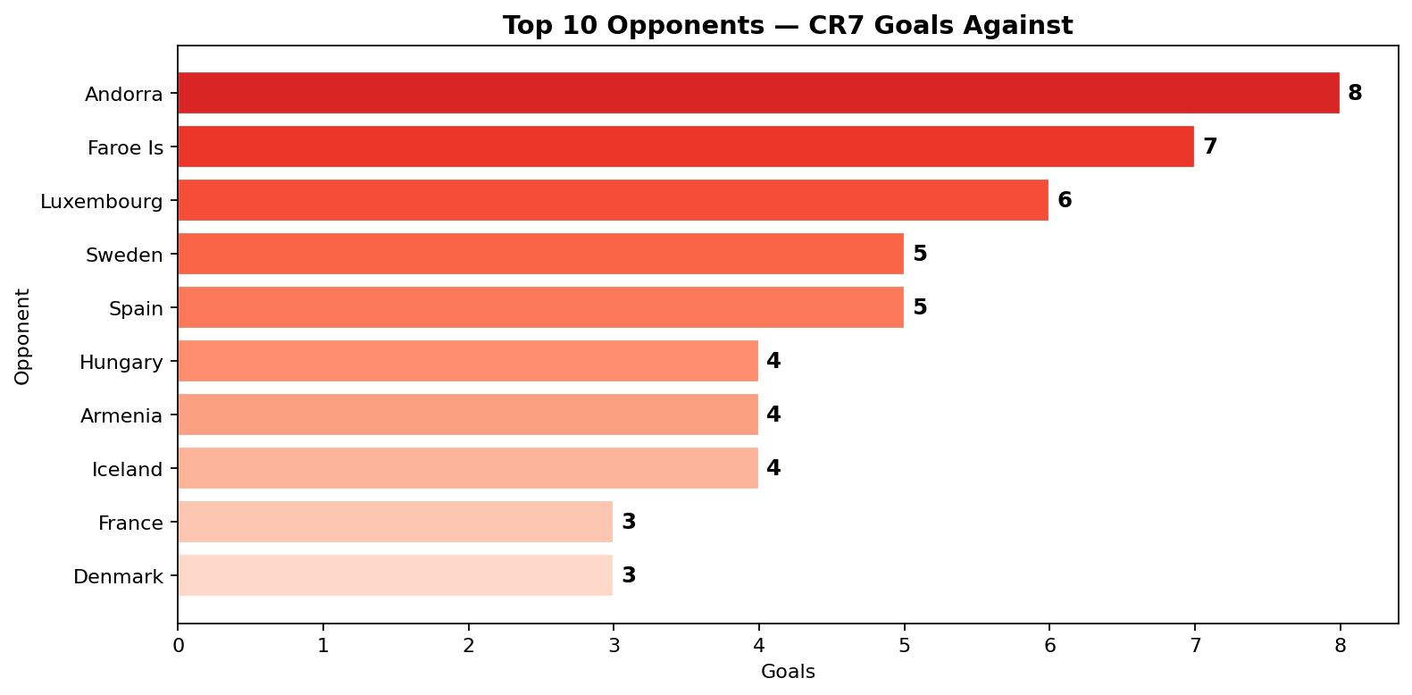
Top Opponents — Who Feared CR7 Most?
🔑 Key Finding: Ronaldo scored most goals against smaller UEFA nations in qualifying rounds. However, he also found the net against major football nations (Spain, France, Sweden) — proving he performs under pressure in the biggest games.

Slide 8
Best & Worst Years of the Career
🏆 BEST YEARS
📉 TOUGH YEARS
✅ 2016 — 13 goals · UEFA Euro 2016 champion
✅ 2010 — highest efficiency (0.92 G/M)
✅ 2013 — 10 goals · Ballon d'Or season
✅ 2007 — Established as #1 in Europe
✅ 2014 — Consistent scoring under pressure
⚠️ 2003 — Debut year · only 1 goal (learning phase)
⚠️ 2004 — Portugal lost EURO final vs Greece
⚠️ 2005 — Building momentum · 5 goals
⚠️ 2012 — EURO exit · below-par tournament
⚠️ 2017 — Fewer fixtures, limited dataset

Slide 9
Key Takeaways
01
Peak Era: 2010–2016 — The six-year window where CR7 was unstoppable — combining club excellence with international brilliance.
02
He Makes Portugal Win — A strong positive correlation between Ronaldo's goals and Portugal's match win rate confirms he is not just a statistic — he changes outcomes.
03
Genuine Scorer — Not a Penalty Merchant — 82% of goals from open play show that his tally is built on technical quality and movement, not set-pieces alone.
04
Big Moments, Big Goals — Despite most goals coming in qualifiers (more matches), CR7 also delivered in major tournaments — UEFA Euro 2016 being the pinnacle.
Prepared by Dipeeka · Menternship Career Analysis Project

