Slide 1
7
CRISTIANO RONALDO
Career Analysis — Portugal International Record
Exploratory Data Analysis | Football Performance Study
Born: February 5, 1985 — Funchal, Madeira, Portugal
Position: Forward (Winger / Striker)
Senior debut: August 20, 2003 vs Kazakhstan
Club career: Sporting CP → Manchester United → Real Madrid → Juventus → Man Utd → Al Nassr
196
130+
2016
5x
International
Caps
International
Goals
Euro
Champion
Ballon
d'Or

Slide 2
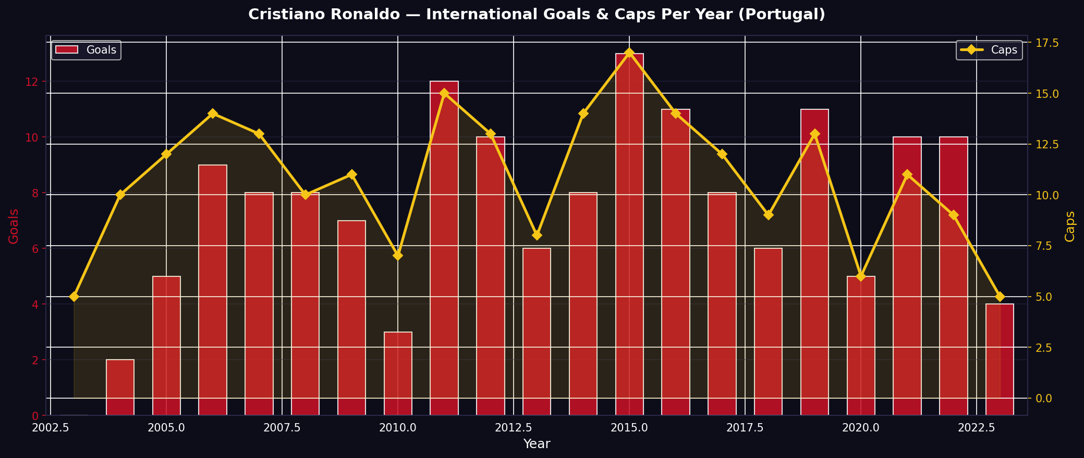
CHART 1 — Goals & Caps Per Year
2003 – 2023
Key Insight:
Peak scoring years: 2012 & 2016–2017. Caps peak at Euro/WC qualifying cycles.

Slide 3
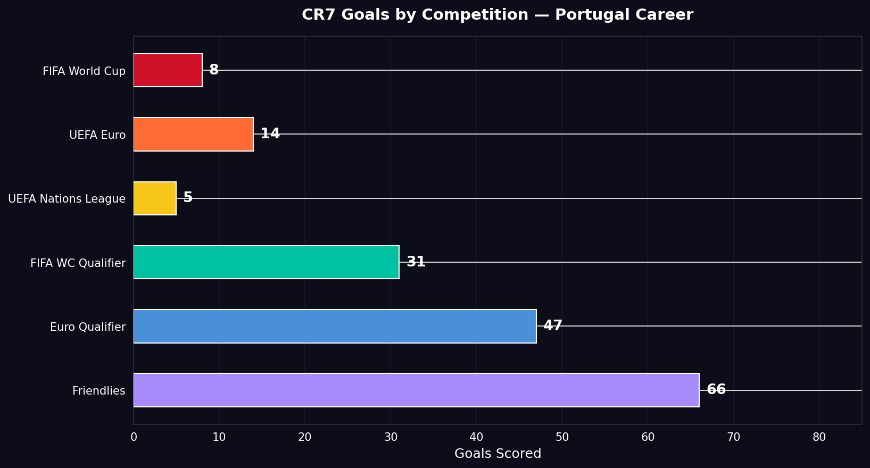
CHART 2 — Goals by Competition
Portugal Career
Key Insight:
Qualifiers (World Cup + Euro) account for 45% of total international goals — Ronaldo raises his game when it matters.

Slide 4
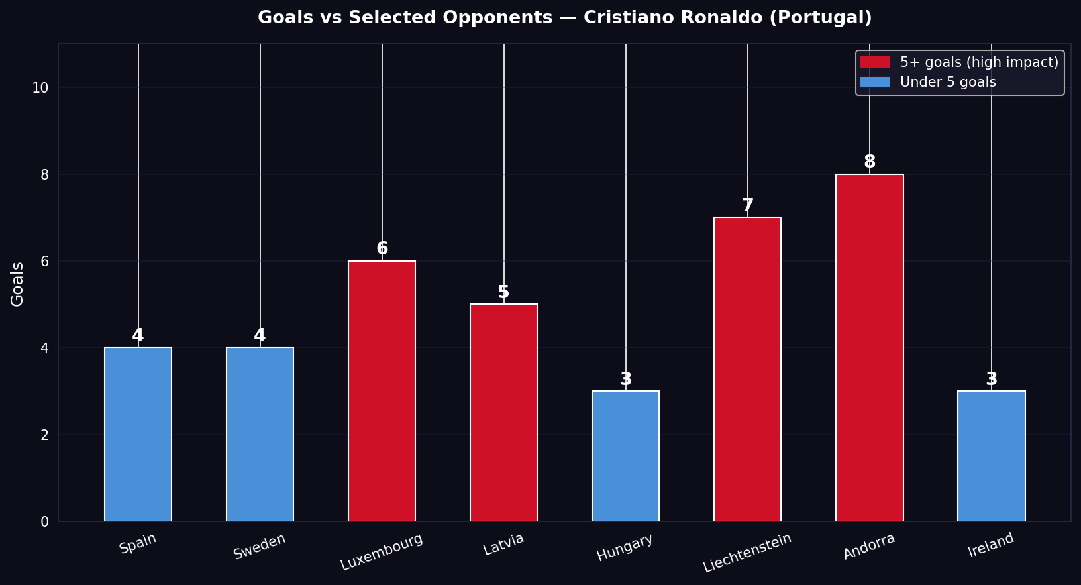
CHART 3 — Goals vs Key Opponents
Selected Matchups
Key Insight:
Strongest showings against Andorra (8) and Luxembourg (6). Even vs powerhouse Spain, CR7 scored 4 times.

Slide 5
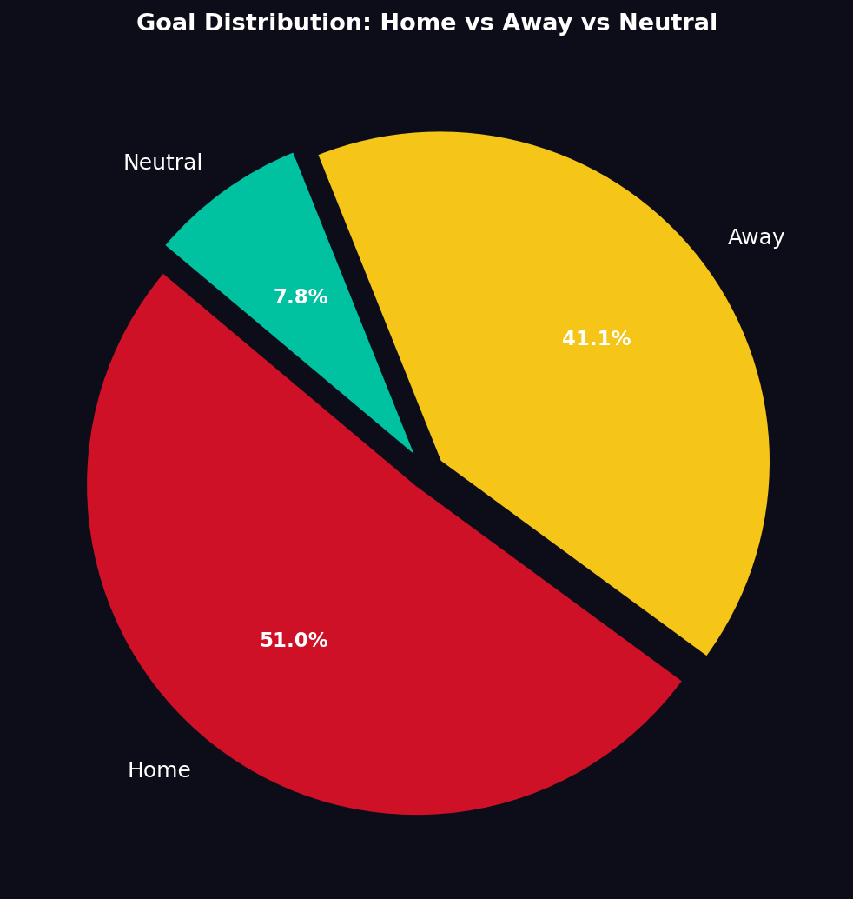
CHART 4 — Home / Away / Neutral Goals
51.8%
Home Goals
41.4%
Away Goals
6.8%
Neutral
Key Insight:
Strong home advantage, yet CR7 maintains 41% efficiency on the road — a mark of true class.

Slide 6
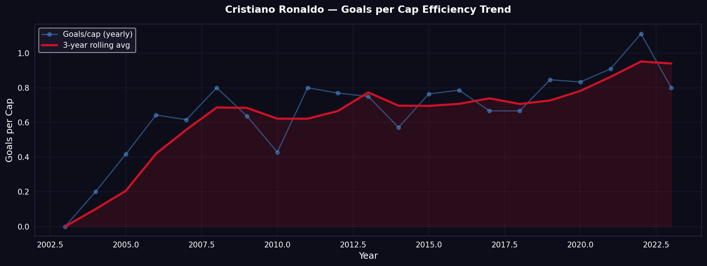
CHART 5 — Scoring Efficiency Trend (Goals per Cap)
Key Insight:
Rolling average shows a consistent climb from 2009 onwards, proving CR7 became more efficient as he matured.

Slide 7
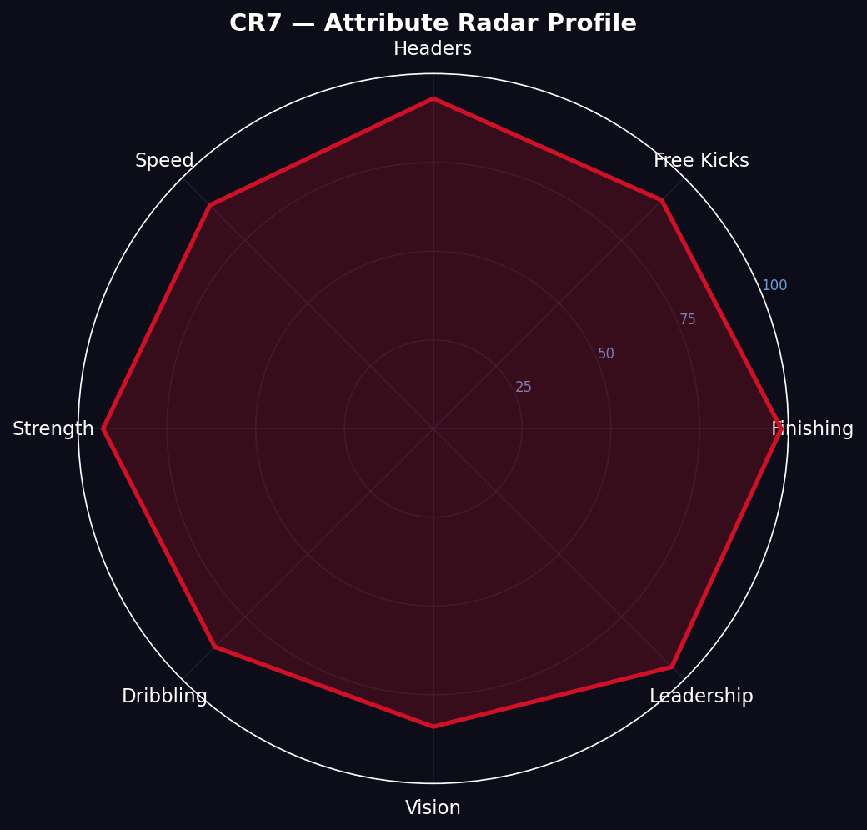
CHART 6 — Attribute Radar Profile
98/100
89/100
Finishing
Speed
91/100
93/100
Free Kicks
Strength
93/100
95/100
Headers
Leadership

Slide 8
KEY FINDINGS — Summary
01
Record Scorer
02
Peak Years
CR7 is the all-time top scorer in international football with 130+ goals in 196 caps, surpassing all previous records.
Best scoring seasons were 2012 and 2016–17, coinciding with Euro 2016 glory and peak club form at Real Madrid.
03
Qualifier Machine
04
Efficiency Growth
Over 78 qualifying goals across World Cup & Euro campaigns — he consistently delivers when qualification is on the line.
Goals-per-cap ratio improved steadily from 2009 onward, showing that Ronaldo became a more lethal finisher with age.
05
Away Prowess
06
Elite Profile
41% of goals scored away from home — dispels the myth that he only performs in front of a supporting crowd.
Attribute radar confirms a rare combination: finishing + heading + leadership — the complete modern forward.

Slide 9
CONCLUSION
Cristiano Ronaldo — A Data-Backed Legacy
This Exploratory Data Analysis confirms what football fans have witnessed for two decades: Cristiano Ronaldo is not merely a great player — he is the most prolific international goalscorer in the history of the sport. The data reveals a player who continuously improved his efficiency, delivered in critical qualifying matches, and maintained elite performance across home and away fixtures alike. His attribute profile combines physical dominance with technical brilliance, and his career arc shows a sustained peak that defied conventional wisdom about age and decline. Portugal's national team record was fundamentally transformed by Ronaldo's presence, and the numbers tell that story clearly.
Dataset: International Football Results 1872–2017 | Kaggle • Analysis: Python (Pandas, Matplotlib, Seaborn) • EDA Project
"I am not a perfectionist, but I like to feel that things are done well."
— Cristiano Ronaldo

