Slide 1

ASSESSMENT 2
Learning the eICU Age Distribution with a GAN
Thomas Jefferson National Accelerator Facility Department of Data Science
Presented by: Dipendra Thapa Magar
JLab Data Science Interview • Assessment 2
02
Notes:
State that the assignment specifically requests a GAN implemented in PyTorch or TensorFlow, coordinated generator and discriminator training, and figures showing the resulting distribution. The synthetic samples represent only ages, not full patient records.

Slide 2
Problem & success criteria
Goal: reproduce the distribution, not individual patient records
Train a generator that maps random noise to synthetic patient ages
Train a discriminator to distinguish real ages from generated ages
Compare empirical distributions and illustrate training dynamics
Assess limitations using statistical and visual evidence
JLab Data Science Interview • Assessment 2
02
Notes:
State that the assignment specifically requests a GAN implemented in PyTorch or TensorFlow, coordinated generator and discriminator training, and figures showing the resulting distribution. The synthetic samples represent only ages, not full patient records.

Slide 3
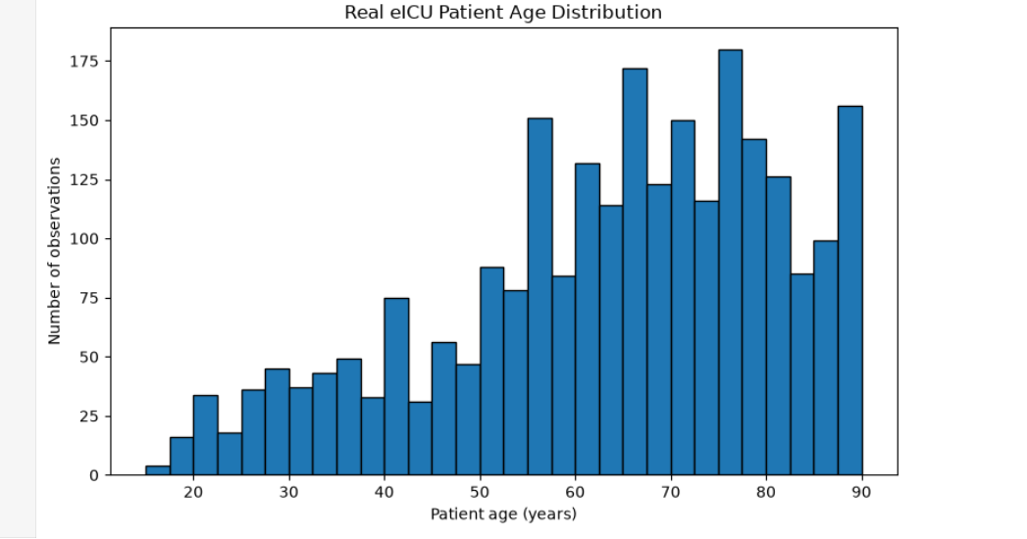
Understanding the real data
2,520 observations • a single numerical feature: age
Key observations
Mean: 63.28 years
Median: 66 years
SD: 17.72 years
More observations at older ages
JLab Data Science Interview • Assessment 2
03
Notes:
The blue histogram represents the actual patient-age distribution. Its x-axis shows ages in years and its y-axis shows frequency. The shape is skewed toward older ages. The upper-end concentration near 90 could partly reflect age encoding; investigate before claiming a clinical effect.

Slide 4
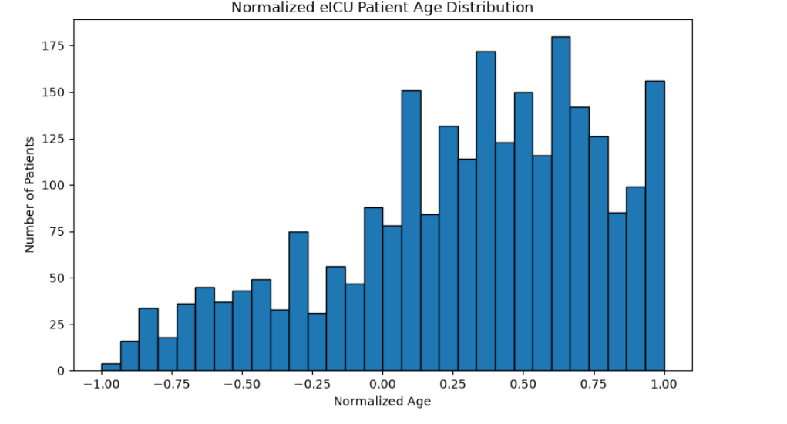
Preprocessing: align real data with Tanh
Convert structured NumPy records, filter invalid values, then scale to [-1, 1]
Normalization
x′ = 2(x − min) / (max − min) − 1
Preserves the relative distribution shape
Matches the Generator’s Tanh output range
PyTorch float32 tensor: [2520, 1]
Shuffled batches of 128 (20 batches)
JLab Data Science Interview • Assessment 2
04
Notes:
Explain that normalization maps the minimum observed age to -1 and maximum to +1. A structured NumPy array required extracting its age field first. Each model example contains one feature. The final mini-batch is smaller than 128.

Slide 5
Our model: a fully connected Vanilla GAN
An MLP fits one-dimensional tabular data without image convolutions
Generator
Noise z ∈ R¹⁶
Linear 16→64 → 64→1
LeakyReLU, then Tanh
Discriminator
Real or fake age ∈ R¹
Linear 1→64 → 64→1
LeakyReLU, raw logit
JLab Data Science Interview • Assessment 2
05
Notes:
Describe the model precisely: a standard or Vanilla GAN using fully connected multilayer perceptrons, not a DCGAN and not a WGAN. Each 16-dimensional noise vector generates one normalized age. The discriminator returns a logit; no explicit sigmoid is needed because BCEWithLogitsLoss includes it.

Slide 6
Adversarial training: two updates per batch
300 epochs • Adam learning rate 0.0002 • betas (0.5, 0.999)
1 Discriminator step
2 Generator step
Real ages → target 1
Draw fresh random noise
Generated ages (detached) → target 0
Pass synthetic ages through D
Average binary cross-entropy loss
Use target 1: try to fool D
Backpropagate and update D
Backpropagate and update G
Track mean D and G loss each epoch; save fixed-noise samples at epochs 1, 25, 50, 100, 200, 300.
JLab Data Science Interview • Assessment 2
06
Notes:
The key code choice is detach for fake data during discriminator training, preventing gradients from modifying generator weights in that step. For generator training, do not detach, so gradients flow through D into G. We update the networks alternately.

Slide 7
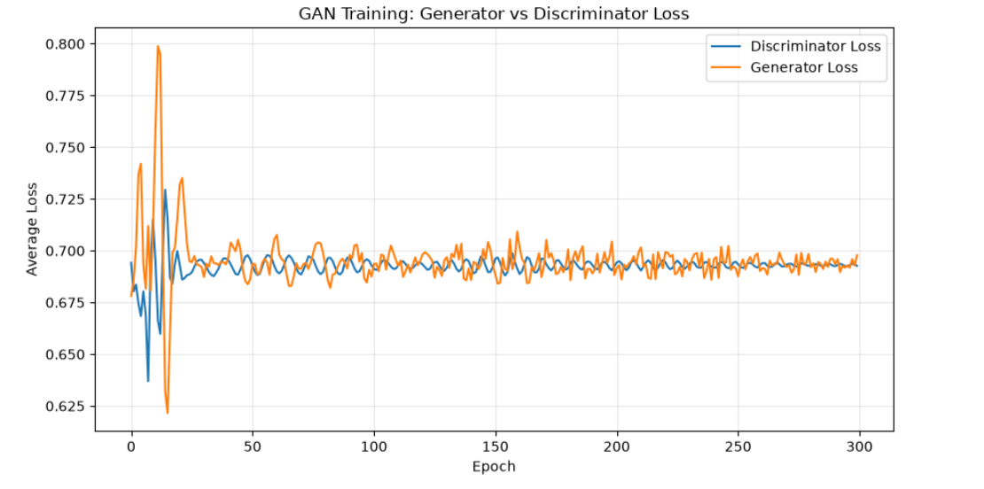
Training loss: an approximate adversarial balance
Loss curves stabilize after early oscillation
Epoch 300
D loss 0.6927
G loss 0.6978
≈ 0.693 suggests uncertain real/fake predictions, not proof of perfect matching.
JLab Data Science Interview • Assessment 2
07
Notes:
Explain x-axis epoch and y-axis average BCE loss. Early oscillations are expected in adversarial learning. Losses near log(2) can correspond to a discriminator predicting 0.5; however this does not establish sample quality. We need to compare actual distributions.

Slide 8
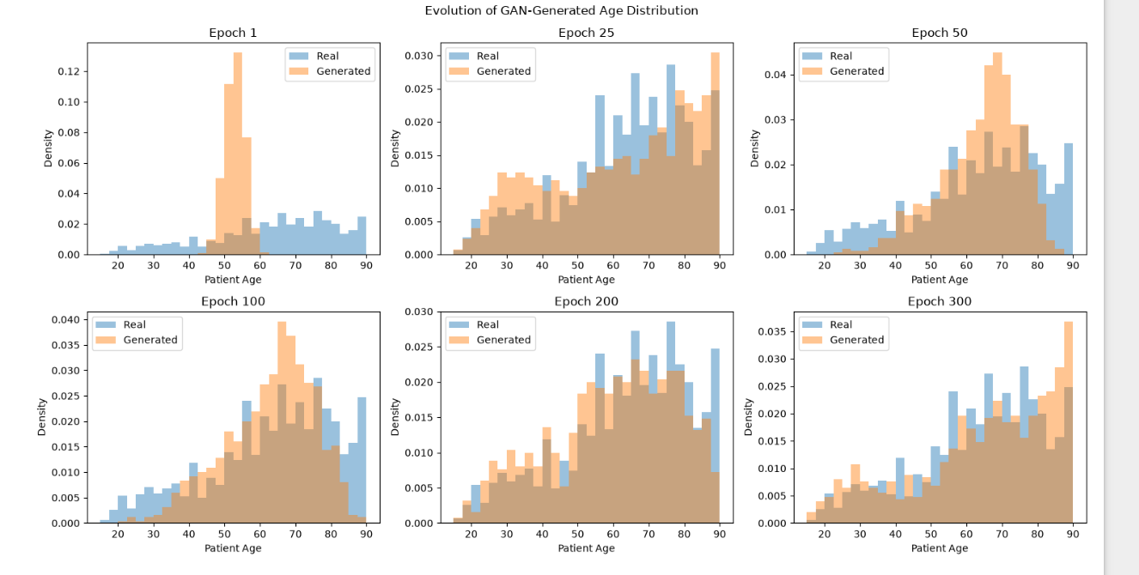
How the generator changes over training
The distribution broadens, but progress is not monotonic
JLab Data Science Interview • Assessment 2
08
Notes:
Walk through six snapshots: epoch 1 very narrow around early 50s; epoch 25 broad range; epoch 50 concentrated around 60 to 75; epoch 100 still imperfect; epoch 200 broad and closer; epoch 300 wide overlap but excess near maximum age. Fixed noise enables meaningful snapshots. This does not establish persistent mode collapse.

Slide 9
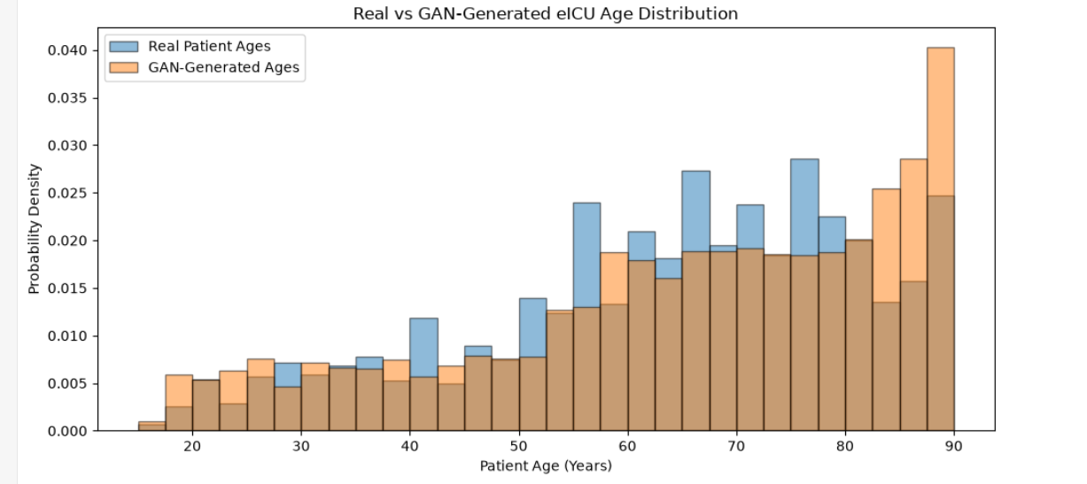
Final result: real vs generated ages
Density-normalized histograms use the same age bins
JLab Data Science Interview • Assessment 2
09
Notes:
Blue is the real distribution; orange is generated. The generator reproduces the broad emphasis on older ages and shows substantial overlap. But it overproduces some high-age values near 85–90 and misses some middle-age frequencies. This is useful approximation, not an exact match.

Slide 10
Quantitative evaluation
Meaningful approximation with measurable discrepancies
Real mean
Generated mean
Real SD
63.28 years
64.99 years
17.72 years
Generated SD
Wasserstein distance
KS statistic
19.61 years
2.54 years
0.1202
Interpretation: the generated mean is 1.71 years higher, variability is greater, and the KS statistic shows a maximum CDF gap of about 12%.
JLab Data Science Interview • Assessment 2
10
Notes:
Wasserstein distance is in the original units: years. KS statistic 0.1202 is the largest vertical distance between empirical cumulative distribution functions. A tiny p-value was also found, but the continuous-null assumption is complicated by discrete real ages; emphasize the statistic and plots. These metrics use the observed training dataset, not an independent holdout.

Slide 11
Limitations and next experiments
Where the model works and where it needs improvement
One-dimensional ages only; not synthetic patient records
Continuous generator outputs vs. integer real ages
Residual bias near the upper-age boundary
Potential improvements: baseline hyperparameter, compare seeds, tune learning rates
JLab Data Science Interview • Assessment 2
11
Notes:
Be candid: 2,520 points, 1D data, output may be fractional, visual high-age mismatch, and 300 epochs selected as baseline. Investigate top-coded ages, use proper train/validation comparisons, and replicate over several seeds.

Slide 12
Reference
Ian J. Goodfellow et. al. “Generative Adversarial Nets”
YouTube: DeepBean “Understanding GANs (General Adversarial Networks)”
Google, ChatGpt
Thank you
JLab Data Science Interview • Assessment 2
12
Notes:
Close with results and limitations. Explicitly disclose AI assistance as requested by Jefferson Lab. Review and verify all code, figures, and numerical claims before interview; supply the GitHub repository by the required deadline.

