Slide 1
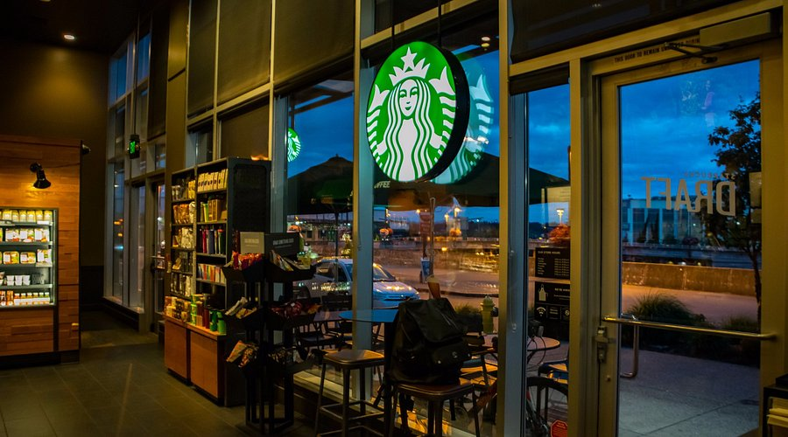
STARBUCKS
DATA ANALYSIS
Submitted By: Dipesh Yadav
Date : 21 August, 2025

Slide 2
Content
Business Context
Business Problem
Business Objective
Technology Stack
Data Overview
Data Dictionary
Data Import Issues
ER-Diagram
Data Processing
Data Audit
Data Inconsistency
Data Discrepancy
Exploratory Data Analysis
Descriptive Analysis
Diagnostic Analysis
Predictive Analysis
Dashboards Layout
Challenges Faced
Key Learnings

Slide 3




Business Context
Mobile App as Core Engagement Tool
Starbucks uses its app to maintain direct communication with customers.
Personalized Promotions
Offers are tailored using customer data, including purchase history and preferences.
Diverse Campaign Types
Includes discounts, BOGO deals, and informational ads to drive sales and awareness.
Targeting Opportunity
Some customers receive no offers in certain weeks, enabling analysis of offer allocation and effectiveness.

Slide 4
Business Problem
1️⃣ 🎯 Starbucks wants to optimize its promotional strategy.
2️⃣ 🔗 Task: Combine transaction, demographic, and offer data.
3️⃣ 🧑‍🤝‍🧑 Identify which demographic groups respond best to which offer type.
4️⃣ ⏱️ Each offer has a validity period before expiration.
5️⃣ 🛒 Example:
🥤 BOGO offer → lasts only 5 days
ℹ️ Informational offer → may influence for 7 days
6️⃣ ⏳ Evaluate how offer validity periods influence customer response.
7️⃣ 📈 Maximize customer engagement and
8️⃣ 💸 Improve return on promotional investments

Slide 5
Business Objective
1️⃣ Data Cleaning 🧹
🗑️ Handle missing values.
✅ Validate offer completion & validity periods.
🔍 Perform consistency checks.
2️⃣ Maximizing Marketing Effectiveness 📈
🧠 Understand customer behavior & preferences.
💸 Optimize marketing spend & ROI.
🎯 Target demographics with specific offers.
🔄 Tailor strategies for higher success rates.
3️⃣ Enhancing Customer Experience 💙
🙋 Deliver personalized & relevant offers.
🌟 Make customers feel valued & engaged.
🤝 Build stronger customer relationships.
🔄 Improve loyalty, satisfaction & retention.

Slide 6
Technology Stack
🛠️ Tool | 📌 Use Case in Project
Python | Load JSON dataset into SQL Server, preprocess raw data, and automate data pipelines.
MS SQL Server | Store and manage the Starbucks dataset (transaction, offer, demographic tables). Perform data cleaning, transformations, and SQL queries for analysis.
MS PowerPoint | Present project findings, data overview, insights, and recommendations in a structured format.
MS Excel | Create visuals and pivot summaries from queried/analyzed SQL data for quick exploration and validation.
Power BI | Build interactive dashboards, visualize customer behavior, offer responses, and key insights.

Slide 7
Data Overview
1️⃣ 🛒 Dataset is simplified — only 1 product vs. dozens in the real Starbucks app.
2️⃣ 📁 Dataset Components
portfolio → Offer details (type, duration, difficulty, reward)
profile → Customer demographics (age, gender, income, membership date)
transcript → Customer interactions (offer received, viewed, completed, transactions)
3️⃣ 👥 Customers (Profile Table)
Demographics: age, gender, income, membership date
Some missing/unknown demographic values
4️⃣ 🎁 Offers (Portfolio Table)
Types: BOGO, Discount, Informational
Attributes: duration (days), difficulty (spend threshold), reward
5️⃣ 📝 Transactions & Events (Transcript Table)
Events: offer received, offer viewed, offer completed, transaction
Time recorded in hours since start of study
Users can receive the same offer multiple times
6️⃣ ⏳ Validity
Offer durations range from 3 to 10 days
Informational offers influence but don’t require completion
Offers may show as completed even if never viewed — not true influence.

Slide 8
Data Dictionary
📂 Source File | 🏷️ Field Name | 📊 Data Type | 📝 Description | 🔎 Notes / Example
👤 profile.json | 🎂 age | 🔢 Int | Age of the customer | Example: 29
 | 📅 became_member_on | 🔢 Int (yyyymmdd) | Date when customer created app account | Example: 20170212
 | 🚻 gender | 🔤 String | Gender of the customer | Values: M, F, O
 | 🆔 id | 🔤 String | Unique customer identifier | Example: 5a2e5a7e5bc
 | 💰 income | 🔢 Float | Customer’s annual income | Example: 72000.0
💳 transcript.json | 📝 event | 🔤 String | Record description (type of activity) | Values: transaction, offer received, offer viewed, offer completed
 | 👤 person | 🔤 String | Customer identifier (links to profile.id) | Example: 5a2e5a7e5bc
 | ⏳ time | 🔢 Int (hours) | Time in hours since start of test | Example: 48 (2 days later)
 | 📦 value | 📑 Dict | Context-dependent values (offer ID or transaction amount) | Example: { "offer id": "abc123" } or { "amount": 10.5 }
🎁 portfolio.json | 🆔 id | 🔤 String | Unique identifier of the offer | Example: ae264e3637204a6fb9bb56bc8210ddfd
 | 🎟️ offer_type | 🔤 String | Type of marketing offer | Values: bogo, discount, informational
 | 📊 difficulty | 🔢 Int | Minimum spend required to complete the offer | Example: 10
 | 🏆 reward | 🔢 Int | Reward given upon offer completion | Example: 2
 | ⏱️ duration | 🔢 Int (days) | Validity period of the offer | Example: 7
 | 📡 channels | 📋 List of Strings | Channels used to deliver the offer | Example: [ "email", "mobile", "web" ]

Slide 9
Data Import Issues
🗂️ Category | ⚠️ Common Issues | 💡 Example
📝 JSON Format | ❌ Malformed JSON (missing braces/commas) | { "id": 1, → ❌ invalid
 | ❌ Trailing commas | [ { "id": 1, }, { "id": 2 } ]
 | ❌ Encoding mismatch | File saved in UTF-16 but read as UTF-8 → garbled text
🏗️ Schema & Structure | ❌ Inconsistent keys | Record 1: { "id": 1, "email": "a@x.com" } Record 2: { "id": 2 }
 | ❌ Deeply nested objects | { "order": { "items": [ { "id": 101, "qty": 2 } ] } }
 | ❌ Dynamic/optional fields | Some rows have "phone", some don’t
🔢 Data Types | ❌ Type mismatch (string vs int) | { "age": "25" } → stored as text
 | ❌ Large numbers overflow | { "population": 999999999999 } → exceeds BIGINT
 | ❌ Date/time parsing issues | "2025-08-18T10:30:00Z" doesn’t match SQL datetime
🚀 Performance | ❌ Large JSON files slow parsing | 500 MB JSON takes minutes to import
 | ❌ Nested arrays cause row explosion | Array of 100 × nested array of 50 → 5,000 rows
 | ❌ No indexing on JSON columns | Querying JSON_VALUE(data, '$.id') without index → slow
🔍 Nulls & Missing | ❌ Absent vs null values | {} vs { "age": null } behave differently
 | ❌ Empty arrays/objects | "items": [] may break joins
🔡 Special Characters | ❌ Unicode/emoji corruption | "name": "Dipesh 😃" → broken if stored in VARCHAR
 | ❌ Quotes & escape issues | "desc": "He said, \"Hello\""
🔧 Tool/Method Issues | ❌ File access errors (BULK INSERT) | Cannot bulk load because file could not be opened
 | ❌ SSIS lacks native JSON source | Must flatten JSON before load
 | ❌ ETL tool encoding mismatch | PowerShell writes extra backslashes: "path": "C:\\data"
✅ Validation & Constraints | ❌ Duplicate IDs (PK violation) | Two records with "id": 1"
 | ❌ Foreign key issues | "order": { "customer_id": 999 } → no matching customer

Slide 10
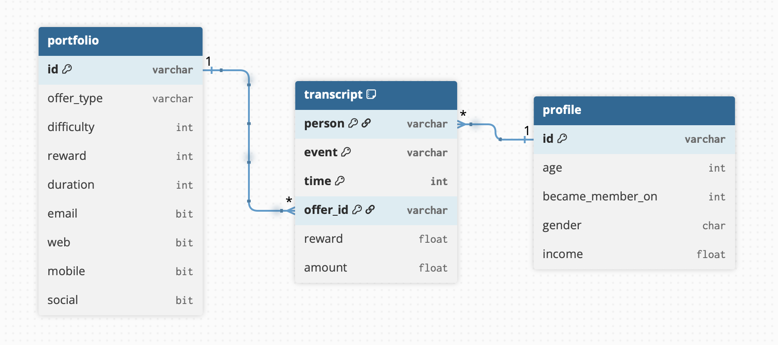
ER-Diagram

Slide 11
Data Preprocessing (1/2)
1️⃣ 🧹 General Data Cleaning:
🧹 Handle missing values – e.g., missing ages, genders, income.
📏 Remove/Cap outliers – extremely high ages or incomes.
🔁 Drop duplicates – especially in transaction/offer events.
⏳ Convert timestamps – transcript time (hrs → days).
2️⃣ 👥 Demographic Data:
👥 Encode categorical variables – gender (M/F/O → numeric or one-hot).
🎂 Bin ages – group into categories (18–25, 26–35, etc.) for better interpretability.
💰 Bin income levels – e.g., low, medium, high income ranges.
🔎 Filter unrealistic values – e.g., age > 100 or income < 0.
3️⃣ 📦 Portfolio (Offer) Data:
📦 One-hot encode offer types – BOGO, discount, informational.
🕐 Standardize validity – ensure days are consistent across dataset.
💲 Normalize reward values – scale or standardize rewards if needed.

Slide 12
Data Preprocessing (2/2)
4️⃣ 🧾 Transcript (Event) Data:
🧾 Separate event types – transaction, offer received, offer viewed, offer completed.
🔗 Map offers to customers – merge portfolio & demographics with transcript.
✅ Check offer completion validity – ensure completion happens within offer validity period.
🛑 Identify invalid completions – e.g., completed without view.
⏱️ Aggregate transactions – sum customer spending within an offer window.
5️⃣ ⚡ Feature Engineering:
📊 Customer activity level – avg. transactions per month.
🥤 Offer responsiveness – ratio of completed offers / received offers.
🧑‍🤝‍🧑 Demographic group features – combine age, gender, income for richer analysis.
💳 Spending patterns – avg. spend per transaction, total spend.

Slide 13
Data Audit (1/2)
Profile
Transcript
Granularity | Customer level
Primary Key | id
Number of attributes | 5
Total records | 17 k
Number of duplicate records | 0
Key missing fields | gender: 2,175 income: 2,175
Unique gender | 3 (i.e. M, F, & O)
Range of numeric attributes | age: 18 – 118 income: ₹30k – ₹120k
Range of joining date | 29 July, 2013 – 26 July, 2018
Granularity | Event level
Primary Key | person, offer_id, event ,& time
Number of attributes | 6
Total records | 306.53 k
Number of duplicate records | 397
Key missing fields | offer_id: 138.95 k amount: 167.58 k reward: 272.96 k
Unique event | 4 (i.e. offer received, offer viewed, transaction, offer completed)
Range of numeric attributes | time: 0 – 714 amount: ₹0.05 – ₹1,062.28 reward: ₹2 – ₹10

Slide 14
Data Audit (2/2)
Portfolio
Granularity | Offer level
Primary Key | id
Number of attributes | 9
Total records | 10
Number of duplicate records | 0
Missing values | 0
Unique offer types | 3 (i.e. bogo, discount, & informational)
Unique channels | 4 (i.e. email, mobile, social, web)
Unique rewards | ₹0, ₹2, ₹3, ₹5, & ₹7
Unique difficulty | ₹0, ₹5, ₹7, ₹10, & ₹20
Unique duration | 3, 4, 5, 7, & 10

Slide 15
Data Inconsistency
1️⃣ 👤 Profile Table (Customer Demographics)
🧒 Age = 118 → This is a placeholder for missing age. Many customers have this unrealistic age.
💸 Income = null → Several customers don’t have income data.
📅 became_member_on → Needs conversion from YYYYMMDD integer to proper date format.
2️⃣ 📜 Portfolio Table (Offer Metadata)
📑 Offer IDs → Unique, but you need to ensure no missing or duplicate IDs.
🔁 Channels → Stored as list (e.g., ["web", "mobile"]) which is not normalized (difficult for SQL/BI).
📅 Duration → Stored in days (integer), but transcript “time” is in hours → unit mismatch.
3️⃣ 📝 Transcript Table (Events & Transactions)
🏷️ Event field → Contains multiple types (offer received, offer viewed, offer completed, transaction). Must be split/standardized for analysis.
💰 Transaction amount → Only available for transaction events; missing (null) for others.
🎁 Offer IDs → Not present for transaction events (only for offer-related events).
⏱️ Time field → Stored as hours since start of dataset, not a proper date/time. Needs conversion.

Slide 16
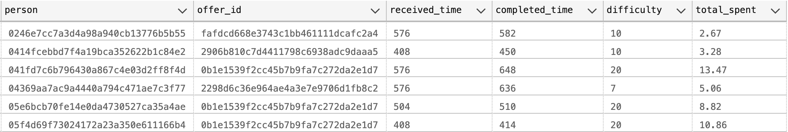
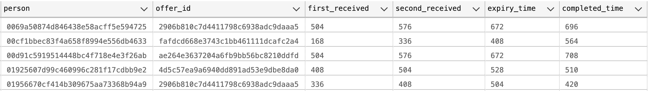
Data Discrepancy
In Transcript Table:
1️⃣ There are 134 records where offers are marked as completed without meeting the minimum transaction amount.
2️⃣ There are 674 records where the same offer was received by a person before its expiration or before it was completed.

Slide 17
Exploratory Data Analysis (1/2)
1️⃣ 📁 Data Structure & Metadata
📏 Dataset shape (rows × columns)
🏷 Data types (categorical, numerical, datetime)
🔍 Missing/null values check
🆔 Unique identifiers (e.g., customer_id, offer_id)
2️⃣ 📉 Univariate Analysis (Single Variable)
👤 Demographics
🎂 Age distribution
🚻 Gender distribution
💰 Income distribution
🎁 Offer Data
📊 Count of offer types (BOGO, Discount, Informational)
🎯 Difficulty (spend threshold) & Reward
⏳ Duration of offers
🛒 Transactions
💵 Transaction amount distribution
🔁 Frequency of transactions per customer
⚠️ Outliers in spending
3️⃣ 🔗 Bivariate Analysis (Two Variables)
👤 Demographics × Offers
🚻 Gender vs Offer Completion Rate
💰 Income vs Offer Completion
🎂 Age vs Offer Completion
🛒 Transactions × Offers
💵 Spend before vs after offer
🎯 Difficulty vs Completion Rate
🎁 Offer Characteristics
⏳ Duration vs Completion Rate
🎁 Reward vs Completion Rate
4️⃣ 📊 Multivariate Analysis (3+ Variables)
🎂 Age × 💰 Income × ✅ Completion (3D/bubble chart)
🚻 Gender × 🎁 Offer Type × ✅ Completion (stacked bar)
👥 Customer Segments vs Response
🧩 Correlation heatmap of numerical features

Slide 18
Exploratory Data Analysis (2/2)
5️⃣ ⏰ Temporal Analysis (Time-Series)
📅 Transactions trend (daily/weekly/monthly)
🎯 Offer response over time
⏱ Time-to-complete an offer
🕒 Peak hours & days for transactions
6️⃣ 👥 Segmentation Analysis
🔵 Customer clusters (K-Means / demographics + spend)
🏆 High-value vs Low-value customers
📊 Response rates by segment
7️⃣ 🎯 Offer Effectiveness
🥇 Best performing offer type (completion %)
📈 Uplift in spend after offers
💸 ROI comparison (Reward vs Spend Increase)
🔄 Funnel: Received → Viewed → Completed
8️⃣ ⚠️ Anomaly / Outlier Detection
💵 Extremely high transactions
🎂 Unrealistic ages (e.g., 118 yrs)
🔁 Customers with very high/low activity
❌ Ineffective offers with poor completion
9️⃣ 📌 Correlation & Relationships
📊 Correlation heatmap (age, income, spend, reward, difficulty)
🔬 Chi-square test (categorical links: gender vs completion)
🌳 Feature importance (Random Forest quick check)

Slide 19
Descriptive Analysis (What Happened?) (1/4)
1️⃣ 👥 Customer Demographics
📊 Age distribution (mean, median, range, histogram)
🚻 Gender distribution (M/F/O)
💰 Income distribution (mean, median, quartiles)
🧑‍🤝‍🧑 Segmentation by age groups & income groups
🔗 Correlation between age & income
2️⃣ 📦 Offers (Portfolio Data)
🧾 Distribution of offer types (BOGO, Discount, Informational)
⏳ Average duration of offers
🎁 Average reward value across offers
📈 % share of each offer type in total offers
3️⃣ 🧾 Transcript (Events Data)
🔄 Frequency of each event type: received, viewed, completed, transaction
⌛ Time distribution of transactions (daily/weekly trends)
💳 Avg. transaction value per customer
🔢 Avg. transaction frequency per customer
4️⃣ 🎯 Offer Effectiveness
📌 View-to-completion ratio for each offer type
✅ Completion rate of offers (completed / received)
⏱️ Avg. time taken from offer received → viewed → completed
👀 % of offers completed without being viewed
🔁 Repeat offers: performance when a customer receives the same offer multiple times

Slide 20
Descriptive Analysis (What Happened?) (2/4)
5️⃣ 👩‍💼 Customer Behavior Analysis
📈 % of customers who respond to at least one offer
🚫 % of customers who never view offers
💳 Avg. spend of customers who respond vs. those who don’t
👨‍👩‍👧 Demographic breakdown of responders (age, gender, income)
💡 Segmentation: High spenders vs. Low spenders
6️⃣ 🕒 Temporal Analysis
📆 Transactions trend over offer validity window (days)
⏰ Peak hours/days for transactions
🌦️ Seasonal/monthly trend (if timestamp covers long enough range)
7️⃣ 🔗 Cross-Analysis
🚻 Gender × Offer Type completion rate
💰 Income group × Average transaction amount
👥 Age group × Offer responsiveness
🎁 Offer type × Avg. reward redeemed
🔁 Repeat customers vs. one-time responders
8️⃣ 📈 Power BI / Visualization-friendly Analysis
🔄 Funnel View: Received → Viewed → Completed
🌡️ Heatmaps: Offer type vs. Completion %
👥📊 Cohort Analysis: Customers grouped by first offer received
💰⏳ Customer Lifetime Value Approximation: Based on spend + responsiveness

Slide 21
Descriptive Analysis (What Happened?) (3/4)
✅ KPI (Key Performance Indicators):
KPIs are success measures that show how well the system/campaign is performing.
👥 Total Customers Analyzed → Number of unique customers in the dataset.
🎟️ Total Offers Distributed → Count of offers sent to customers.
👀 Offer View Rate (%) → % of received offers that were viewed.
✅ Offer Completion Rate (%) → % of offers completed after being received.
💳 Average Spend per Customer → Total spend ÷ total customers.
🔄 Repeat Transaction Rate (%) → % of customers making multiple transactions.
⏱️ Average Offer Response Time → Time taken to complete an offer after receiving.
📈 Demographic-wise KPIs:
Age group distribution
Income group response rate
Gender-wise completion rate
⚠️ KRI (Key Risk Indicators):
KRIs are warning signals highlighting risks or inconsistencies.
🔁 Duplicate Offers Sent → Cases where the same offer was sent before expiry/completion.
🚫 Offers Completed Without Transactions → Customers marked “completed” without meeting minimum spend.
⚡ Low Engagement Rate → Large share of offers neither viewed nor completed.
❓ Missing Demographic Data → % of customers with missing age, gender, or income.
📉 Inactive Customers → Customers receiving offers but making no transactions.
⏳ Expired Offers → % of offers that expired without action.
🔎 Demographic Bias Risk → Certain groups over/underrepresented in engagement.

Slide 22
Descriptive Analysis (What Happened?) (4/4)
🎯 KRA (Key Result Areas):
KRAs are broad focus areas that descriptive analysis is trying to achieve.
👥 Customer Segmentation → Grouping customers by age, gender, income, or behavior.
🎟️ Offer Effectiveness Analysis → Measuring which offers types (BOGO, Discount, Informational) perform better.
💳 Transaction Behavior → Understanding spend patterns, frequency, and recency.
📊 Engagement Funnel Tracking → Received → Viewed → Completed funnel.
📈 Business Uplift Measurement → Identifying revenue impact from offers.
🛡️ Data Quality & Reliability → Highlighting missing values, duplicates, and inconsistencies.
✅ In summary:
KPI →
What’s working well (performance metrics)
KRI →
Where risks/alerts exist (warning signals)
KRA →
What areas we must focus on (broad goals)

Slide 23
Diagnostic Analysis (Why It Happened?) (1/4)
1️⃣ 🧾 Offer Completion Drivers
⚖️ Compare completion rates across offer types (BOGO vs Discount vs Informational)
🎁 Check if offers with higher rewards have higher completion
⏳ Diagnose if longer validity offers → higher completion
❓ Investigate % of completed offers without being viewed (possible auto-completion bias)
2️⃣ 👥 Customer Demographics Impact
🚹🚺 Gender vs Offer Completion → Do men or women respond better to certain offers?
👶🧑👵 Age groups vs Offer Completion → Younger vs older customers’ response
💵 Income groups vs Offer Completion → Do higher earners complete more offers?
📈 Correlation of income with average transaction size
3️⃣ 📊 Offer Engagement Funnel Analysis
🔻 Drop-off analysis: Received → Viewed → Completed → Transaction
🧐 Diagnose whether low viewing rate or low completion rate is the bigger issue
4️⃣ 🕒 Time-based Diagnostics
🏃 Do shorter duration offers fail due to insufficient time?
⏱️ Time to view vs time to complete → Are quick viewers more likely to complete?
📅 Transaction timing (weekends vs weekdays, morning vs evening) impact on completion

Slide 24
Diagnostic Analysis (Why It Happened?) (2/4)
5️⃣ 💰 Spend Behaviour Diagnostics
💳 Compare spending patterns of offer responders vs non-responders
📊 Diagnose if spending increases after receiving an offer
🎯 Do customers redeem offers only when transaction ≥ reward threshold?
🛒 Is average spend higher for BOGO vs Discount offers?
6️⃣ 🔗 Cross-Analysis (Multivariate)
💵 × 🎁 Income × Offer Type × Completion → Which offers resonate best with each income segment?
👶🚹🚺 Age × Gender × Offer Responsiveness → e.g., Younger females may prefer Discounts, older males prefer BOGO
🎁 ⏳ Offer Reward Value × Duration → Is high reward effective only with longer validity?
7️⃣ 🛑 Failure / Non-response Diagnostics
🙈 Customers who never view offers — are they low-spenders or inactive?
👀 Customers who view but don’t complete → High spending threshold issue?
💤 Identify inactive vs active users: Transactions but no offers vs Offers but no transactions
8️⃣ 📈 Advanced Diagnostics (Statistical Tests)
🧮 Chi-square test → Association between demographics & offer completion
📊 ANOVA / t-test → Spending difference between responders vs non-responders
🔗 Correlation analysis → Income vs Offer Responsiveness, Transaction Frequency vs Completion

Slide 25
Diagnostic Analysis (Why It Happened?) (3/4)
✅ KPI (Key Performance Indicators):
KPIs here focus on factors influencing performance (root cause insights).
📉 Offer Drop-off Rate by Stage → % lost at each stage (Received → Viewed → Completed).
🎟️ Offer Completion by Offer Type → BOGO vs. Discount vs. Informational success rates.
👥 Offer Completion by Demographics → Age, gender, income group completion %.
💳 Spend per Transaction vs. Offer Type → Average spend under different offers.
⏱️ Response Time by Customer Segment → Which groups respond faster/slower to offers.
🔄 Repeat Engagement KPI → How many customers complete multiple offers.
⚠️ KRI (Key Risk Indicators):
KRIs in diagnostic analysis highlight causes of poor performance or hidden risks.
🚫 Mismatch Between Offer & Customer Behavior → E.g., BOGO sent to low-spend customers.
⚠️ Low Completion in Certain Demographics → Income <30K, or older age groups show very low rates.
⏳ High Expiry Rate in Certain Offers → Some offers always expire without usage.
🕳️ Engagement Funnel Gaps → High “received → not viewed” or “viewed → not completed” gaps.
📉 Negative Business Impact Segments → Customers redeeming offers without increasing spend.
🔁 Over-Saturation Risk → Customers receiving too many offers too frequently.

Slide 26
Diagnostic Analysis (Why It Happened?) (4/4)
🎯 KRA (Key Result Areas):
KRAs here are about pinpointing the “why” behind descriptive results.
👥 Customer Segment Diagnostics → Identifying which groups drive or drag performance.
🎟️ Offer-Type Diagnostics → Why certain offer types outperform others.
💳 Behavioral Diagnostics → Why customers spend more/less with offers.
🔄 Engagement Path Diagnostics → Understanding drop-offs in the engagement funnel.
🛡️ Risk Diagnostics → Pinpointing mismatches, redundancies, or waste in campaigns.
📈 Root Cause Identification → Mapping factors (demographics, income, offer type, timing) to outcomes.
✅ In summary:
KPI →
Metrics showing what factors influence performance
KRI →
Red flags explaining poor outcomes
KRA →
Areas of focus for root-cause investigation

Slide 27
Predictive Analysis (What Will Happen?) (1/3)
1️⃣ 📩✅ Offer Response Prediction
👀 View prediction
🤝 Engagement prediction
🏆 Completion prediction
2️⃣ 💰📈 Customer Lifetime Value (CLV) Prediction
💳 Future spend estimation
📊 Regression-based forecasting
3️⃣ ⚠️👋 Customer Churn Prediction
🚨 At-risk customer detection
📉 Behavioural trend analysis
4️⃣ 🧩👥 Segmentation with Predictive Clustering
🏠 Grouping by demographics
🛍️ Clustering by transactions
5️⃣ ⏳🛒 Next Purchase Prediction
⏰ Purchase timing forecast
📆 Time-series modeling
6️⃣ 🎯💵 Offer Value Optimization
💲 Minimum spend threshold prediction
❌💸 Avoiding over-discounting
7️⃣ 📊📢 Campaign ROI Forecasting
📈 Success rate estimation
💼 Budget allocation guidance
8️⃣ 🔮👤 Propensity Modeling
🎲 Engagement likelihood prediction
👩‍🦰👨‍🦱👩‍🦳 Segment-wise testing
9️⃣ 📆📈 Seasonality & Trend Forecasting
🗓️ Monthly/weekly pattern analysis
🎉 Festival trend forecasting
🔟 ➕🛍️ Cross-Sell & Up-Sell Prediction
🛒 Extra product purchase prediction
🔗 Association rule mining

Slide 28
Predictive Analysis (What Will Happen?) (2/3)
✅ KPI (Key Performance Indicators):
Predictive KPIs focus on forecasted success, risks, and behavior.
📈 Predicted Offer Completion Rate → Probability that an offer will be completed based on customer profile & past behavior.
👥 Customer Lifetime Value (CLV) Forecast → Expected revenue from each customer segment.
🎯 Offer Success Probability by Type → Forecasted success % for BOGO, Discount, Informational.
🛒 Predicted Incremental Spend Uplift → How much additional spend an offer is expected to generate.
🔄 Predicted Repeat Engagement Rate → Likelihood of customers re-engaging with future offers.
⏱️ Time-to-Completion Forecast → Predicting how quickly different customers will redeem offers.
⚠️ KRI (Key Risk Indicators):
Predictive KRIs warn about future risks & uncertainties.
🚫 Churn Probability → Risk of customers dropping out if engagement is low.
⚠️ Offer Ineffectiveness Risk → Forecasted offers that are unlikely to meet completion targets.
🕳️ Customer Segment Risk → Demographic groups predicted to have very low responsiveness.
🔄 Over-Redemption Risk → Customers likely to redeem offers but not increase spend (fake success).
📉 Cannibalization Risk → Customers predicted to redeem discounts they would have paid full price for.
⏳ High Expiry Risk → Offers forecasted to expire without usage in specific segments.

Slide 29
Predictive Analysis (What Will Happen?) (3/3)
🎯 KRA (Key Result Areas):
Predictive KRAs highlight future-focused strategy areas.
👥 Customer Response Forecasting → Identifying who is most/least likely to respond.
🎟️ Offer-Type Strategy → Deciding which offer mix will perform best in future campaigns.
💳 Revenue & Spend Forecasting → Estimating future sales lift from promotions.
🔄 Engagement Retention Strategy → Ensuring predicted high churn customers are re-targeted.
🛡️ Risk Mitigation Strategy → Acting on predictive KRIs to avoid wasteful or risky offers.
📊 Resource Allocation → Focusing marketing budget on offers and customers with the highest predicted ROI.
✅ In summary:
KPI →
Forward-looking success metrics (e.g., predicted offer completion, CLV forecast).
KRI →
Future red flags (e.g., churn risk, cannibalization risk).
KRA →
Strategic focus areas for proactive decisions.

Slide 30
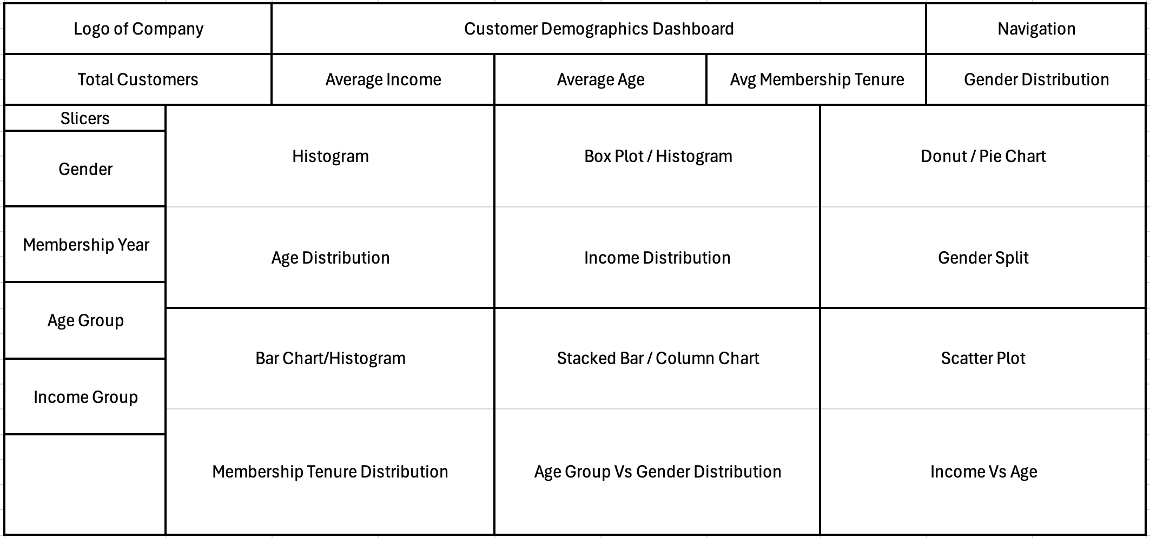
Dashboard Layout (1/4)
1️⃣ Customer Demographic Dashboard👥
Purpose: Understanding customer base & segmentation.
Stakeholders:
👨‍💼 Marketing Team:
To design targeted campaigns.
📊 Data Analysts:
To study customer trends & clusters.
🎯 Customer Insights/Research Team:
To refine personas & loyalty strategies.

Slide 31
Insights & Recommendations
🔍 Insights
Customer Profile: Majority customers belong to specific age groups & income brackets – useful for segmentation.
Gender Split: Gender distribution shows potential for gender-targeted campaigns.
Income vs Age: Higher income tends to be concentrated in middle-age customers, highlighting key spending groups.
Membership Trends: Average tenure insights reveal loyal vs new customers, useful for retention strategies.
Clusters: Age group and income group combinations reveal distinct customer segments.
✅ Recommendations
Targeted Campaigns: Personalize offers based on age-income clusters and gender preferences.
Loyalty Programs: Design rewards to strengthen retention among long-tenure high-value customers.
New Customer Engagement: Create onboarding campaigns for recent members to boost early retention.
Segmented Marketing: Focus promotions on high-spending age groups while nurturing emerging segments.
Continuous Monitoring: Regularly track demographic shifts to adapt strategies dynamically.

Slide 32
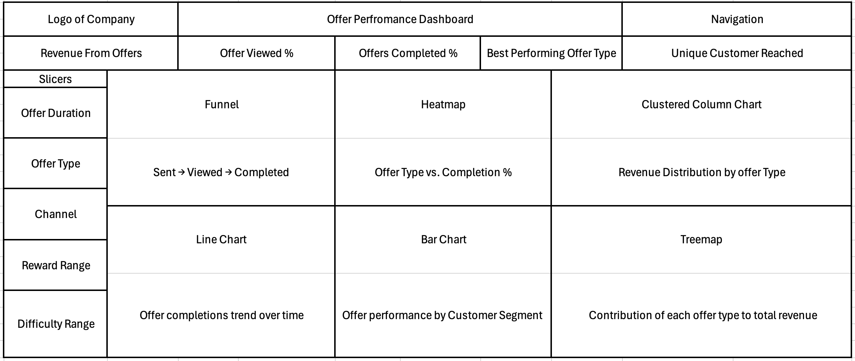
Dashboard Layout (2/4)
2️⃣ Offer Performance Dashboard 🎟️
Purpose: Evaluating effectiveness of offers & engagement funnel.
Stakeholders:
🎯 Campaign Managers:
To see which offers worked best.
📢 Marketing Executives:
To allocate budgets to high-performing offers.
🧮 Data Science/Analytics Team:
To track KPIs like completion rates & conversions.

Slide 33
Insights & Recommendations
🔍 Insights
Revenue varies widely by offer type.
Big drop-off between viewed vs completed offers.
BOGO/Discount offers perform best.
Limited customer reach in some segments.
Clear seasonality in completion trends.
Certain customer groups show higher engagement.
✅ Recommendations
Focus on high-ROI offer types.
Reduce friction in redemption funnel.
Personalize offers by customer segment.
Prioritize high-engagement channels.
Experiment with duration & reward levels.
Use trends to plan seasonal campaigns.

Slide 34
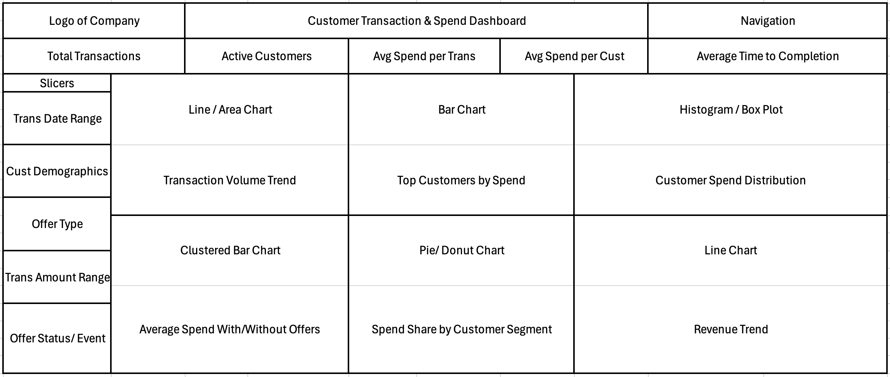
Dashboard Layout (3/4)
3️⃣ Customer Transaction Dashboard 💳
Purpose: Tracking spend behavior, purchase frequency & channels.
Stakeholders:
🛒 Product Managers:
To optimize product/channel mix.
📊 Operations Team:
To manage transaction flows & identify anomalies.
👩‍💻 Business Analysts:
To link spending patterns with customer engagement.

Slide 35
Insights & Recommendations
🔍 Insights
High spenders show stronger offer completion.
Shorter completion times → higher engagement.
Spending peaks align with weekends/offer releases.
Older & higher-income groups spend more consistently.
Some segments receive offers but rarely complete them.
✅ Recommendations
Target high-spend, low-completion groups with better incentives.
Shorten offer validity for faster conversions.
Push offers during peak spend days.
Personalize by age, income, and membership tiers.
Reduce redundant offers to non-responding customers.

Slide 36
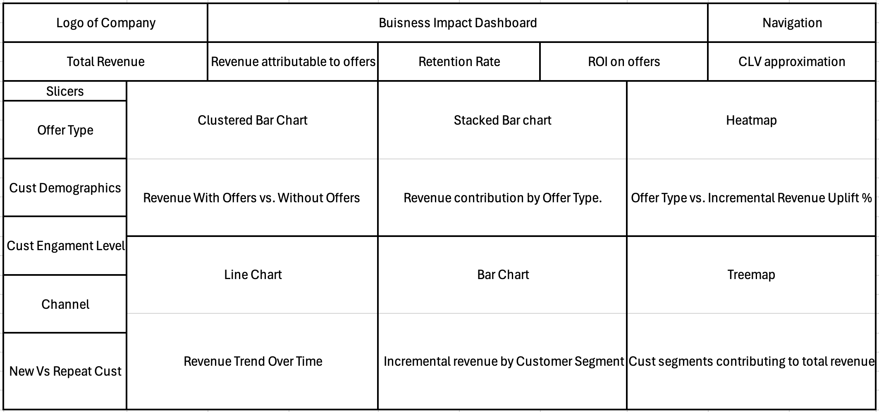
Dashboard Layout (4/4)
4️⃣ Business Impact Dashboard 💼📈
Purpose: Measuring financial uplift, ROI, and long-term impact.
Stakeholders:
💼 Executive Leadership (C-Suite: CEO, CFO, CMO):
To monitor ROI & strategy impact.
📈 Finance Department:
To validate revenue uplift & incremental gains.
🎯 Strategy & Planning Team:
To decide whether to scale campaigns or change tactics.

Slide 37
Insights & Recommendations
🔍 Insights
Offers drive measurable revenue uplift.
BOGO & Discount offers outperform informational ones.
Higher CLV & retention seen in engaged customer segments.
App & in-store channels deliver stronger ROI vs. email.
Offers attract new customers, but retention impact varies.
✅ Recommendations
Scale high-ROI offers; reduce low-performing ones.
Personalize campaigns by demographics & engagement level.
Prioritize channels with stronger ROI (app > email).
Balance acquisition vs. retention strategies.
Track long-term CLV & ROI, not just short-term sales spikes.

Slide 38
THANK YOU!
For your attention

