Slide 1

Visualisation

Slide 2
Purpose of Visualisation
The purpose of the visualisations is to:
Understand the relationship between alcohol consumption and happiness
Identify overall trends and patterns
Check whether a correlation analysis is appropriate
Visual exploration helps verify assumptions before running statistical tests.

Slide 3
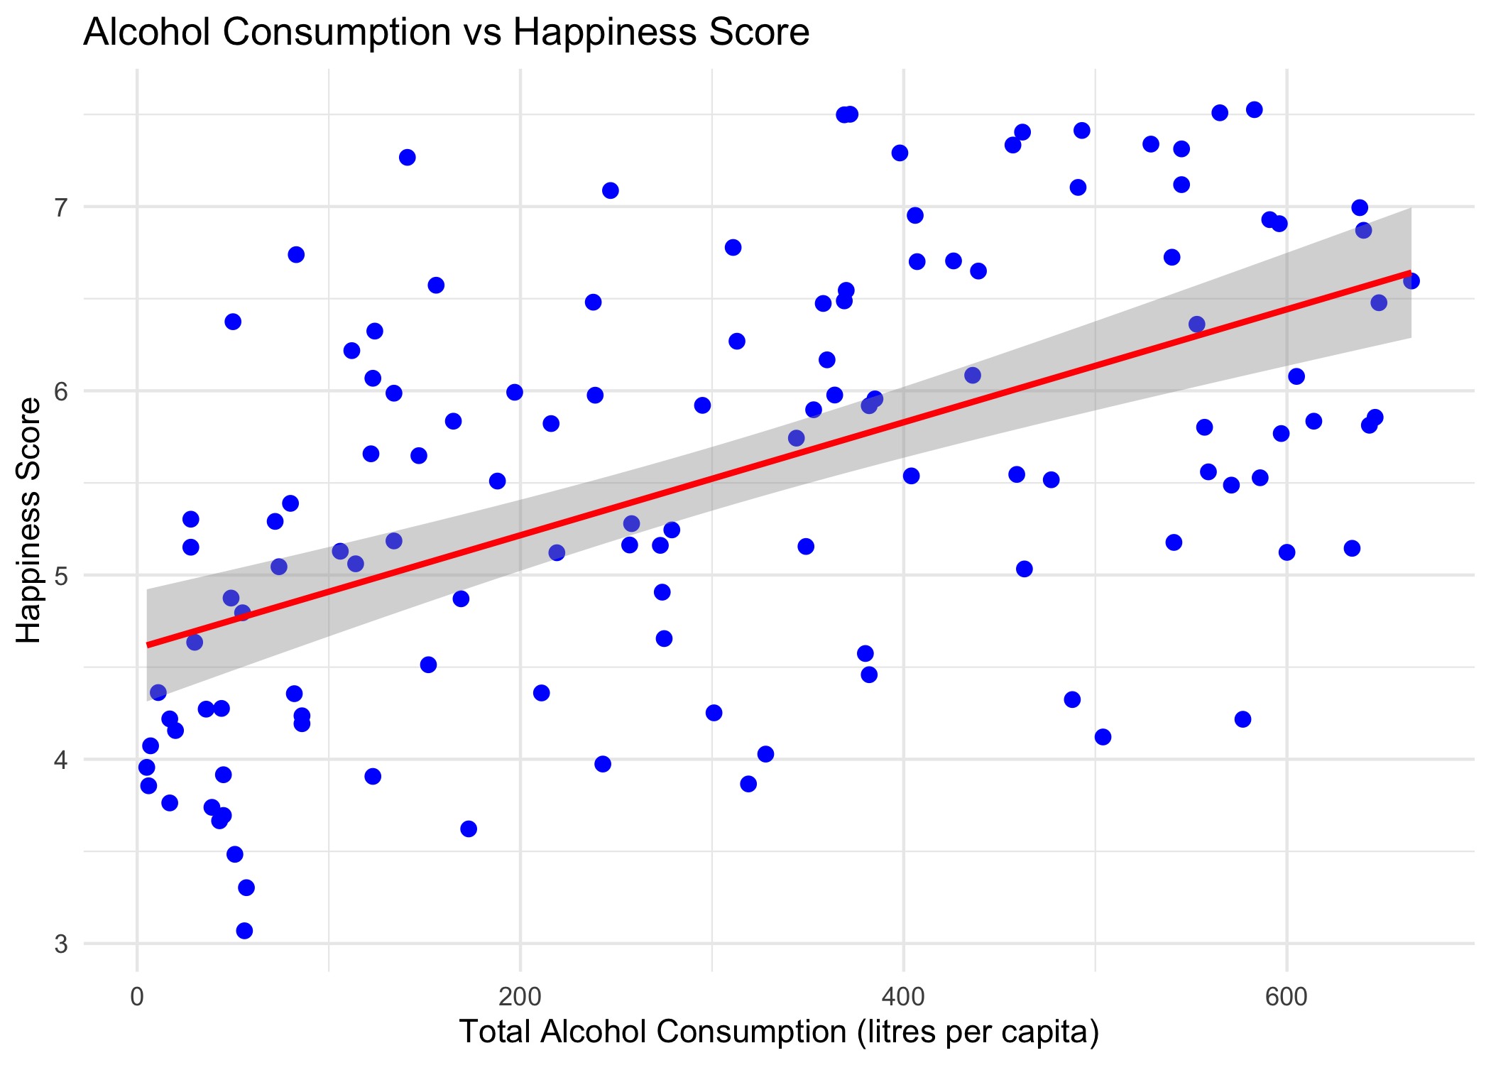
Scatter Plot: Alcohol Consumption vs Happiness Score
Each point represents a country
X-axis shows total alcohol consumption per capita
Y-axis shows happiness score
The upward trend suggests a positive relationship
A linear trend line is added to highlight this pattern
This visual supports using Pearson correlation.

Slide 4
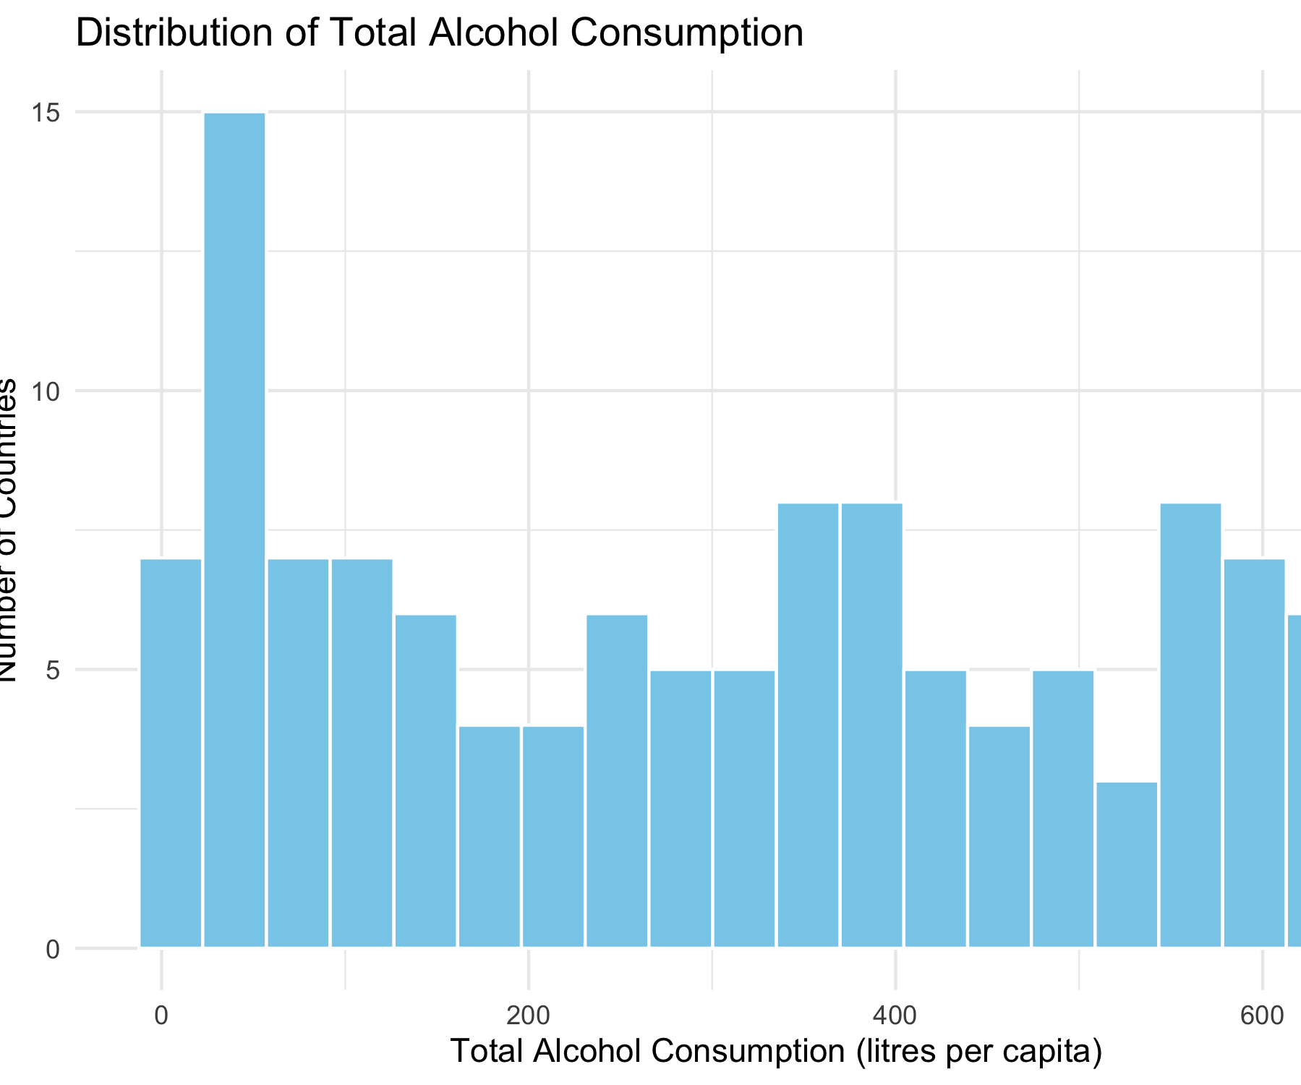
Histogram of Total Alcohol Consumption
Shows how alcohol consumption is distributed across countries
Most countries fall within a moderate consumption range
The distribution is reasonably smooth, without extreme skew
This supports the use of parametric statistical tests.

Slide 5
How Visualisations Support the Research Question
Research Question:
Is there a correlation between alcohol consumption and happiness across countries?
The scatter plot visually suggests a positive correlation.
The histogram shows acceptable data distribution.
Therefore, a Pearson correlation test is appropriate.

Slide 6
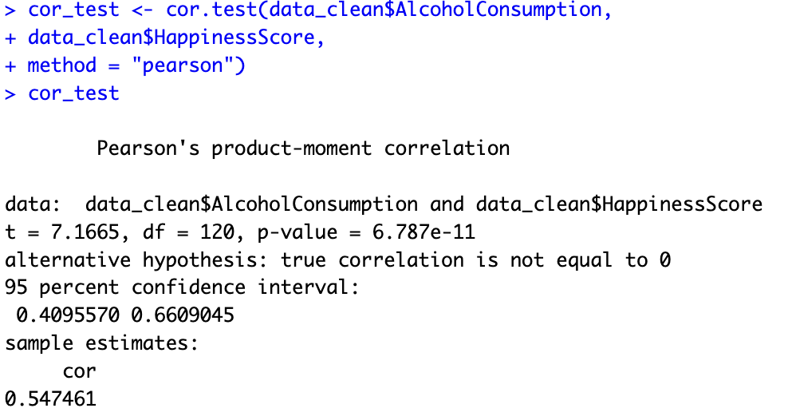

Slide 7
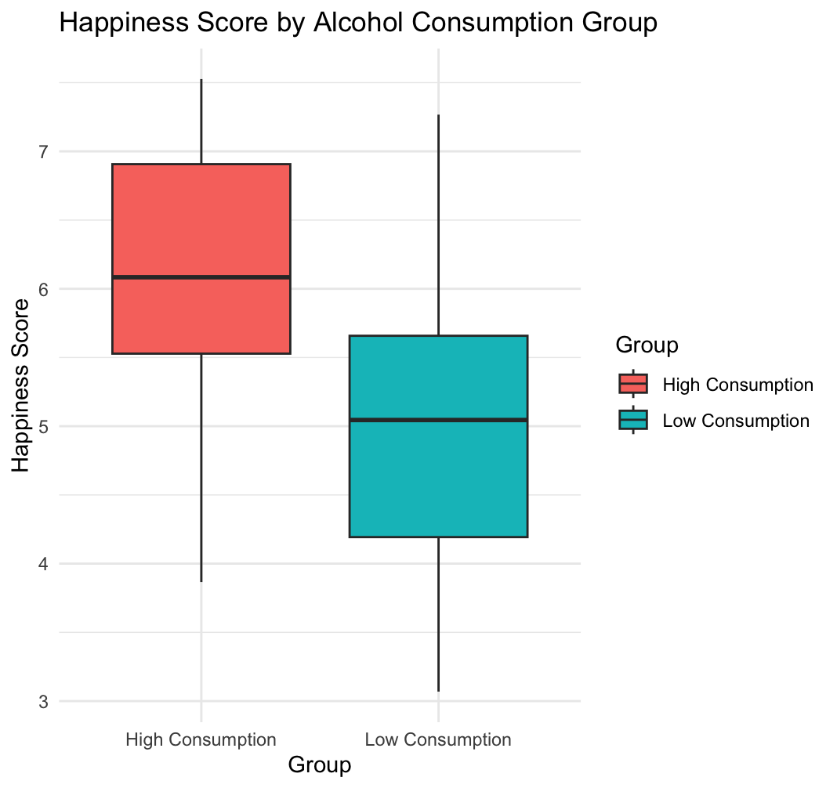
Box-plot

