Slide 1
Research Question
Tutorial Presentation for Feedback
Group B: 103

Slide 2
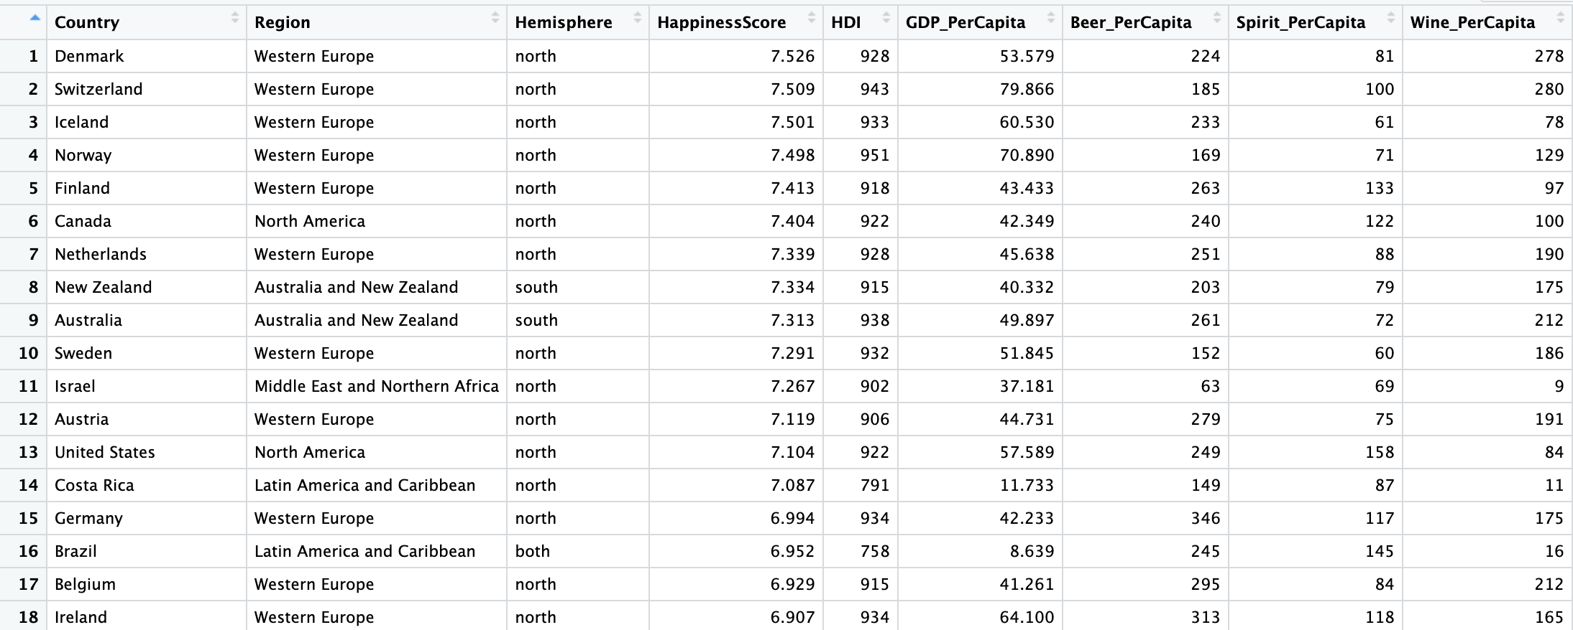
Dataset ID: DS222
Dataset ID:
HappinessAlcoholConsumption.csv
Number of rows:
Approximately 122 countries
Sample of Variables Used:
Beer_PerCapita
Spirit_PerCapita
Wine_PerCapita
HappinessScore
Each row represents one country.

Slide 3
WHY THIS DATASET
This dataset is interesting to us because it allows us to explore how lifestyle factors, such as alcohol consumption, may be related to happiness levels across different countries.

Slide 4
VARIABLES AND DATA TYPES
Independent Variable:
Total Alcohol Consumption (litres per capita)
(Calculated from beer, spirit, and wine consumption)
Independent Variable Data Type:
Interval / Measurement data
Dependent Variable:
Happiness Score
Dependent Variable Data Type:
Interval / Measurement data

Slide 5
RESEARCH QUESTION
Research Question:
Is there a correlation between total alcohol consumption and happiness score across different countries?

Slide 6
Hypothesis
Null Hypothesis (H0):
There is no correlation between total alcohol consumption and happiness score across countries.
Alternative Hypothesis (H1):
There is a correlation between total alcohol consumption and happiness score across countries.

Slide 7
Group
Module: 7COM1079
Dataset: HappinessAlcoholConsumption.csv
Group Number: B 103
Name of Student Presenting: Venkatesh Kancharlapalli
Names of Student Attendees:
Dipesh Kumar Yadav
Venkatesh Kancharlapalli
Aftab Abdul Shakur Wadkar (invited)

