Slide 1
CI - Working with Jenkins
LEVEL – LEARNER & PRACTITIONER

Slide 2
Srinivasan S – 309934
White Box Testing – CoE
Version 1 – 05/12/2013

Slide 3







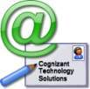

Icons Used
Hands on Exercise
Questions
Tools
Coding Standards
Test Your Understanding
Reference
A Welcome Break
Demonstration
Contacts

Slide 4
Objectives
After this session you will get an idea about:
Introduction to Jenkins
Running Jenkins
Create a new Job in Jenkins
Create a new view in Jenkins
Adding projects as dependency
Parameterizing the build
Manage Plugins in Jenkins

Slide 5
Test Your Understanding
What is Continuous Integration ?
What are the various stages available in the CI process?

Slide 6
CI - Working with Jenkins
Chapter 1: Introduction to Jenkins

Slide 7

Jenkins Introduction
Jenkins is an award-winning application that monitors executions of repeated jobs, such as building a software project or jobs run by cron (time-based job scheduler).
Jenkins currently focuses on the following two jobs:
Building/testing software projects continuously
Monitoring executions of externally-run jobs

Slide 8
Jenkins Features
Easy installation: Just java -jar jenkins.war, or deploy it in a servlet container. No additional install, no database.
Easy configuration: Jenkins can be configured entirely from its friendly web GUI with extensive on-the-fly error checks and inline help. There's no need to tweak XML manually anymore, although if you'd like to do so, you can do that, too.
Change set support: Jenkins can generate a list of changes made into the build from Subversion/CVS. This is also done in a fairly efficient fashion, to reduce the load on the repository.
Permanent links: Jenkins gives you clean readable URLs for most of its pages, including some permalinks like "latest build"/"latest successful build", so that they can be easily linked from elsewhere.
RSS/E-mail/IM Integration: Monitor build results by RSS or e-mail to get real-time notifications on failures.

Slide 9
Jenkins Features
After-the-fact tagging: Builds can be tagged long after builds are completed.
JUnit/TestNG test reporting: Junit/TestNG test reports can be tabulated, summarized, and displayed with history information, such as when it started breaking, etc. History trend is plotted into a graph.
Distributed builds: Jenkins can distribute build/test loads to multiple computers. This lets you get the most out of those idle workstations sitting beneath developers' desks.
File fingerprinting: Jenkins can keep track of which build produced which jars, and which build is using which version of jars, and so on. This works even for jars that are produced outside Jenkins, and is ideal for projects to track dependency.
Plugin Support: Jenkins can be extended via 3rd party plugins. You can write plugins to make Jenkins support tools/processes that your team uses.

Slide 10
CI - Working with Jenkins
Chapter 2: Running Jenkins

Slide 11


Running Jenkins
Jenkins can be downloaded from the following link
http://mirrors.jenkins-ci.org/war/latest/jenkins.war
Before starting Jenkins, we need to download and install Apache Tomcat Webserver, as Jenkins is a web application in the form of .war file.
Jenkins can be started in three ways
Simply running the war file as below
java –jar jenkins.war
Running it as a windows service
Copy the jenkins.war file to webapps folder of tomcat server and start the tomcat server
To view Jenkins UI
Type http://localhost:8080 in your browser

Slide 12
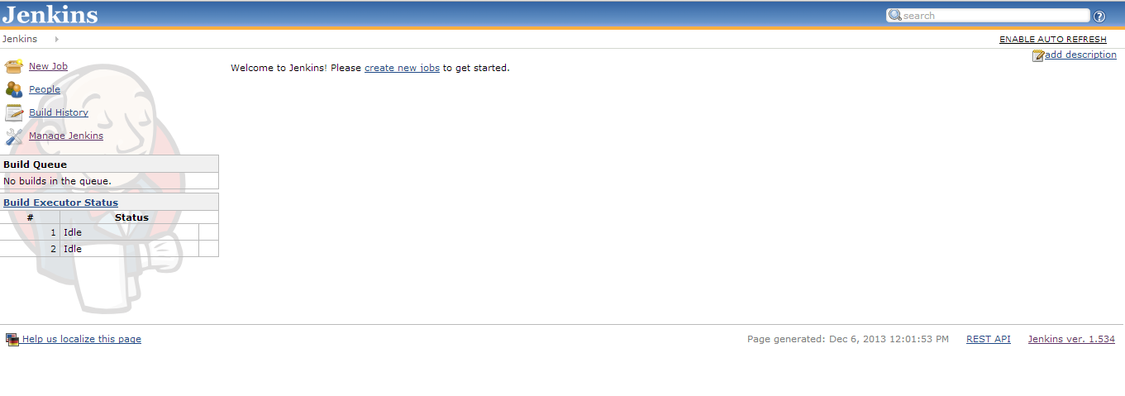
Running Jenkins

Slide 13
CI - Working with Jenkins
Chapter 3: Create a new job in Jenkins

Slide 14
Creating a new job in Jenkins
When Jenkins is installed for the first time, new jobs can be created in two ways
Click on the ‘New Job’ link which is displayed in the left navigation menu to create a new job.
Click on ‘create new jobs’ link which is displayed in the middle of the page.
Enter the name of the job to create.
Select the type of the job from the following options.
Build a free-style software project: This is the central feature of Jenkins. Jenkins will build your project, combining any SCM with any build system, and this can be even used for something other than software build.
Build a maven2/3 project: Build a maven 2/3 project. Jenkins takes advantage of your POM files and drastically reduces the configuration.
Build multi-configuration project: Suitable for projects that need a large number of different configurations, such as testing on multiple environments, platform-specific builds, etc.
Monitor an external job: This type of job allows you to record the execution of a process run outside Jenkins, even on a remote machine. This is designed so that you can use Jenkins as a dashboard of your existing automation system.
Click ‘Ok’ button.

Slide 15
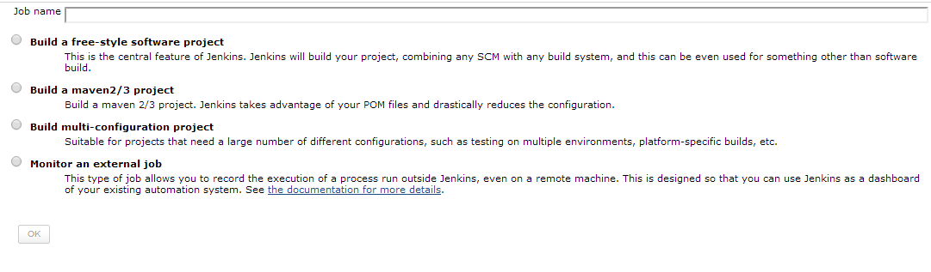
Creating a new job in Jenkins

Slide 16
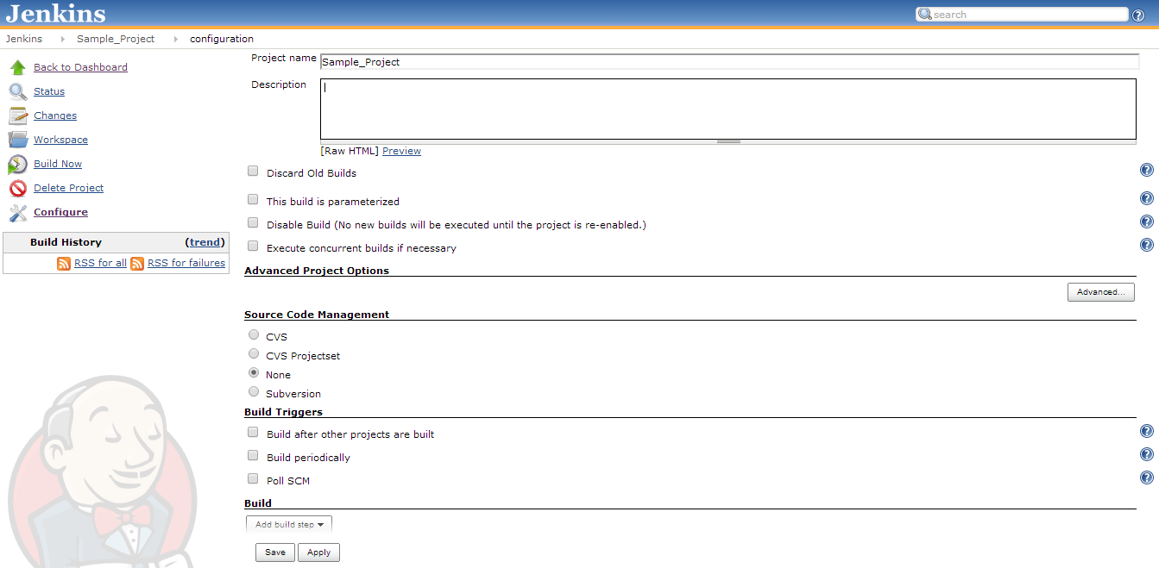
Creating a new job in Jenkins
Once the job is Jenkins , Jenkins will navigate to the new job configuration page.

Slide 17
Creating a new job in Jenkins
Enter the description which will identify the description of the project. (Optional) Jenkins
Source Code Management
Select the option from where the source code needs to be pulled, for building the project.
Select CVS/SubVersion options from pulling from respective repository.
When None is selected, it implies that the source code is available locally in the jenkins folder and not available in any central repositories.
Build Triggers
Build after other projects are built: A project will schedule a new build, only when dependent project finishes its building.
Build periodically: Build the project periodically like nightly/weekly.
Poll SCM: Jenkins will poll for any changes in SCM. It is an expensive operation for CVS, as it needs to scan the entire workspace and verify it with the server. Best practice is to, set up a ‘push’ trigger to avoid this overhead.

Slide 18
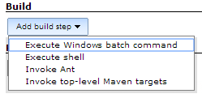
Creating a new job in Jenkins
Build
Execute Windows batch command: Runs a Windows batch script for building the project.
Execute Shell: Runs a shell script (defaults to sh, but this is configurable) for building the project
Invoke Ant: This causes Jenkins to invoke Ant with the given targets and options.
Invoke top-level Maven targets: This causes Jenkins to invoke Maven with the given goals and options.

Slide 19
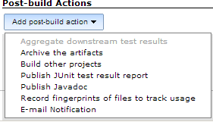
Creating a new job in Jenkins
Post-build Actions
Aggregate downstream test results: Jenkins best practice involves splitting test executions into different jobs, possibly in multiple different jobs.
Archive the artifacts: Archives the build artifacts (for example, distribution zip files or jar files) so that they can be downloaded later.
Build other projects: Trigger builds of the other projects once a build is successfully completed. Multiple projects can be specified by using comma, like "abc, def".
Publish Junit test result report: Jenkins understands the JUnit test report XML format (which is also used by TestNG) and publishes it.
Public Javadoc: Jenkins will publish JavaDoc.
Record fingerprints of files to tract usage: Jenkins can record the 'fingerprint' of files (most often jar files) to keep track of where/when those files are produced and used.
E-mail Notification: Jenkins will send out an e-mail to the specified recipients when a certain important event occurs.

Slide 20
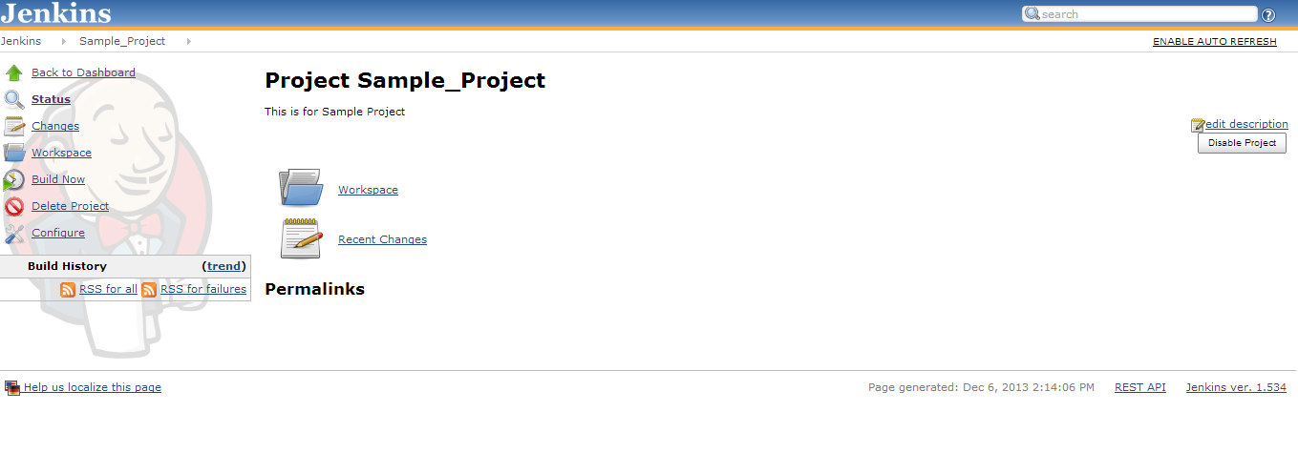
Job page in Jenkins

Slide 21
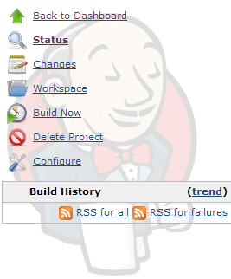
Job page in Jenkins
Back to Dashboard: This link will navigate to Jenkins dashboard page.
Status: This link will navigate to project page.
Changes: This link will navigate to the changes page which will track all the changes that happened in this build.
Workspace: This link will navigate to the workspace page which will show the workspace folder created, once the build is executed.
Build Now: This link will start the build of a project.
Delete Project: This link will delete the current project/job in which we are in.
Configure: This link will navigate to the configuration page of the current project/job, to add/update the configuration.
Build History table will show all the builds that were triggered till now in the current project/job.

Slide 22
CI - Working with Jenkins
Chapter 4: Create a new view in Jenkins

Slide 23
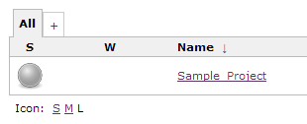
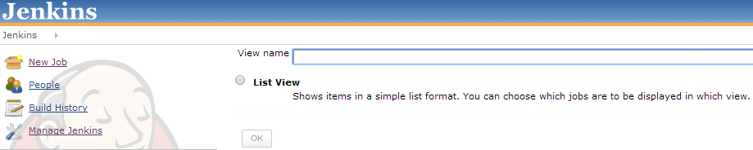
Create a new view in Jenkins
Click on the ‘+’ button tab which is in the Jenkins dashboard.
Enter a view name in the view name text box.
Click on List View radio button.
Click ‘OK’ button.
This will navigate to view configuration page, where we can choose the jobs and columns to the displayed in the created view.

Slide 24
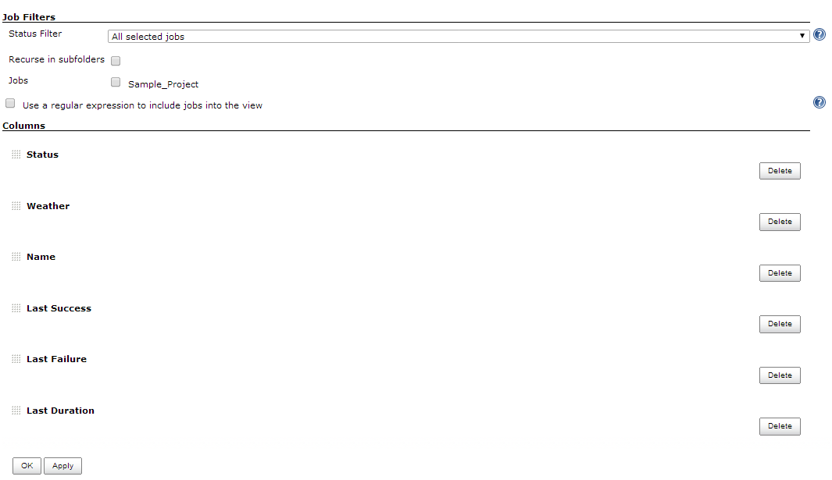
Create a new view in Jenkins

Slide 25
Test Your Understanding
How to create a new job in Jenkins?
What are the different Build options available in job configuration page?
What are the different Post-build Action options available in the job configuration page?
How to create a new view in Jenkins?
How to add existing jobs in the newly created view?

Slide 26
CI - Working with Jenkins
Chapter 5: Adding projects as dependency

Slide 27
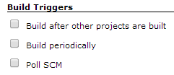
Adding projects as dependency
Multiple/other projects can be added as dependency of a single project in the following two ways
‘Build after other projects are built’ option under Build Triggers section. This option is like pre-condition.
When the other project(s) build is succeeded, then only the current project build will start.
‘Build other projects’ option under Post-build Actions section.
This option is like post-condition. When the current project’s build is succeeded, then only the other project(s) build will get started.

Slide 28
CI - Working with Jenkins
Chapter 6: Parameterizing the build

Slide 29
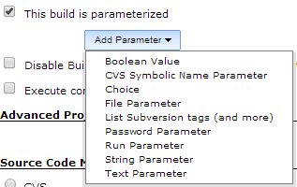
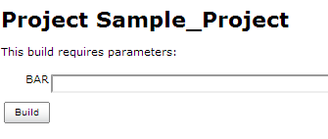
Parameterizing the build in Jenkins
It is sometimes convenient to be able to "parameterize" a build, by requiring a set of user inputs to be made available to the build process.
To use parameterized option, click on ‘This build is parameterized’ checkbox.
This will display ‘Add Parameter’ button.
We can add different types of parameters to the build, by selecting the required options.
Parameters created in this place, can be used in Build section in the same project/job.
Once the parameter is created, the link of Build will change to Build with Parameters.
When ‘Build with Parameters’ link is clicked, then a text box will be shown for us to enter the parameter we need.

Slide 30
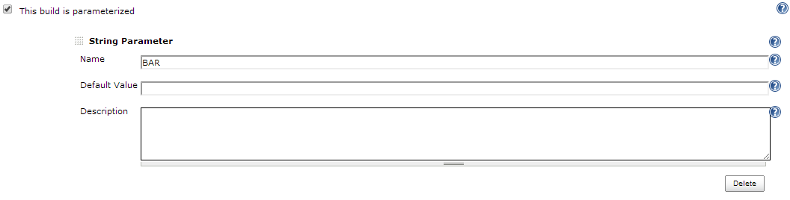
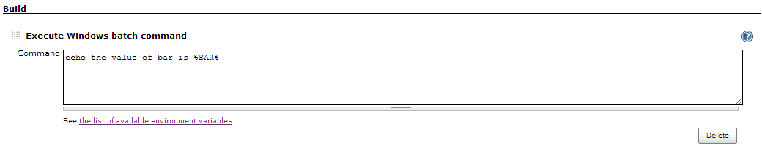
Parameterizing the build in Jenkins

Slide 31
CI - Working with Jenkins
Chapter 7: Manage plugins in Jenkins

Slide 32
Manage Plugins in Jenkins
Jenkins defines extensibility points, which are interfaces or abstract classes that model an aspect of a build system.
Those interfaces define contracts of what needs to be implemented.
Jenkins allows plugins to contribute those implementations.
Plugins can be managed under ‘Manager Plugins‘ option in Manage Jenkins page.
We can do the following in Manage Plugins page which extends the functionality of Jenkins
Add a new plugin.
Remove an existing plugin.
Disable the plugin
Enable the plugin
Update an existing plugin if any update in available.
Manage Plugin page will have 4 tabs
Updates: This tab will give the list of plugins whose updates are available.
Available: This tab will give the list of all the plugins that are available in Jenkins.
Installed: This tab will give the list of plugins that are currently installed.
Advanced: This tab will give the option of setting the proxy server, upload the plugin through .hpi file and update the site.

Slide 33
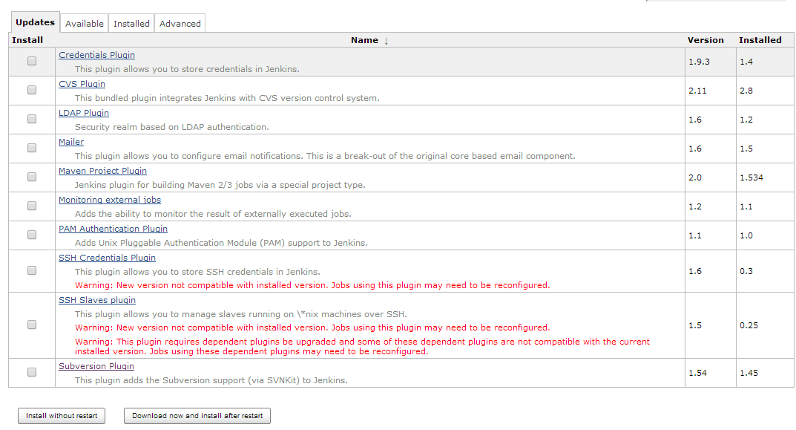
Manage Plugins in Jenkins

Slide 34
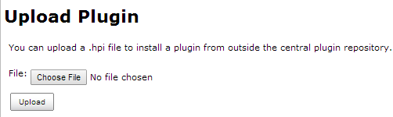
Manage Plugins in Jenkins
Check the checkboxes of the plugins which you need to install/update.
There are three ways by which a plugin can be installed.
Install without restart: This option will download the plugin now and it will install only when Jenkins is restarted.
Download now and install after restart: This option will download the plugin and install it immediately without restart.
Manually: Download the plugin file (.hpi) manually from internet. Go to Manage Jenkins -> Manage Plugins -> Advanced tab. Upload the .hpi plugin file manually.

Slide 35
Summary
What is Jenkins?
How to create a new job in Jenkins
How to create a new view in Jenkins
Adding project dependencies in Jenkins
How to parameterize the build in Jenkins?
Manage plugins in Jenkins

Slide 36
Source
WBTCoE Training Contents
https://wiki.jenkins-ci.org
Disclaimer: Parts of the content of this course is based on the materials available from the Web sites and books listed above. The materials that can be accessed from linked sites are not maintained by Cognizant Academy and we are not responsible for the contents thereof. All trademarks, service marks, and trade names in this course are the marks of the respective owner(s).

Slide 37
Continuous Integration
You have successfully completed -
Continuous Integration

