Slide 1
K-Nearest Neighbors (KNN)

Slide 2
Instance Based Learning
Instance-based learning (also known as memory-based learning or lazy learning) refers to Machine Learning systems that memorize training examples and generalize to new instances based on a similarity measure.
Key Characteristics:
Hypotheses are built from training instances.
Processing is delayed until a new instance must be classified.
Time complexity depends on the size of training data (worst-case complexity: O(n)).

Slide 3
Instance Based Learning
Advantages:
Local approximations can be made to the target function.
Easily adapts to new data collected over time.
Disadvantages:
High classification costs.
Requires a large amount of memory for data storage.
Each query involves starting identification from scratch.
Common Algorithms:
K Nearest Neighbor (KNN)
Self-Organizing Map (SOM)
Learning Vector Quantization (LVQ)
Locally Weighted Learning (LWL)

Slide 4
The KNN Algorithm
Based on feature similarity
K-Nearest Neighbor is a
Supervised
Non-parametric
Lazy

Slide 5
What do you Need?
Dataset with labeled data
Distance Metric
Value of k (Number of Neighbor)

Slide 6
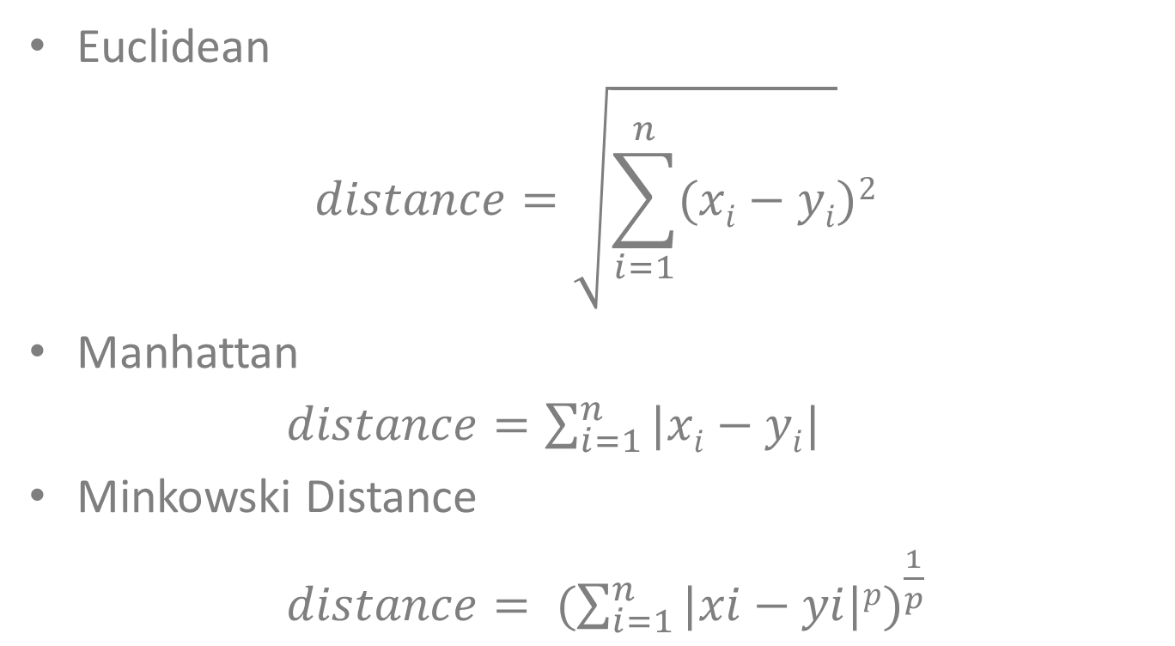
The Distance Metric
Euclidean
$$distance=\sqrt{\sum_{i=1}^{n}{(xi}−yi})2$$
Manhattan
$distance=\sum_{i=1}^{n}{|xi}−yi|$
Minkowski Distance
$distance= {(\sum_{i=1}^{n}{|xi−yi|p})}^{\frac{1}{p}}$

Slide 7
The Algorithm
Start
Take a data point for which prediction have to be made
Calculate its distance with all the data points in training data set
Sort the result in ascending order
Take first “K” data points
Take mode/mean for classification/regression
Stop

Slide 8
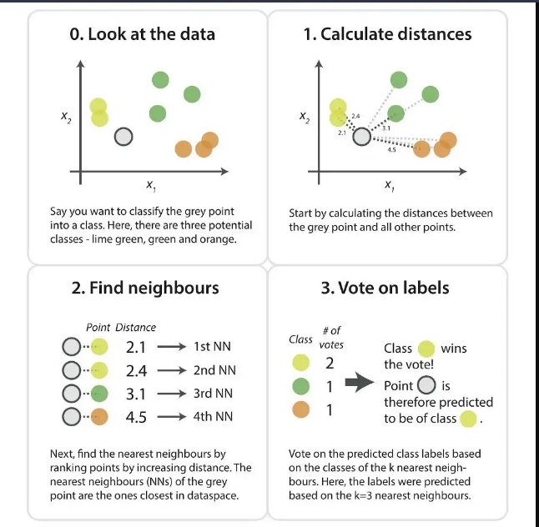
A Visual Example

Slide 9
A Numerical Example: The Problem
Available Training Data
Height (in) | Weight (lbs) | Age (years) | T-shirt Size
73 | 225 | 35 | L
67 | 140 | 25 | M
70 | 180 | 30 | M
75 | 200 | 40 | L
69 | 130 | 20 | M
72 | 210 | 35 | L
71 | 190 | 30 | L
68 | 150 | 25 | M
Make Prediction of T-shirt Size for a person with
Height = 75
Weight = 250
Age = 40
Use k=3

Slide 10
A Numerical Example: Distance Calculation
Distance Calculation
Sorting the Result
Height (in) | Weight (lbs) | Age (years) | Tshirt Size | Distance
73 | 225 | 35 | L | 25.57
67 | 140 | 25 | M | 111.31
70 | 180 | 30 | M | 70.89
75 | 200 | 40 | L | 50.00
69 | 130 | 20 | M | 121.80
72 | 210 | 35 | L | 40.42
71 | 190 | 30 | L | 60.96
68 | 150 | 25 | M | 101.36
Height (in) | Weight (lbs) | Age (years) | Tshirt Size | Distance
73 | 225 | 35 | L | 25.57
72 | 210 | 35 | L | 40.42
75 | 200 | 40 | L | 50.00
71 | 190 | 30 | L | 60.96
70 | 180 | 30 | M | 70.89
68 | 150 | 25 | M | 101.36
67 | 140 | 25 | M | 111.31
69 | 130 | 20 | M | 121.80

Slide 11
A Numerical Example: Select K data points
Height (in) | Weight (lbs) | Age (years) | Tshirt Size | Distance
73 | 225 | 35 | L | 25.57
72 | 210 | 35 | L | 40.42
75 | 200 | 40 | L | 50.00
71 | 190 | 30 | L | 60.96
70 | 180 | 30 | M | 70.89
68 | 150 | 25 | M | 101.36
67 | 140 | 25 | M | 111.31
69 | 130 | 20 | M | 121.80
In First K=3 data points T-shirt size is “L” so the predicted T-shirt size is “L”

