Slide 1
Machine Learning

Slide 2
Artificial Intelligence (AI)
"AI began with an ancient wish to forge the gods.”
Pamela McCorduck
Machines Who Think, 1979
"AI is attempt to understand our mind and recreate echoes of it in machines.”
Lex Fridman
Algorithms Enabled by
Representation that support
Models targeted at
Thinking Perception and Action

Slide 3
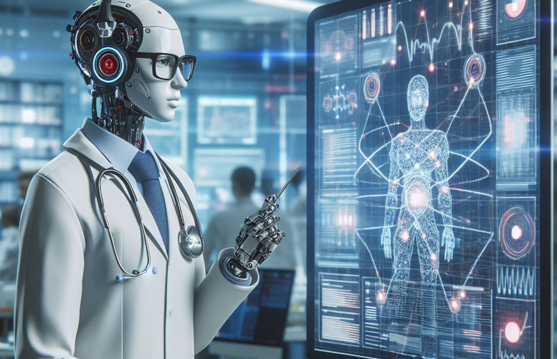

Types of AI
Artificial General Intelligence (AGI) is a type of artificial intelligence that has the ability to understand or learn any intellectual task that a human being can.
Narrow intelligence, also known as weak AI, is a type of artificial intelligence that is only capable of understanding or learning specific tasks within its area of expertise

Slide 4
Branches of AI
Artificial Intelligence
Machine Learning
Robotics
Natural Language Processing (NLP)
Computer Vision/Sensory Data Understanding

Slide 5
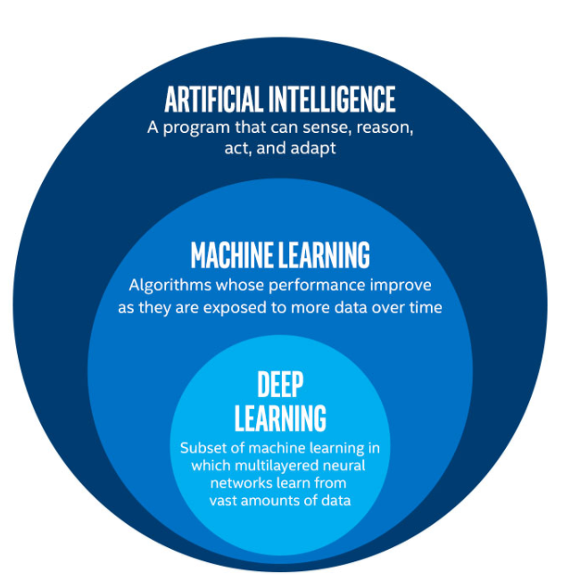
AI, ML and DL

Slide 6
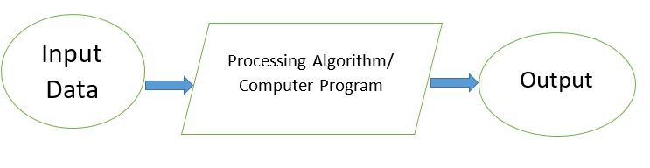
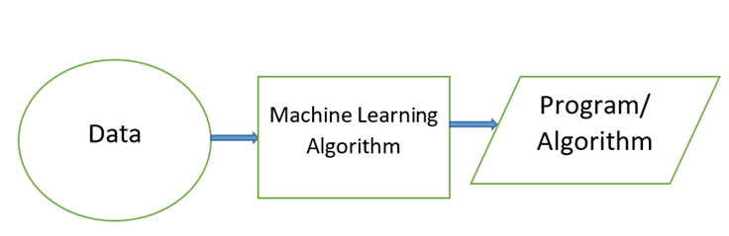
Traditional Computing Vs Machine Learning

Slide 7
Classification of ML Algorithms
Machine Learning
Supervised
Regression
Classification
Unsupervised
Clustering
Reinforcement

Slide 8
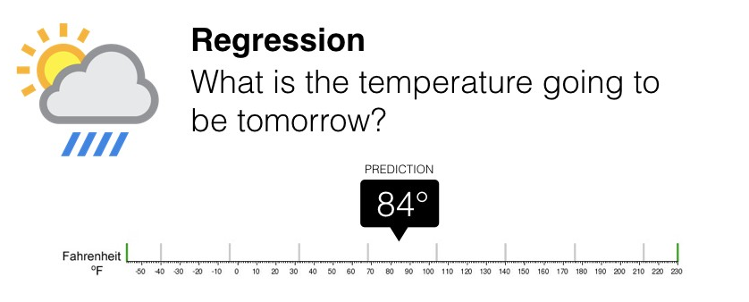
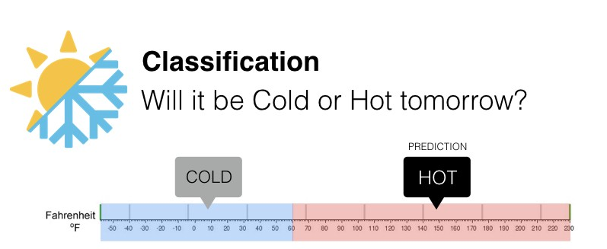
Regression Vs Classification

Slide 9

Clustering
Image Source: https://miro.medium.com/v2/resize:fit:4800/format:webp/0*TAjr_sqKXtrHQ92f.png

Slide 10
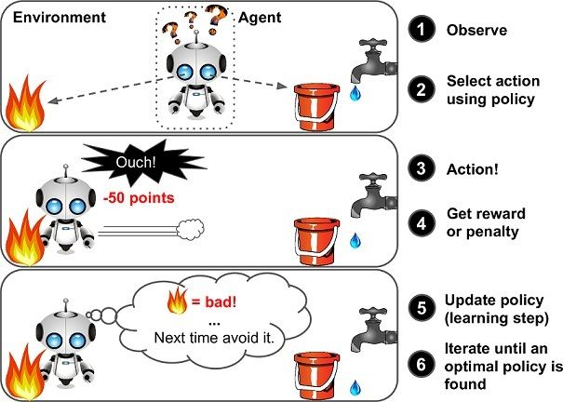
Reinforcement Learning
Image Source: https://cdn-gcp.new.marutitech.com/small_RL_1_3932c27f5d.jpg

Slide 11
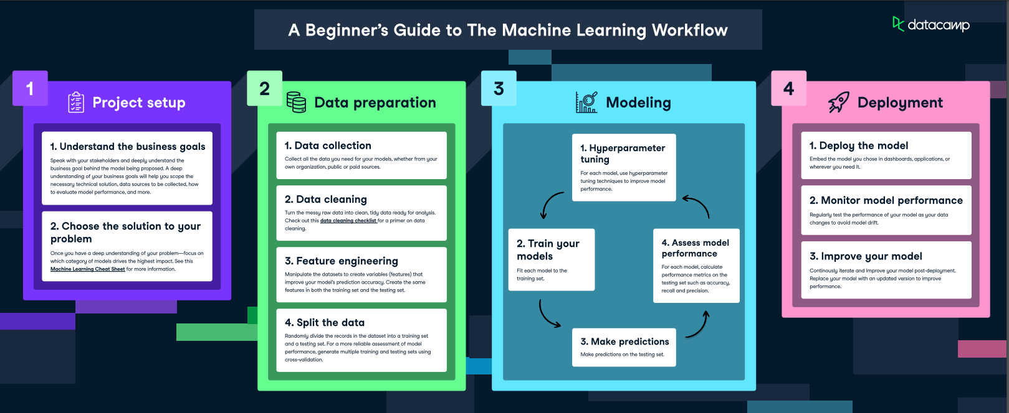
Machine Learning Workflow
Image Source: https://images.datacamp.com/image/upload/v1662709040/Marketing/Blog/Machine_Learning_Workflow.pdf

Slide 12
Meaning of Training a Model
Assume we have following Data
We want to Predict Life Satisfaction when GDP per Capita is given
Country | GDP per capita (USD) | Life satisfaction
Russia | $ 26,456.39 | 5.8
Greece | $ 27,287.08 | 5.4
… | …. | ….
Turkey | $ 28,384.99 | 5.5

Slide 13
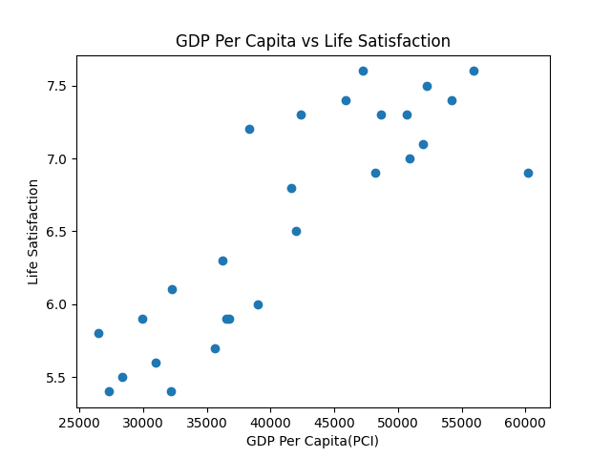
Find Equation of Line
We can find the Equation of Straight Line that fits the data

Slide 14
Problem: Which Line to Choose?

Slide 15
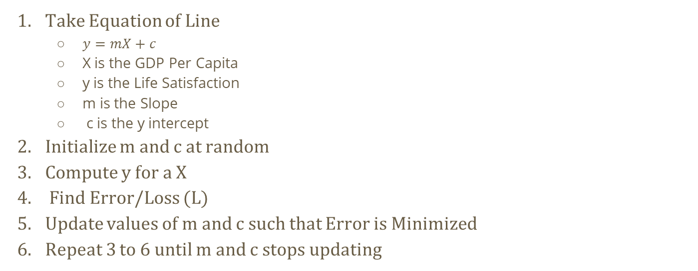
Solution
Take Equation of Line
$y=mX+c$
X is the GDP Per Capita
y is the Life Satisfaction
m is the Slope
c is the y intercept
Initialize m and c at random
Compute y for a X
Find Error/Loss (L)
Update values of m and c such that Error is Minimized
Repeat 3 to 6 until m and c stops updating

Slide 16
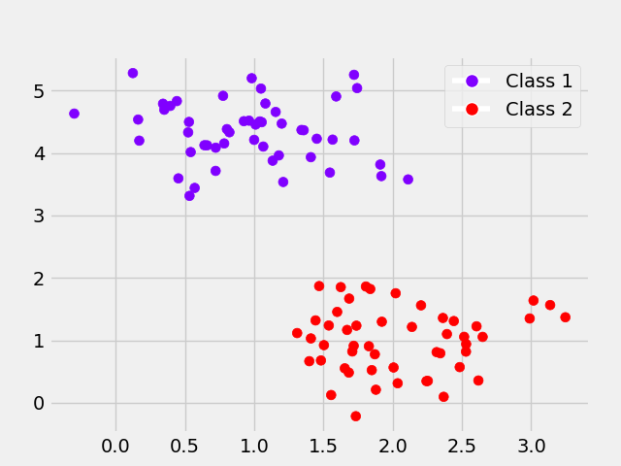
Classification
Find a Decision Boundary

Slide 17
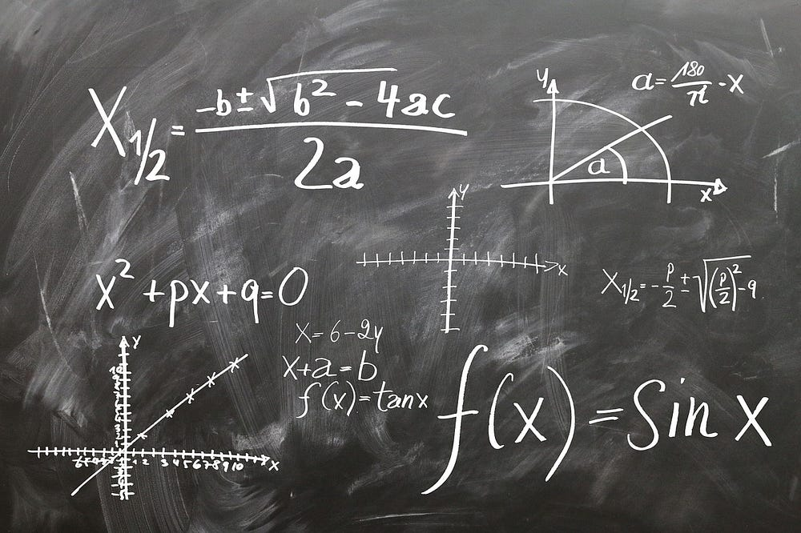
Machine Learning in Essence
The Essence of Machine Learning in Function Estimation
Image Source: https://medium.com/theboredhuman/the-essence-of-machine-learning-is-function-estimation-c3a773c841ce

