Slide 1
Data Warehousing

Slide 2
Agenda
Introduction
OLAP vs OLTP
Star and Snowflake Schema
Fact and Dimension Table
The ETL Process
Slow Changing Dimensions (SCD)

Slide 3
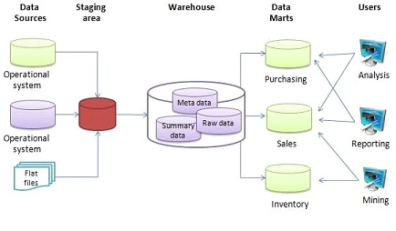
What is a Data Warehouse?
A Data Warehouse (DW) is a centralized repository for integrated data from multiple sources.
Optimized for query and analysis rather than transaction processing.
Supports decision-making, reporting, and data mining.
A Data Warehouse (DW) is a centralized repository for integrated data from multiple sources.
Optimized for query and analysis rather than transaction processing.
Supports decision-making, reporting, and data mining.
According to William H. Inmon, a leading architect in construction of Data warehouse systems, “A data warehouse is a subject oriented, integrated, time-variant and nonvolatile”

Slide 4
Characteristics of Warehouse
Subject-Oriented
Integrated
Non-volatile
Time-Variant

Slide 5
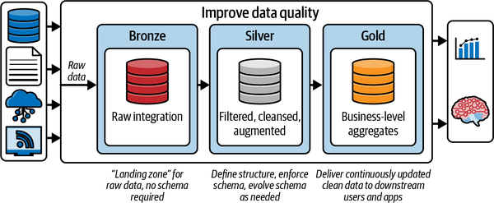
The Kimball Approach

Slide 6
OLAP vs OLTP
Criteria | OLAP | OLTP
Purpose | OLAP helps you analyze large volumes of data to support decision-making. | OLTP helps you manage and process real-time transactions.
Data source | OLAP uses historical and aggregated data from multiple sources. | OLTP uses real-time and transactional data from a single source.
Data structure | OLAP uses multidimensional (cubes) or relational databases. | OLTP uses relational databases.
Data model | OLAP uses star schema, snowflake schema, or other analytical models. | OLTP mostly uses normalized models.
Example applications | OLAP is good for analyzing trends, predicting customer behavior, and identifying profitability. | OLTP is good for processing payments, customer data management, and order processing.

Slide 7
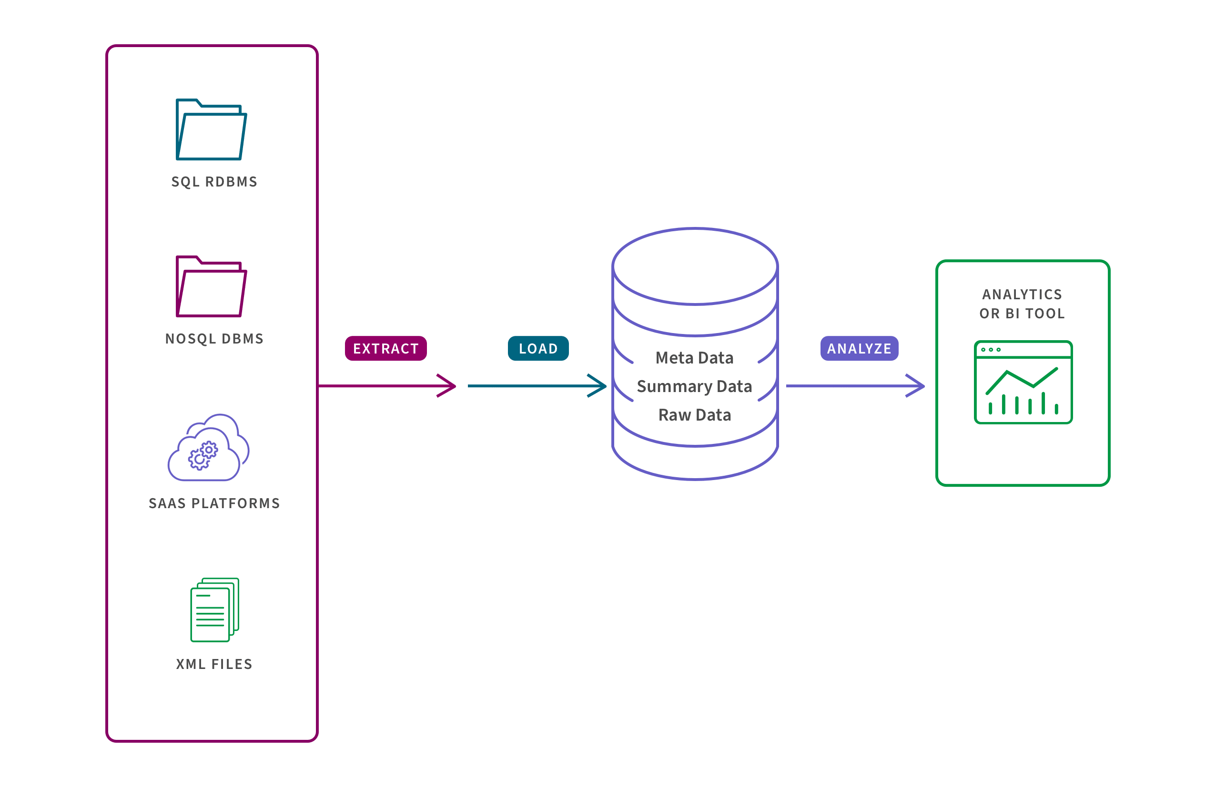
ETL Process
Source: https://www.qlik.com/us/data-warehouse

Slide 8
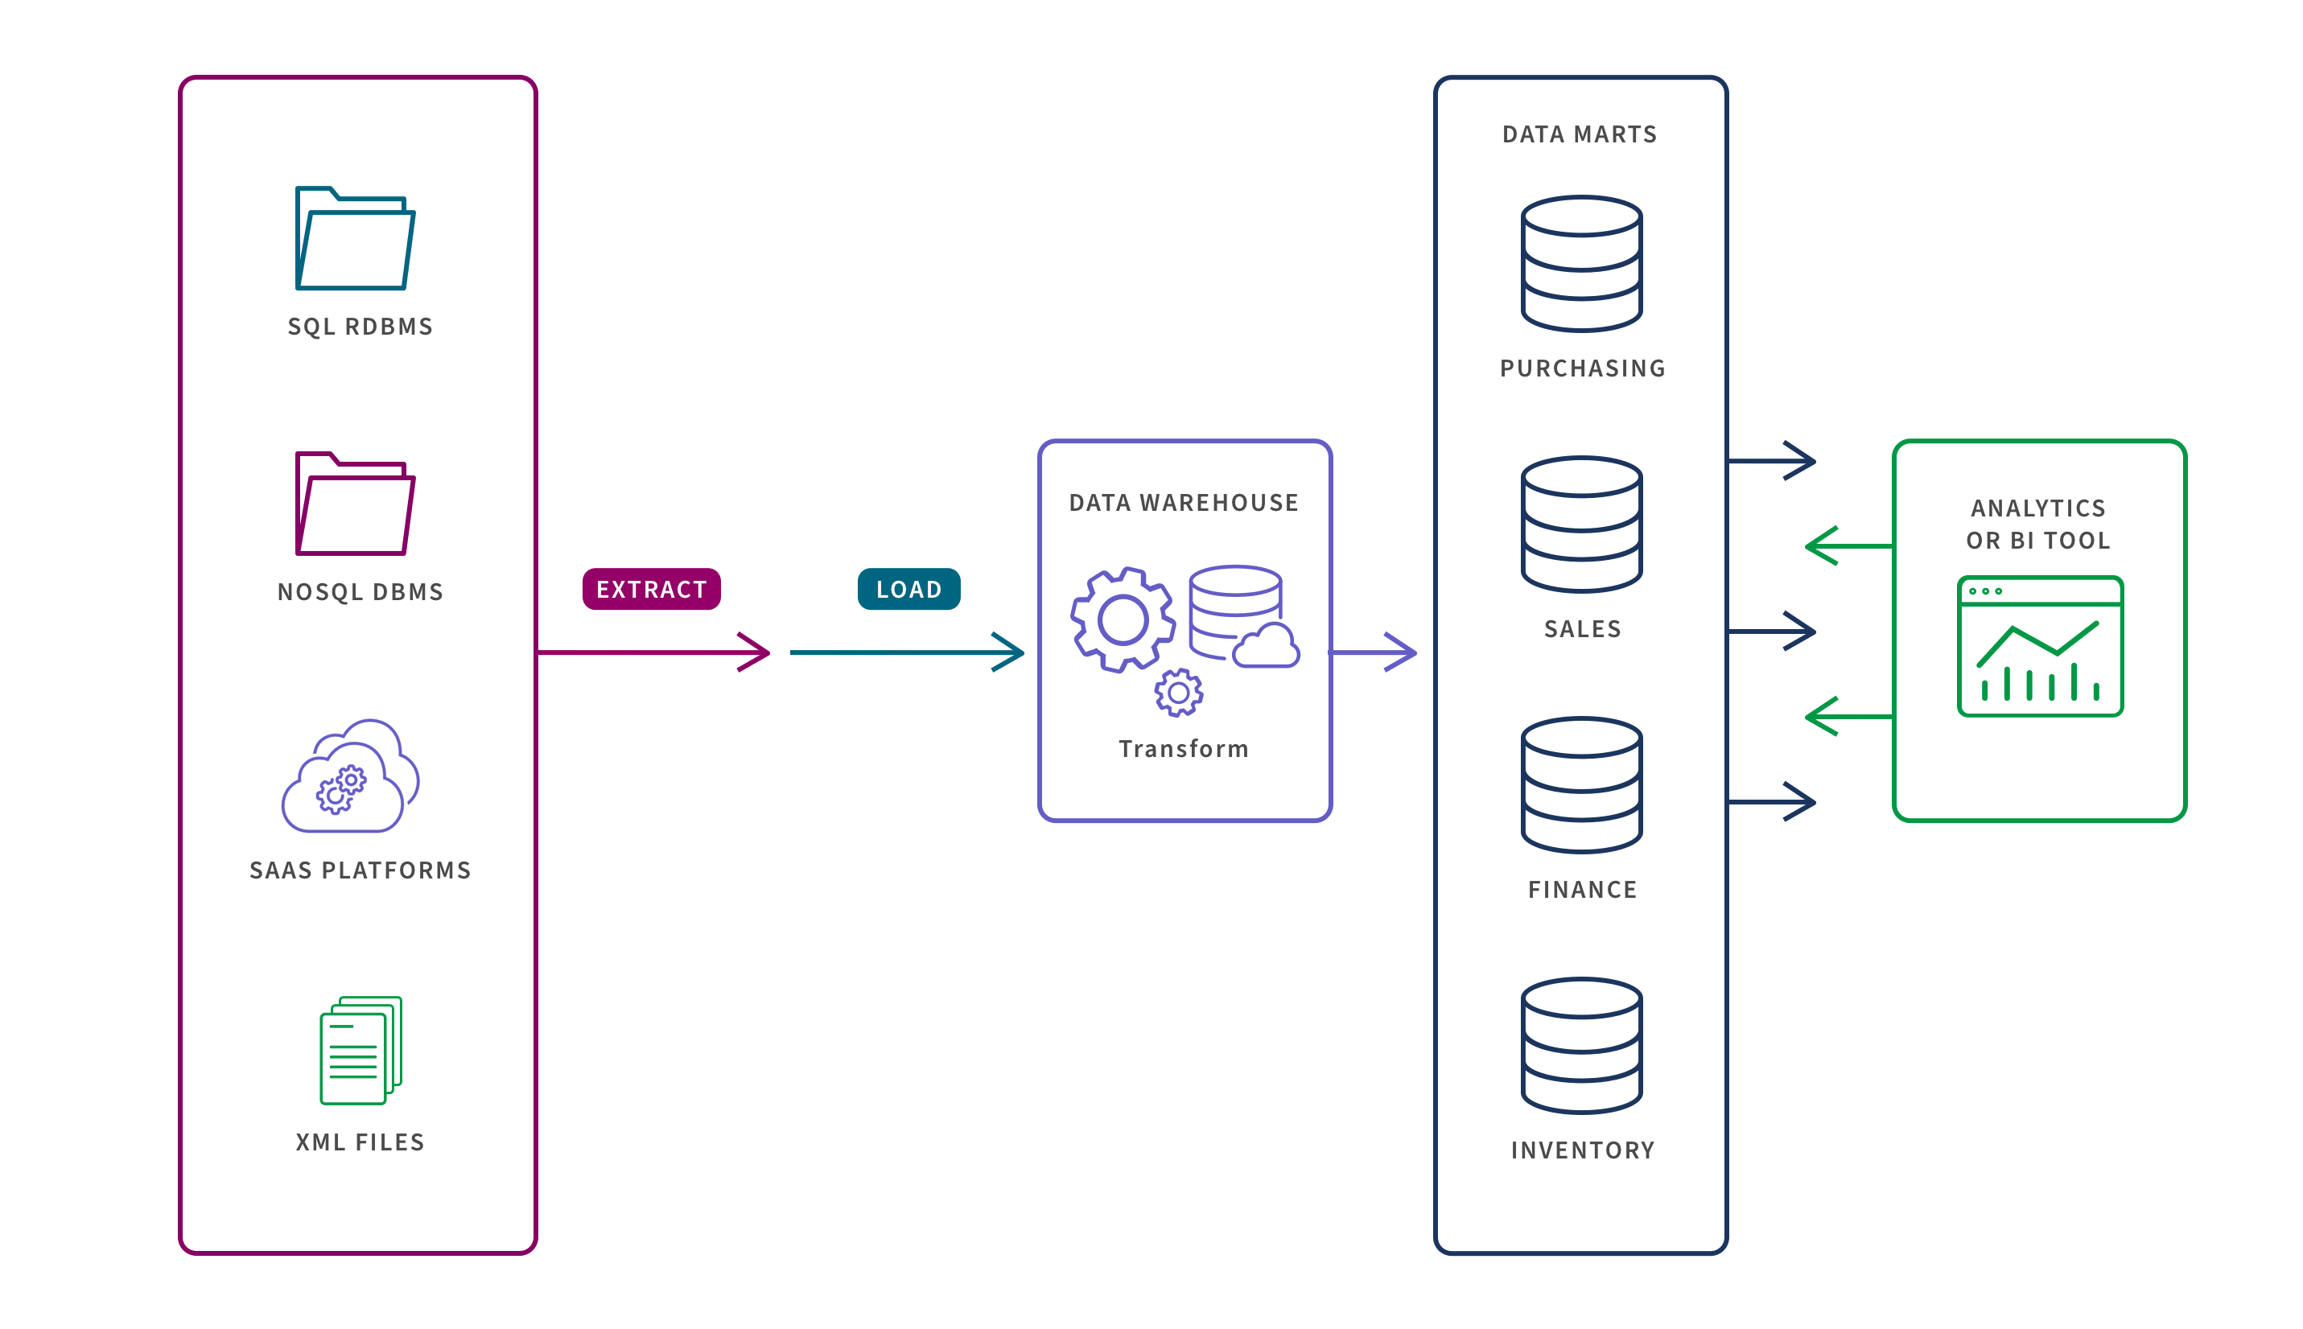
Data Warehouse vs Data Mart, Database, and Data Lake

Slide 9
Fact and Dimensions
A fact table is a table with measures (column where you will perform an aggregation sum, …).
A dimension table contains descriptive attributes (context) related to the facts.

Slide 10
Data Modeling in Data Warehouses
Database schemas define how data is organized within a database or data warehouse.
There are two main types of schema structures used in data warehouses:
the star schema and
the snowflake schema
Star and snowflake schema are both dimensional data models designed to optimize data retrieval speeds.
Dimensional models increase redundancy to make it easier to locate information for reporting and retrieval.

Slide 11
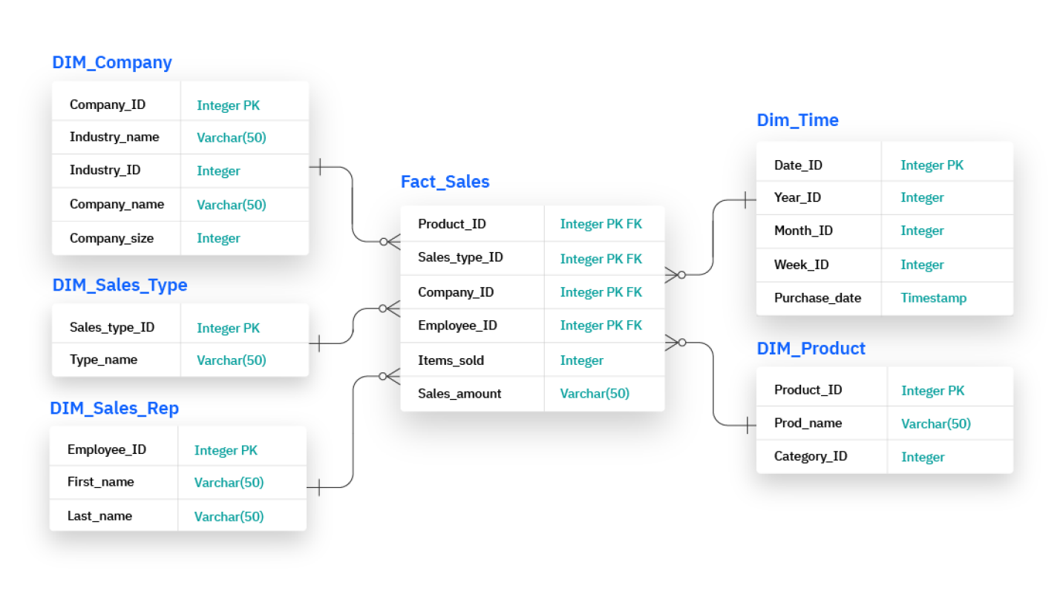
Star Schema
This schema consists of one fact table joined to dimension tables.

Slide 12
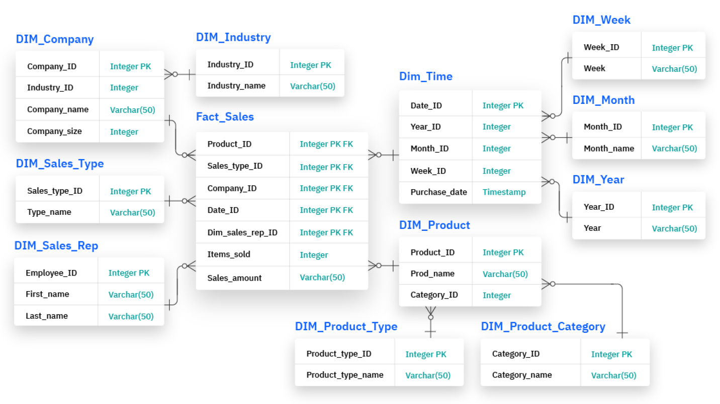
Snowflake Schema
In this case, the fact table is connected to several normalized dimension tables containing descriptive data about the facts in the central fact table.

Slide 13
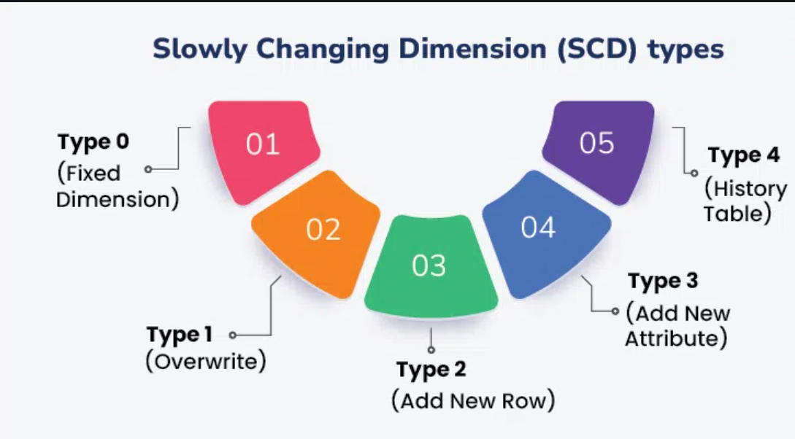
Slow Changing Dimensions (SCD)
A Slowly Changing Dimension (SCD) refers to a data management concept where the attributes of dimension tables change slowly over time, rather than frequently.
It's used to track changes in data that don't happen in real time but are still important to retain for historical analysis.

Slide 14
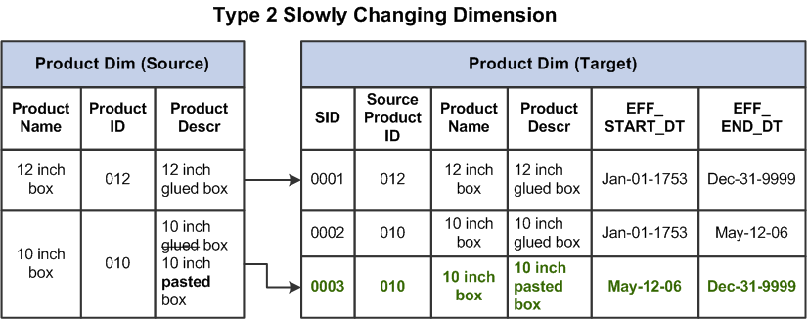
SCD Type 2

Slide 15
Thank you

