Slide 1
Unsupervised Learning – Clustering
Dipesh Poudel
Roll Number: 10

Slide 2
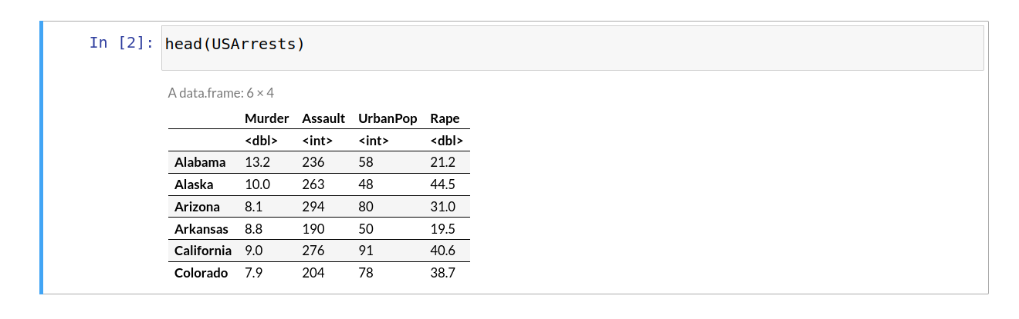
Loading the USArrests dataset into variable df
df<-USArrests

Slide 3
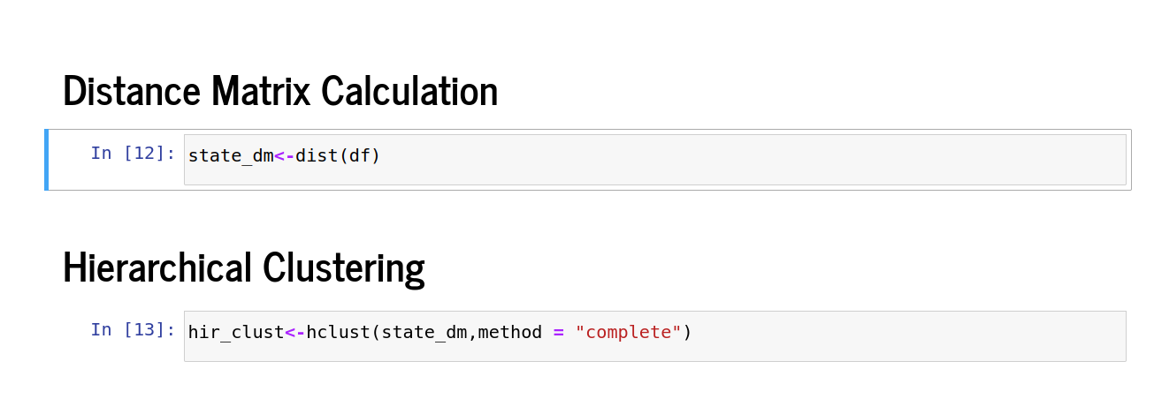
Distance Matrix and Hierarchical Clustering

Slide 4
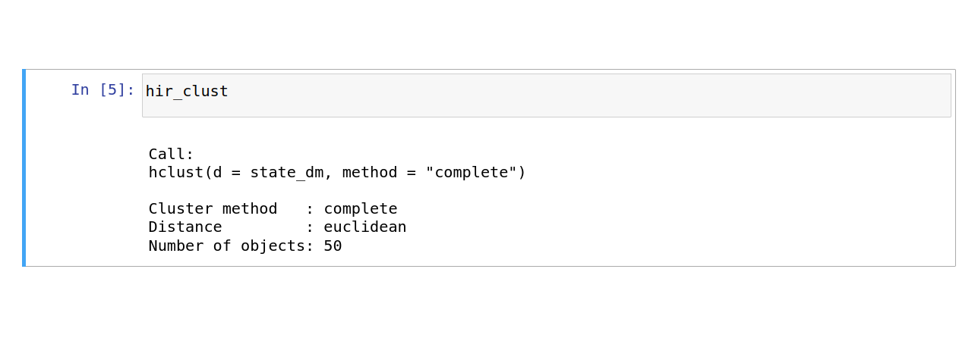
Checking the Result

Slide 5
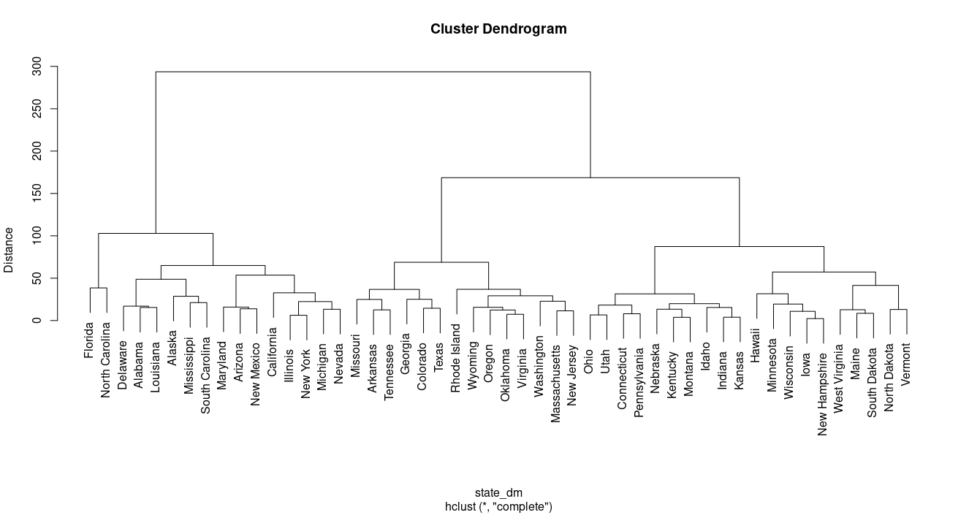
Plotting Dendrogram
plot(hir_clust,labels = rownames(df), ylab = "Distance")

Slide 6
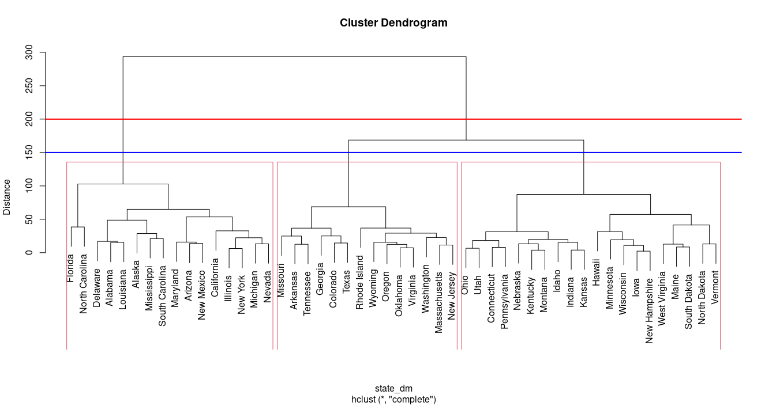
Plotting Dendrogram with K=3
plot(hir_clust,labels = rownames(df), ylab = "Distance")
abline(h=200, col="red", lwd=2)
abline(h=150, col="blue", lwd=2)
rect.hclust(hir_clust, k=3)

Slide 7
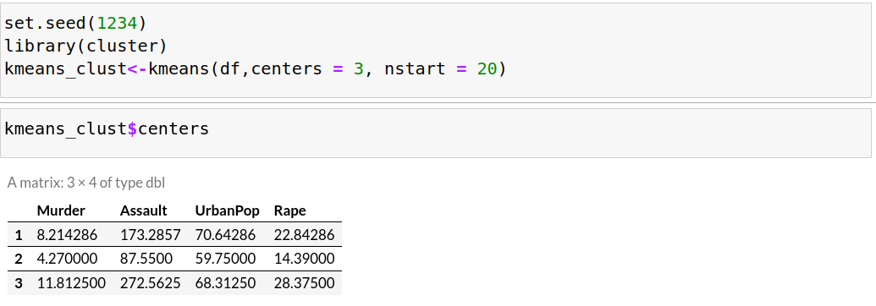
K-Means Clustering

Slide 8
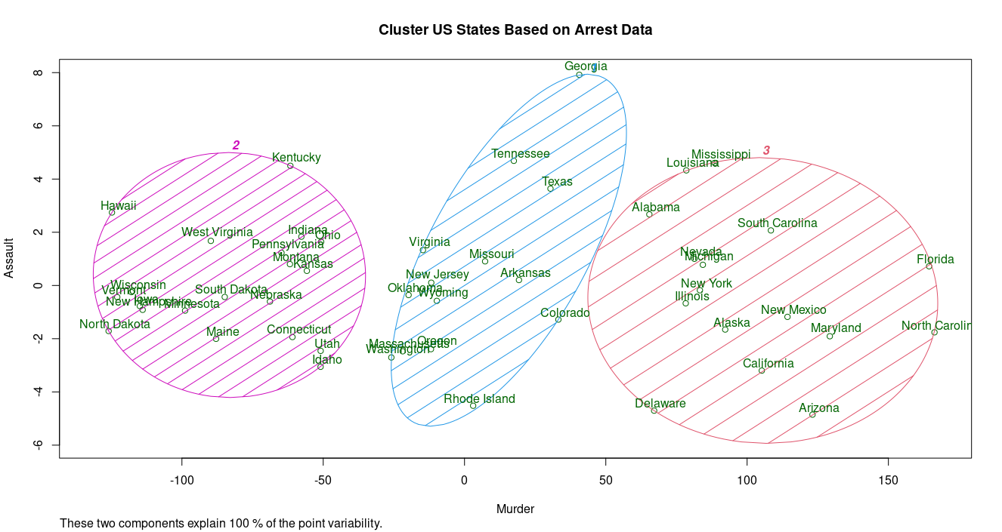
Cluster Visualization
y_kmeans <- kmeans_clust$cluster
clusplot(df[, c("Murder","Assault")],
y_kmeans,lines = 0,shade = TRUE, color = TRUE,labels = 2,
plotchar = FALSE, span = TRUE,
main = paste("Cluster US States Based on Arrest Data"),
xlab = 'Murder',ylab = 'Assault')

Slide 9
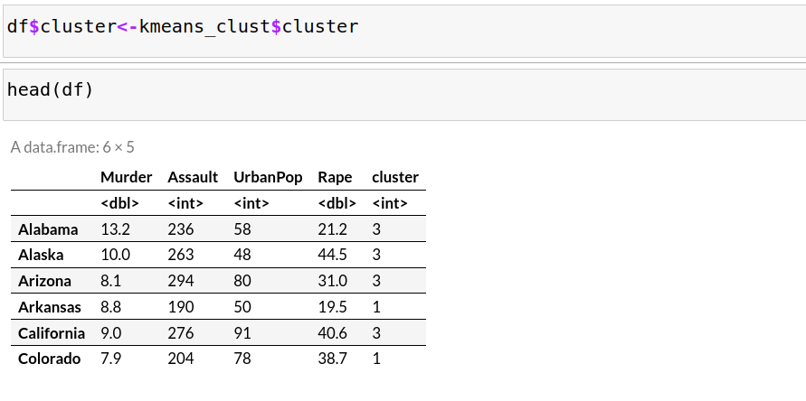
Assigning Cluster to Original Data

