Slide 1
Simulation of 2D Ising Model
Presented By: Dipesh Poudel

Slide 2
Introduction
The Ising model is a mathematical model used to describe the behavior of a system of interacting spins.
Named after the physicist Ernst Ising, who first introduced it in his PhD thesis in 1925
The 2D Ising model is one of the simplest models of a phase transition

Slide 3
Project Objective
To simulate the interaction of particles at different temperatures to find the critical temperature
To simulate the interaction of particles at a given temperature and see how they behave with respect to time

Slide 4
The Algorithm
The Monte Carlo Simulation of 2D Ising model according to Metropolis-Hastings algorithm. The
major steps of the algorithm are
Generate a initial spin configuration randomly. Use +1 as sping up and -1 as spin down
Choose a spin at random
Calculate energy (E_old)
Flip the spin
Calculate new energy (E_new)
If (E_new<E_old) accept the flip and go to step 2 for another step else go to step 7
Find en = ((E_new-Eold)/T) and generate random number between 0 and 1 say ®
Accept the flip if r>en else do not flip
Go to step 2 (Until Converges)

Slide 5
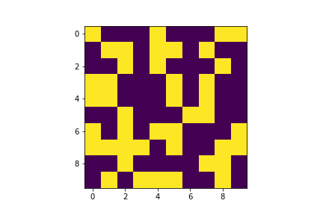
The Initial Configuration
The Initial Configuration of 10x10 Lattice

Slide 6
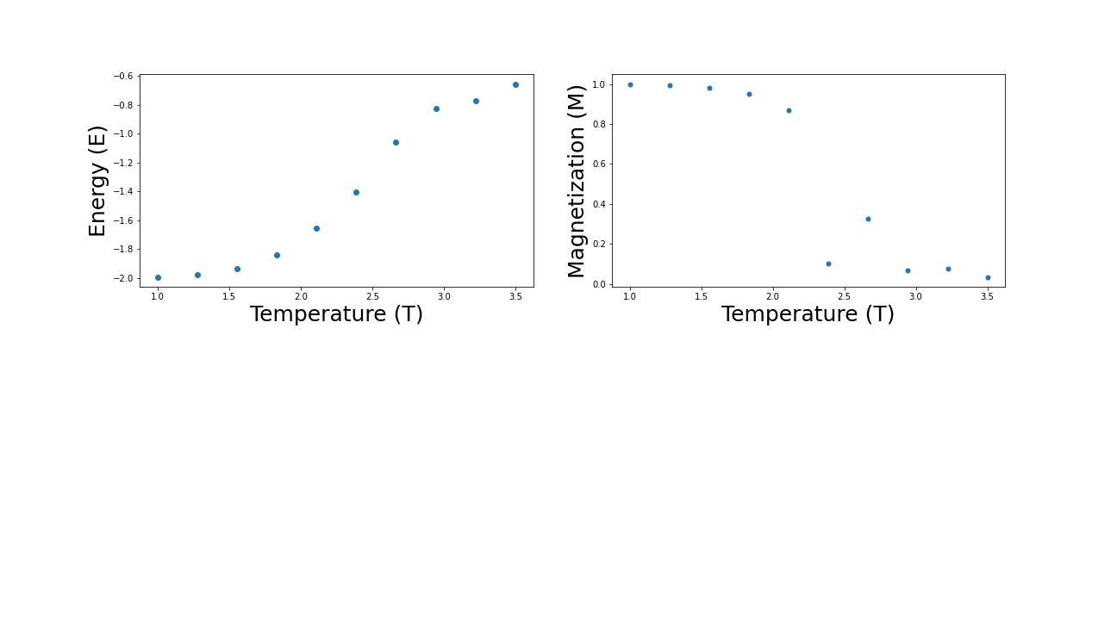
Energy and Magnetization
Change in Energy and Magnetization with Increase in Temperature

Slide 7
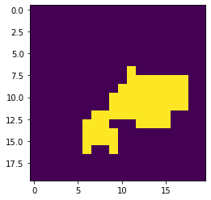
Sample Snapshot
Configuration of 10x10 Lattice after some steps

Slide 8
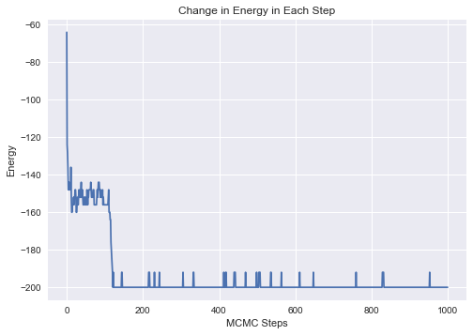
Energy in Each Step
Energy Decreases as step increases

Slide 9
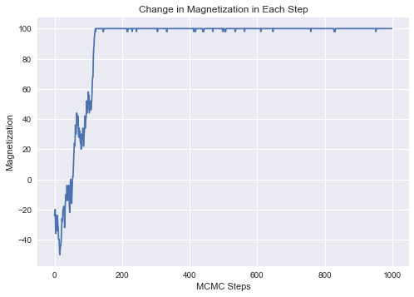
Magnetization in Each Step
Magnetization Increases with number of steps

Slide 10
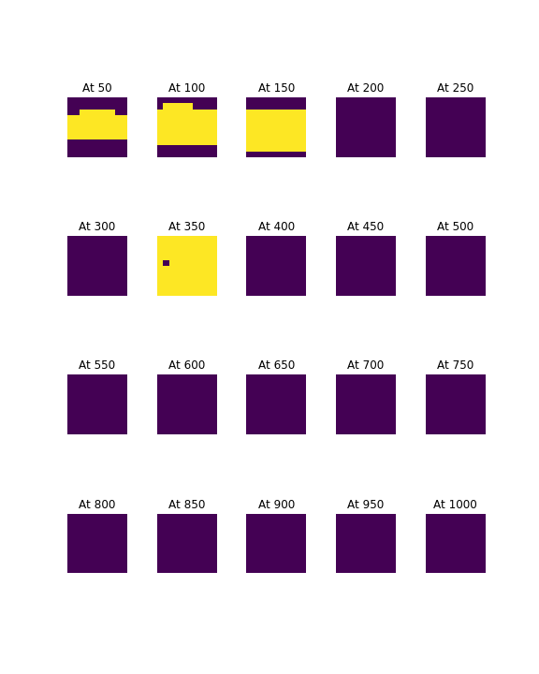
Snapshots At Different time for 10x10 Lattice

Slide 11
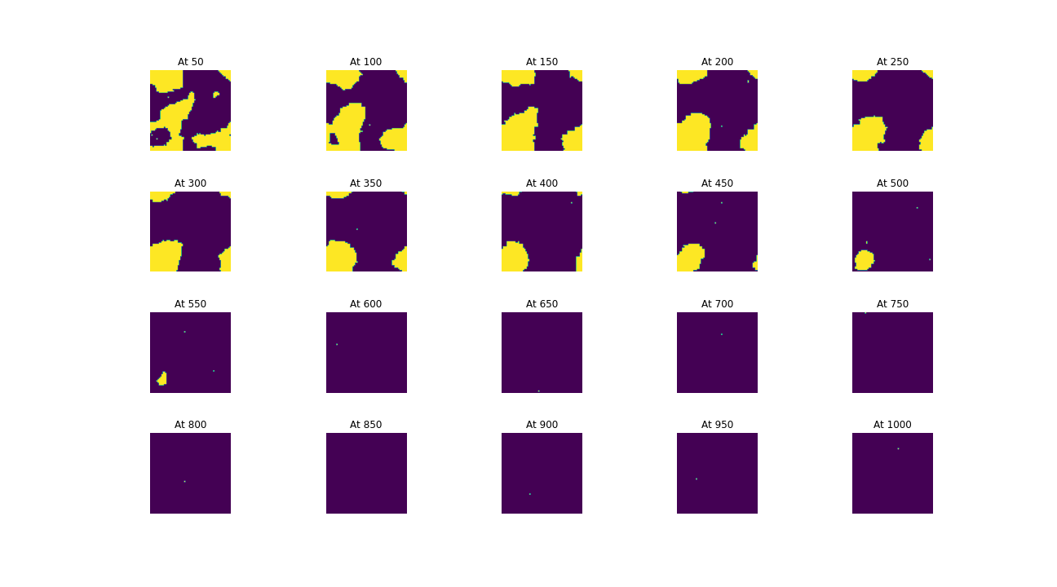
Snapshots At Different time for 64x64 Lattice

Slide 12
Conclusion
Achieved the Objectives set at the beginning
Simulated the interaction of particles at different temperatures and found out the critical temperature
Simulated the interaction of particles at a given temperature and see how they behave with respect to time

Slide 13
References
Hammel, B. D. (2017, Jun 10). B. D. Hammel. Retrieved from http://www.bdhammel.com/ising-model/
Leban, J. (2020, May 8). Medium. Retrieved from Towards Data Science: https://towardsdatascience.com/monte-carlo-method-applied-on-a-2d-binary-alloy-using-an-ising-model-on-python-70afa03b172b
Mahapatra, J. M. (2018). A comparative study of 2d Ising model at different boundary conditions using Cellular Automata. International Journal of Modern Physics C.
Singh, R. (2022, Feburary). Retrieved from https://rajeshrinet.github.io/blog/2014/ising-model/

Slide 14


