Slide 1
Simulation of 2D Ising Model
Presented By: Dipesh Poudel

Slide 2
Introduction
The Ising model is a mathematical model used to describe the behavior of a system of interacting spins.
named after the physicist Ernst Ising, who first introduced it in his PhD thesis in 1925
The 2D Ising model is one of the simplest models of a phase transition

Slide 3
Project Objective
To simulate the interaction of particles at different temperatures to find the critical temperature
To simulate the interaction of particles at different temperature and see how they behave with respect to time

Slide 4
The Algorithm
The Monte Carlo Simulation of 2D Ising model according to Metropolis-Hastings algorithm. The
major steps of the algorithm are
Generate a initial spin configuration randomly. Use +1 as sping up and -1 as spin down
Choose a spin at random
Calculate energy (E_old)
Flip the spin
Calculate new energy (E_new)
If (E_new<E_old) accept the flip and go to step 2 for another step else go to step 7
Find en = ((E_new-Eold)/T) and generate random number between 0 and 1 say ®
Accept the flip if r>en else do not flip
Go to step 2 (Until Converges)

Slide 5
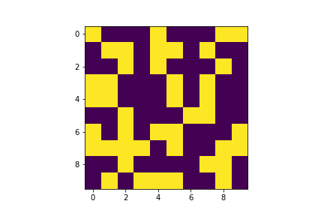
The Initial Configuration

Slide 6
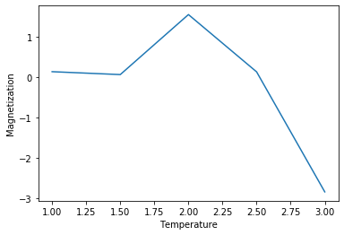
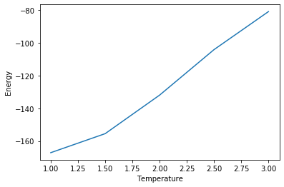
Energy and Magnetization

Slide 7
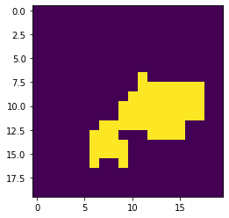
Final Stage for Temperature=1

Slide 8
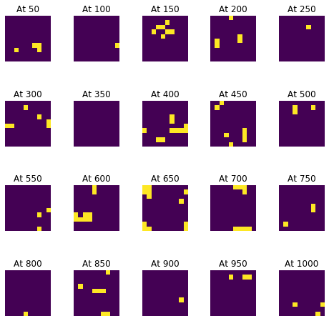
Snapshots

Slide 9


